Slide 1


Hyper compression with
Create very small archives that are both in COLOUR and perfectly LEGIBLE with the revolutionary I.R.I.S. compression technology

Slide 2
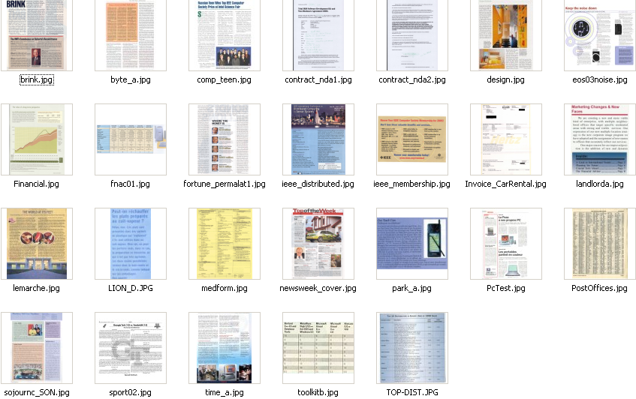
Example: 26 documents, including pictures, graphs, tables, text, watermarks, etc.

Slide 3
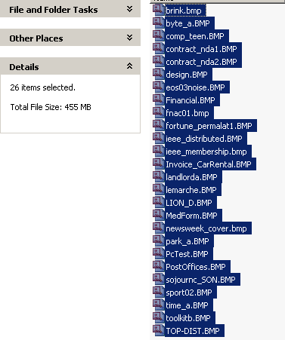
These files, uncompressed
455 Mb

Slide 4
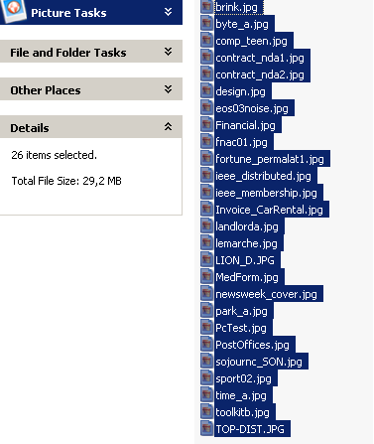
Using jpg with a 80% compression ratio
(preserving image quality)
29,2 Mb
→ 15x smaller!

Slide 5
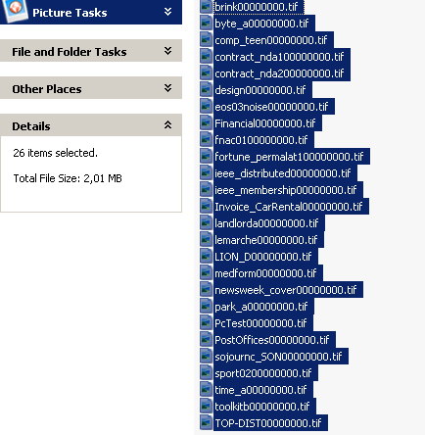
In B/W TIFF G4 with IRIS technology or other specialised technologies
2,01 Mb
→ 225x smaller!
But, B/W means loss of information…

Slide 6
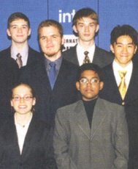
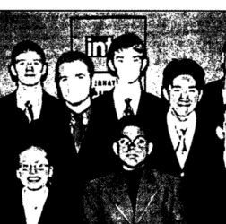
The value of Colour vs. B/W

Slide 7
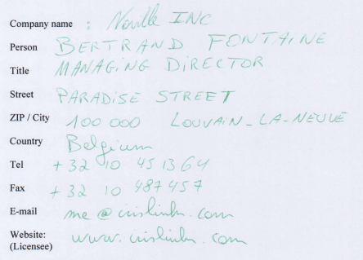
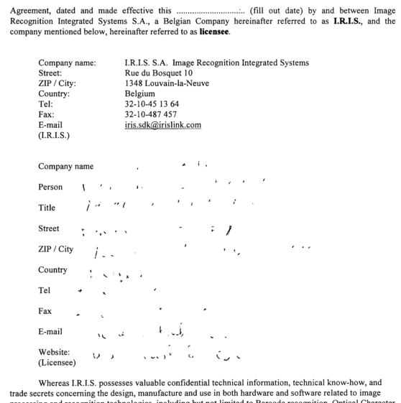
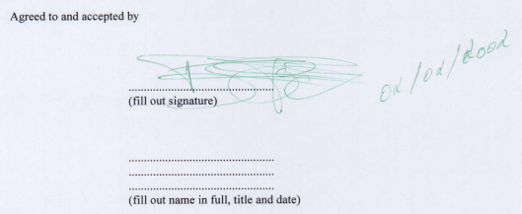

The value of Colour vs. B/W

Slide 8
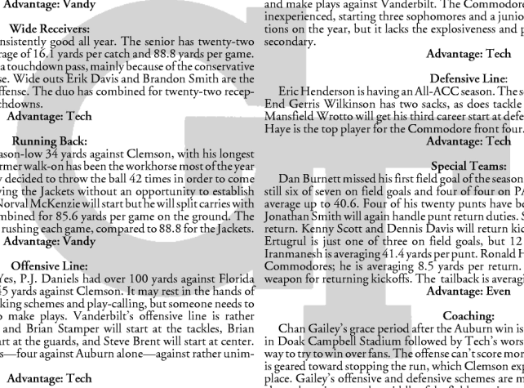
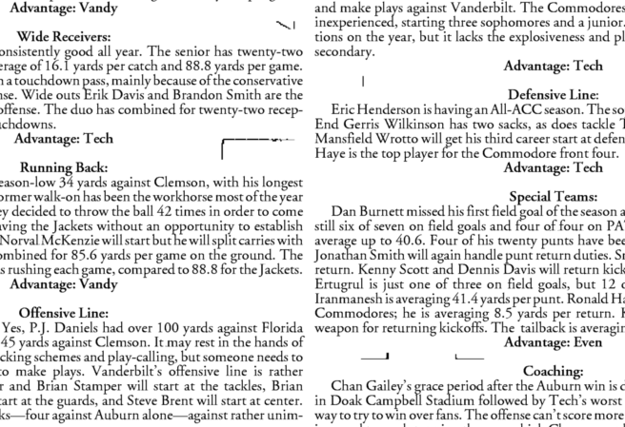
The value of Colour vs. B/W

Slide 9
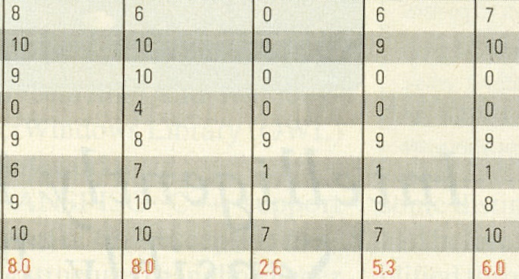
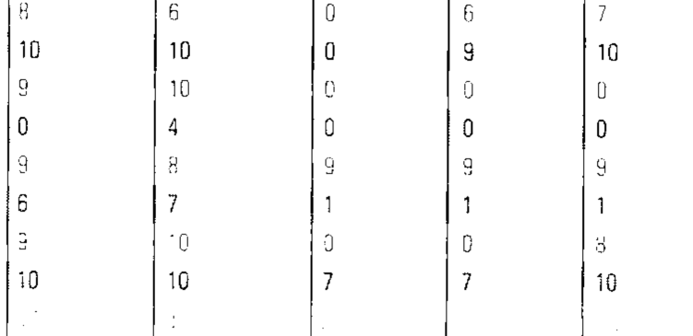
The value of Colour vs. B/W

Slide 10
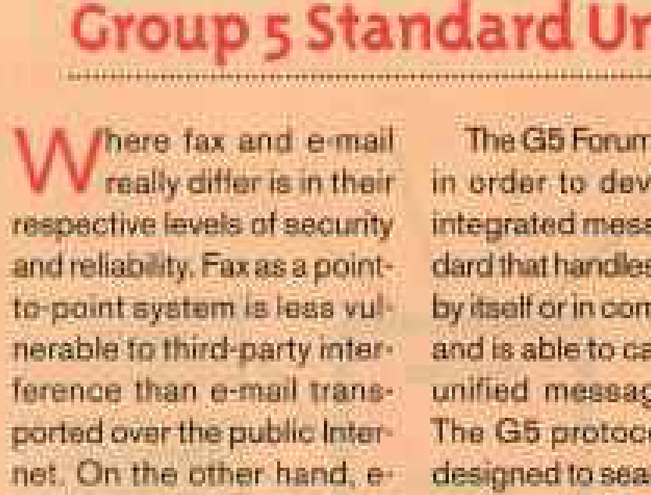
Standard JPEG compression gives poor legibility

Slide 11



Bad for both text and images

Slide 12
Size has to be considered with quality
Introducing...
intelligent High Quality Compression

Slide 13

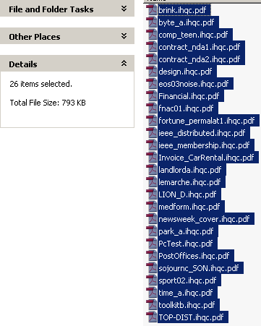
Results with for the same 26 images
793 Kb!
→ 570x smaller
455 Mb uncompressed - 29,2 Mb jpg - 2,01 Mb B/W TIFF G4

Slide 14
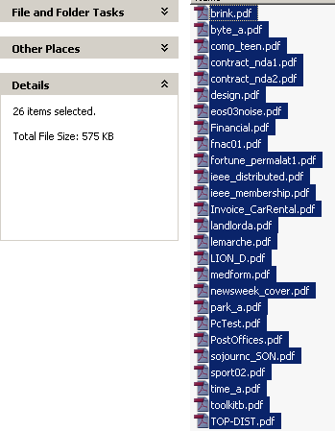
Same without OCR
575 Kb!
790x smaller
455 Mb uncompressed - 29,2 Mb jpg - 2,01 Mb B/W TIFF G4

Slide 15
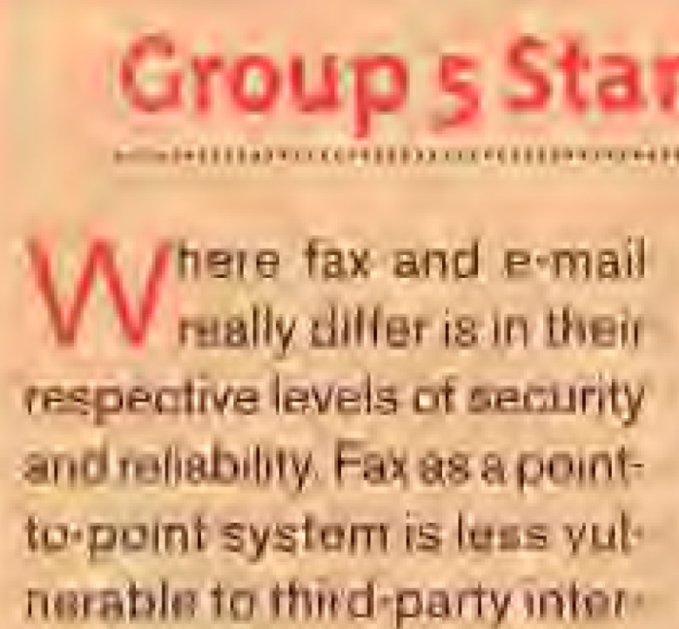
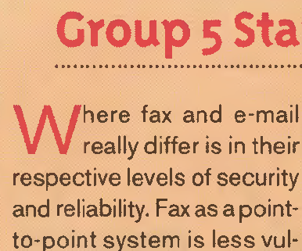
Without conceding to quality!
JPEG
New IRIS iHQC™

Slide 16

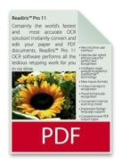


Available formats
PDF
  Level I & II & III
PDF/A
  Level I & II
XPS
  Level I

Slide 17
New : I.R.I.S. is member of the PDF/A competence center
PDF/A
  for the long-term archiving of electronic documents.
  based on the PDF 1.4 from
  is defined by an ISO Standard.
  subset of PDF, obtained by leaving out PDF features not suited to long-term archiving
Several standards
  I.R.I.S. supports PDF/A-1b
iHQC level limitation
  Level 1 and 2

Slide 18
Demo

Slide 19
HOW DO WE DO IT?
THIS IS A SECRET !

Slide 20
Basic explanation
We analyze each document and use different compression techniques depending on the type of information on the document
We use our 23 years of experience in document analysis to accurately reproduce the original document.

Slide 21
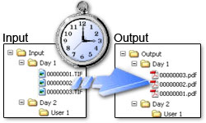

Main advantages
The documents are MUCH smaller:
  The files take much less storage space
  The files can be sent over the network
iHQC™ compression keeps the documents as legible as the original
PDF and XPS iHQC™ files can be opened by the standard viewers
+ these documents are fully searchable
  thanks to I.R.I.S. OCR

Slide 22



How to face your major challenge:
Do more with less, while reducing your carbon footprint
iHQC™ files need less storage space => less waste
iHQC™ files can be sent more easily over the network => less energy waste
  is to document…
  … what MP3 is to music

Slide 23

Thank you
We hope this presentation has interested you
Note this only is one of MANY possibilities
Please visit our stands for more information

