Slide 1
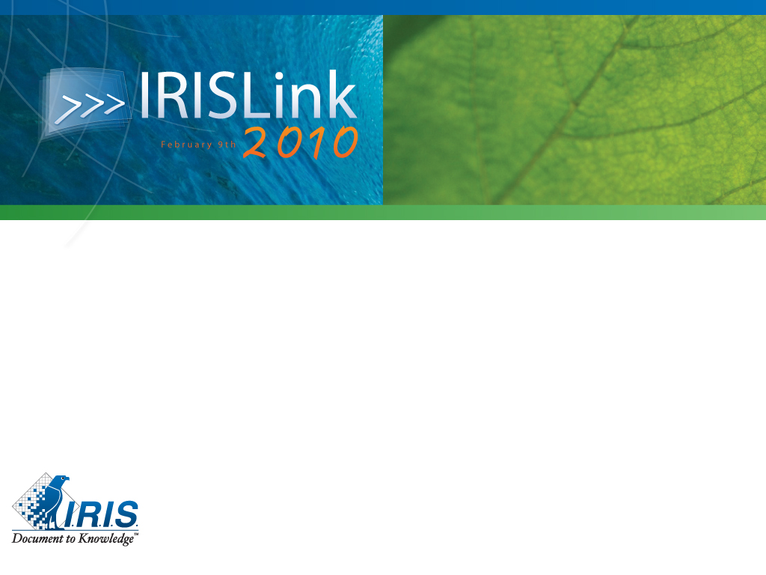
Virtualization what is the real return on investment for a company ?
Stefan Verbist – IRIS ICT

Slide 2
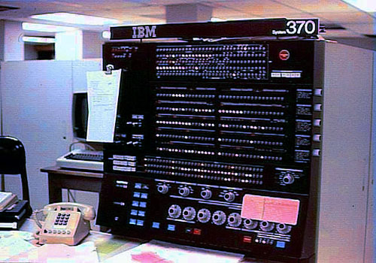
Virtualization: how it started ...
Virtualization is a proven concept that was first developed in the 1960s by IBM as a way to logically partition large, mainframe hardware into separate virtual machines. These partitions allowed mainframes to "multitask"; run multiple applications and processes at the same time. Since mainframes were expensive resources at the time, they were designed for partitioning as a way to fully leverage the investment.
Today, computers based on x86 architecture are faced with the same problems of rigidity and underutilization that mainframes faced in the 1960s. Virtualization can address underutilization and other issues, overcoming many challenges in the process. It is rapidly transforming the IT landscape and fundamentally changing the way that people compute.

Slide 3
Virtualization History
1960's IBM S/360 Mainframe
  1st System with full Hardware Virtualization Virtual Machines
  1967 CP/CMS fully Virtualized (S/360-40)‏
    Utilized for MIPS Scaling Simulations from 1 to 10 to 50/100 MIPS¹‏
  1972 CP67 Paravirtualized (OS/370)‏
1980's -> 1990's
  Client Server model
  Distributed computing resources
2000’s
  Inexpensive hardware, low utilization of computing resources
  VMware releases GSX and ESX Server 1.0 in 2001
2003-2004
  Introduction of Xen
    Xen project at Cambridge University, lead by founder of XenSource, Inc. (now Citrix XenServer)‏
    2004: MS Virtual PC (Connectix) competitor to VMware GSX
  MS Virtual Server 2005 in late 2004 (reliability, performance and issue)
2005-2006
  Late 2006 XenSource and VI released
  VMware dominates the market
2007-2008
  Fall/Winter: Citrix acquires XenSource, Oracle announces Oracle VM, Sun announces x-VM, MS releases Hyper-V
  Several dozen management tools
MS Virtual Server 05, XenSource, Virtual Iron
Citrix XenServer, Oracle VM, Sun xVM Server, Microsoft Hyper-V
MS Virtual PC
Introduction of Xen
IBM S/360 Mainframe
VMware ESX Server 1.0
1965
2000
2010
3
Notes:
3
3

Slide 4
Virtualization History
2009 (in progress)
  VMware releases vSphere 4.0
  Microsoft announces:
    WS08 R2 Hyper-V (LiveMigration)
    Hyper-V paravirtualized code (Integration Components) released to Linux community
  Oracle acquires:
    Virtual Iron
    Sun (VirtualBox, xVM Server, and xVM OpsCenter)
  Management offerings continue to expand rapidly
MS Virtual Server 05, XenSource, Virtual Iron
Citrix XenServer, Oracle VM, Sun xVM Server, Microsoft Hyper-V
Introduction of Xen
MS Virtual PC
VMware ESX Server 1.0
IBM S/360 Mainframe
1965
2000
2010
¹William F Newman
4
Notes:
4
4

Slide 5
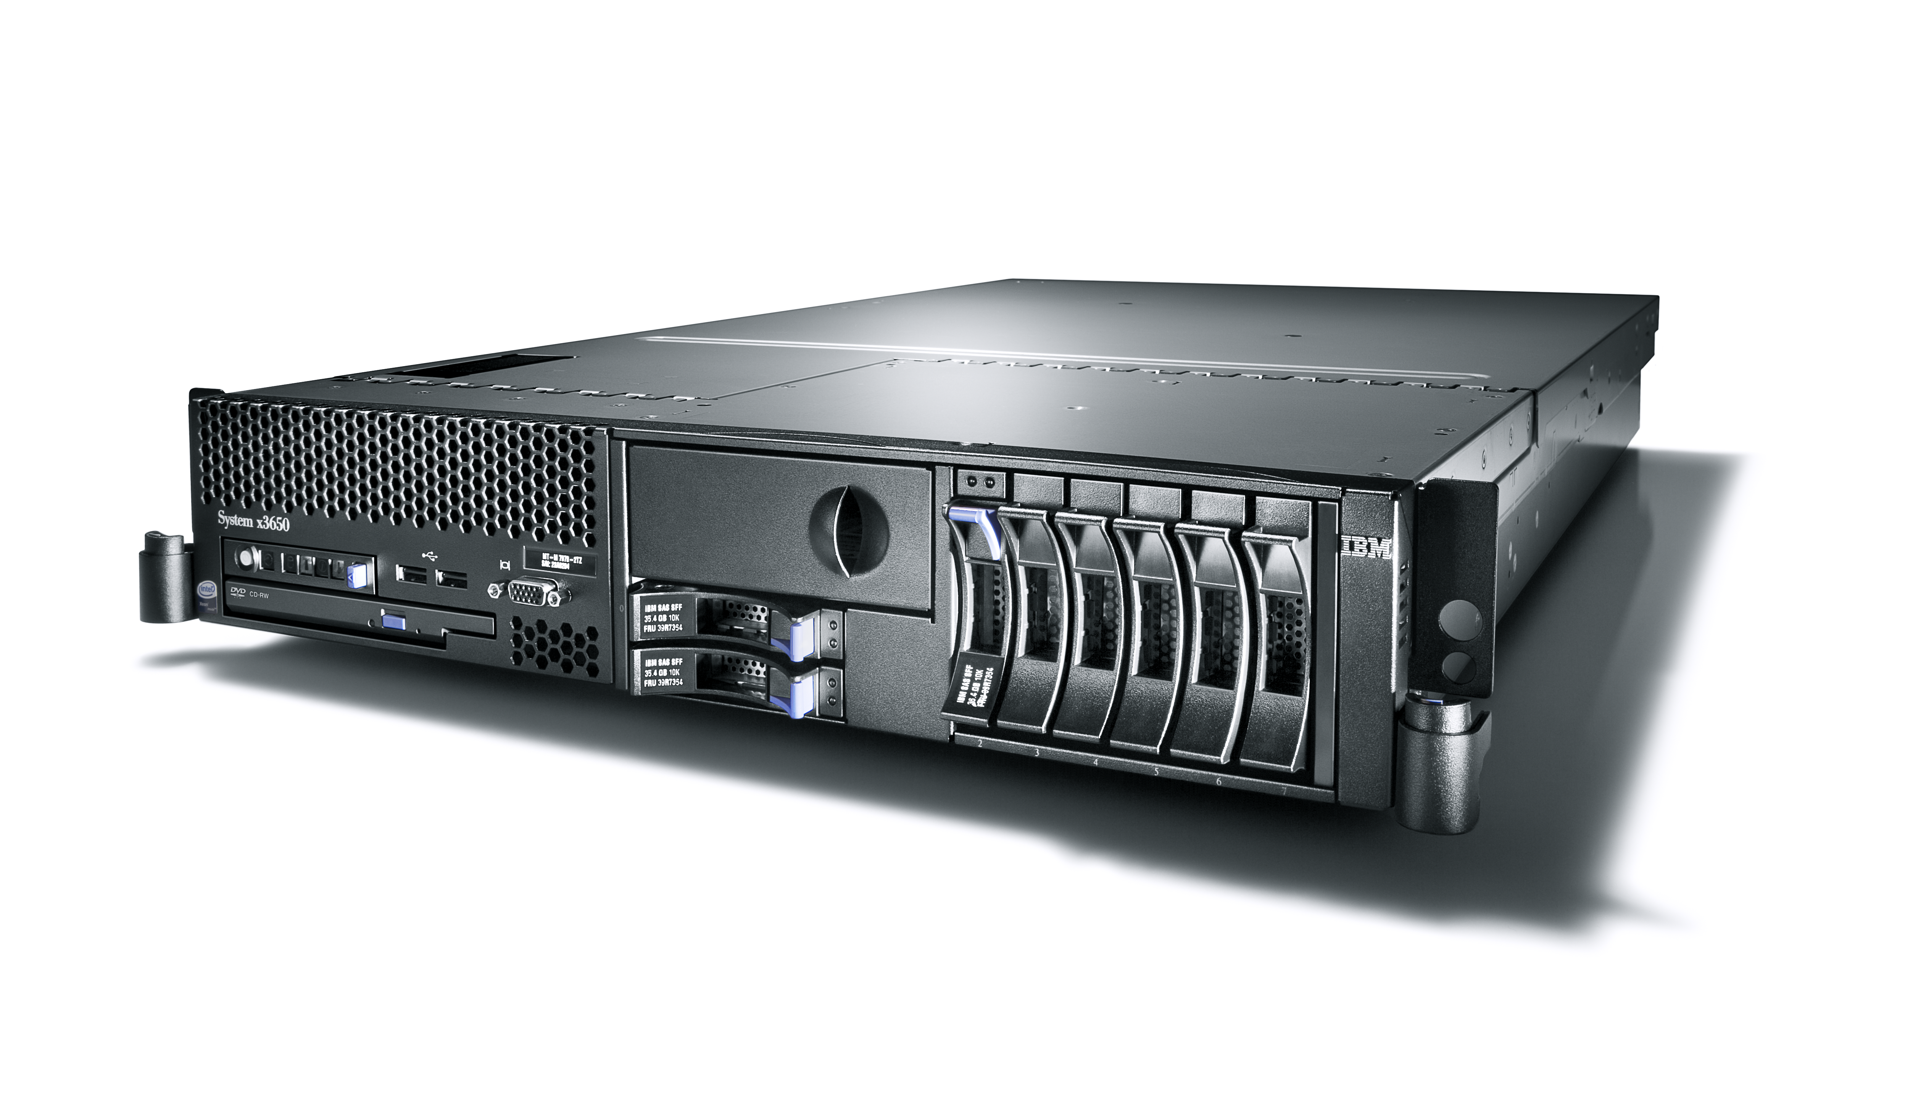
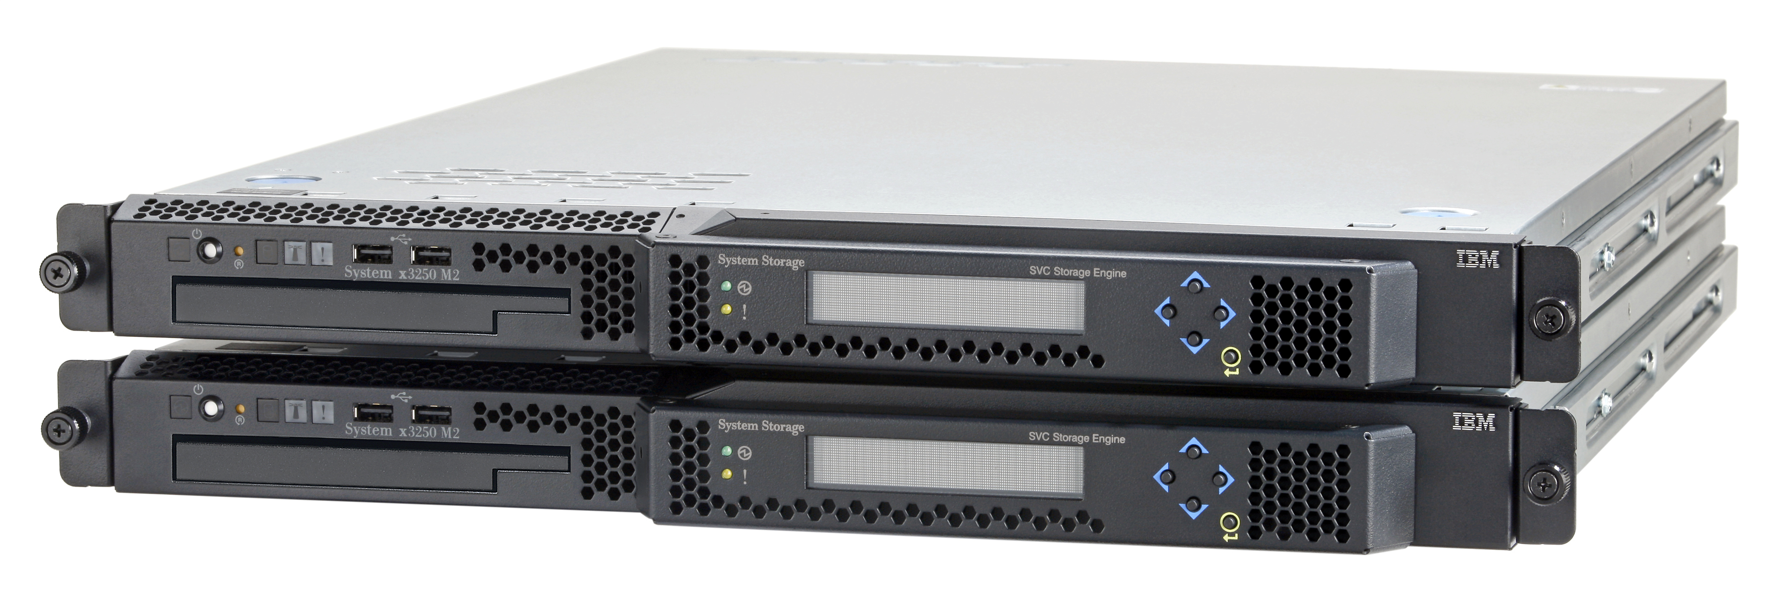
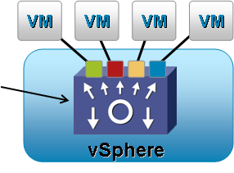



Virtualization is widespread ...
Virtualization is now on every layer:
  Servers
  Storage
  Network
  Desktop
  Applications

Slide 6
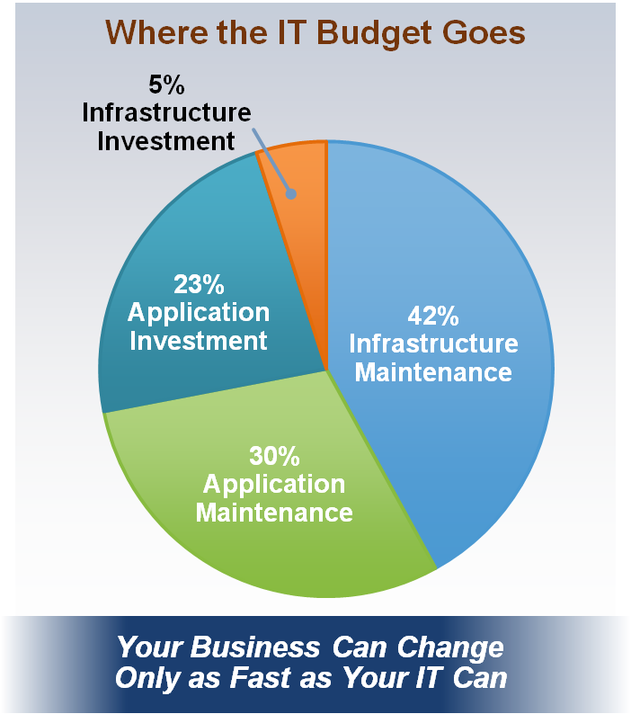
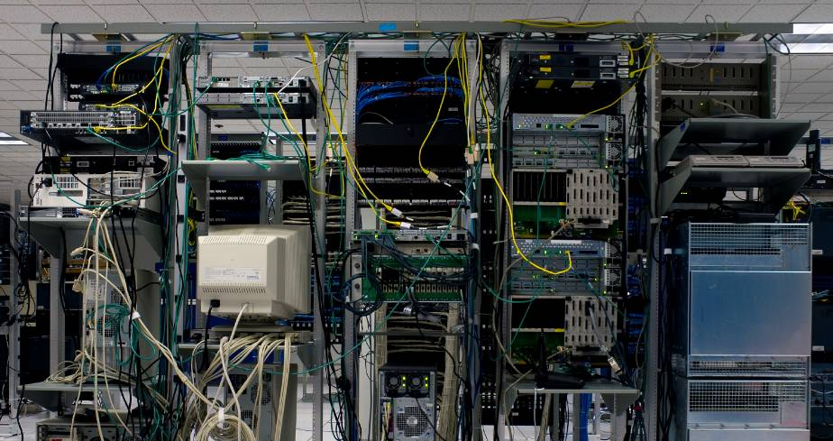
The Problem before virtualization
Overwhelming complexity
>70% of IT budgets just to keep the lights on
<30% of IT budgets goes to innovation and competitive advantage
Notes:
6
The Traditional Model Of IT…..has become inoperable
The overwhelming complexity of today’s infrastructure is what keeps IT occupied most of the time; fighting fires, running routine maintenance is a task fraught with complexity
No room to manoeuver
In today’s highly automated, technology-enabled economy, business capability has become inextricably linked to IT capability. As IT infrastructure has become increasingly complex, it can best be described as inflexible, brittle, and costly. In fact, the typical company spends upwards of 70% - 80% of their IT budgets to simply maintain the status-quo, leaving the business starved for new and updated capabilities. We have reached a point where business opportunity is literally trapped in IT infrastructure.

Slide 7

The Goal
IT
as a Service
(Internally or
Externally
Provisioned)
Efficiency
Control
Choice
Notes:
7
7
7
The VMware goal is to eliminate this complexity, turn IT into a ubiquitously available service – within 3 main operating principles.
We turn IT into a service while still maintaining the lowest possible costs (providing IT as a service with maximum efficiency and lowest operational overhead)
We make it easy for IT to provide and maintain operational control over service levels they provide to the business
We enable IT to become a service provider without locking IT into any specific application, OS or hardware architecture. We turn IT into a service – in a future proof manner

Slide 8
How to measure virtualization impact ?
Have much have you saved ?
  Used less HW
  Used current storage more efficient
  Reduced network complexity
  Reduces carbon footprint

Slide 9
Hidden challenges
What are you doing with old HW ?
Utilization rate on under-utilized servers before and afterwards (after virtualization)
(higher CPU utilization is GOOD)
How do you handle your assets ? (physical servers vs virtual servers)

Slide 10
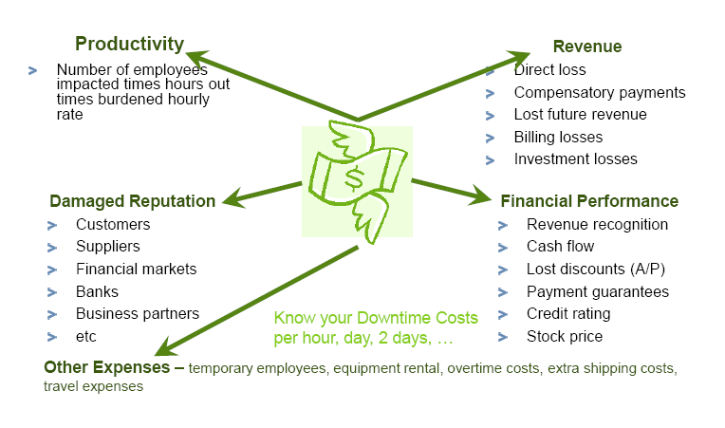
Cost of downtime ?

Slide 11
Benefits of Lifecycle mgmt

Slide 12
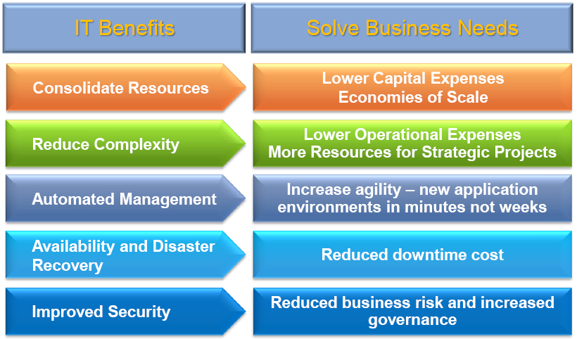
Translate IT Benefits into Business Value

Slide 13
Think beyond hardware and energy costs
Companies must look beyond the costs of servers, storage and network infrastructure, she says: Too many IT organizations fail to measure how virtualization changes spending on security technology, staffing, training, application development, testing, consulting needs and support contracts.

Slide 14
Costs & Saving related to virtualization
How Virtualization Delivers Cost Savings:
• The most obvious benefit of virtualization is reduced server infrastructure costs. (consolidation ratio from 10:1 to 5:1)
• Increased administrator productivity
• Reclaimed network ports
• Reclaimed data center capacity

Slide 15
Coming soon… HS22V
High memory, high performance blade optimized for virtualization
Internal USB
(Embedded Hypervisor)
2x Nehalem EP
Processors
(Westmere-ready)
Dual GbE LOM
(10GbE Option)
Up to 50%+ more average VMs... Coming soon!
Same I/O as HS22
(1x CIOv + 1x CFFh)
Additional Features
IMM & UEFI
Advanced Power Mgmt
TPM 1.2
Light Path Diagnostics
Expansion blades
2x 1.8” SSD
(HW RAID 0/1)
18x VLP DDR3 Memory
(144GB Max / 1333MHxz Max)
Notes:
We have exciting innovation built into our LS42 – we can scale from a single wide 2-socket blade to a double-wide 4-socket in about 20 seconds
No one else in the industry can do this – HP and Sun both have monolythic 4-socket blades
We’ve had this design since the LS41, but now we’ve got a special pricing rebate we’re working with AMD to offer MP processors at DP prices
With IBM, customers can buy a scalable, 2-socket blade for the same price as HP offers a non-scalable 2-socket
With us, you get investment protection at no extra cost

Slide 16
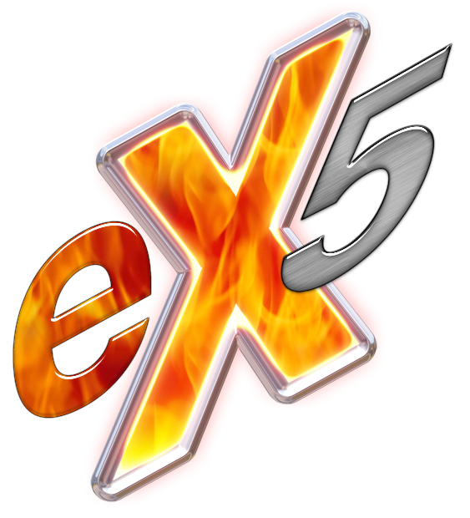
Coming soon… IBM BladeCenter HX5

Slide 17
Why is this important ?
Trends is that virtualization sizing is becoming unbalanced computing
Nbr of DIMMS are not in relation with nbr of cores (64-bit requires +/- 2,5x more RAM than 32-bit workloads)
Before announcement of new Intel Nehalem CPU, utilization trends was back to 25%

Slide 18
Reversing The Utilization Trend
Average Utilization Reaches 60 to 80%
Average Utilization Down to 25%
3 to 5% Average Utilization
Source: Curve Line tool in PowerPoint
Virtualization drove tremendous increase in processor utilization
  Multi-core has driven that trend backwards
  It doesn’t have to – memory density is the modern virtualization bottleneck
Modern x86 workloads resemble traditional Mainframe workloads
  Servers should be designed for the workload they intend to run

Slide 19
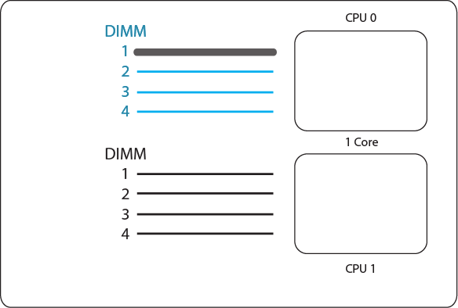
The Original 2-Socket Server
4 DIMMS per CPU Socket
1 CPU Core per Socket
Usually 2 to 4 DIMMs per CPU populated

Slide 20
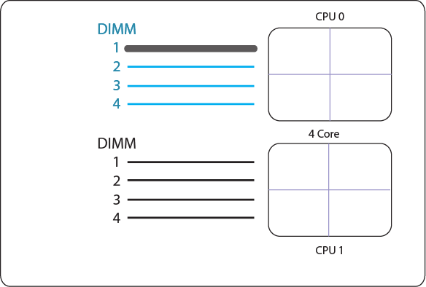
The Modern 2-Socket Server
4 DIMMS per CPU Socket
4 CPU Core per Socket
Usually 4 DIMMs per CPU populated

Slide 21
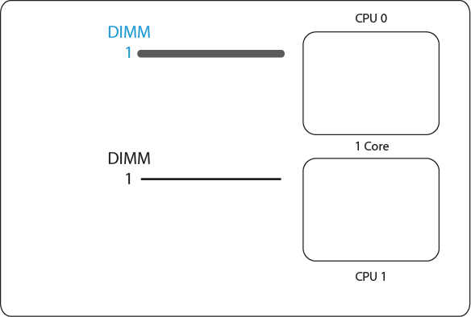
The Modern 2-Socket Server DIMM Ratio
Added cores
  Didn’t add DIMMs
Cores do more work per clock than previous cores
  Modern core produces 3x to 6x performance of previous generation single core

Slide 22
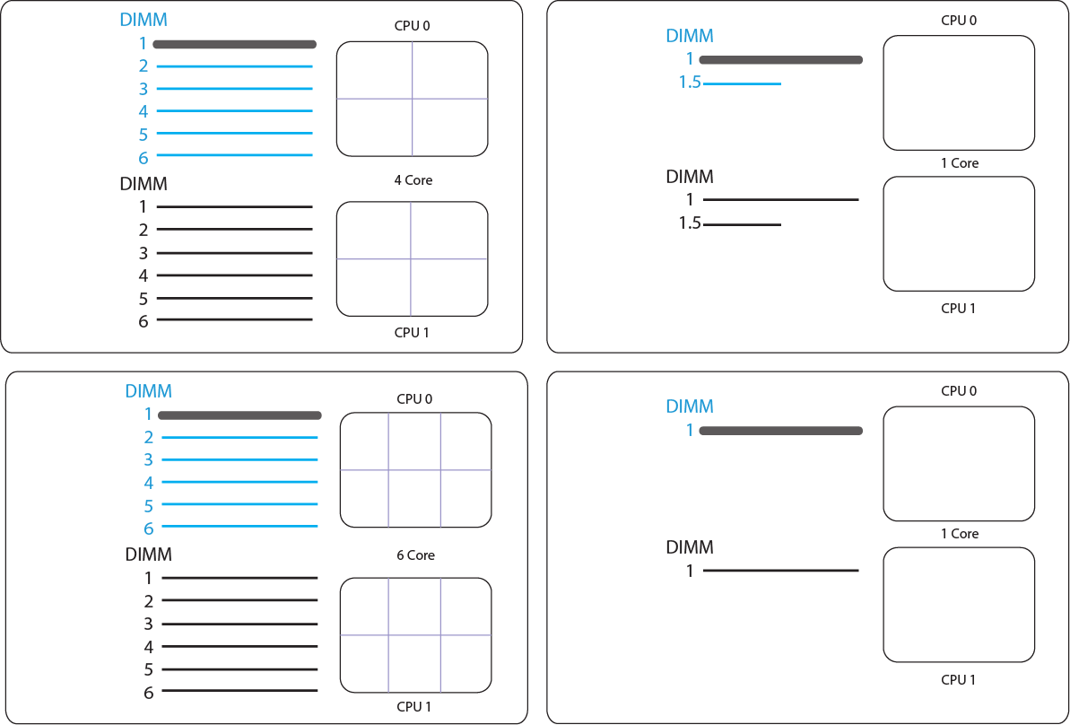
The Evolution Continues
4 Cores
6 DIMMs
1.5 DIMMs per core
6 Cores
6 DIMMs
1 DIMM per core

Slide 23
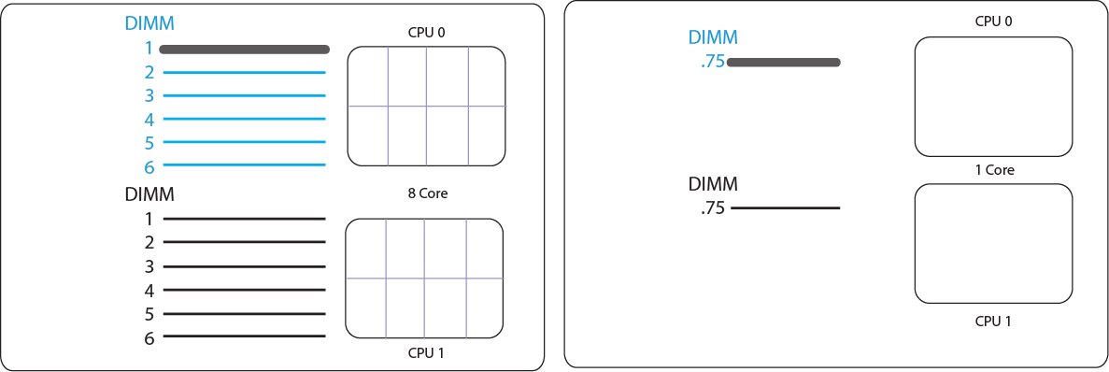
Would You Buy This Server?
Forthcoming 8 Core Server
DIMM Ratio Equivalent
The trend toward unbalanced computing is continuing
We are increasing the number of cores and the efficiency of cores at a far greater rate than we are the quantity and efficiency of memory

Slide 24

Thank You

