Slide 1

UNIX virtualization:
Experience the POWER

Slide 2
Agenda
What is PowerVM
More ……Power

Slide 3
Agenda
What is PowerVM
More ……Power

Slide 4
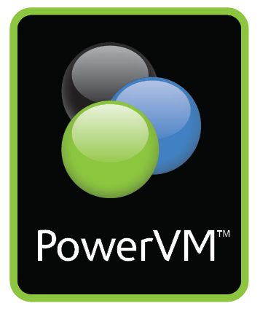
IBM’s History of Virtualization Leadership
A 40 year tradition continues with PowerVM™
1967
1973
1987
1999
2004
2007
2008
IBM develops hypervisor that would become VM on the mainframe
IBM announces first machines to do physical partitioning
IBM announces LPAR on the mainframe
IBM announces LPAR on POWER™
IBM intro’s POWER Hypervisor™ for System p™ and System i™
IBM announces POWER6™, the first UNIX® servers with Live Partition Mobility
IBM announces PowerVM
PowerVM is the leading virtualization platform for UNIX, IBM i and Linux® clients
Unify virtualization branding & technology for AIX®, i and Linux
Exploit 40 years of IBM virtualization leadership

Slide 5

What is PowerVM?
Hardware and software that delivers industry-leading virtualization on IBM POWER processor-based servers for UNIX, i and Linux clients
PowerVM Editions feature
Micro-Partitioning™
Virtual I/O Server
Integrated Virtualization Manager
Live Partition Mobility
Lx86
Logical Partitioning
PowerVM is the new umbrella branding term for Power™ Systems Virtualization (Logical Partitioning, Micro-Partitioning, POWER Hypervisor™, Virtual I/O Server, etc.)

Slide 6
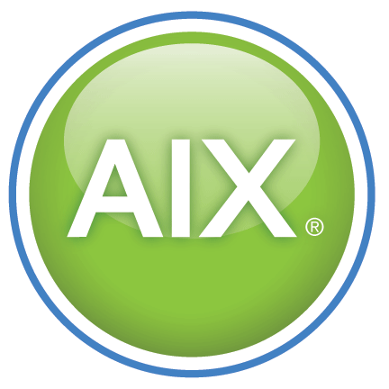

PowerVM Technologies
The leading virtualization platform for UNIX, i and Linux enables a more agile and responsive infrastructure
Hypervisor
  Support for multiple operating environments
Dynamic Logical Partitioning
  Micro-partitioning, resource movement
Multiple Shared Processor Pools
  Cap processor resources for a group of partitions
Virtual I/O Server
  Virtualizes resources for client partitions
Integrated Virtualization Manager
  Simplifies partition management for entry systems
Lx86
  Supports x86 Linux applications
Live Partition Mobility
  Move running AIX and Linux partitions
System Planning Tool
  Simplifies the planning for and installation of Power servers with PowerVM
VIOS
Power Hypervisor

Slide 7
PowerVM Dynamic Logical Partitioning
Supports multiple operating systems on a single server
Reduces Costs
  Supports AIX, i and Linux operating system partitions on one server
  Micro-Partitioning supports up to 10 partitions per processor
Increases Flexibility
  Partitions can have capped or uncapped processor resources
  Processor resources can automatically move between partitions
  Shared processor pools enables capping of a group of partitions
Included with all PowerVM Editions
  Supports AIX, i and Linux partitions
  Managed by Hardware Management Console or Integrated Virtualization Manager
i
AIX
Linux
Power Hypervisor

Slide 8
PowerVM Virtual I/O Server
Virtualizes resources for client partitions
Reduces Costs
Share physical SCSI and Ethernet resources between partitions
Increases Flexibility
Create partitions on the fly with no requirement for additional hardware
Included with all PowerVM Editions
Supports AIX, i 6.1 and Linux partitions
VIOS
i
AIX
Linux
Power Hypervisor

Slide 9
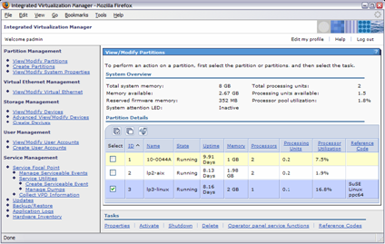
PowerVM Integrated Virtualization Manager
A virtualization solution for small and mid-size companies
Simplifies Management
Brower-based tool for creating and managing partitions
Reduces Costs
Eliminates the need to purchase a dedicated hardware console
Included with all PowerVM Editions
Runs in the Virtual I/O Server partition

Slide 10
PowerVM Lx86
Run x86 Linux applications on Power Systems along with your
AIX, i and Linux applications
Reduces Costs
Simplifies migration of Linux on x86 applications enabling customers to realize the energy and administration savings of consolidation
Strengthens Application Portfolio
Run most existing 32-bit x86 Linux applications* with no application changes
Included with all PowerVM Editions
Runs in a Linux partition
PowerVM
Supported Linux OS
AIX OS
POWER
Linux OS
Application
AIX OS
Application
PowerVM
Lx86
Power Systems Platform

Slide 11
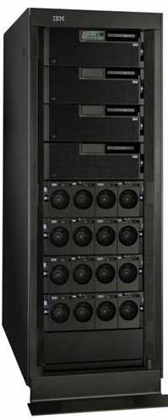
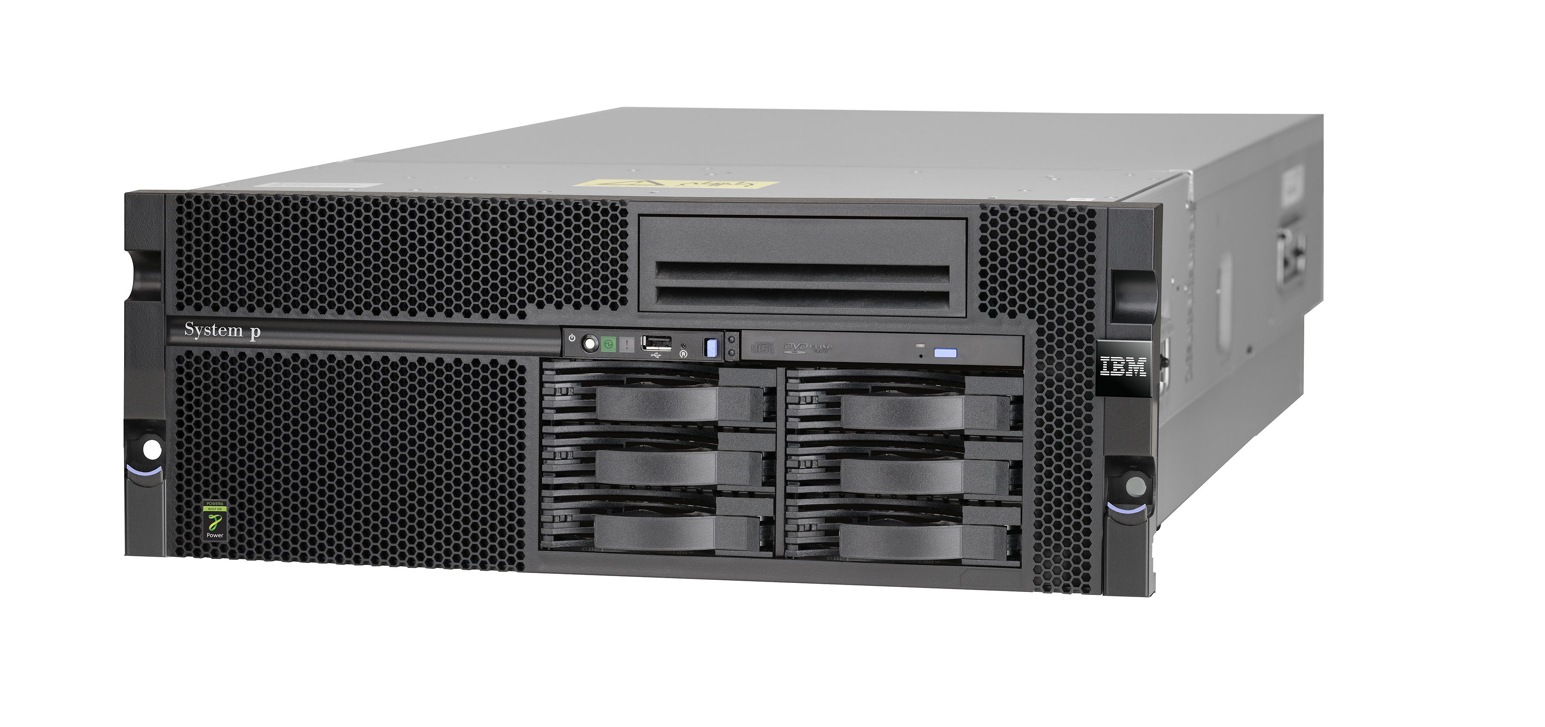
PowerVM Live Partition Mobility
Move running AIX and Linux operating system workloads from one POWER6 processor-based server to another!
Improves Availability
Helps eliminate many planned outages
Balances Workloads
During peaks and to address
spikes in workload
Included with PowerVM Enterprise Edition
Supports AIX and Linux partitions with VIOS on Power servers
Virtualized SAN and Network Infrastructure

Slide 12
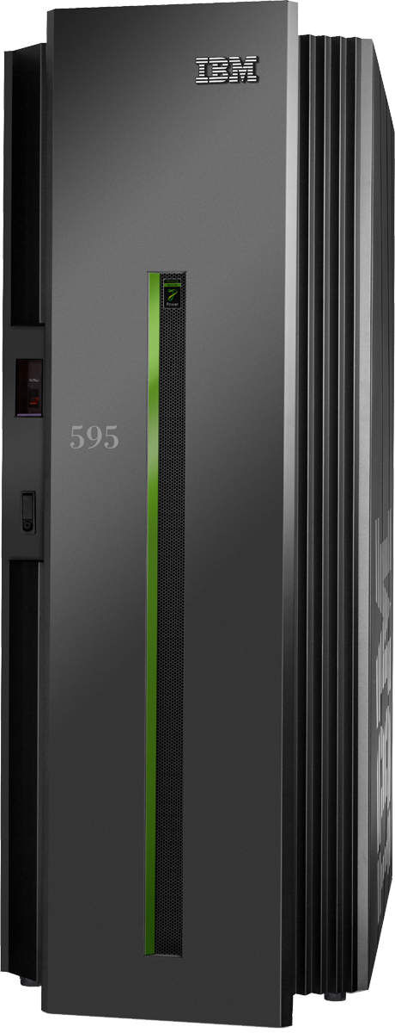
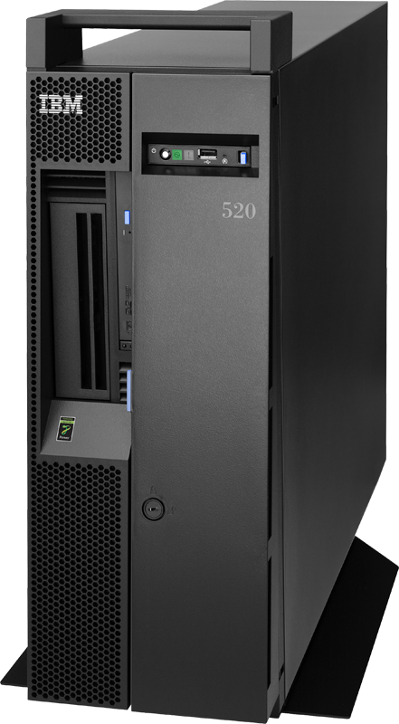





Mobility on Power Systems
Live Partition Mobility
PowerVM Live Partition Mobility
Move an entire Logical Partition from one system to another while it is running with almost no impact to end users
Moves the entire LPAR including the operating system
Requires POWER6, PowerVM Enterprise Edition, and all I/O must be through the Virtual I/O Server
Works with partitions running AIX V5.3, AIX 6 and Linux
Movement of the OS and
applications to a different server with no loss of
service
Virtualized SAN and Network Infrastructure
Live Application Mobility
AIX Live Application Mobility
Move a Workload Partition from one AIX system to another AIX system while running with almost no impact to end users
Moves only the WPAR, the AIX operating system is not moved
Requires AIX 6, Workload Partitions Manager, and all WPAR filesystems must be NFS
Works on POWER4™, POWER5™, and POWER6
AIX # 1
AIX # 2
Workload
Partition
Application
Server
Workload
Partition
eMail
Workload
Partition
QA
Workload
Partition
Web
Workload
Partition
Billing
_{Workload}
_{Partitions}
_{Manager}
NFS and virtualized network infrastructure

Slide 13

NPIV
N_Port ID Virtualization (NPIV) provides direct Fibre Channel connections from client partitions to SAN resources , simplifying SAN management
  Fibre Channel Host Bus Adapter is owned by VIOS partition
  Supported with PowerVM Express, Standard, and Enterprise Edition
  Supports AIX 5.3 and AIX 6.1 partitions
  Power 520, 550, 560, and 570, with an 8 GB PCIe Fibre Channel Adapter
Statement of Direction
  IBM intends to support N_Port ID Virtualization (NPIV) on the POWER6 processor-based Power 595, BladeCenter JS12, and BladeCenter JS22 in 2009.
  IBM intends to support NPIV with IBM i and Linux environments in 2009.
VIOS
FC Adapter
Virtual FC Adapter
Virtual FC Adapter
Power Hypervisor
  Enables use of existing storage management tools
  Simplifies storage provisioning (i.e. zoning, LUN masking)
  Enables access to SAN devices including tape libraries

Slide 14
NPIV Simplifies SAN Management
Current
Virtual SCSI model
N-Port ID Virtualization
POWER5 or POWER6
POWER6
AIX
AIX
Virtualized
disks
Disks
generic scsi disk
generic scsi disk
DS8000
EMC
Virtual SCSI
Virtual FC
FC Adapter
VIOS
VIOS
Shared
FC Adapter
FC Adapters
FC Adapters
SAN
SAN
DS8000
DS8000
EMC

Slide 15
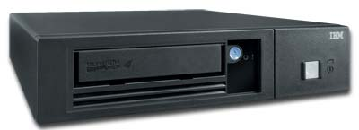
VIOS Virtual Tape Support
Enables client partitions to directly access selected SAS tape devices, sharing resources and simplifying backup & restore operations
  SAS adapter is owned by VIOS partition
  Included with PowerVM Express, Standard, or Enterprise Edition
  Supports AIX 5.3 & 6.1 partitions
  POWER6 processor-based systems
VIOS
SAS Adapter
Virtual SCSI Adapter
Virtual SCSI Adapter
Power Hypervisor
  Tape drives supported
  DAT72: Feature Code 5907
  DAT160: Feature Code 5619
  HH LTO4: Feature Code 5746

Slide 16
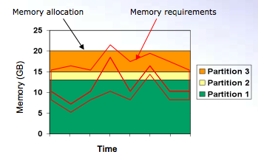
PowerVM Active Memory™ Sharing
Partitions with dedicated memory
  Memory is allocated to partitions
  As workload demands change, memory remains dedicated
  Memory allocation is not optimized to workload
Partitions with shared memory
  Memory is allocated to shared pool
  Memory is used by partition that needs it enabling more throughput
  Higher memory utilization
Memory Usage (GB)
Time

Slide 17
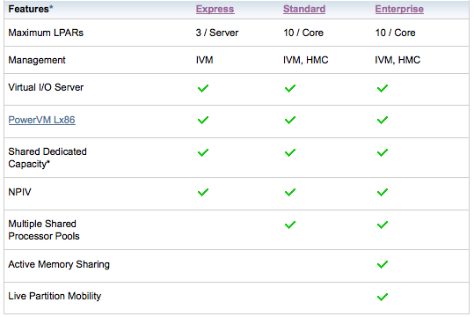
PowerVM Editions

Slide 18
Agenda
What is PowerVM
More ……Power

Slide 19


Slide 20
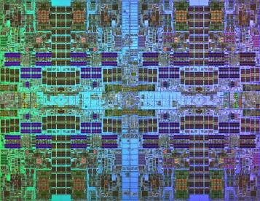

Technology Leadership
4, 6 or 8 cores per socket
3.0 to 4.14 GHz
Up to 4 threads per core
Integrated eDRAM L3 Cache
Dynamic Energy Optimization

Slide 21
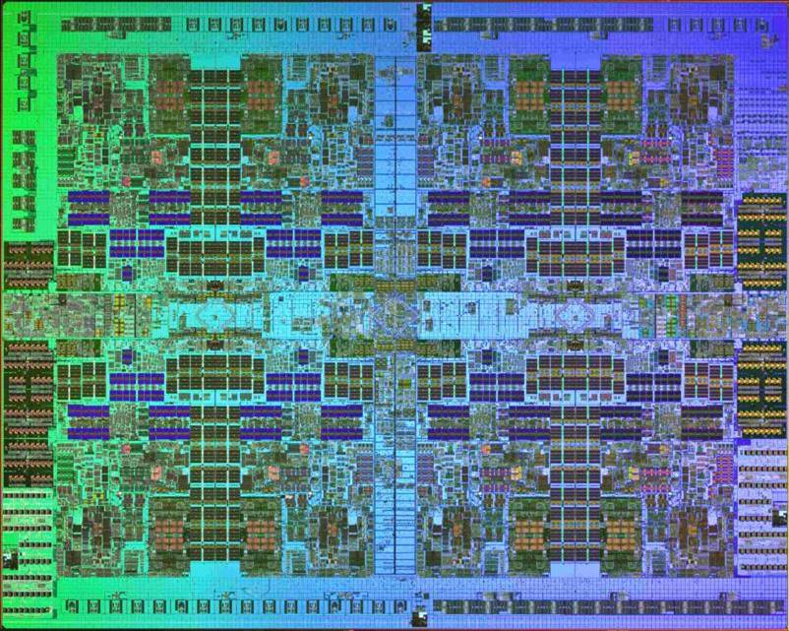
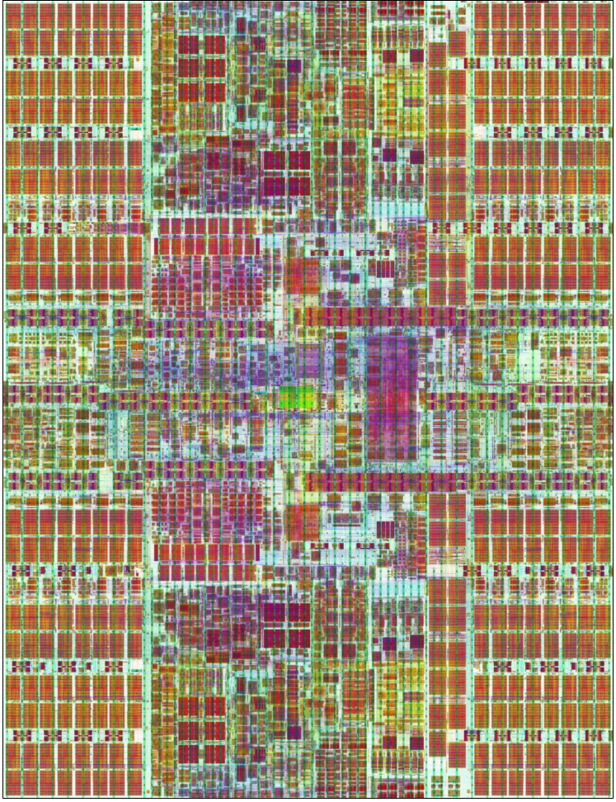
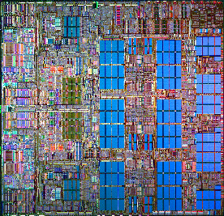

Processor Technology Roadmap
POWER8
POWER7
45 nm
POWER6
65 nm
POWER5
130 nm
POWER4
180 nm
Dual Core
Chip Multi Processing
Distributed Switch
Shared L2
Dynamic LPARs (32)
Dual Core
Enhanced Scaling
SMT
Distributed Switch +
Core Parallelism +
FP Performance +
Memory bandwidth +
Virtualization
Dual Core
High Frequencies
Virtualization +
Memory Subsystem +
Altivec
Instruction Retry
Dyn Energy Mgmt
SMT +
Protection Keys
Multi Core
On-Chip eDRAM
Power Optimized Cores
Mem Subsystem ++
SMT++
Reliability +
VSM & VSX (AltiVec)
Protection Keys+
Concept Phase
2001
2004
2007
2010

Slide 22

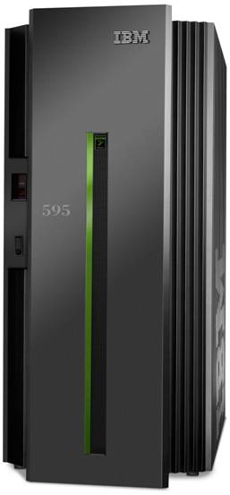



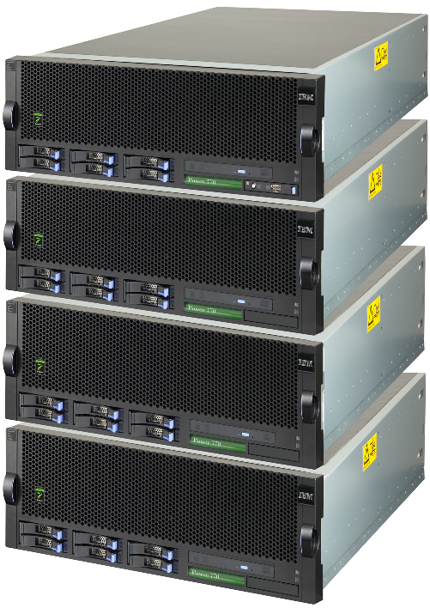



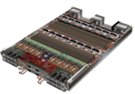













Power Systems – February 2010
New POWER7 in middle of the line
  Power 750 Express
  Power 755 for HPC
  Power 770 modular
  Power 780 modular high-end
POWER6 continues
  Power 520, Blades
  Power 550
  Power 560
  Power 570
  Power 575
  Power 595
Power 780
Power 770
Power 750
Power 560
Power 755
JS Blades
IBM Systems Software

Slide 23
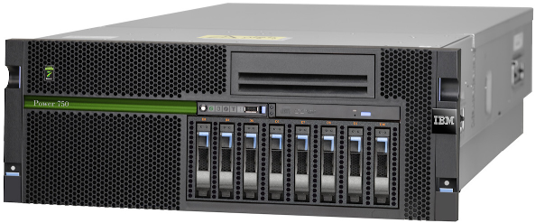
Power 750 Express
4 Socket 4U
6 or 8 cores per socket
3.0 to 3.55 GHz
Energy-Star Qualified

Slide 24


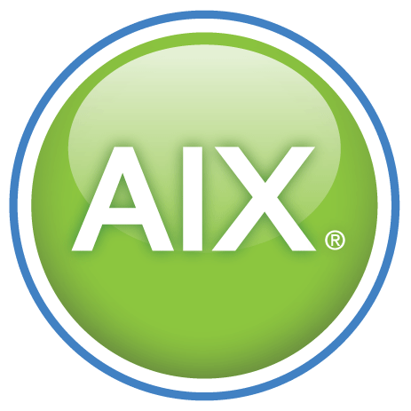


IBM Power 750 Express
Performance
More than two and a half times better performance than Sun SPARC Enterprise T5440
Greater than six times the performance of Sun SPARC Enterprise M4000 and ten times the performance of HP Integrity rx6600
Energy Efficient
Four times better performance per watt than Sun SPARC Enterprise T5440
More than eight times better performance per watt than Sun SPARC Enterprise M4000 and HP Integrity rx6600
Reduce costs through consolidation
Consolidate 92 Sun UltraSPARC® T1 or 29 UltraSPARC® T2 servers into one Power 750
IBM Power 750 Express
(8233-E8B)
1- to 4-socket server
6-core and 8-core POWER7 processor modules
  6-core 3.3 GHz
  8-core 3.0, 3.3 GHz and 8-core 3.55 GHz(32-core)
Up to 512 GB of Memory
ENERGY STAR-qualified
Light Path Diagnostics
Source: SPECint_rate2006. For the latest SPEC benchmark results, visit http://www.spec.org.
See Power 750 power and efficiency claims page in backup for full substantiation detail

Slide 25
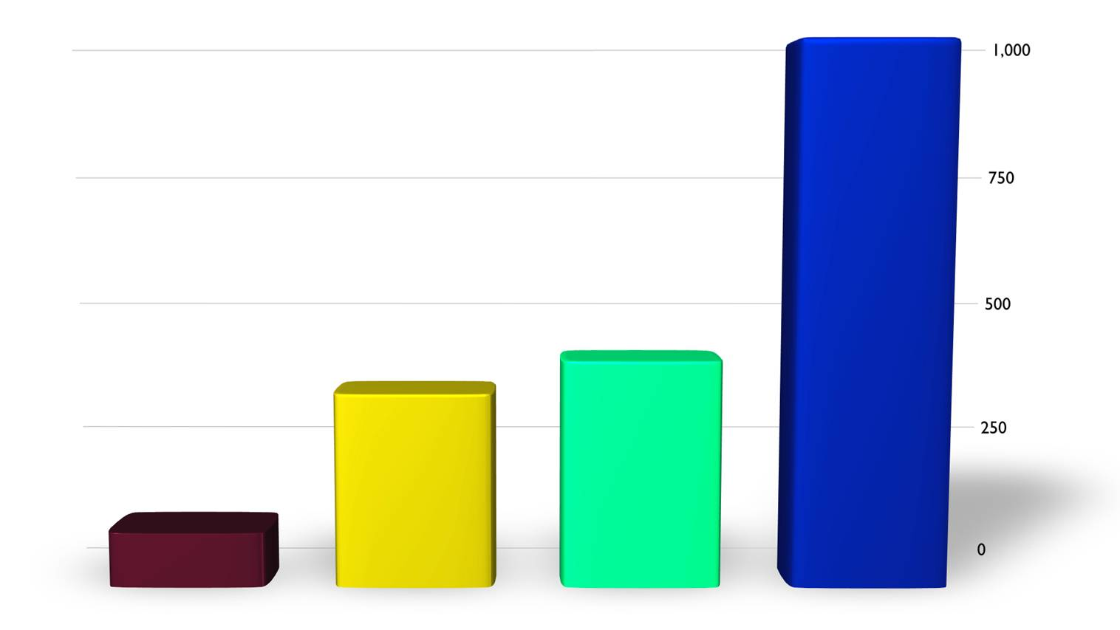
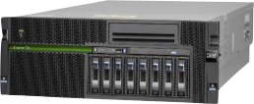
The highest performing 4-socket system on the planet
POWER7 continues to break the rules
with more performance
SPECint_rate
Power 750
Itanium
HP rx6600
SPARC
Sun T5440
x86
HP DL585
POWER7
Power 750
with PowerVM

Slide 26
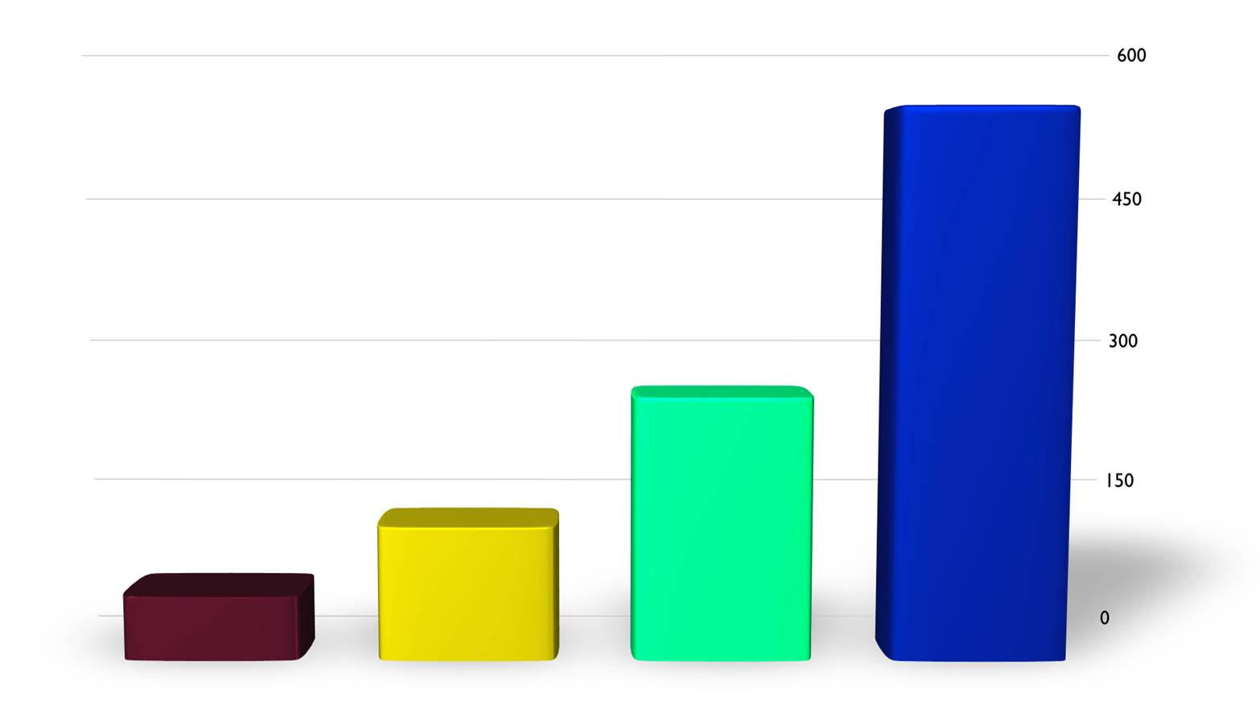

The most energy efficient 4-socket system on the planet
The first Energy Star certified RISC system
Power 750
Most energy efficient systems
Performance Per Watt
Itanium
HP rx6600
SPARC Sun T5440
x86
HP DL585
POWER7
Power 750
with PowerVM

Slide 27
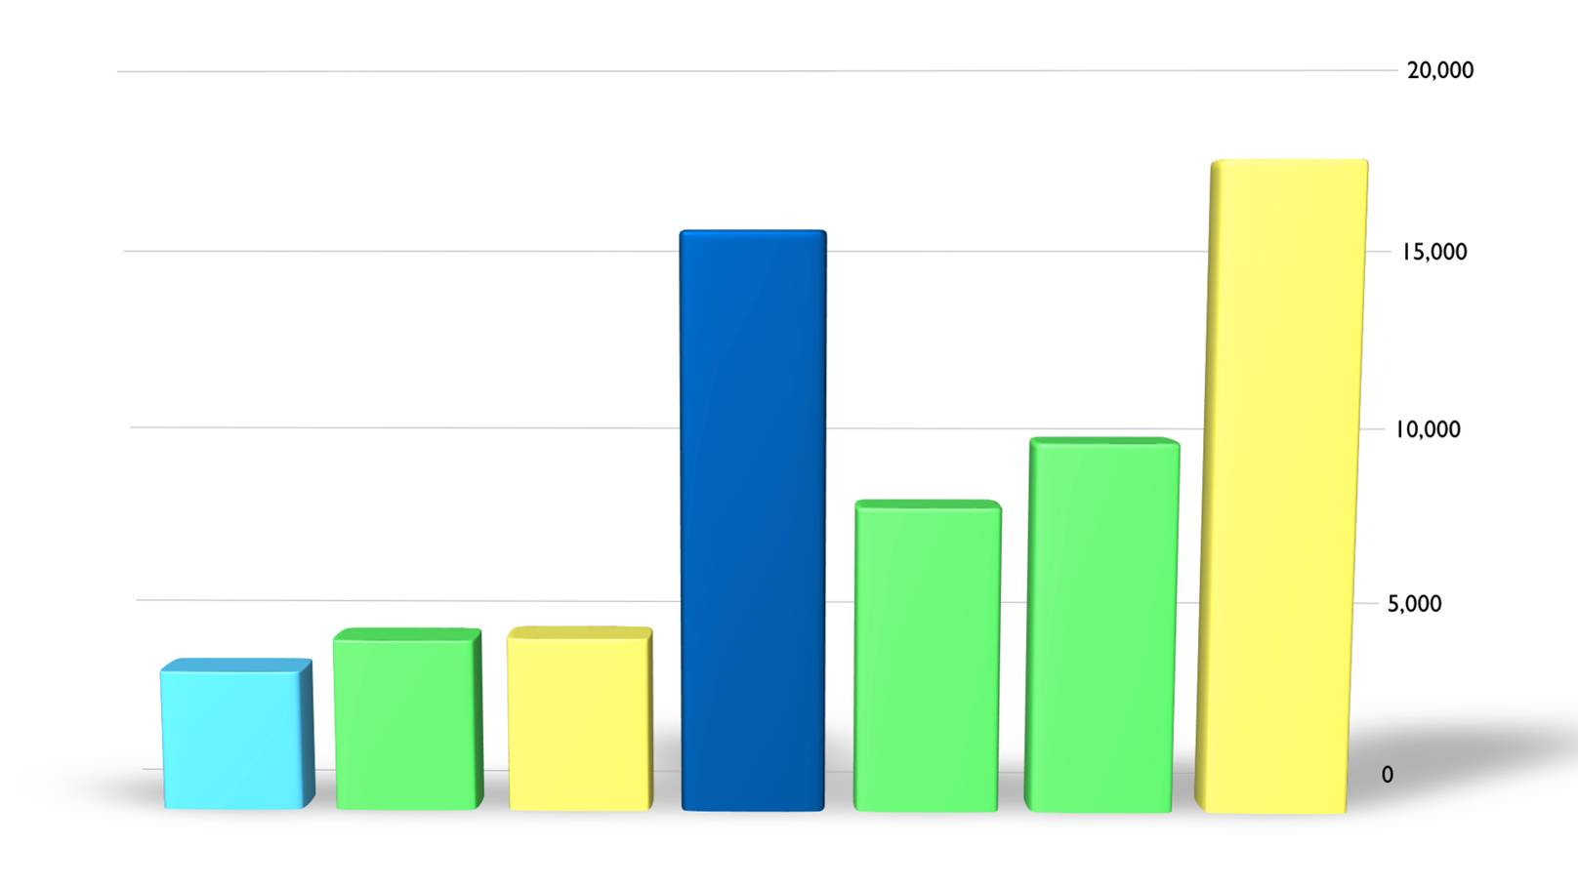

More SAP performance than any 8-socket system in the industry
Comparable to a 128-core, 32-socket Sun M9000
15,600
SAP users on SAP SD 2 Tier
Power 750 Express with DB2
8-core
Sun Fire X4270
Xeon 5500
24-core
HP DL585
AMD
32-core
Sun T5440
32-core
Power 750
48-core
HP DL785
AMD
48-core
Sun x4640
AMD
128-core
Sun M9000
2-sockets
4-sockets
8-sockets
32-sockets
Best SAP 2-Tier Results for 2, 4 , 8 and 16 sockets.
See SAP Benchmarks chart for detail or SAP website
http://www.sap.com/solutions/benchmark/sd2tier.epx

Slide 28
Power 750 Express system performance
More than quadruples performance of POWER5+ servers
More than triples performance of POWER6+ servers
Capacity for more workloads
See Power 750 compared to POWER5+ and POWER6+ servers substantiation for detail.

Slide 29
Power 750 performance per watt
More than 5X performance/watt of POWER5+ servers
More than triples performance/watt of POWER6+ servers
See Power 750 compared to POWER5+ and POWER6+ servers substantiation for detail.

Slide 30
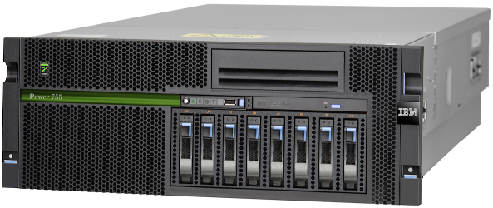
IBM Power 755
Performance per node
2X improvement in Single Instruction Multiple Data (SIMD) acceleration
  Full AltiVec™ (VMX) instruction set support
  Extended VSX instruction set
Up to 8.4 TFlops per Rack (10 nodes per Rack)
Cluster Interconnect
  2-Port InfiniBand 12X DDR
IBM HPC software stack
Boost frequency for better performance & performance/watt
IBM Power 755
(8236-E8C)
4-socket, 4U server
8-core POWER7 processors
  32-core 3.3GHz configuration
Up to 256GB of memory
Up to 64 clustered nodes
Energy Star-qualified

Slide 31
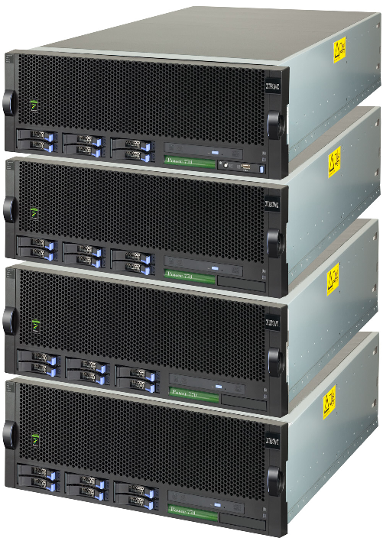
Power 770
12 or 16 core 4U Nodes
Up to 4 Nodes per system
3.1 and 3.5 GHz
Capacity on Demand
Enterprise RAS

Slide 32
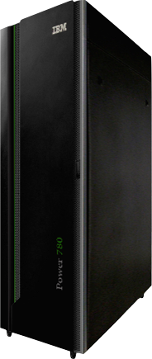
Power 780
New Modular High-End
Up to 64 Cores
TurboCore
3.86 or 4.14 GHz
Capacity on Demand
Enterprise RAS
24x7 Warranty
PowerCare

Slide 33
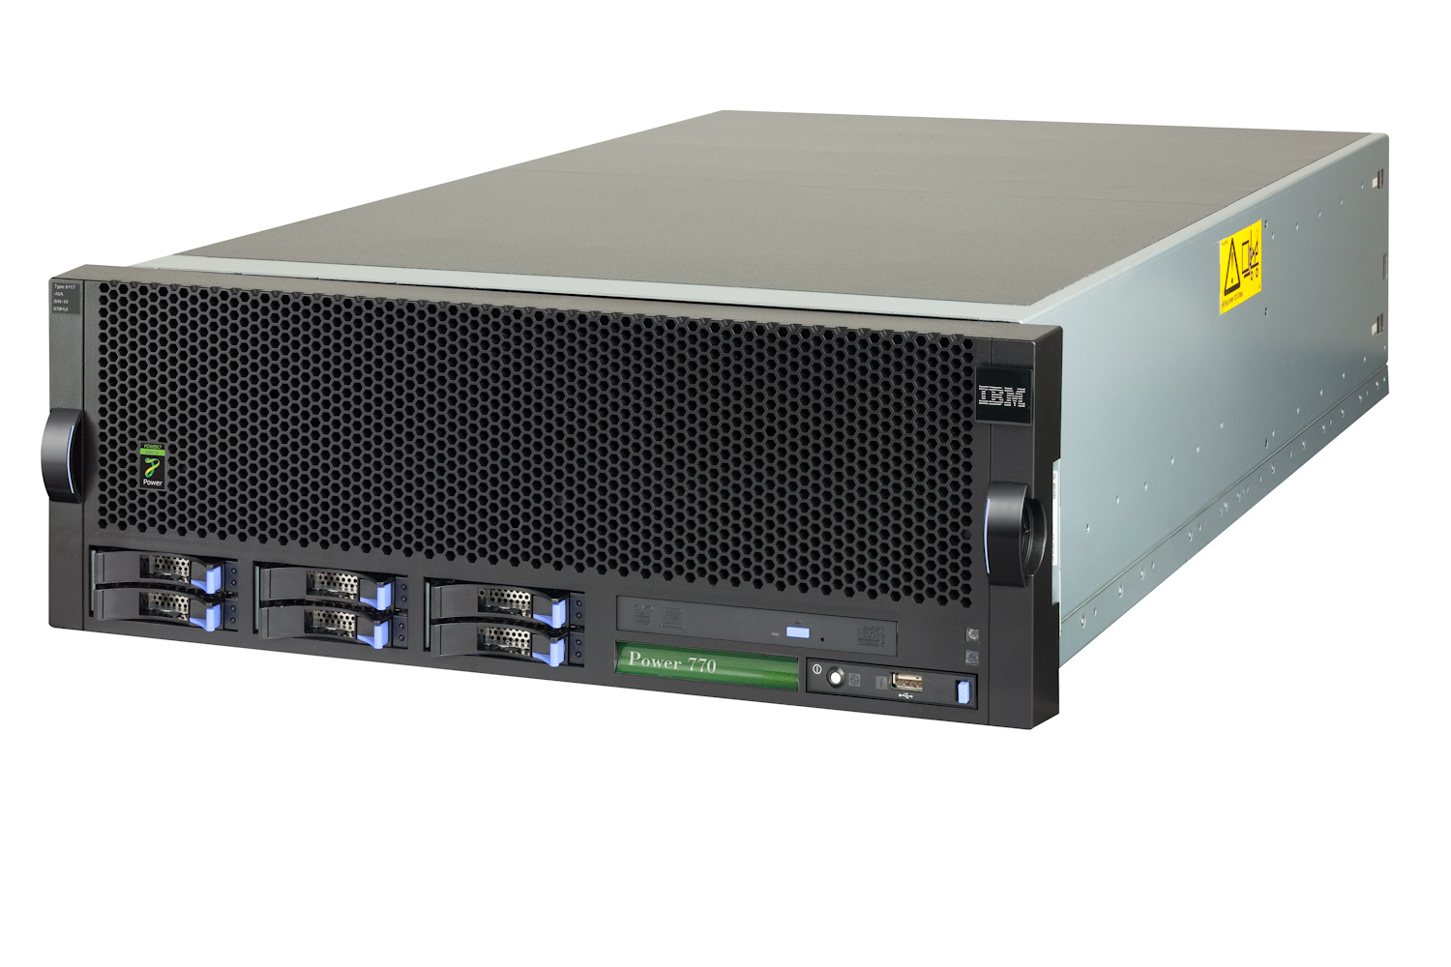
Power 770
Power 770
Processor Technology | 6 Cores @ 3.55 GHz 8 Cores @ 3.1 GHz
L3 Cache | On Chip
Redundant Power & Cooling | Yes
Redundant Server Processor | Yes / Two Enclosure minimum
Redundant Clock | Yes / Two Enclosure minimum
Concurrent Add Support | Yes
Concurrent Service | Yes
 | Single Enclosure | 4 Enclosures
Processors | Up to 2 Sockets | 8 Sockets
DDR3 Memory (Buffered) | Up to 512 GB | Up to 2 TB
SAS / SSD SFF Bays | 6 | 24
Media Bays | 1 Slim-line | 4 Slim-line
SAS / SATA Controller | 2 / 1 | 8 / 4
PCIe (Internal) | 6 PCIe | 24 PCIe
GX++ Bus Slots | 2 | 8
Integrated Ethernet | Std: Quad 1Gbt Opt: Dual 10Gbt + Dual 1 Gbt | Std: Four Quad 1Gbt Opt: Four x Dual 10Gbt + Dual 1 Gbt
USB | 3 | 12
Remote I/O Drawers | Max: 4 T19 | Max: 16 T19
4U x 32 inches Depth
Maint Coverage
9 x 5

Slide 34
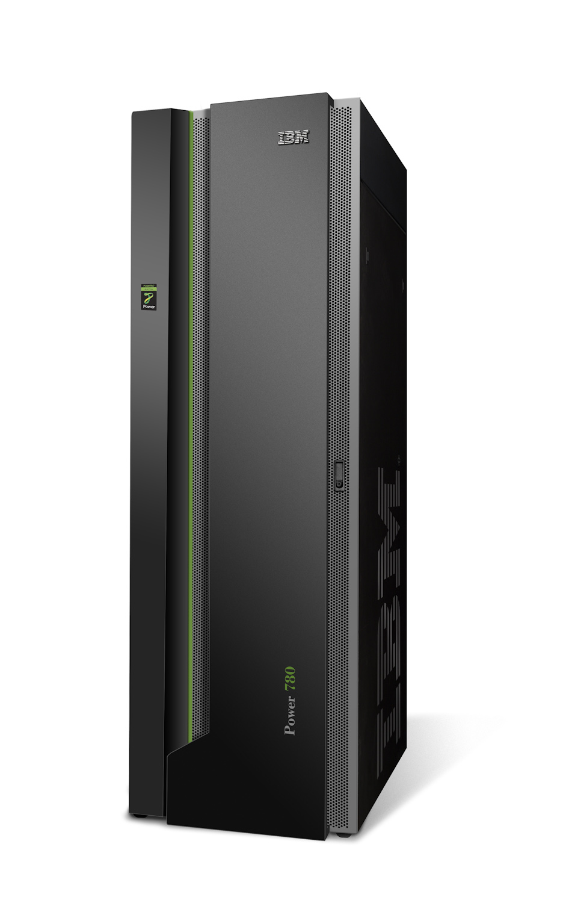
Power 780
Power 780
Processor Technology | 4 Cores @ 4.1 GHz TurboCore 8 Cores @ 3.8 GHz
L3 Cache | On Chip
Redundant Power & Cooling | Yes
Redundant Server Processor | Yes / Two Enclosure minimum
Redundant Clock | Yes / Two Enclosure minimum
Concurrent Add Support | Yes
Concurrent Service | Yes
 | Single Enclosure | 4 Enclosures
Processors | 2 Sockets | 8 Sockets
DDR3 Memory (Buffered) | Up to 512 GB | Up to 2 TB
SAS / SSD SFF Bays | 6 | 24
Media Bays | 1 Slim-line | 4 Slim-line
SAS / SATA Controller | 2 / 1 | 8 / 4
PCIe (Internal) | 6 PCIe | 24 PCIe
GX++ Bus Slots | 2 | 8
Integrated Ethernet | Std: Quad 1Gbt Opt: Dual 10Gbt + Dual 1 Gbt | Std: Four Quad 1Gbt Opt: Four x Dual 10Gbt + Dual 1 Gbt
USB | 3 | 12
Remote I/O Drawers | Max: 4 T19 | Max: 16 T19
Maint Coverage
24 X 7
PowerCare Support

Slide 35
What is TurboCore?
Technology
Four of the eight cores and L2 cache are turned off
Shared L3 cache is now doubled for remaining cores
Remaining cores run at 4.1 GHz frequency
Remaining cores share memory and I/O bandwidth
Provides up to 22% per core performance gain compared to having all eight cores turned on
Unused cores are powered off to improve energy efficiency
Implementation
3.8 GHz processors are purchased with Power 780 system as needed
Required number of activations are purchased with Power 780 system
System is configured by user for TurboCore mode operations
System is powered on and cores are made available in TurboCore mode (up to 4 cores per processor)
System can be reconfigured by user with a reboot
The entire system is either in TurboCore mode or MaxCore mode
P7
Core
P7
Core
P7
Core
P7
Core
P
O
W
E
R
S
M
P
F
A
B
R
I
C
L2
L2
L2
L2
G
X
L3 Cache
B
U
S
L2
L2
Memory Interface
L2
L2
P7
Core
P7
Core
P7
Core
P7
Core
TurboCore
Cores
Unused
Core

Slide 36
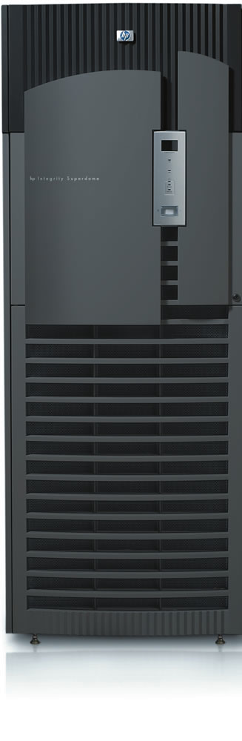
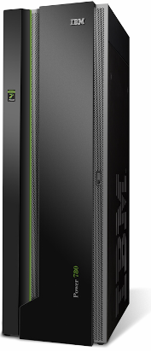
8 to 1
Number of HP Integrity Superdome 64-core systems utilized at 30% that can be consolidated into a single IBM Power 780 modular high-end system utilized at 80% saving 87% of the cores for software licensing, reduces floor space required from
80 square feet to just 7.6, and reduces energy costs by 92%.
Super Power indeed.

Slide 37
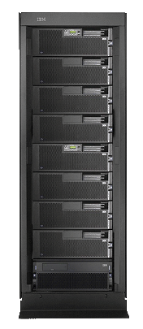

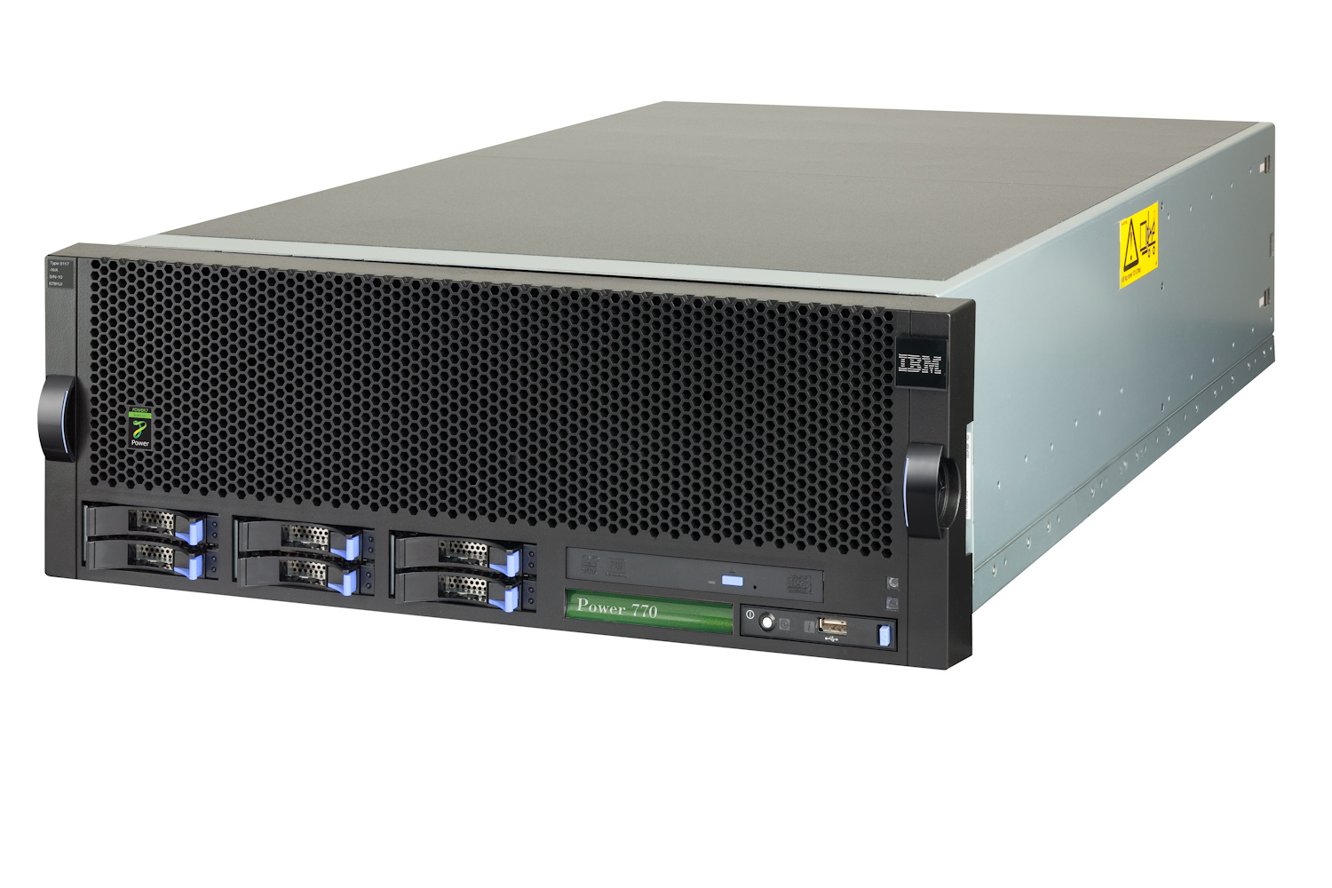
84%
Reduction in energy usage moving from POWER5 to POWER7.
Savings extend to floor space, software license costs,
and maintenance. Increase your performance and capacity.
4
1
Power 770
24 cores @ 3.5 GHz
60% utilization
POWER5 570 systems
64 cores @ 1.9 GHz
30% utilization
50% effective capacity increase
84% reduction in energy usage
~$250K maintenance savings over 3 years
> $1M savings in software licensing

Slide 38
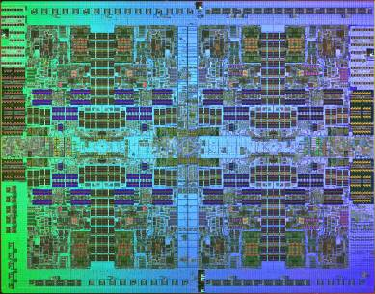
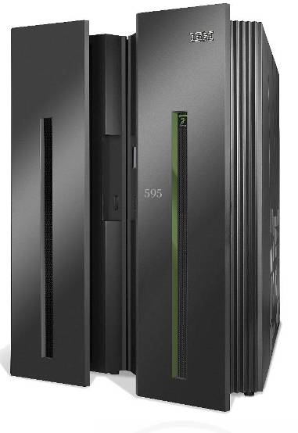
POWER7 High-End Server Statement of Direction
IBM plans to deliver a new high-end server in 2010
with up to 256 POWER7 processor cores
Designed to operate within the same physical footprint and energy envelope of the current 64-core Power 595 server.
High-Voltage DC Power option
IBM also plans to provide an upgrade path from the current IBM Power 595 server with 12X I/O to the new POWER7 high-end server.
Enterprises with multiple systems leveraging PowerVM Live Partition Mobility may use this function to maintain application availability during the upgrade process.

Slide 39
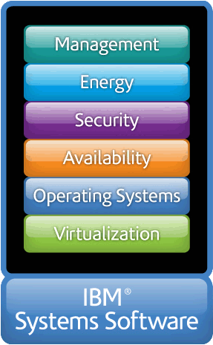
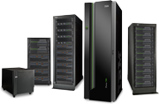



Power your planet.
+
AIX - the future of UNIX
Total integration with i
Scalable Linux ready
for x86 consolidation
Workload-Optimizing Systems
Virtualization without Limits Drive over 90% utilization Dynamically scale per demand |  | Dynamic Energy Optimization 70-90% energy cost reduction EnergyScale™ technologies
Resiliency without Downtime Roadmap to continuous availability High availability systems & scaling |  | Management with Automation VMControl to manage virtualization Automation to reduce task time
Smarter Systems for a Smarter Planet.

Slide 40
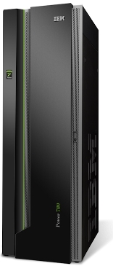
Power is Workload Optimization
Power Systems offers balanced systems designs that automatically optimize workload performance and capacity at either a system or VM level
TurboCore™ for max per core performance for databases
MaxCore for incredible parallelization and high capacity
Intelligent Threads utilize more threads when workloads benefit
Intelligent Cache technology optimizes cache utilization flowing it from core to core
Intelligent Energy Optimization maximizes performance when thermal conditions allow
Active Memory™ Expansion provides more memory for SAP
Solid State Drives optimize high I/O access applications
Workload-Optimizing Features make POWER7
#1 in Transaction and Throughput Computing

Slide 41

Power is Virtualization without Limits
Performance without penalty - all benchmarks
published in a virtualized environment
Consolidate AIX & i databases with Linux application
servers on one system or a system pool
Up to 32x the VM size & 8x the memory of VMware and Dynamically add & remove VM resources unlike VMware
Live Partition Mobility with VM’s of any size up to
entire system unlike VMware
Drive systems to over 90% utilization
for maximum ROI

Slide 42


Power is Resiliency without Downtime
PowerHA SystemMirror for AIX and i provide active/standby datacenter and multi-site disk clustering solutions for resiliency
PowerHA pureScale provides active/active high performance data transfer, cluster coordination, and centralized locking and is built-into DB2 pureScale
PowerVM Live Partition Mobility enables planned system downtime without application downtime

Slide 43


Questions?
Thank you

