Slide 1
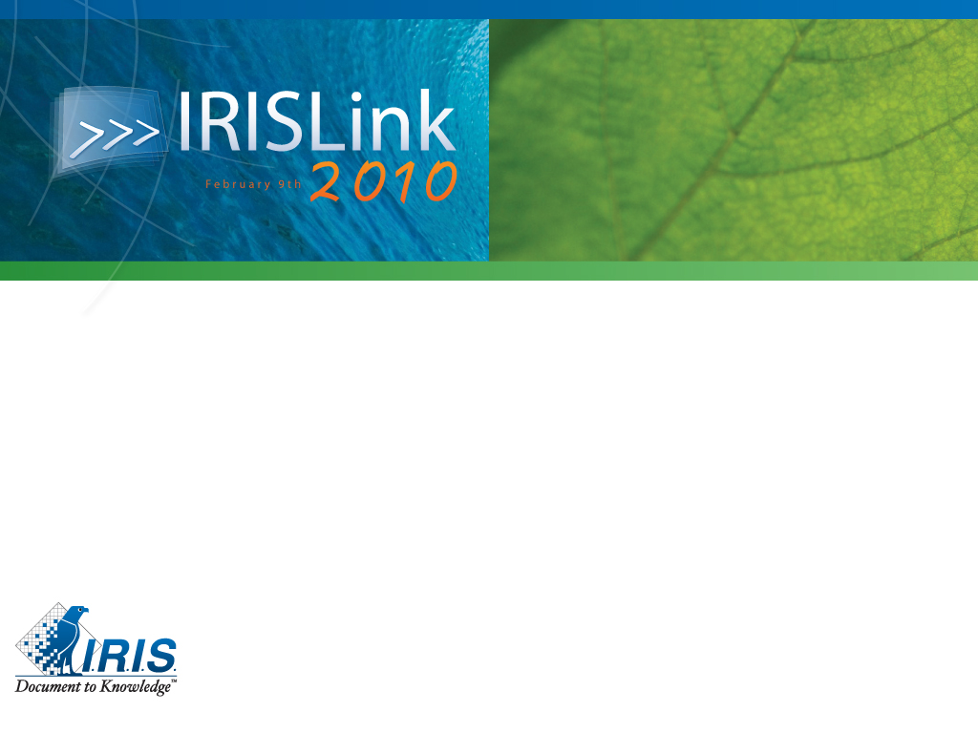
Creating a Secured and Trusted Information Sphere in Different Markets
Giuseppe Contino

Slide 2

Introduction
IT has dramatically changed the way we think about security and trust information
Electronic information is not seen as trusted as paper information
Electronic information is not seen as secured as paper information
…but why ? And what’s the
operational reality ? What are
the options ?

Slide 3
Some example from the real life
HR: I prefer to store the HR Files in a secured and locked physical cabinet because I don’t know who can really access my electronic files
Sales: I need the physical copy of the proposal sent to the customer because I cannot trust the electronic one (I don’t know if it’s the version sent to the customer) and I need to solve a problem…
Banking: Classic email or internet communication is not sufficient to exchange trusted information, we have to be sure about the sender identity…

Slide 4
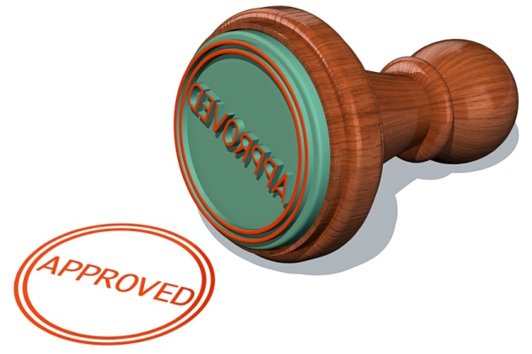
What make you trust an electronic information ?
I know the author
I know the final approver
I can verify the validity
I’m able to make a cross-check
I’m sure that’s the latest version approved
I made myself the information
…and I’m sure no one changed it…

Slide 5

When do you consider an electronic information is secured ?
I can decide who can access and be sure that’s enforced
I’m aware of who do what with this information
It’s physically secured (network, storage)
When operation can be restricted
When information could only be read
by the recipient

Slide 6

Security and trust : the ecosystem
Actors
Content
Container
Rules
Process
Audit
  Report
  Prevention
  Live monitoring / alert
IT Infrastructure
Security Infrastructure

Slide 7

Implementing and secured and trusted information sphere step by step

Slide 8
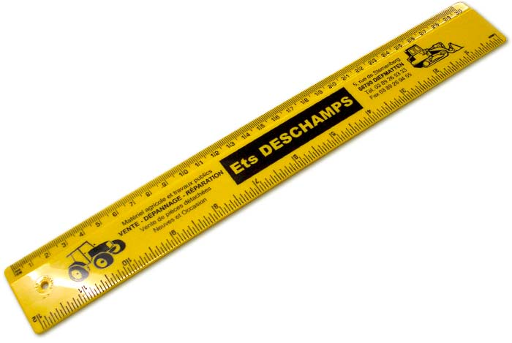
Step 1 : define requirement
Classify critical information (give them a type)
For each type of critical information:
  What do I need to trust the information ?
  When do I considered this information is enough secured ?
Gap analysis
  What’s already in place ?
  What’s the cost to fill the gap ?
Decide
  What type can be covered
Don’t
  Do something partially >> trust and partially are not friend

Slide 9

Step 2 : Actors
Classical for internal users, have a central directory
  Classical but not trivial for large companies and groups: Meta directory tools are available on the market to consolidate heterogeneous directory and virtualizes a central directory with all users
In extension, PKI solution could be setup to ensure identity and non rejection of a user authentication
  Login and password could be exchanged but not a physical certificate (on usb key or smartcard)
For external users
  Implement a additional directory
  Exchange certificate (PKI or PGP), enforce a validation of certificate (disallow outdated, only validated by a recognized certification authority)
Implement multi-layer authentication (with SSO)
  Company -> Network -> Container -> Content

Slide 10
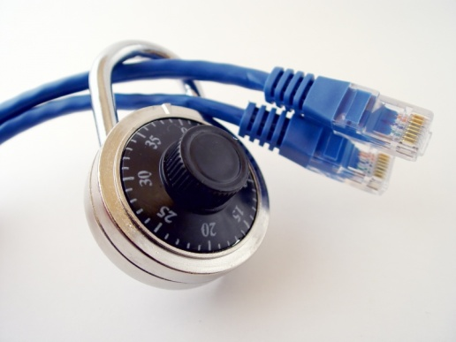
Step 3 : Infrastructure & architecture
Define the network topology based on the requirement
  Do we have to create separate network for very critical information ?
  Do we need partner access to information that require specific extranet security configuration, software and hardware ?
  …
Define the storage strategy based on the requirements
  Do I need a physically encrypted storage ?
  Do I need a secured addressable storage (such as IBM DR550 or Centera) ?
    you cannot browse the content, you need to know the ID to get the content, it ensure that there’s no access outside the application which created the content
Information Security needs a strong expertise in complex ICT
Infrastructure.

Slide 11
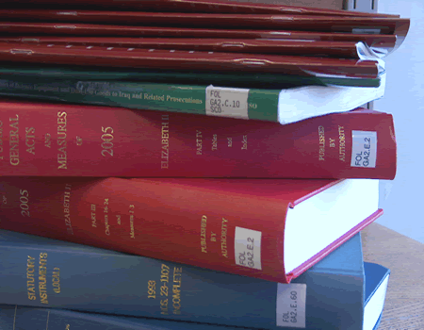
Step 4 : Content & Container
Configure your repository to have a clear distinction for critical type of information
  Users should not define themselves if it’s critical or not
Automate security definition
  Users should have limited options defining security on critical information
Automate process that enforce compliance and risk management
  Track and enforce trust by getting sure an information is correctly approved
If needed, define separate container for very critical information
Define audit trail based on the requirement per type of information

Slide 12
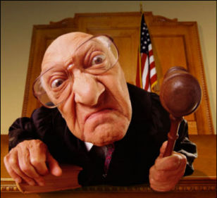
Step 5 : Rules & Process
Information are critical because, in many case, they are key in some process or decisions and they are subjects to specific rules:
  Example: A customer contract is critical because it’s the reference if any problem or legal issues come
Define rules that protect critical information
  Example: A contract could not be changed after it has been signed by the customer -> this rule impact the security after a certain point of the document lifecycle
Define process that enforce critical information trust
  Example: A contract must be approved before being sent
  -> this is a content based processed automated
Define rules that restrict operation on critical information
  Example: this medical report could not be printed or sent
This could be achieved combining ECM and DRM platform

Slide 13

Global Review
Information security and trust requires:
  Network security
  Storage architecture
  Certificate based authentication
  Right Management
  Content Management
  Process Management
  A global approach to achieve pragmatically requirements and address all issues

Slide 14

Thanks!
Q&A
Giuseppe.contino@iriscorporate.com
+352 691 497 535

