Slide 1

Scan2DMS
Sebastiaan Bos
Business Unit Manager I.R.I.S. Netherlands

Slide 2
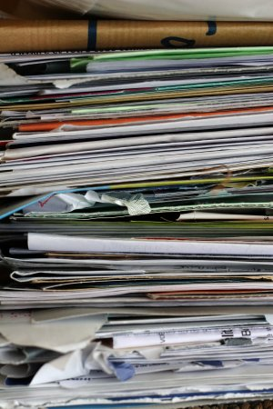
Does this look familiar?

Slide 3
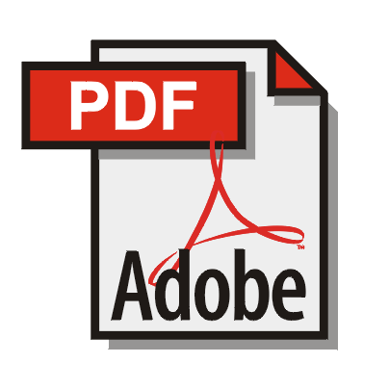
Ever heard of…

Slide 4
Why?
Scanning is increasing every day, incoming mail, contracts, client documents and archive(s).
Not the paperless office but the paper “less” office.
PDF is hot, PDF/A is booming but PDF’s are not OCR-ed.
What to do with the PDF files you receive from your clients?
Do your MFP’s OCR?
Do you store your documents in the correct format?
Notes:
Story do you store your documents in the correct format:
Format refresh is a particular issue with electronically stored information. We can read a scroll of papyrus that was written 3000 years ago. But we can’t read a 5¼” disk with WordPerfect files from 10 years ago. Information that is locked into obsolete mediums or proprietary formats and systems, is worthless to an organization. So long-term preservation, media refresh and format refresh, need to be considered proactively. Information strategies that include the use of format standards (e.g. TIFF or PDF/A) and audited content refresh cycles, will ensure that information remains accessible for the whole period that it is being kept for.

Slide 5
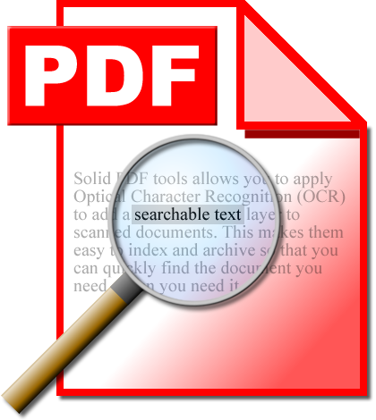
Can you see the difference?
Notes:
Explain that you cannot see based on the PDF that a PDF is OCR-ed or not!!!

Slide 6
What are the issues?
Scanned documents are not OCR-ed and therefore difficult to find in the DMS.
Scanned documents are very large.
Scan 2 email function leaves scanned documents in the user inbox.
PDF files sent to your clients are too big.
Multifunctionals cannot do all the work.

Slide 7
Solution: Scan2DMS
PDF Reconcile for iManage version 1.0.
Scan2DMS for bulk or archive scanning.
Scan2DMS for multifunctionals.
iHQC hyper compression.

Slide 8






PDF Reconcile for iManage
OCR PDF File
Compress PDF file
Save PDF file
Searchable PDF file
Find NON OCR PDF/Tiff file

Slide 9
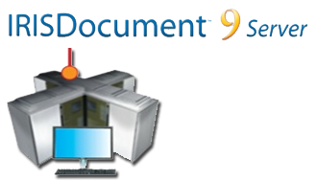
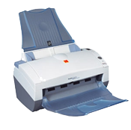
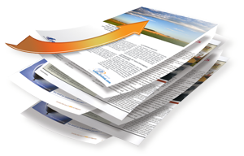




Scan2DMS for Bulk scanning
High speed OCR
Release to DMS
Compress Documents
PDF/A Output
Place documents
Process mass scanned images
Improve scanned image
Add metadata for indexing
Document are automatically filed into the workspace/folder
Folder

Slide 10
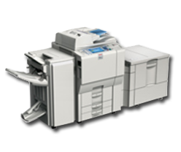
Scan2DMS for Multifunctionals
High speed OCR
Release to DMS
Compress Documents
Multi format output
Input entry on the MFP:
Matter/client number
Chose personal information
Scan to email
Place documents
Document are automatically filed into the workspace/folder
Folder

Slide 11

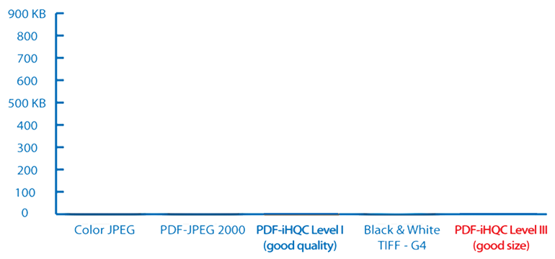
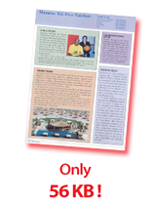
800kb
400kb
200kb
100kb

Slide 12


How to face your major challenge:
Do more with less, while reducing your carbon footprint
  When files are digital accessible from the ECM or DM system it is more easy to work from home or directly on the road which saves of course a lot of carbon emission.
  When the paper archive is not growing, or even digitalized you can reduce archiving costs but also light and heating for the archive which is better for the environment.
  Paperless or paper”less”- A little goes a long way.
    according to a 2007 State of the Paper Industry Report, the benefits decreasing paper use slightly or going “paper”less” should not be underestimated. In fact, if the U.S. cut its office paper use by roughly 10 percent or 540,000 tons, greenhouse gas emissions would fall by 1.6 million tons — equivalent to taking 280,000 cars off the road for a year.

Slide 13


