Slide 1

Portals in a business environment
Carol.VanderDonck@iriscorporate.com

Slide 2
Agenda
What are portals
Portal overview, features and components
Reference KBL
Key take-aways
Q&A

Slide 3
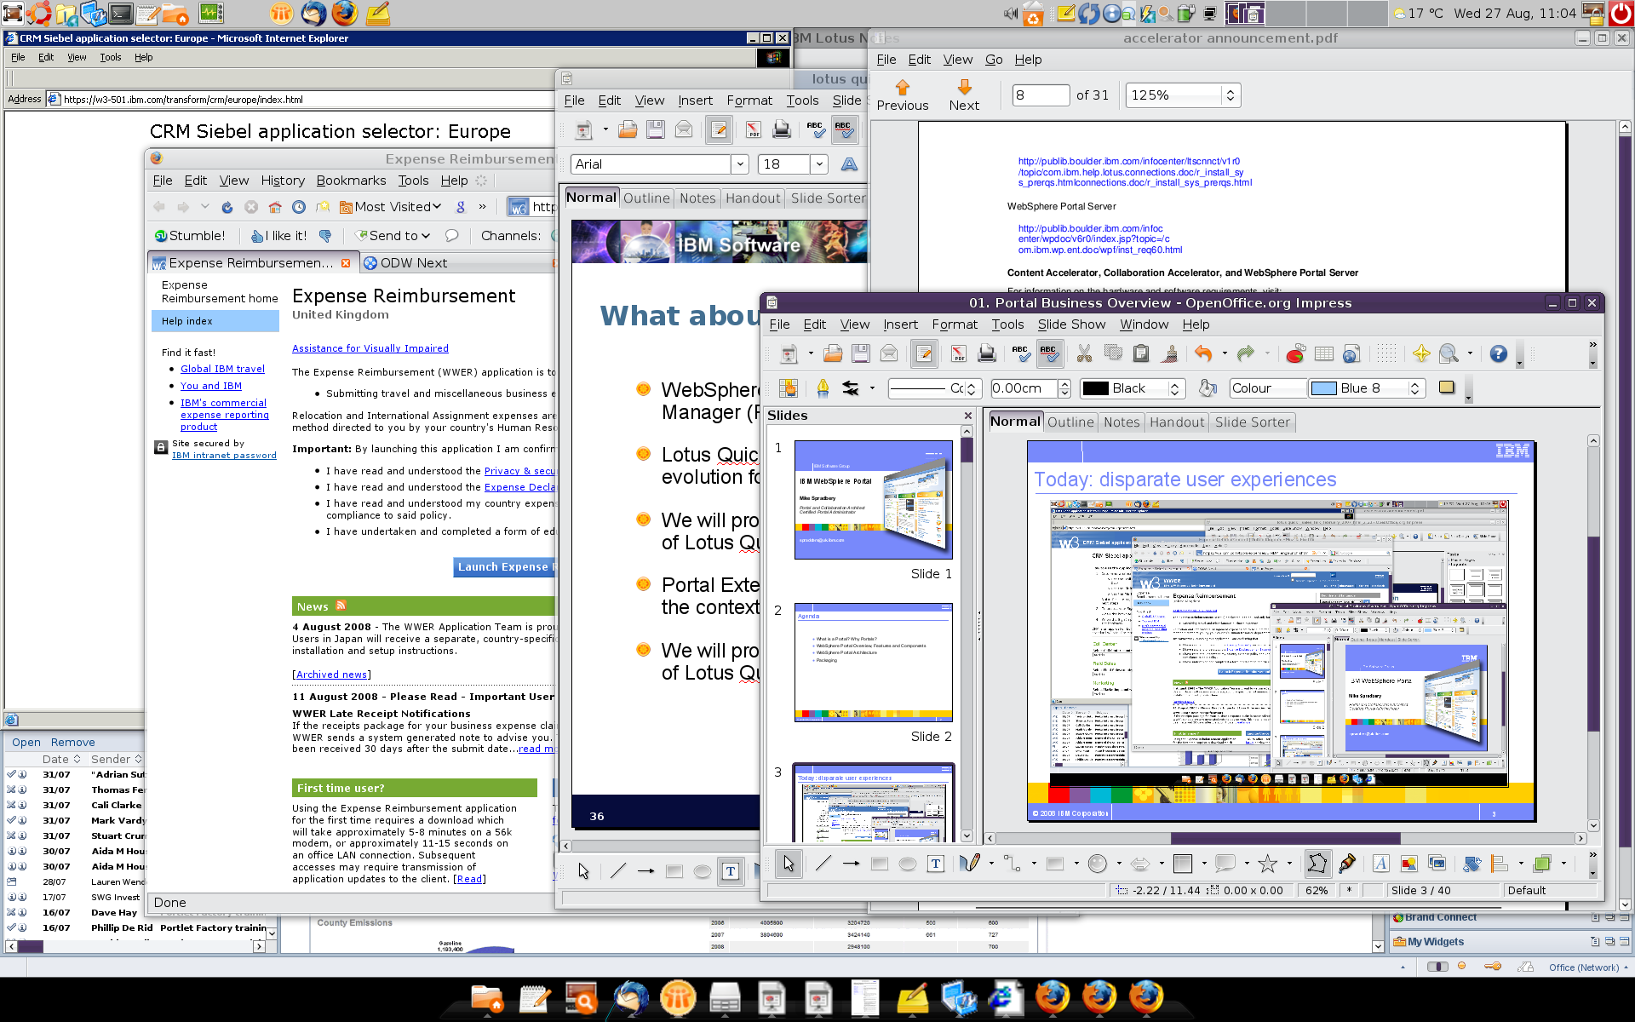
Today: disparate user experiences

Slide 4
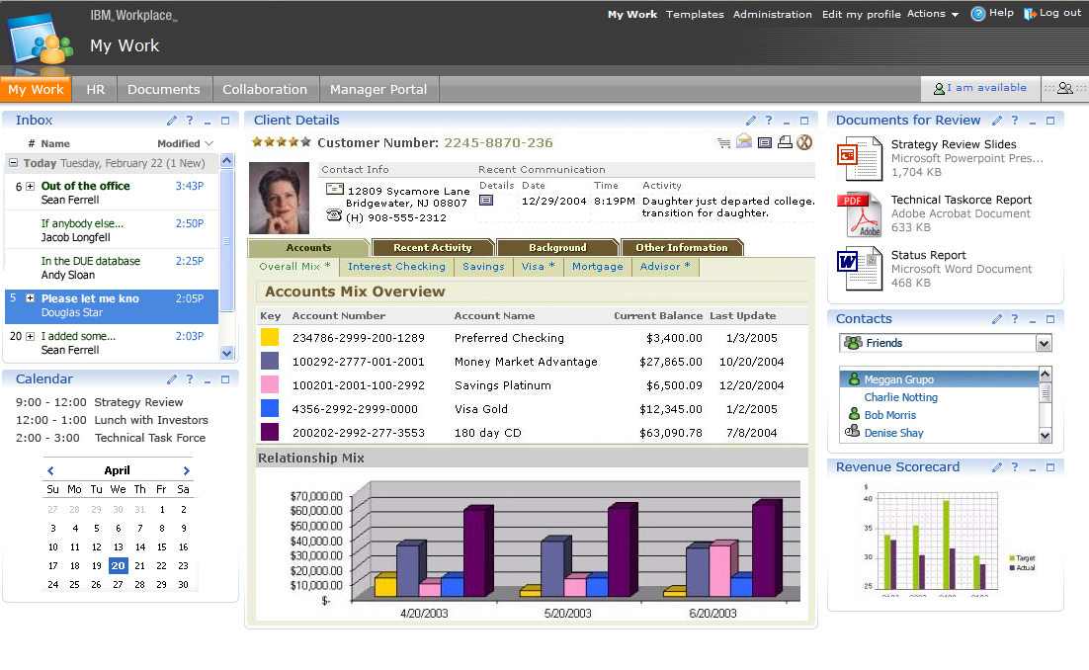
Portal Definition
A well-known point of access to many different resources, presented in a consistent, integrated and personalized manner.
WebSphere Portal

Slide 5

Key Benefits and Capabilities of Enterprise Portals
CRM Application
User Perspective
Databases
Integration
“at the glass”
Content Management
Collaboration
eHR
Dynamic experience
Collaboration
Customization
Personalization
Engaging UI
Single Sign-on
People Awareness
Secure Access, SSO
Role-based Deployment
Scalability & Reliability
Administration
Navigation
Application interfaces
Aggregation
Syndicated Content
Web Services
Other web content
IT Perspective
Notes:
5

Slide 6
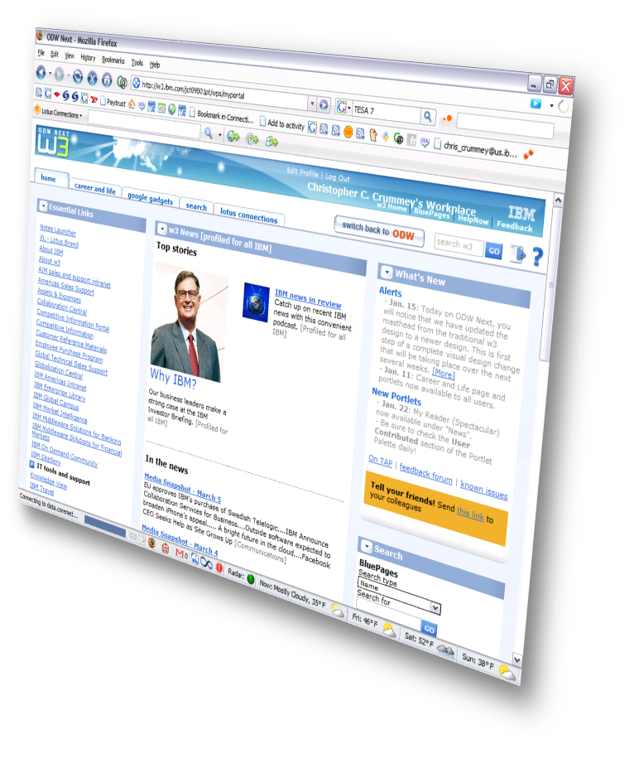
Portal services
Single User Experience
Navigation Model
Single Sign On
Security
Web Content Mgmt.
eForms
Workflow
Templates
Admin
Search
Devices
Internationalization
Notes:
6

Slide 7
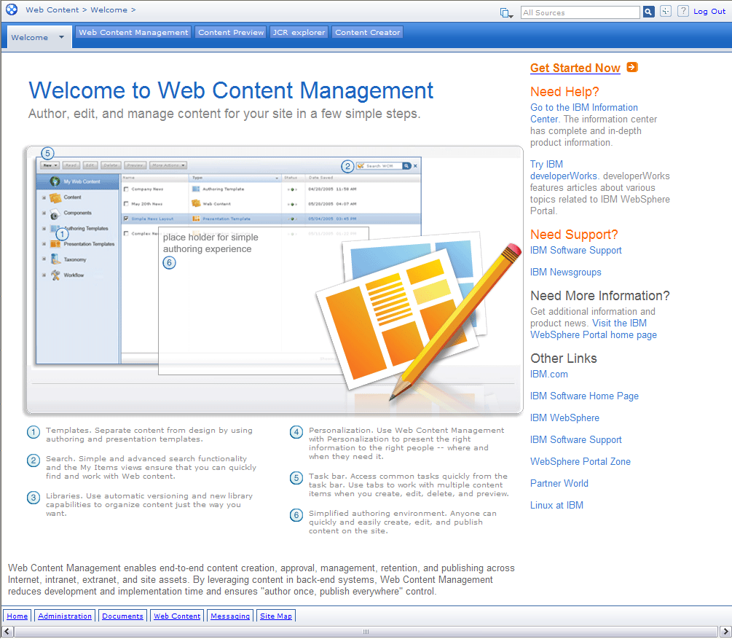
Web content management
Inline Editing for infrequent users
User-friendly, simple templates for entering content
Full text, attribute and taxonomy search
Simplified process for including personalization rules in content and layout
Views allow users to find their content easily
User interface can be customized easily to provide tailored experience
Link Management and RSS Integration

Slide 8
Web content artifacts
Presentation Template
Authoring Templates define content attributes(elements), properties, and other metadata such as categorization, workflow, security and history
Components are reusable design items.
Presentation Templates reference Authoring Template Elements
A Portlet or a Web Page will render content using a Presentation Template or design Component.
Components
Authoring Template
Elements
Portlet(s) or Web Page
8
Notes:
An IBM Proof of Technology
Go to 'View-->Headers and Footers' to change this to match "Presentation" section title
8

Slide 9
Web content management
Authoring Template
Content
Presentation Template
News example (ATNews)
Identification
- Name
Title
(Profile)
(Content Properties)
Content
- Summary
- Body
- Confidential
- DisplayImage
(Workflow: StandardWorkflow)
(Access)
(History)
News example (News2)
Identification
- Name: News2
- Title: What is new with IBM …
(Profile)
(Content Properties - ATNews)
Content
- Summary : There are many impro…
- Body : Rapidly manage intranet, …
- Confidential: External Use Permitted
- DisplayImage : SiGeSilconGermanium.jpg
Workflow : StandardWorkflow
(Access)
(History)
News example (PTNewsDetail)
<html>
…
<Element key="DisplayImage“ …/>
…
<IDCmpnt … field="title"/>
…
<Element key=“Summary" … "/>
…
</html>
Published or Previewed Content
Define one or more content type(s)
Create content based on this type
Show content in one or more different formats
(HTML, RSS, etc.)
Content can be versioned
Separate content from presentation

Slide 10
Portal look and feel
Themes & Skins = Look, feel & navigation
Programmable & Dynamic
Basis for “Branding”
Virtual Portals
All successful portals have their own “identity”
What ever you can do in HTML, CSS, images & JavaScript (Reuse your corporate branding)
Make it look anyway you want
Notes:
10

Slide 11
Portal Document Management
What is the Portal Document Manager
Centralizes and shares documents in Portal like Word, Excel, PDF, images or other text files
The users can :
  Import new documents
  Read and download documents
  Modify (Locking)
  Share documents with others users or group of users (LDAP)
  Search documents using index or Full-text.
Integration in Windows Explorer and MS Office application

Slide 12
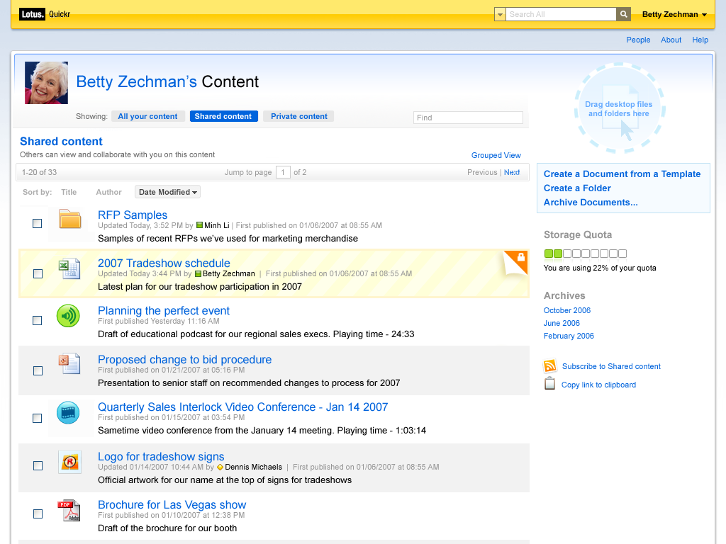
Portal Document Management
Provided by IBM Lotus Quickr
User can navigate through a hierarchy of user-defined folders and documents.
Add, delete or modify folders
Easily add documents of any format from local file system
Share documents with teams
Collaborate on documents and team places

Slide 13
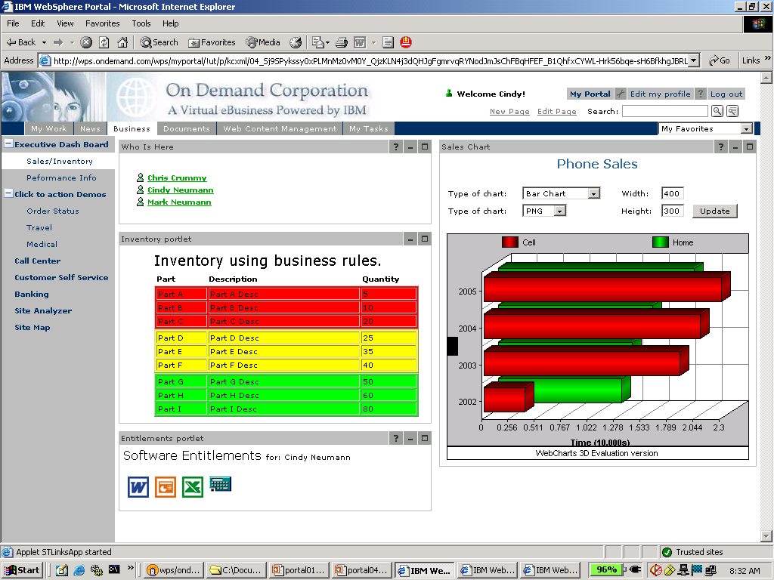
Building a Portal Page
Security
Theme
Customisation
Navigation
Personalised
Portlets

Slide 14
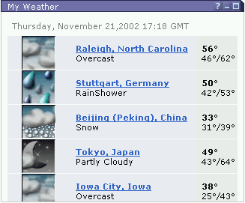
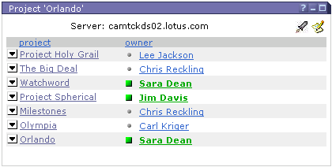
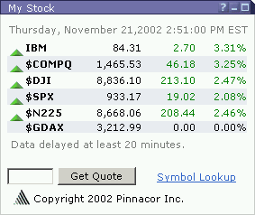
Portlet Principle
Each portlet is a separate Web application
Developed independently
Can be placed anywhere on the page
Dynamic deployment; dynamic configuration
Portlets support multiple markups
Phones, Organizers, Voice
Unique views for each device
Business logic can be shared
Web 2.0
Portlets support Client Side Aggregation to retrieve and share information without server round-trips
Portlets can refresh individually
Support for AJAX and DoJo

Slide 15
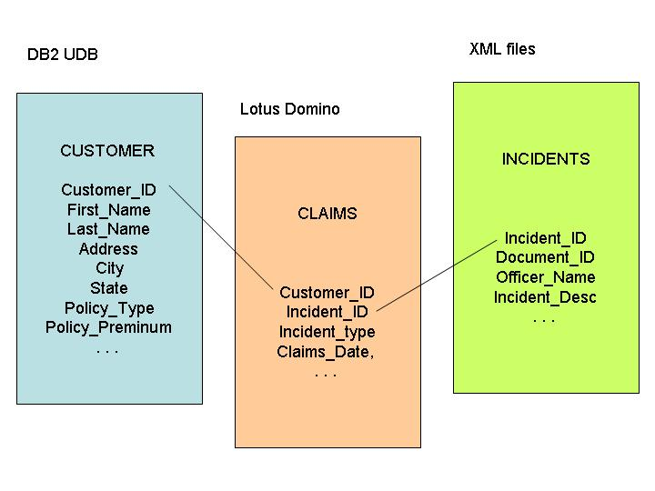
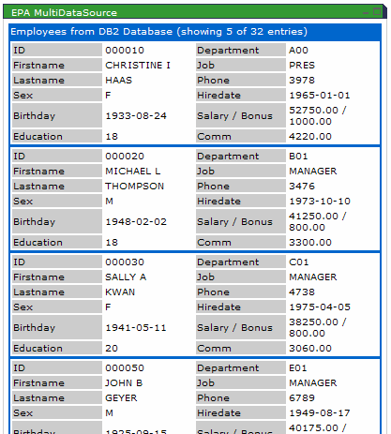
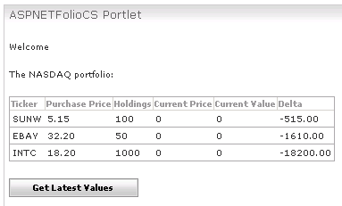
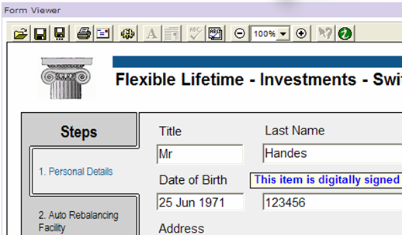
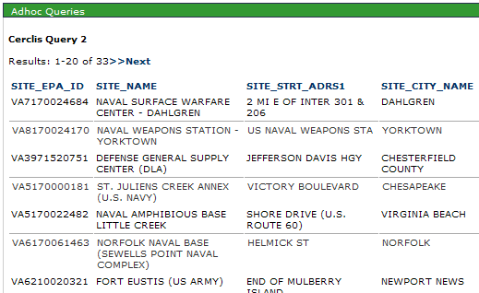
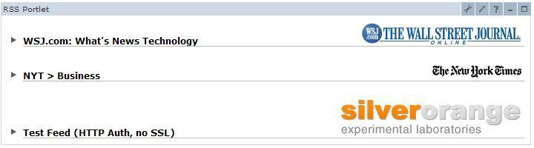
Access to data and applications
Data Joins
Info Integration
.NET Apps
Dashboard
RSS Feeds
e-Forms
Data Queries
Transactions
Web Services
Notes:
15

Slide 16
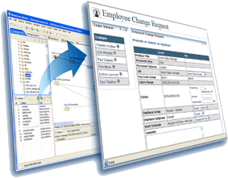
IBM WebSphere Portlet Factory
IBM WebSphere® Portlet Factory is a dedicated portlet creation environment for WebSphere Portal that simplifies & accelerates the development, deployment, maintenance and reuse of custom portlets – including SAP, Domino, PeopleSoft, Siebel and Web Service portlets.
Automation
Change
Reuse
WebSphere Portlet Factory provides rapid application development and integration to existing applications, data & other IT assets for custom portlet creation - reducing the complexity of J2EE development and speeding WebSphere Portal deployments
16
Notes:
An IBM Proof of Technology
Discovering WebSphere Portal Server v6.0 - WebSphere Portlet Factory v6.0
16

Slide 17
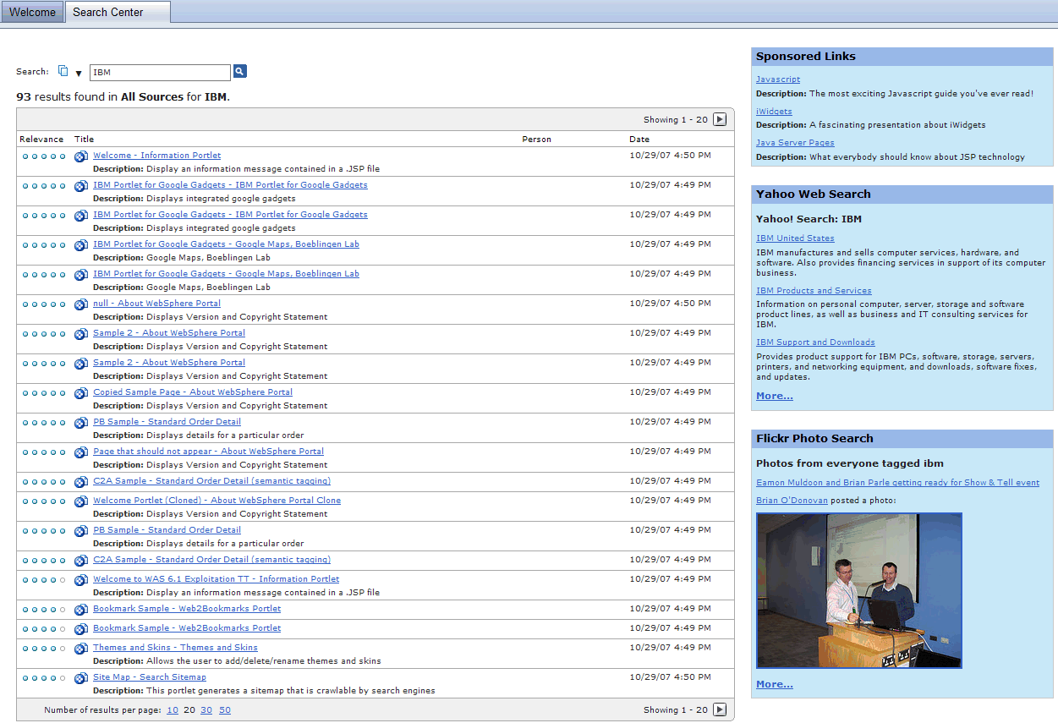
Portal Search helps raise productivity
Usability
  Site map provides Secure “outline” of Portal hierarchy
  Search API (SIAPI) published externally for applications
  Relevance ranking
Integrate External Search Engines
External Search of Portal Content
  Better search results from Google and other search engines

Slide 18
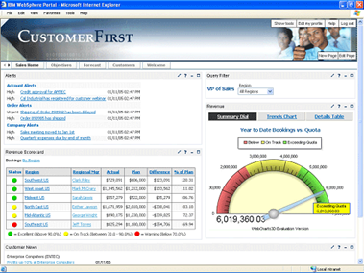
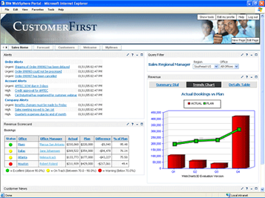
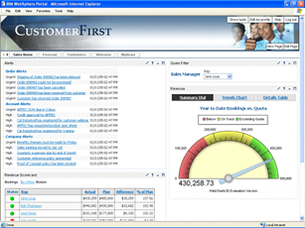
Build Real-time Personalized Dashboards
Sales Vice President
Regional Mgr
Local Sales Mgr
Notes:
18

Slide 19

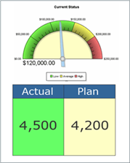
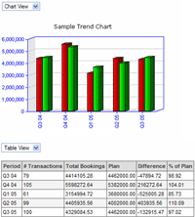
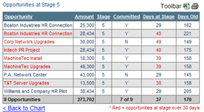


Repository of reusable design components
Workplace Dashboard Framework is a set of reusable assets, robust administration tools, and dashboard-specific features that speed the creation of custom dashboards.
Hierarchy Drill Down
Status Page
Summary & Drilldown
Summary Row
Query Filter
Record List & Detail
Status Indicator
Notes:
19

Slide 20
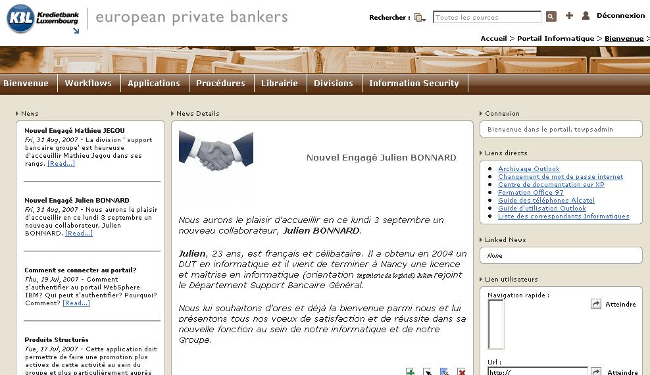
Concrete example
ICT Portal (1)

Slide 21
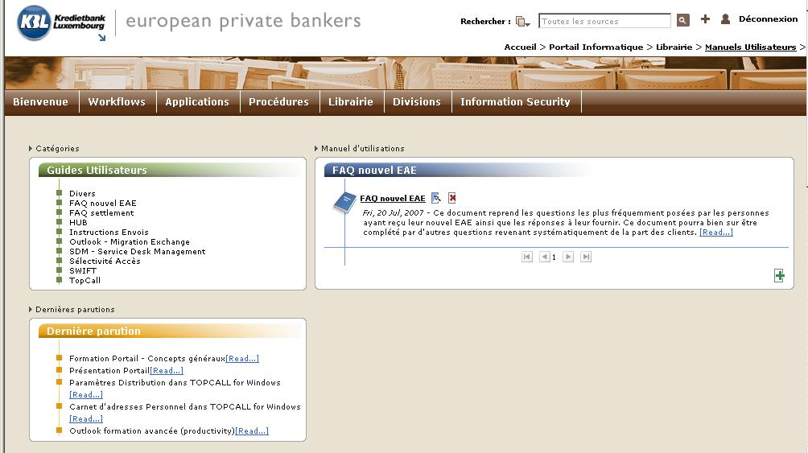
Concrete example
ICT Portal (2)

Slide 22
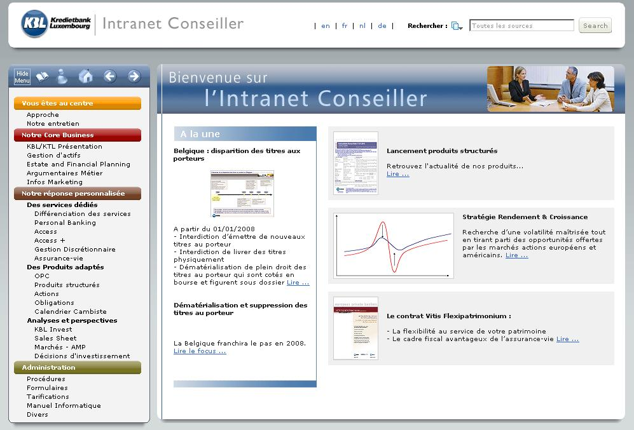
Concrete example
Intranet conseillers (1)

Slide 23
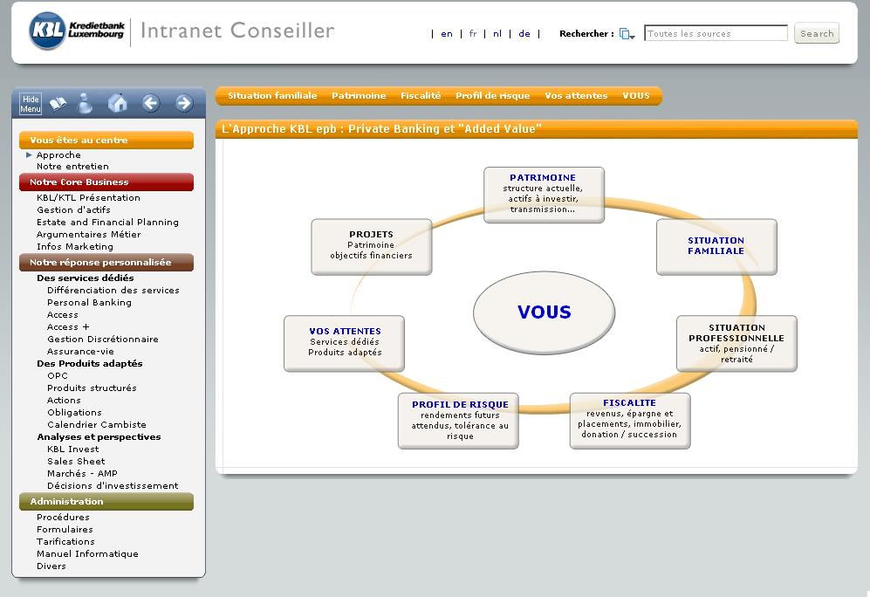
Concrete example
Intranet conseillers (2)

Slide 24
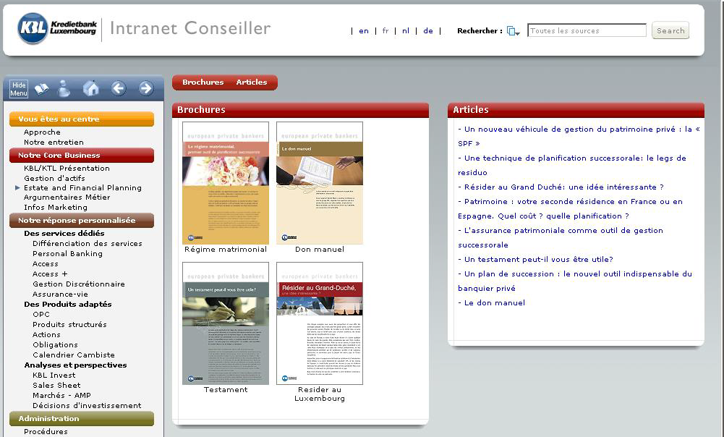
Concrete example
Intranet conseillers (3)

Slide 25
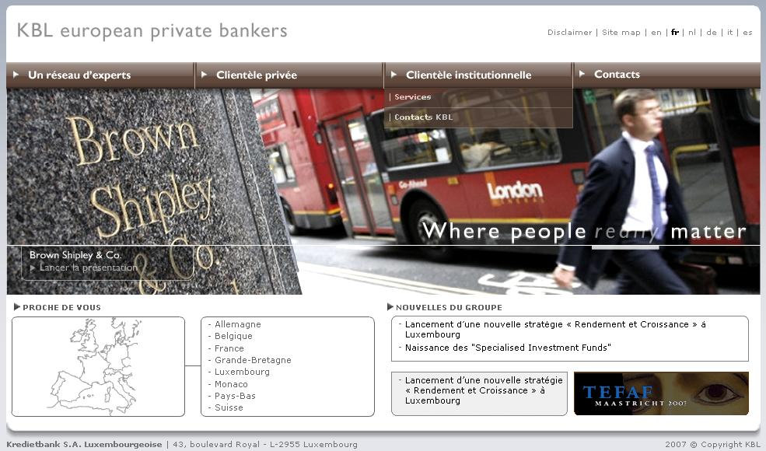
Concrete example
Internet (1)

Slide 26
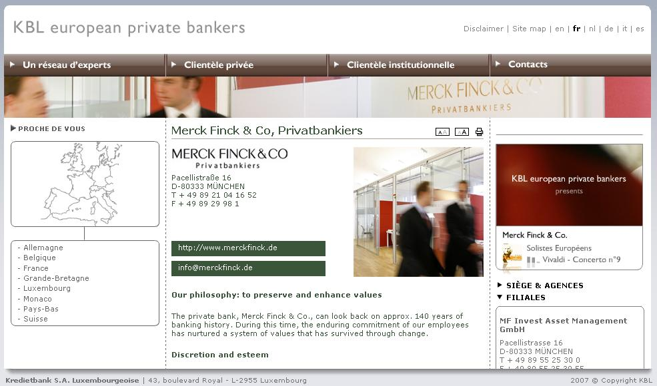
Concrete example
Internet (2)

Slide 27
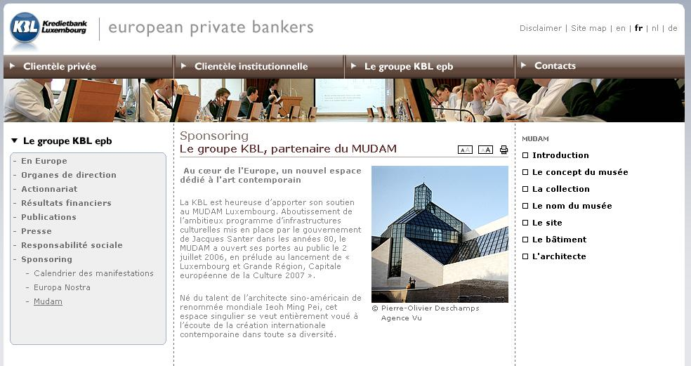
Concrete example
Internet (3)

Slide 28
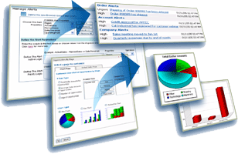
Key take-aways
Business drivers:
  Improve decision quality
  Speed decision execution
  Monitor and improve daily operations
IBM Workplace Dashboards
Technical needs:
  Compose SOA services
  Application focus
    Fast creation
    Quick deployment
    Rapid iteration
    Highly maintainable
  Example applications:
  Intranet / Extranet / Internet
  Customer self service portal
  Interactive shopping sites
  Dashboards
  Citizen portals
  360° views
Portlet Factory Tooling
Dashboard Framework
Component Designer

Slide 29


How to face your major challenge:
Do more with less, while reducing your carbon footprint
Single access point for latest, up-to-date information wherever it resides
Leverage existing investments, multisite management on unique platform, application integration
Use of templates and reusable portlet components / factory

Slide 30

Portals in a business environment
Carol Van der Donck
International ECM Practice

