Slide 1

OEM Opportunities with I.R.I.S.
Alejandro Grüssi

Slide 2
What’s happening in the market?
As the general economy started to melt down, companies began to look at expenditures much closely
Consequently new actions came into scene
Re-negotiation of current contracts (ex. fuel providers)
Internal measures to reduce costs (ex. Printing management)
Reallocation of responsibilities
Etc...

Slide 3
A New Figure Was Born
“The Complete Technology Provider”
End customers were requesting to
Reduce suppliers
Reduce workflow redundancy
Reduce efforts to create connectors
Increase control
Etc...
Consequently Software/Hardware producers wanted to
Provide a more complete offer to their customers ➔Add value to their products
Avoid multiple negotiations, multiple royalty licenses,... ➔ 1 Technology Provider
This is why you see now ECM, DMS, ERP, Workflow SW producers adding Capture/ Classification/ Invoice Processing/ OCR/ Hyper Compression/... to their products

Slide 4
What do we want to show today?
How I.R.I.S. can help you to add new value to your current offer and remain competitive
Why we are “The Complete Technology Provider”

Slide 5



















I.R.I.S. Today

Slide 6
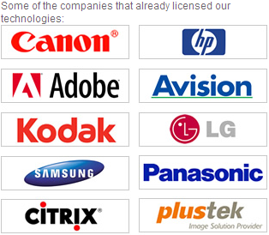
I.R.I.S’ Main OEM Customers

Slide 7
I.R.I.S. Intellectual Property
Intelligent
Document
Recognition
Scanning
Classification
Compression
Recognition
Document Creation
Data Extraction

Slide 8
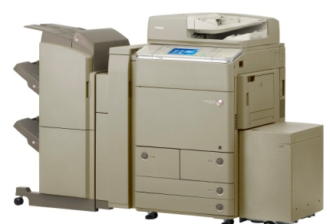
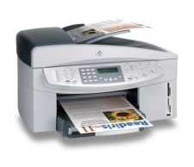
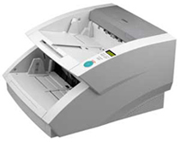

Scanning
I.R.I.S.
Technology
Core
We interface with:
TWAIN
ISIS
VRS – TWAIN
VRS – ISIS
Many years of expertise
though mostly out of
sight…
Scanning
Compression
Classification
Document Creation
Recognition
Data Extraction

Slide 9
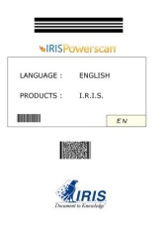
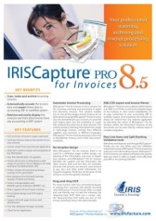
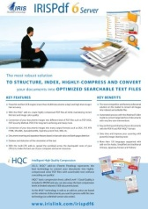
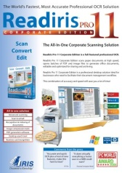
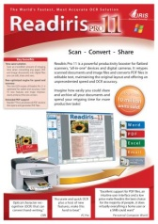
Classification
I.R.I.S.
Technology
Core
Classification as the ability to
separate and identify
documents automatically
I.R.I.S. Classification
technologies is based on
sophisticated clustering
technology, including the
unique IRISFingerPrint™
Scanning
Compression
Classification
Document Creation
Recognition
Data Extraction
Notes:
Information used
OCR
ICR
MICR
Barcode
Patch Code
Graphics
Image Layout ( FingerPrint )
=> Combination
Classification method
Zone
Full Page
FreeForm
Keywords
Contextual
=> Combination

Slide 10



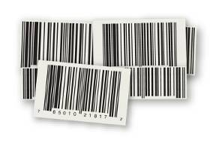
Recognition
OCR - MANY languages
  Latin based
  Cyrillic based
  Arabic
  Chinese
  Japanese
  Korean
  Hebrew
  …
ICR
Barcode
  1D
  2D : PDF417 & QR
MICR
  OCR-A
  OCR-B
  E13B
  CMC7
Graphics
I.R.I.S.
Technology
Core
Scanning
Compression
Classification
Document Creation
Recognition
Data Extraction

Slide 11
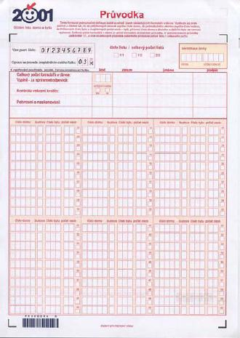
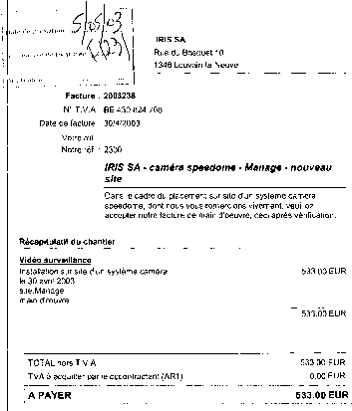
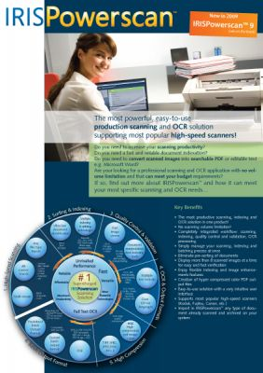
Data Extraction
Structured
  Forms
Semi-Structured
  Invoices
Unstructured
  Mailroom /
  ANY document
I.R.I.S.
Technology
Core
Scanning
Compression
Classification
Document Creation
Recognition
Data Extraction

Slide 12

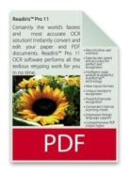


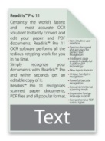

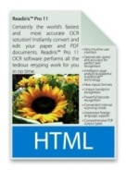
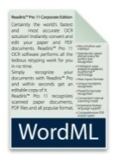
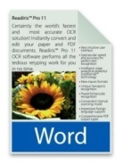
Document Creation
PDF, PDF-A, PDF-iHQC, XPS, XPS-iHQC, Word, RTF, XML,
WordML, HTML, Text, SpreadsheetML, ODT…
I.R.I.S.
Technology
Core
Scanning
Compression
Classification
Document Creation
Recognition
Data Extraction

Slide 13

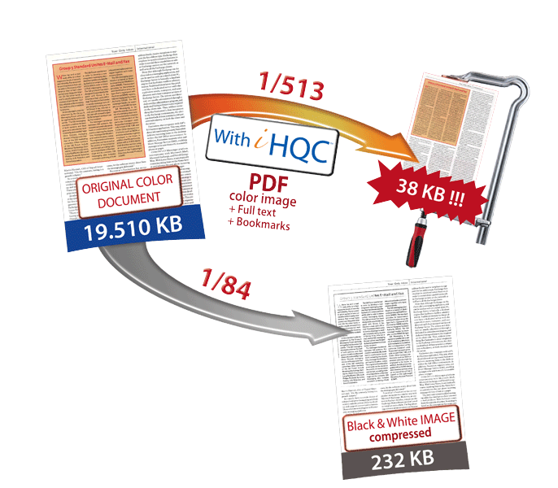
Compression
I.R.I.S.
Technology
Core
Intelligent High Quality Compression
( )
for PDF, PDF/A and XPS documents
MUCH smaller documents means
    Less storage space
    Faster network
Can be opened by
ANY standard viewers
Scanning
Compression
Classification
Document Creation
Recognition
Data Extraction

Slide 14
Conclusion
All these technologies are developed and maintained by I.R.I.S. We own all the intellectual property (100%)
We’re amongst the 3 market leaders in ALL of these technologies.
Our products contain different combinations of these technologies to match the typical needs of our clients
I.R.I.S.
Technology
Core
Scanning
Compression
Classification
Document Creation
Recognition
Data Extraction

Slide 15
Solution Proposals
I.R.I.S. provides a comprehensive range of components, products and solutions for the Document Capture/Document Management area
  Professional Scanning Service
  Server OCR Service
  Hyper-Compression Server (iHQC™)
  Automatic Document Classification Service
  Automatic Invoice Processing Service
  Automatic Form Processing Service
  Etc…
Notes:
our IDR solutions are built as Service Oriented Applications (SOA)

Slide 16
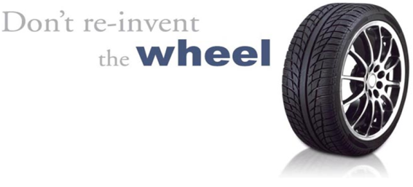
Leverage
“IRIS Scanning Production Service”
The strongest scanning service in the market for all
professional scanners

Slide 17
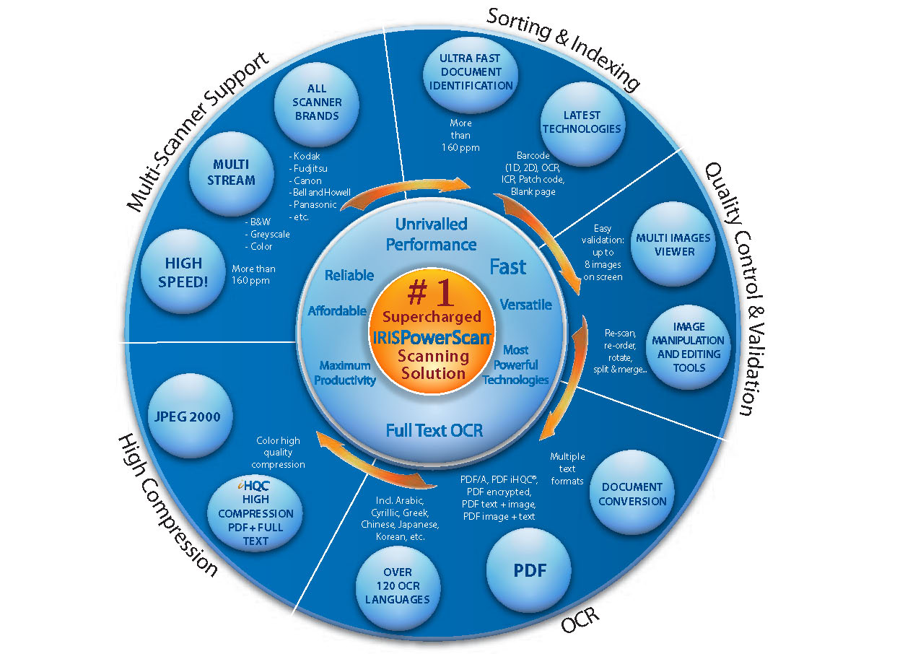
Don’t reinvent the wheel!!
Notes:
Powerful document identification and indexing

Slide 18
IRIS Scanning Service
Costs Related of Reinventing the Wheel
Constant development efforts to satisfy demanding market requests
Intensive quality control and tests
Consecutive efforts for Scanner Validation
Multiple licenses costs (diff. policies, protection mechanisms, limitations,...)
Multiple negotiation efforts with multiple suppliers (time consuming and cost ineffective)

Slide 19
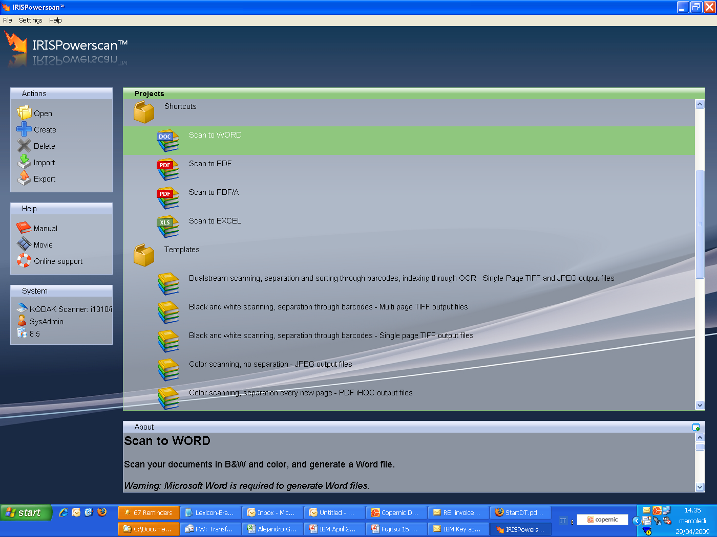
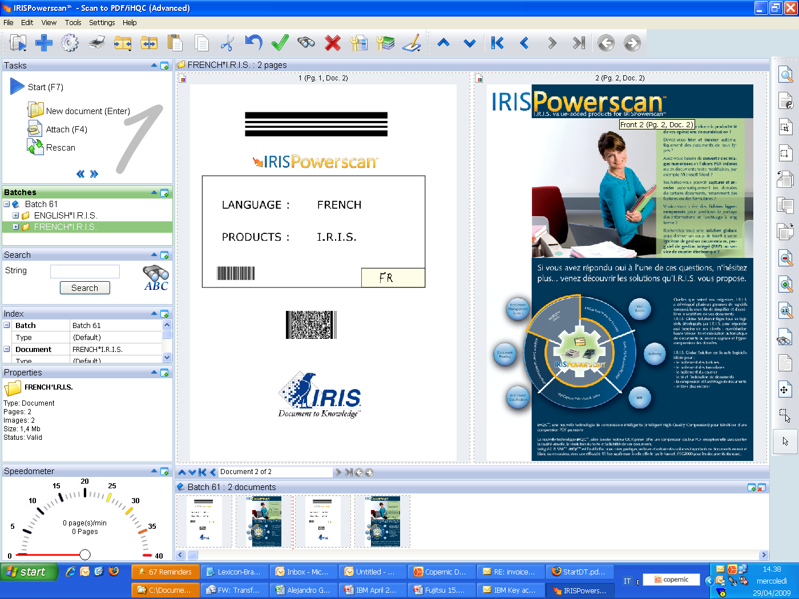

Slide 20
IRIS Scanning Service
Some Technical Benefits
Ready to scan/import “Solutions Packages”
Integrated OCR/ ICR/ Barcode by default
Highly speed scanning, more than 180 pages per minute
Parallel execution of output formats (PDF, PDF-A iHQC, PDF-iHQC, XPS, XPS-iHQC, Word, RTF, XML, XML, WordML, HTML, Text, SpreadsheetML, ODT, Image)
iHQC (Intelligent High Quality Compression) – no quality loss – in Standard PDF format
Direct connectors
Powerful document identification and indexing
Background processing
.Net API for creation of output formats
For heavy duty OCR/compression process, asynchronous process using IRISDocument Server
Asian language support - Chinese (Traditional and Simplified), Japanese and Korean
Arabic, Farsi and Hebrew
Fingerprint technology for doc. Classification
Super friendly interface
Notes:
Powerful document identification and indexing

Slide 21
IRIS Scanning Service
Some Commercial Benefits
Continuous investment in new features (application competitive at worldwide level - Close follow up of competition and constant benchmark)
Free R&D capital
Unify efforts (one solution/ one supplier/ one negotiation)
Cost saving
Synchronization with I.R.I.S. Product Managers
Page Per Minute policy achieving incredible speed (no unwelcome run out of pages surprises)
Long term support (100% I.R.I.S. technology)
Possibility to contribute to I.R.I.S roadmap
Attractive commercial flexibility

Slide 22
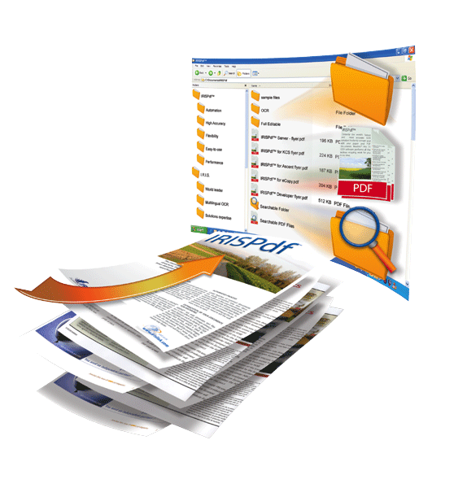
Leverage
“IRIS OCR and Hyper-Compression Service Wheel”

Slide 23


IRIS OCR & iHQC Server
High speed Image Transformation Software for large volume paper
Up to 11 simultaneous export formats
Own OCR in 137 languages / up to 5 Different languages same page
Designed to run 24 hours – 7 days a week
Up to 20.000 pages per day/per Server
Up to 256 Watch Folders
Unlimited Pages
Unlimited Users
High PDF Compression
High XPS Compression
Indexing based on OCR/BCR
Works as a Service behind
Add User Own lexicom
Batch/Watch Folder
Digital PDF Signature
PDF/A 1-b complaint
Notes:
add some words about features not mentioned like, multi-CPU

Slide 24

IRIS Capture Services
One engine.
Forms Recognition
(Structured Docs)
20 years
experience.
Free Text Recognition
(Unstructured Docs)
100% IP
Content Classification
(Structured & Unstructured Docs)
Latest
Technology.

Slide 25
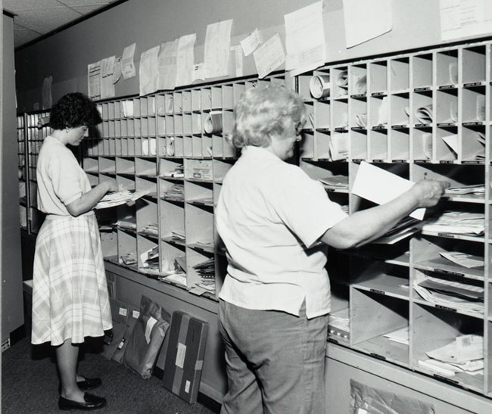
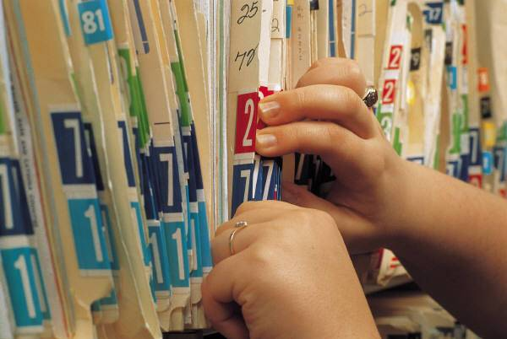
Advanced Clustering Service
Mailroom without Automatization
Electronic Files without Electronic
Does your application need to do anything of this automatically?

Slide 26



Many Solution Packages
Business Process Solutions
Digital Mailroom Solutions
Solution Package
Accounts Payable
Solution Component
Capture Plus
Solution Package
Factoring
Solution Component
Forms
Solution Package
Healthcare
Solution Package
HR (Human Resources)
Solution Package
Orders
Solution Package
Banking
Solution Package
Tax
Solution Package
Personalized Mail

Slide 27

Interconnecting Technologies
Let me tell you,
The whole is greater than
the sum of parts!
Advanced Scanning Service
OCR Server Service
Advanced Clustering Service
Capture Service

Slide 28
I.R.I.S. Toolkits
Currently 4 main toolkits for integration/OEM are available:
  iDRS™ SDK (Compression, Imaging, Recognition toolkit)
  IRISFingerprint™ SDK (Fast Document classification toolkit)
  IDR™ SDK (Intelligent Document Recognition toolkit)
  Cardiris™ SDK

Slide 29


I.R.I.S. Toolkits
Functionality wise, these 3 SDK’s can be subdivided into:
  Image enhancement SDK, pre-processing
  Character Recognition SDK (OCR, ICR, MICR)
  Document Creation SDK(PDF, HTML, RTF, XPS, ...)
  Barcode Recognition SDK(1D, 2D)
  Intelligent Compression SDK(iHQC™)
  Business Card Recognition SDK
  IRISFingerprint™ SDK, Fast Document classification
  Invoice recognition SDK
  Classification/Digital mailroom SDK
  Form recognition SDK

Slide 30
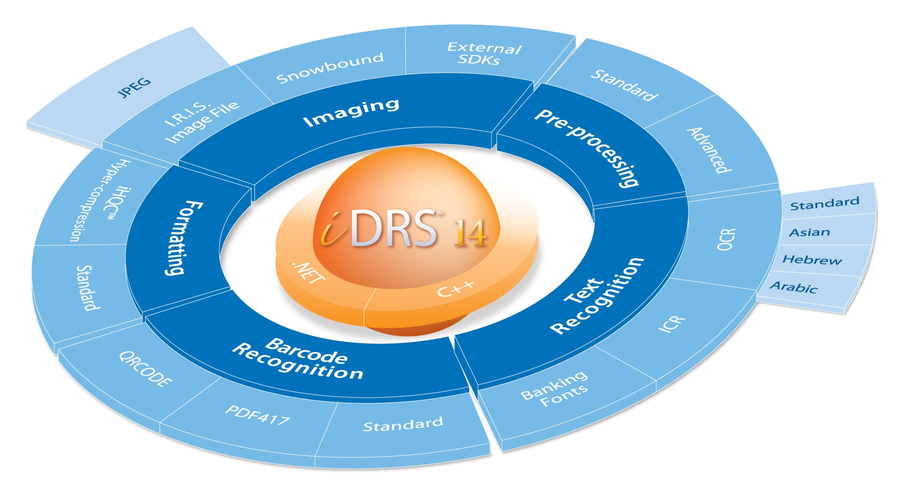
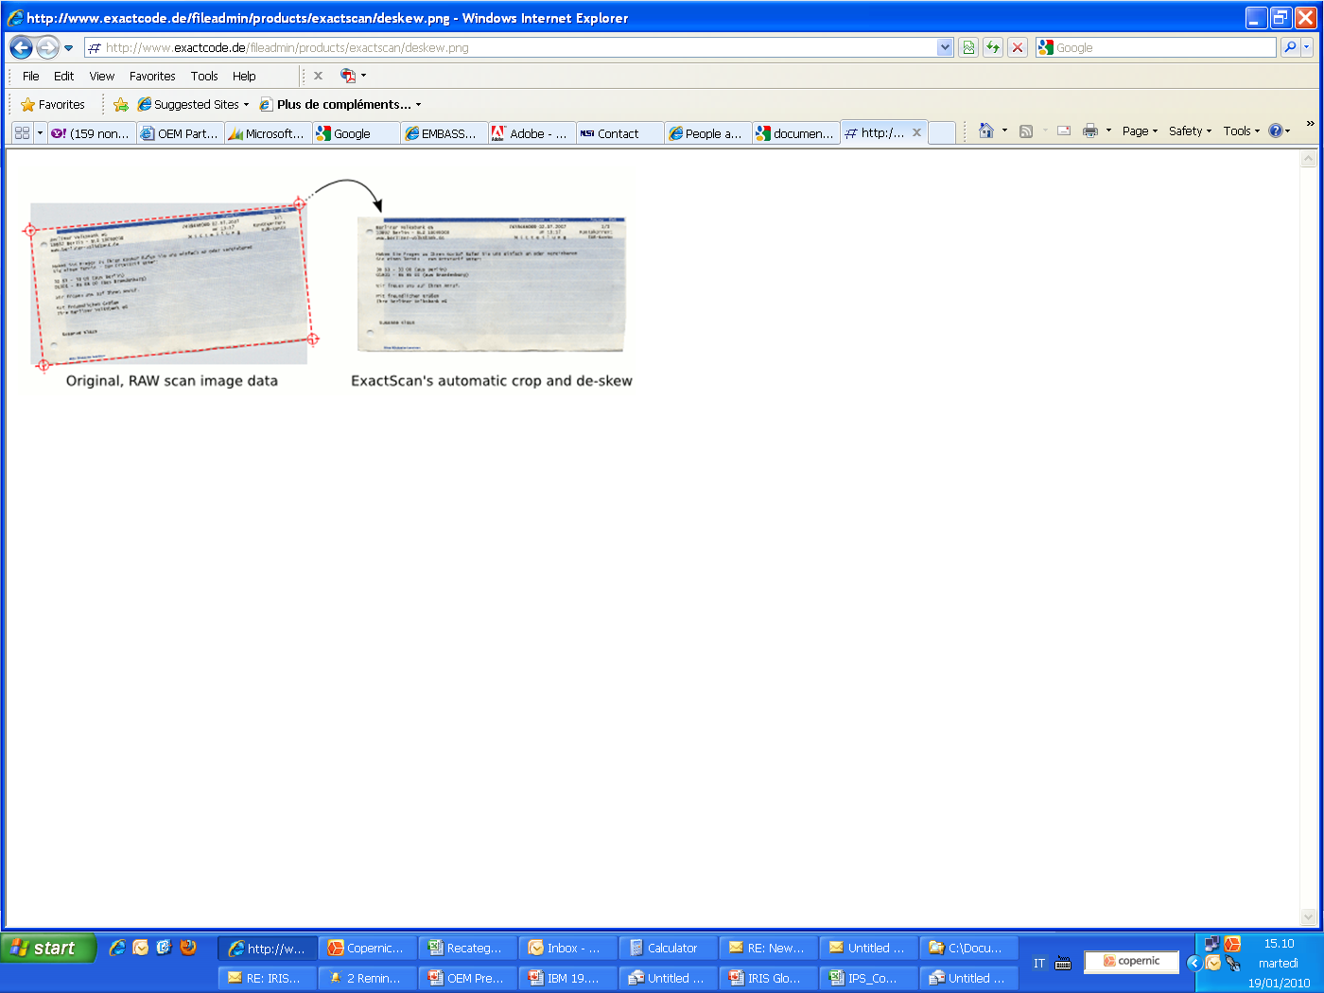
IRIS Developer Reading System
1) iDRS™ SDK

Slide 31
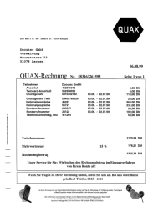

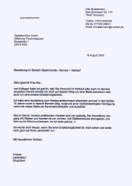
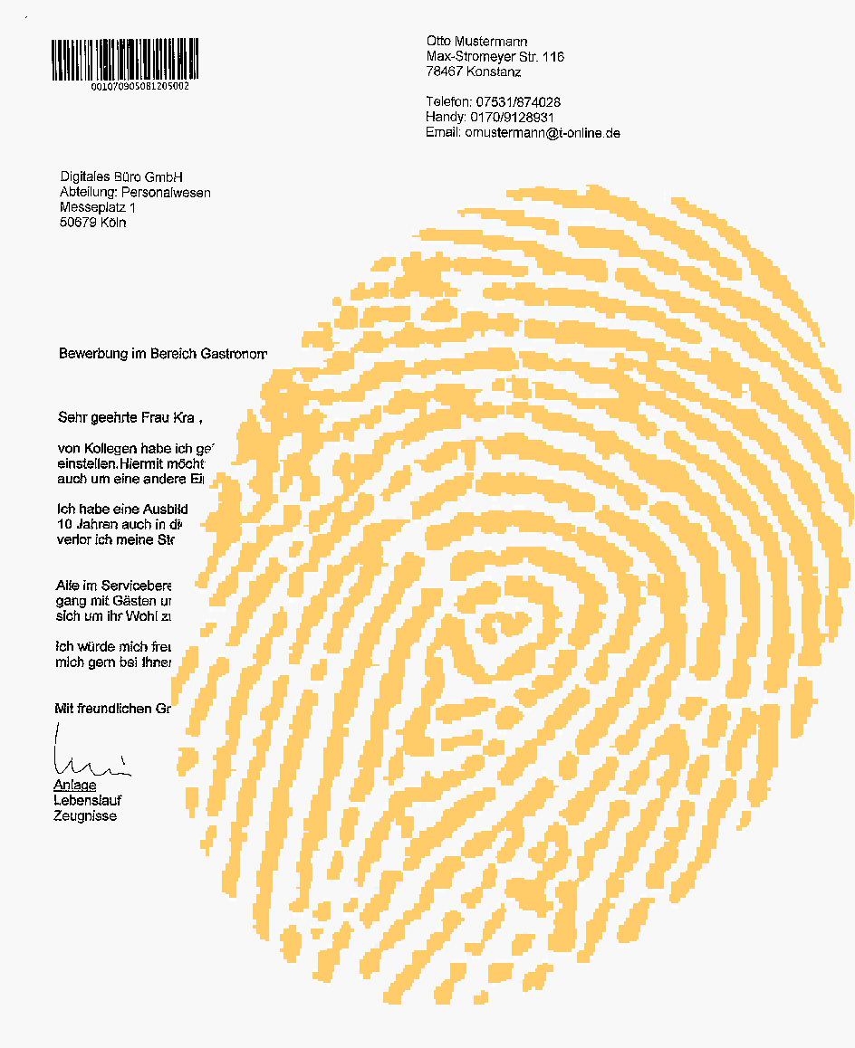
2) IRISFingerprint™ SDK
Fast Document Classification
Class A
Fingerprint
SDK
Class B
Class C
Notes:
Powerful classification SDK - uses only graphical features to classify documents in milliseconds
Details and text information are not relevant – Fingerprint can also be used with bad quality OCR documents like faxes
Uses training to create repositories of learned page layouts
Can deal with large amount of stored fingerprints without affecting classification speed

Slide 32
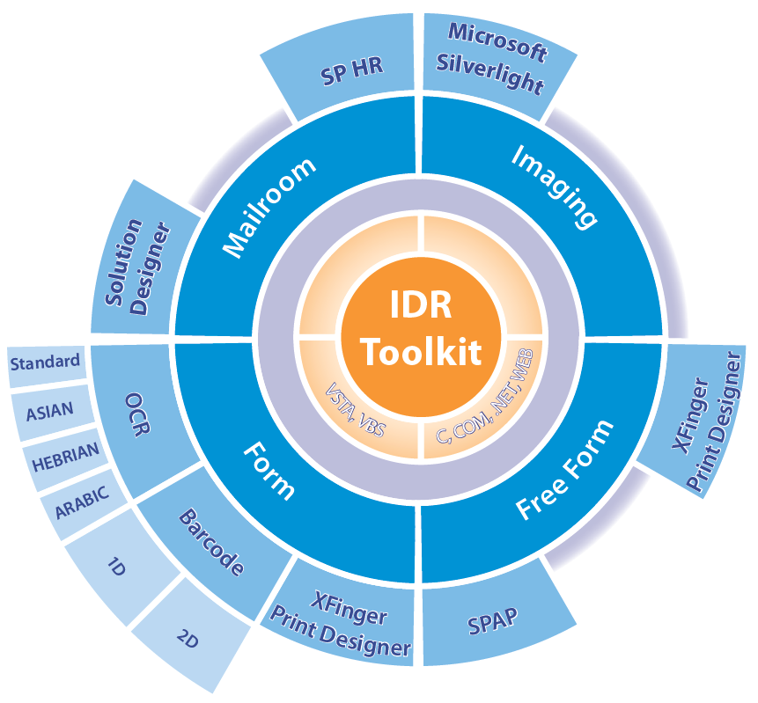
3) IDR™ SDK
Notes:
Powerful all-in-one recognition and classification SDK - Fits all document types – freeform, invoices, forms etc
Predefined solution packages - only need to load appropriate configuration to create a fully-fledged document processing application
Provides state-of-the-art classification technologies – classify your documents based on graphical layout (Fingerprint) or context analysis
Very easy-to-use – just a few functions independent of the document type
Multi-language support – elegant interface supporting native C and .Net

Slide 33




IDR™ SDK
Intelligent Document Recognition -
Customize ruleset with the designer
Load predefined ruleset: solution packages
SP Accounts Payable
Init()
LoadEnvironment()
LoadMasterData()
CompileMasterData()
InitializeDocument()
LoadPage()
ProcessDocument()
CloseEnvironment()
SP Human Resources
SP Banking
SP Factoring
IDR ruleset
DESIGNER
SP Capture Plus
load image
XML

Slide 34
4) Cardiris™ SDK
SDK for scanning and recognizing business cards
Easy-to-use COM interface – supports VB and .Net languages
Intelligent field extraction – uses a knowledge database to extract all
relevant information like first and last name, city, state, telephone number, job title, etc...
Various export possibilities – extracted information can easily be
exported to Outlook, Lotus Notes, Excel, XML, iPod, CRM and many more
Support for scanning business cards with the portable IRISCard scanner

Slide 35
Some Benefits of IRIS Toolkits
Technical
    Robust architecture
    Enormous quantity of formats supported
    Easy integration into third party applications
    Lot of samples available
    Intellectual property: 100% I.R.I.S.
    Flexible on licensing: matching integrator’s business model
    Modular approach to quickly extend functionalities
    IDR SDK: predefined rule set for (Invoices, Classification, Digital mailroom, Free-forms,..)
    Etc...
  Commercial
    Good market value
    Long term support
    No page limitation policy required
    Unique differentiator
    Etc...

Slide 36

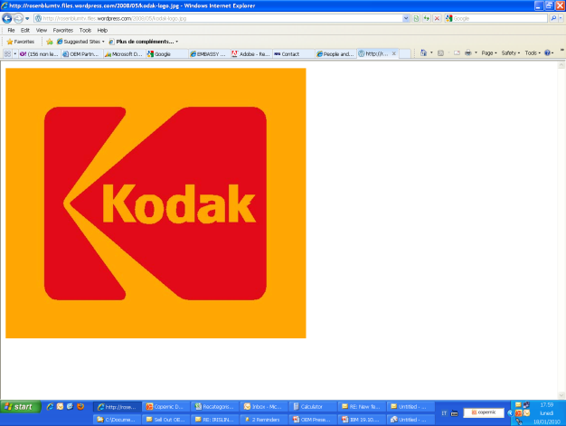

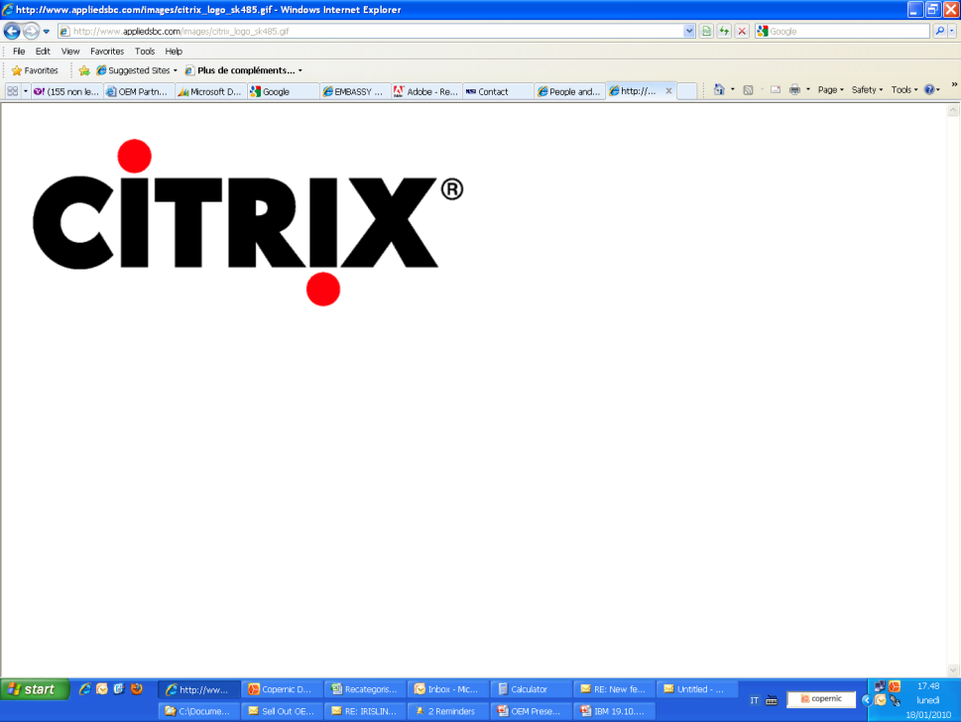
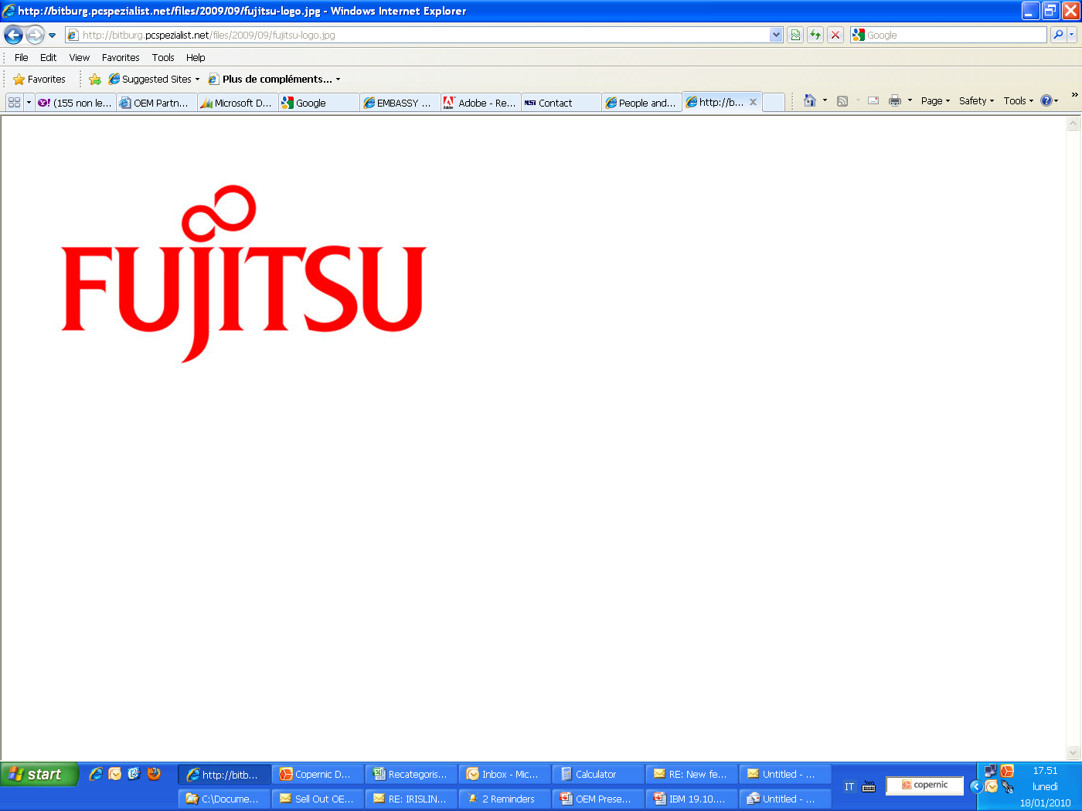
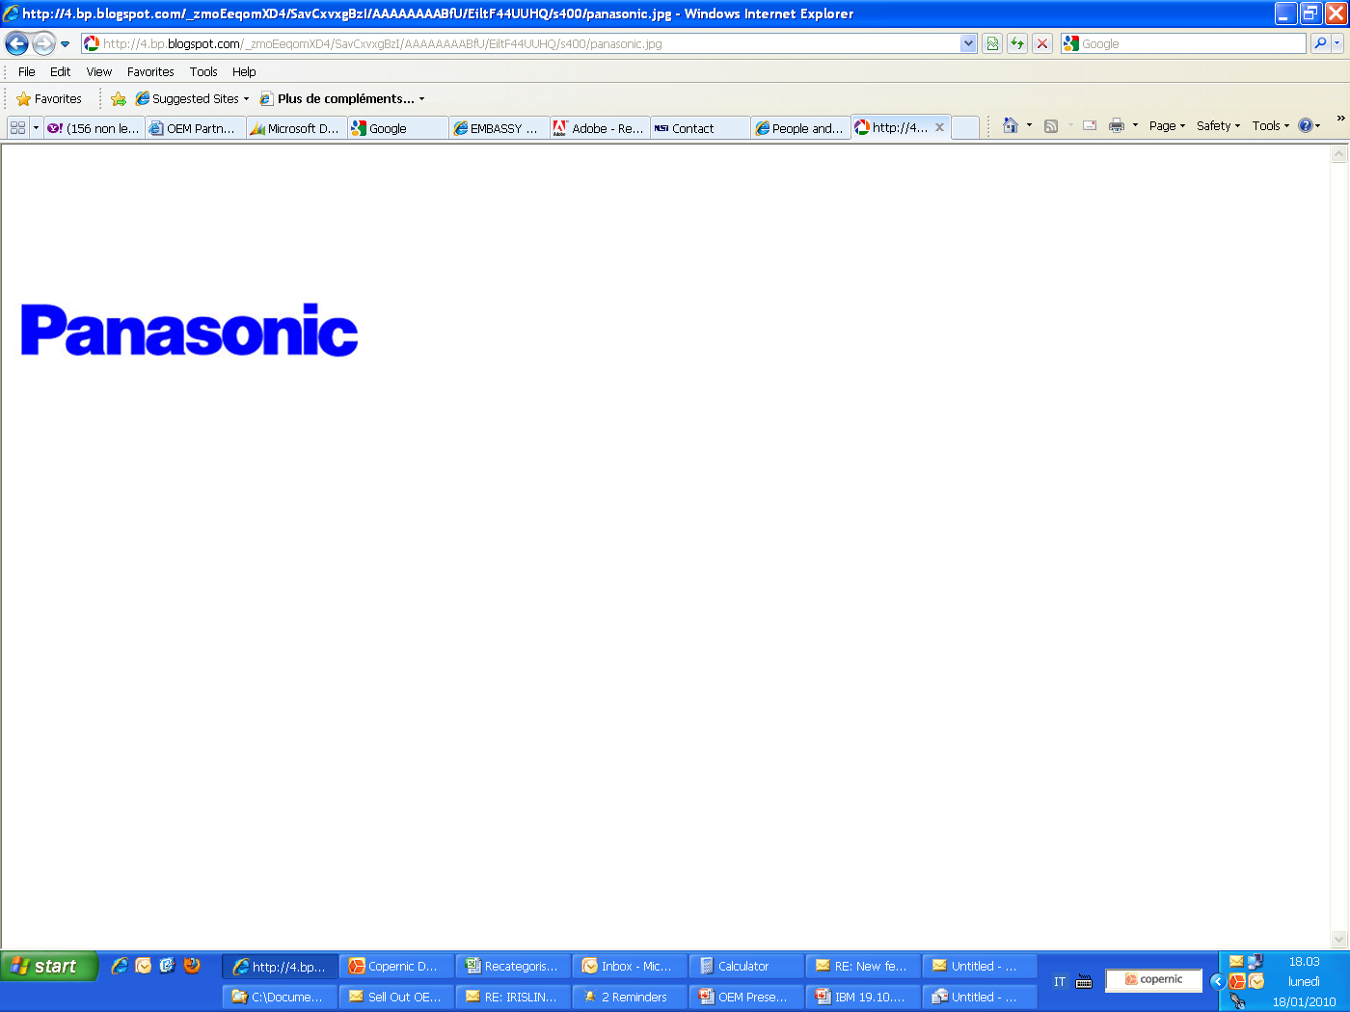


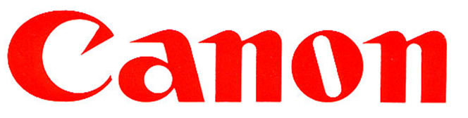












Long-term OEM Partners

Slide 37
Conclusion
I.R.I.S. is the only company in the market to provide a comprehensive
“Technology Partnership”
  for the Document Capture/ Document Management market
  We can provide:
  Components
  Advanced Toolkits
  Products from $ 49 to $ 100,000
Notes:
Only a few companies can offer this range of technologies

Slide 38
“Unique Technology Partnership”
Sample Project: Creating an Invoice Workflow Product
Rough Components
(OCR, Line removal, Deskew, etc…
Invoice Processing SDK
(Configuration Ruleset for Accounts Payable)
Rebranding of Package Invoice Product
(Straight forward, easy to use Invoice product)
Rebranding of Advanced Invoice Processing
(Advanced invoice and classification service based on sophisticated clustering and capture technologies)

Slide 39


How to face a major challenge:
”Do more with less, while reducing your carbon footprint”
At I.R.I.S. we provide the technologies to help your customers reduce their paper and energy consumption
Less Network traffic
Less paper workflow
More efficient resource administration

Slide 40

Thank you!
Alejandro Grüssi | OEM Sales Manager
_____________________________________________________________________________________________________________________________________________
I.R.I.S. S.A. - Louvain La Neuve – Belgium - D. Line: +32 (0)10 48 74 15
Website: www.irislink.com/toolkits - E-mail: alejandro.grussi@iriscorporate.com

