Slide 1



I.R.I.S. Software Solutions for large volume scanning, indexing and conversion
&

Slide 2
WHY? → TYPICAL COMPANY NEEDS
High speed scanning of documents
Separate, Classify and Rename these documents and Extract key data
Create and Compress into different types of searchable documents
Storage on a Document Management System according to document classification and extracted data

Slide 3
THE I.R.I.S. SOLUTION
High speed scanning of documents
Separate, Classify and Rename these documents and Extract key data
Create and Compress into different types of searchable documents
Storage on a Document Management System according to document classification and extracted data
or
or

Slide 4
First of all, the products individually

Slide 6
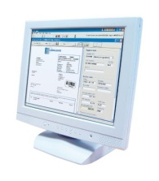
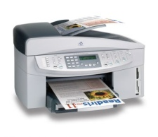
Connects to nearly any scanner
High volume scanning
Project based with ready to use templates
Projects can be easily configured for simple and very complex processing
Can connect to other applications for post-processing of the documents (Export API)

Slide 7
Scanning
Pre-Processing
Document Identification
Document Structuring
Document Indexing
Quality control
Export

Slide 8
Scanning
Scanning
From Scanner
Pre-Processing
TWAIN, TWAIN-VRS or ISIS-VRS
Native ISIS support available as an Add-on
Multi-stream: generate colour and B/W or colour and greyscale images EVEN if the scanner does not support it
Document Identification
Document Structuring
From Files
Document Indexing
Scan from files: import pre-scanned images
Quality control
Export

Slide 9
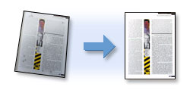
Pre-processing
Scanning
Pre-Processing
Deskewing
Advanced binarization
Despeckling
Line Removal
Black border Removal
Colour dropout
Smoothening
Document Identification
Document Structuring
Document Indexing
Quality control
Export

Slide 10
Document Identification
Scanning
Document identification done using:
Pre-Processing
Zonal OCR
Zonal ICR
Zonal/Full page Barcode
IRISFingerprint™ : image layout analysis to determine the document type.
Document Identification
Document Structuring
Document Indexing
Quality control
Export

Slide 11
Document Structuring
Scanning
Document separation done using:
Pre-Processing
Zonal OCR
Zonal ICR
Zonal/Full page Barcode
Zonal/Full page Patch Code
Blank Page
Document Identification
Document Structuring
Document naming done using:
Document Indexing
Zonal OCR
Zonal ICR
Zonal/Full page Barcode
Zonal/Full page Patch Code
Combination with date, system values...
Quality control
Export

Slide 12
Document Indexing
Scanning
Document indexing using:
Pre-Processing
Zonal OCR
Zonal ICR
Zonal/Full page Barcode
Document Identification
Document Structuring
Indexing done according to document type!
Indexes can be customized through scripting
→ can even pick up data from an ODBC database
Document Indexing
Quality control
Export

Slide 13
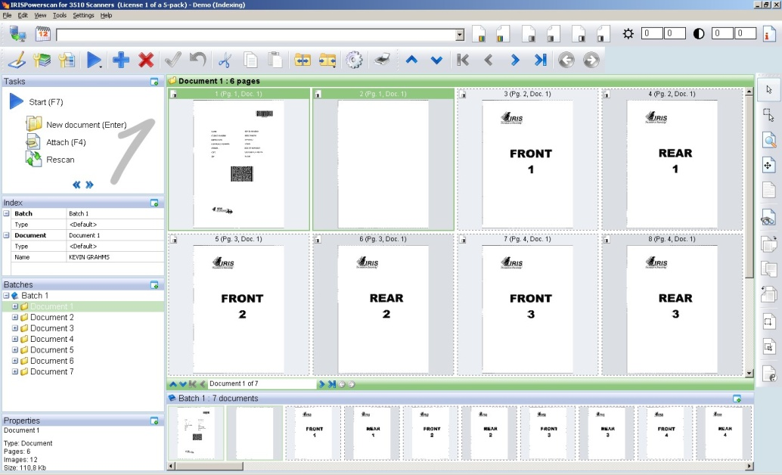
Quality Control
Scanning
Quality control via user interface. The user can modify:
Pre-Processing
Batch and Document ID
Document and Batch structure
All Indexes
Images ( rotation, binarisation…)
Document Identification
Document Structuring
Document Indexing
Quality control
Export

Slide 14
Export - Document Creation
Scanning
Document creation done by integrated IRISDocument™
Pre-Processing
MANY document formats possible
Full page OCR
Renaming of document according to IPS Index or …
Document compression => iHQC
Can export data after to ANY application with index XML as argument
Can export both the documents and the indexes to a Document Management System (e.g. SharePoint, Therefore)
Document Identification
Document Structuring
Document Indexing
Quality control
Export

Slide 15
Export Connectors
Scanning
Pre-Processing
Standard list including:
  IRISCapture™ Pro
  IRISDocument™
  …
C++ and .NET API available to create your own Export Connector
Extended Output Connector
  Scripting
  On-disk saving
  Etc...
Document Identification
Document Structuring
Document Indexing
Quality control
Export

Slide 16
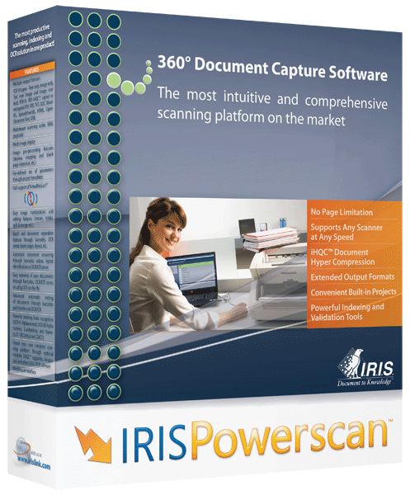
Other cool features of IRISPowerscan™ 9
  SharePoint v2 Connector
  Booklet reordering
  Barcode voting
  ISIS support
  IRISFingerPrint™
  Event Handler SDK
  LDAP Authentication
  Multi-user centralized management
  Custom installation
  New Background processing

Slide 17
Barcode Voting
For high volumes, Barcode Voting takes the best results of both engines
Example: 90% (Engine 1) + 90% (Engine 2) → 99% (Voting)

Slide 18



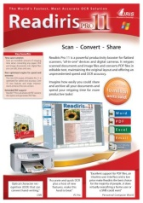
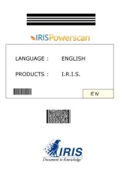
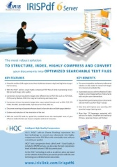

IRISFingerPrint™ is a Document Identification Technology based on the structure of the document
No OCR, No Barcode, No Patch Code…
Extremely fast
Extremely easy to set up
Available as an Add-On
No need to put barcodes on your separators !
Type A
Type B
Type C
Type D
Type E

Slide 19

  LDAP Authentication
IRISPowerscan™ is a multi-user application and therefore has the notion of Users and Roles.
This information can be stored on your Active Directory and accessed by IRISPowerscan™.
This makes for much easier centralised security management.
2 Solutions
Automatic login using the Windows User Credentials
Semi-automatic login where the Windows User Credentials are prefilled in the login window

Slide 20
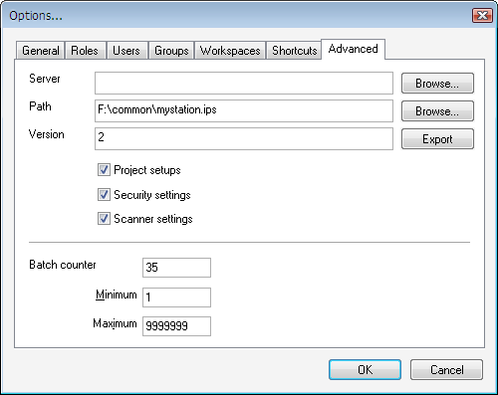
  Multi-User Centralized Management
IRISPowerscan™ Settings and Data can be saved in a central network location.
A manual or automatic push/pull system synchronizes the data
IPS Data
IPS Settings
  Project Setup
  Security Settings
  Scanner Settings

Slide 21
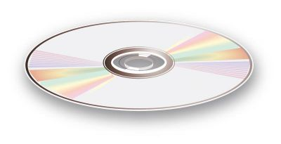
  Custom installation
You can easily be customize the installation
Put in your set of pre-configured projects
Put in your Connectors and Event Handlers
…
Make one pre-configured CD and install the same on all PCs
→ no need to reconfigure all the PCs
Note that I.R.I.S. can also create custom packages for OEM bundling

Slide 22
The most robust solution to structure, index, compress and convert
all your documents into optimized text files

Slide 23
  The issues...
PAPER
Despite the importance of electronic exchange, document sorting and archiving are still paper-based
Very important waste of time to retrieve and access paper documents
  … professionals spend 50 percent of their time looking for information … (Gartner Research)
A lot of documents get lost
  … Companies typically misfile up to 20 percent of their records forever… (ARMA International)
Manual encoding of information leads to waste of time and important risk of mistakes
…resulting in an uneconomic storage of your scanned documents!
SEARCH
LOSS
ENCODING
MONEY

Slide 24
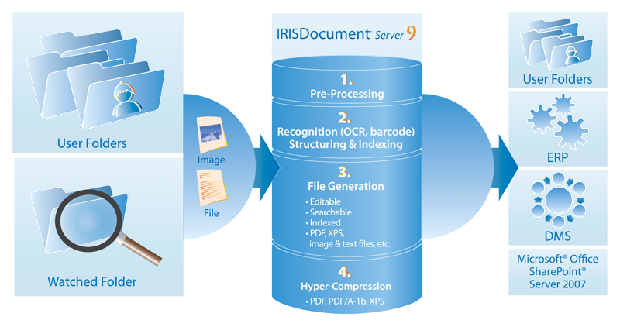
IRISDocument™ Server - Workflow

Slide 25






Major Benefits
SPEED
Up to 60,000 documents a day per workstation!
Multi-CPU add-on
24/7 processing
Service mode
hyper-compression
Create color or black and white PDF files smaller than TIFF black and white .
Also available for PDF/A-1b or XPS
With searchable text
With perfect legibility
Perfectly standard: open them with your usual viewer
Many output formats:
PDF (4 different file modes: Image, Image-Text, Text, Text-Image, with many options: PDF/A-1b compliance for longterm archiving, certification, encryption)
PDF with iHQC™ hyper-compression (3 different compression levels, many options: PDF/A -1bcompliance,certification, encryption)
XPS (4 different file modes: Image, Image-Text, Text, Text-Image)
XPS with iHQC™ hyper-compression (3 different compression levels, many options)
Common file formats such as TXT, RTF, DOC, OpenDocument text, HTML, XML, WordML, SpreadsheetML
Most common image file formats including TIFF, JPEG and PDF
COMPRESSION
OUTPUTS

Slide 26


Main features
INPUT FORMATS
  All the most common formats including TIFF, PDF, JPEG2000 and DjVu
  Detect orientation, deskew, despeckle, smoothen colors
  137 languages supported with add-ons for Arabic, 4 Asian languages and Hebrew
  Up to 5 languages recognized on the same document
  Barcodes (more than 28 different types)
  Partial recognition of a batch of documents
  Documents Renaming
  Blank pages detection
  Possibility to choose between speed and accuracy
  Keep structure and colors, dualstream pictures support, etc.
  Including barcode and blank page detection
  XML Index Creation, PDF, etc. with possible simultaneous multi-output
  To Microsoft SharePoint
  Create your own export : IRISDocument Server calls the .exe with the index.xml file as parameters
PICTURE ENHANCEMENT
CHARACTER RECOGNITION
DOCUMENT STRUCTURING
DOCUMENT BUILDING
EXPORT
Notes:
All the most common formats: .img, .gif, .jpeg, .jpg, .j2c, .j2k, .jp2, .psd, .pct, .pbm, .png, .tif, .tiff, .bmp, .pcx, .dcx
PDF files, JPEG2000 files, DjVu files

Slide 27


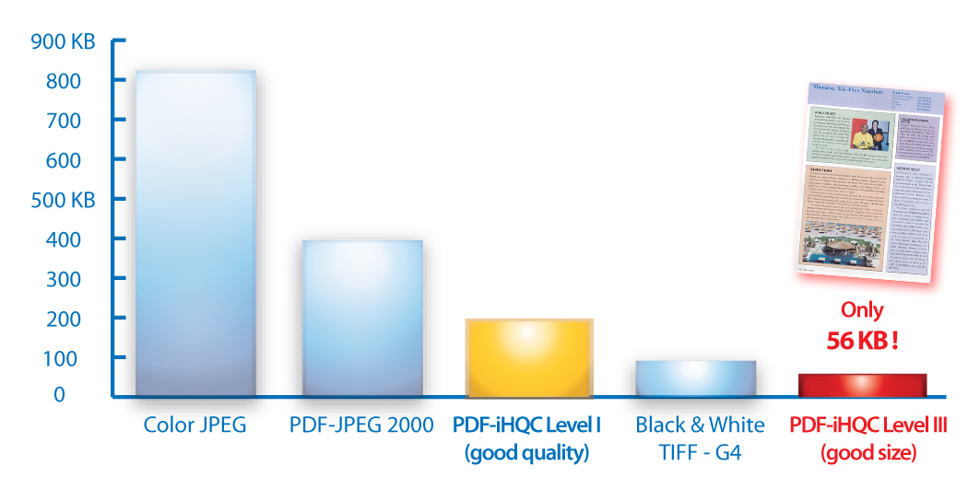
Generates fully searchable PDF, XPS or PDF/A-1b files (high quality color image with the OCRed text)
Several levels of compression (Best Size ⬄ Best Quality)
Exceptional readability (same as the original document)
Less bandwidth used to share your documents
Less storage space to archive all your files

Slide 28
This is all very nice, but how do they work hand in hand?

Slide 29

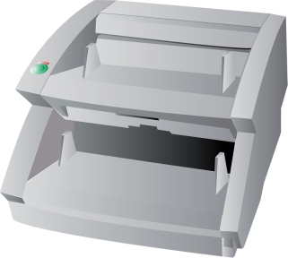
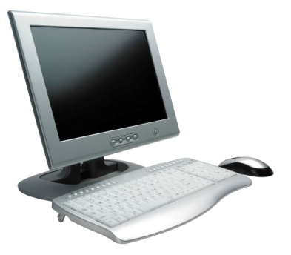

Workflow example 1
Document Management System

Slide 30
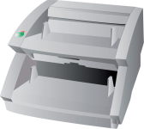
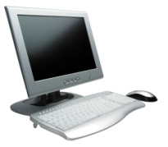
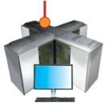

Workflow example 2
Document Management System

Slide 31
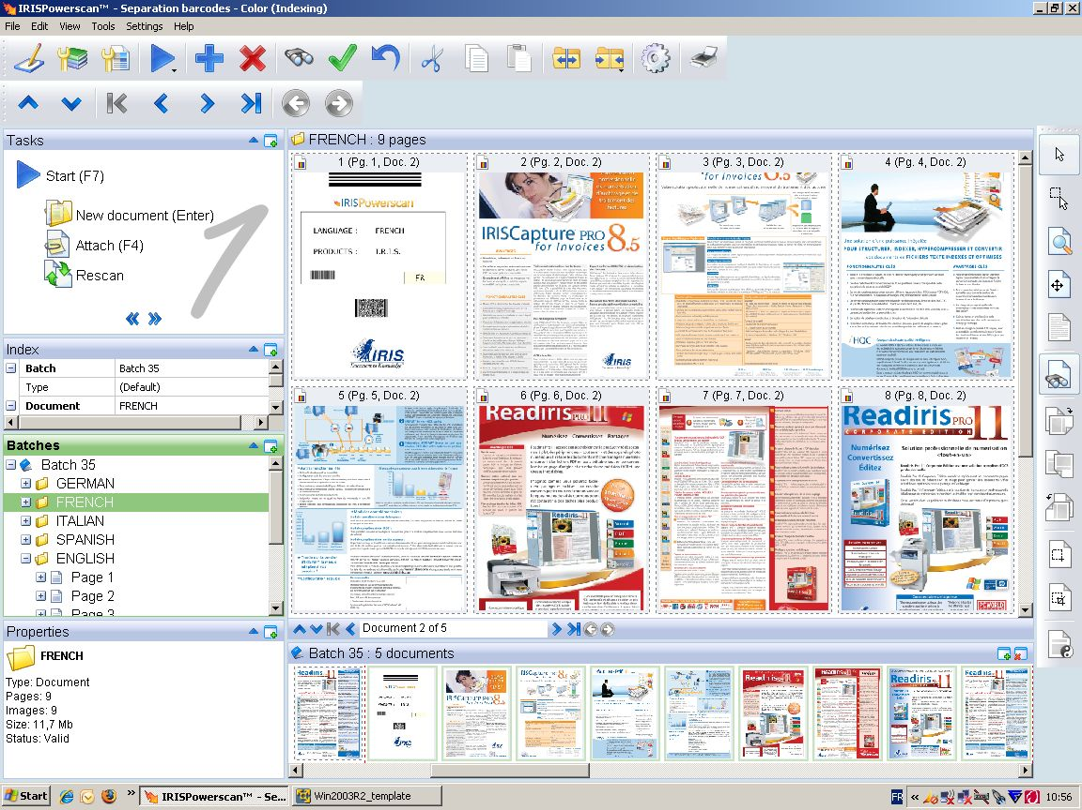
The IRISPowerscan™ Interface

Slide 32
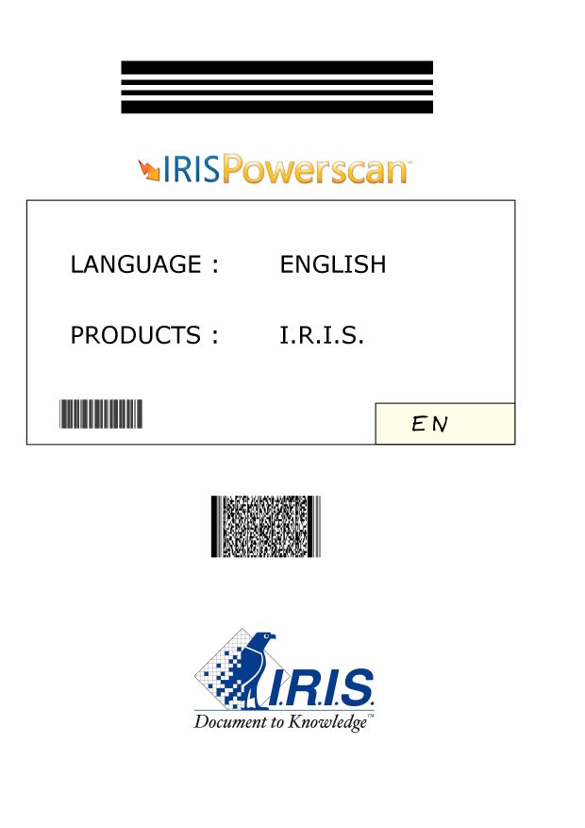

Separation and indexing
Done in
OCR Separation or indexing
ex: Name of the document = Language
  English
  French
  Spanish
  Italian
  German
Barcode Separation or indexing

Slide 33
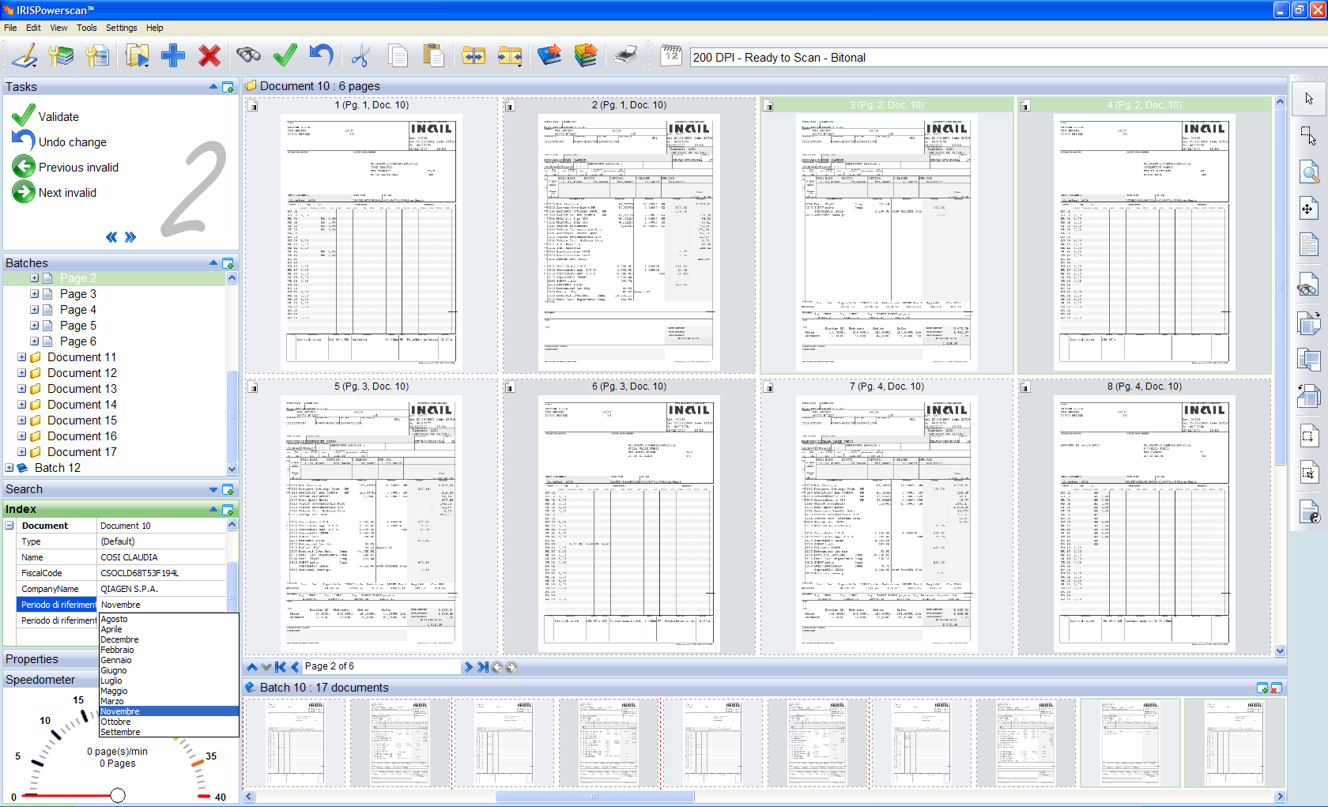
Validation
Done in

Slide 34
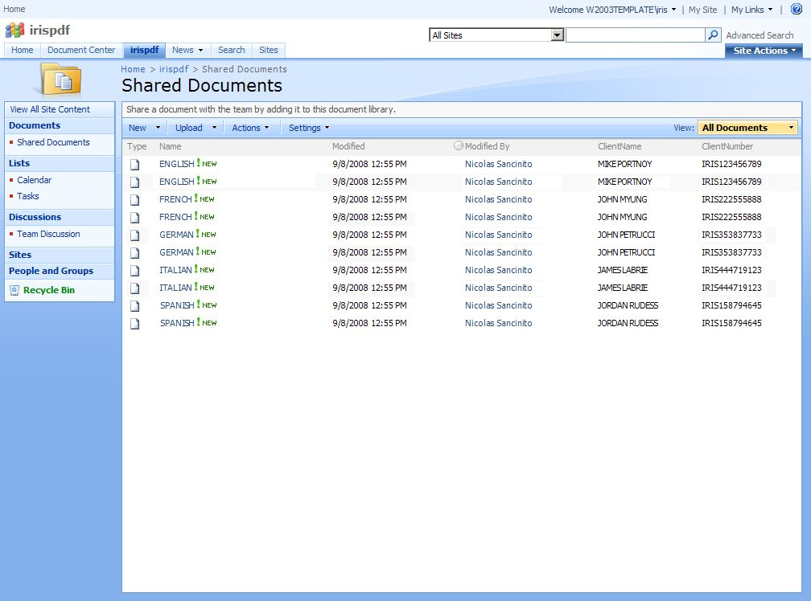
Exporting
Done in
or in
Documents renamed as planned
Indexes are automatically populated
(ex: SharePoint, Therefore, etc.)
→ Perfect integration between both products!

Slide 35
Is that it?

Slide 36
Of course not! ☺
I.R.I.S. offers a wide range of technologies that are able to deal with any type of document need, any volume and any speed.
Technologies:
  Classification
  Identification
  Free-form indexing
  Form indexing
  etc...
Solutions
  Invoices reading
  Form reading
  Mailroom
Visit our booths for more information

Slide 37

Thank you!

