Slide 1
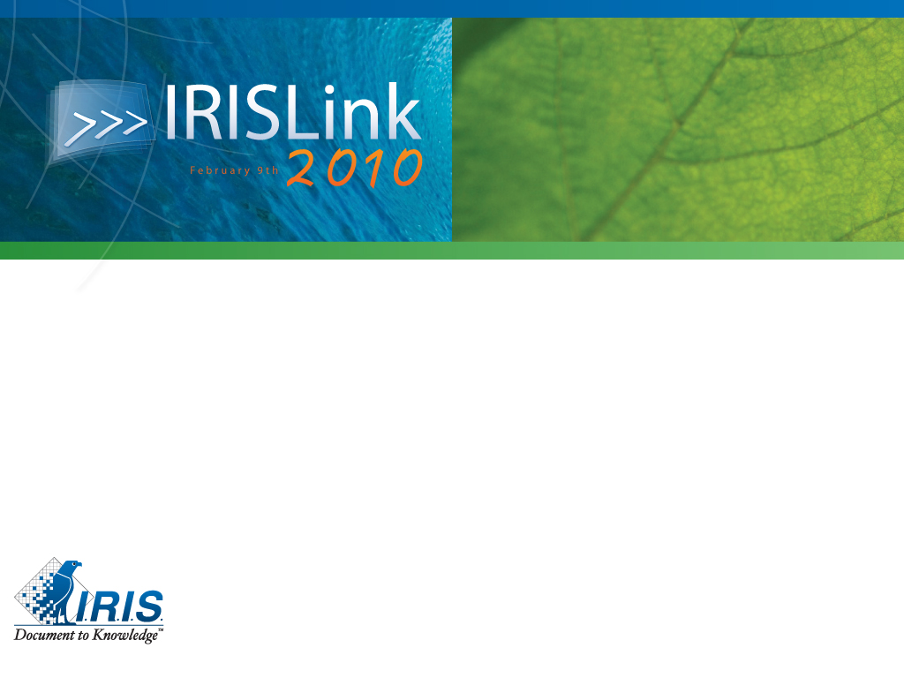
3,5 kilometers pension insurance files:
How AllBidigit and I.R.I.S. scan, classify and index paper based files for Aegon
Ludy van Dijk, LUDOC b.v.
Leo Vondenbusch, IRIS Ag

Slide 2
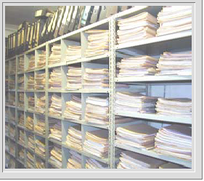
Why Digital Files?
More than 80% of digital information is stored in „personal files“ 1)
Knowledge will be lost, when „people with knowledge“ leave the company 1)
editing, storage, transfer, archiving, delete will cost 15 til 20% of worktime (AIIM)
Every document will be copied 5 times in average (IDC)
90% of all relevant informations for Knowledge-workers are paper based and are not registered in ECM-solutions (AIIM)
1) The Knowledge Worker Investment Paradox” Gartner Research

Slide 3
AEGON Pensions department had over 3.500 meters of fysical archive.
Containing 60.000 files with
10.000.000 pages alltogether
Files were only indexed by contract-number.
The content of the file was not categorized or indexed.
Case

Slide 4
AEGON did not only want the documents to be scanned, but also to put indexes on the images.
To be provided:
  The contract number
  A document type
  A document date
Goal: to have a more accurate acces to the information in the files
Case

Slide 5
AEGON had a budget struggle for 4 years, due to a business case which was based on manually indexing.
Question: what number of Full Time Equivalents is needed to index 60.000 files / 10.000.000 pages manually?
Case

Slide 6
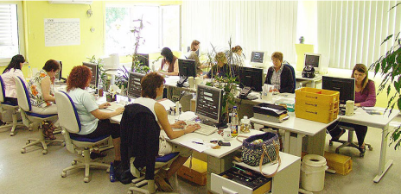
In a test in which a few hundred files were indexed AEGON calculated that the numer of FTE nessesarry to manually index the archive was:
102
Case

Slide 7

LUDOC b.v. proposed to scan the documents and index them automated determing the document type and document date by OCR technology
A Request For Proposal was sent out, and won by Allbidigit together with IRIS
The Software involved was Xtract for Documents
Case

Slide 8


Rollout of the project at Aegon together with:
&

Slide 9
60.000 files will be scanned in batches
Every file consists of 100 – 200 pages
Separator sheets will be used with the contract numbers from a database.
Solution
for Aegon

Slide 10
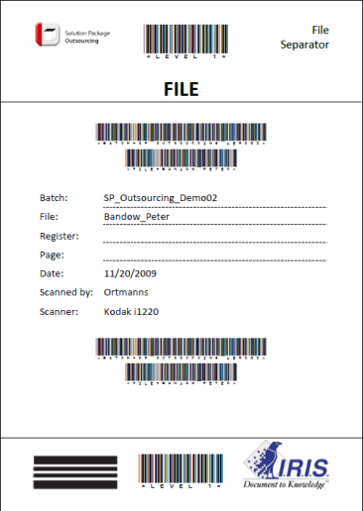
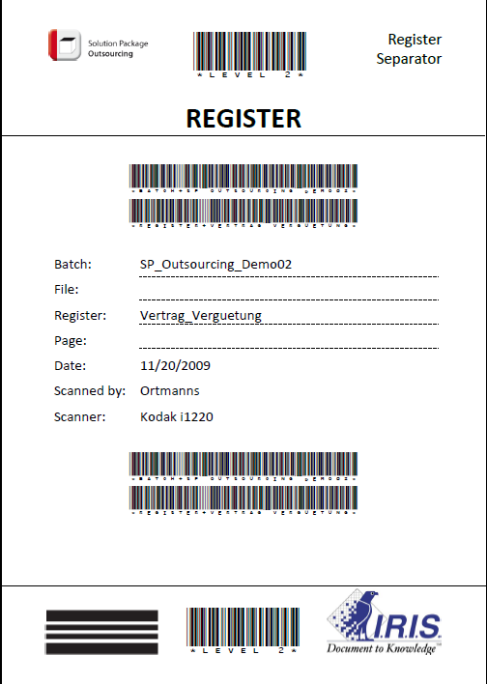
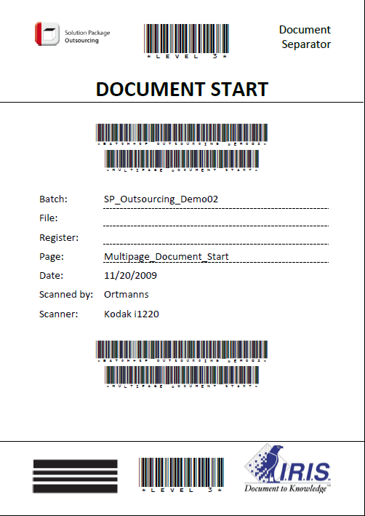
Separator Sheets – how useful are they ?
Batch
File
Register 1
Multi
Page
Document
Start
Multi
Page
Stop
Register 2
Document
Document
Multipage Document
Document
Document
Barcode for the classification of the level within the batch
Barcode for the assignment of the contract number to a database
Barcode for the assignment of the register to the document

Slide 11
Together with AEGON’s archive manager we determened 20 document types to be recognized by the IRIS solution.
Of each document type about 100 examples were fed into the system, bearing in mind that the oldest file is over 90 years old, and documents changed in time.
After training the system before starting and manual evaluation during the first weeks, we managed to get an overall quality of 95% accuracy
Solution
for Aegon

Slide 12
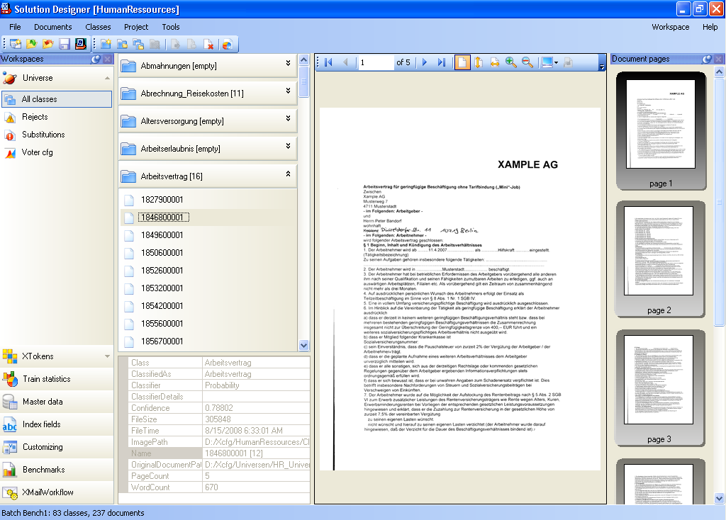
Training of documents – what does it mean?
step 1: definition of
a filing structure

Slide 13
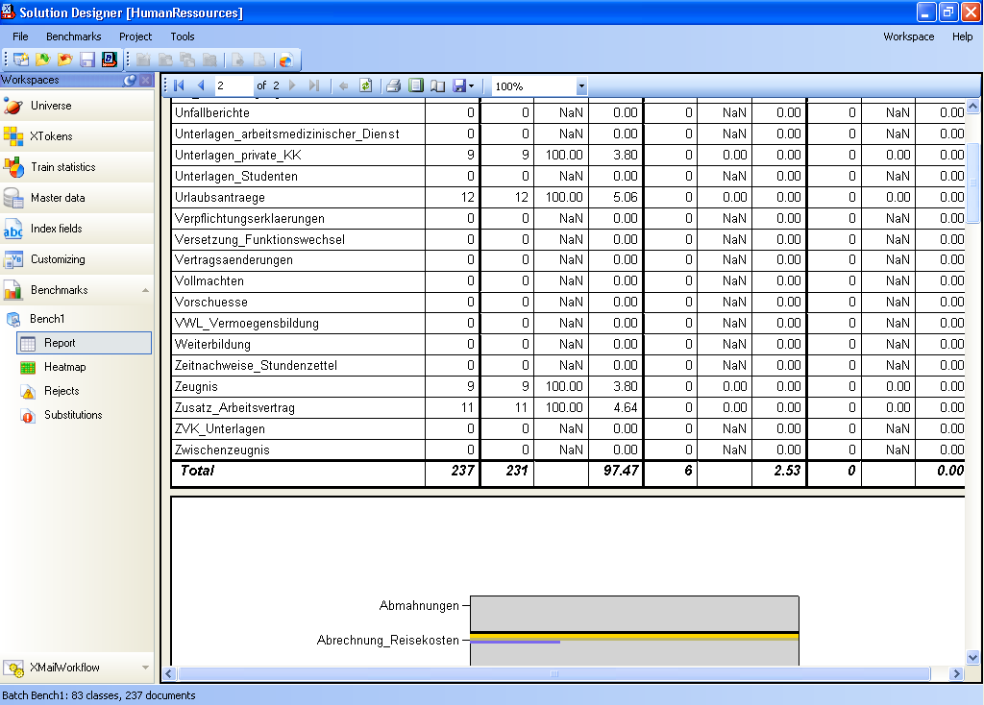
step 2: train the
document types

Slide 14
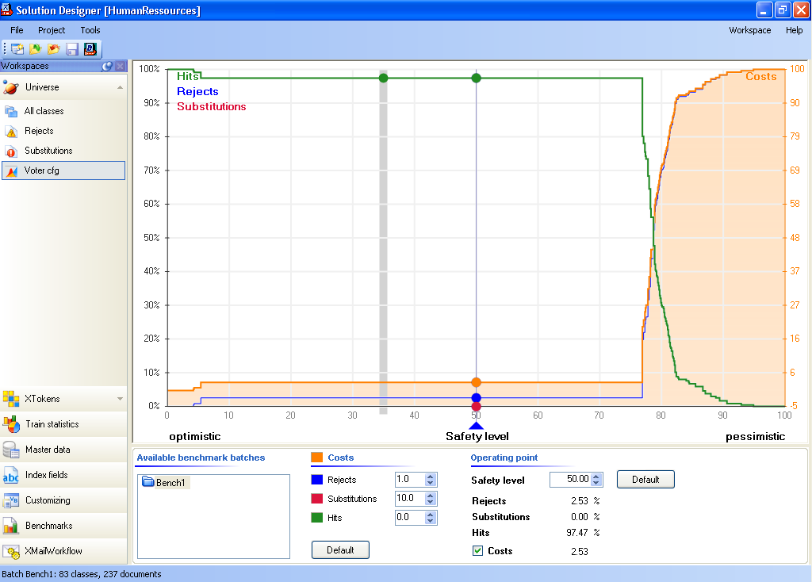
step 3: quality control
of trained documents

Slide 15
The document date is less precise, we were just looking for a date, mentioned on the first 1/3 of the first page.
The system automatically converted a date into the required format for the archive: 8-2-10, 8 february 2010 was converted into 08-02-2010
Document Fulltext is available for queries
Solution
for Aegon

Slide 16
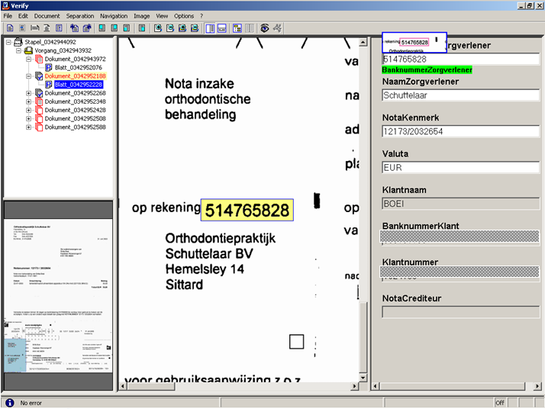
Reading results – what is possible?

Slide 17
The project started in january 2009 and was finalized in june.
All authorized personel of AEGON has direct access to the archive.
The number of people working in the archive area has been reduced from 4 to 1
Solution
for Aegon

Slide 18
IRIS and Allbidigit implemented and trained the system based on the predefined Solution Package Outsourcing.
Allbidigit provided the preparation and scanning facility together with Canon, hired the right amount of people, and managed the project.
Thank you, it was fun working with your team.
Solution
for Aegon

Slide 19
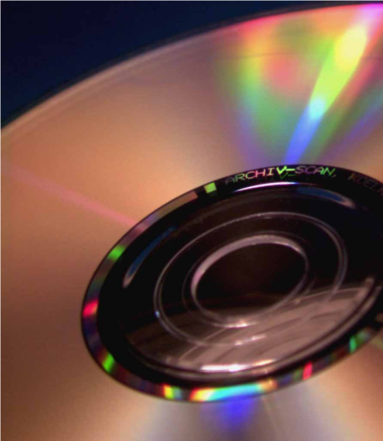
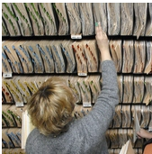
Success Factors
Conversion of paper files

Slide 20
Reduced process time
Time to search and transfer data will be optimized due to the electronic archive.
Documents and related information can be mailed if needed.
Better knowledge of the content
Information can be searched – all data is available even if more than one file is needed.
Response time for the customer goes down – as data is available for all customer related employees
Quicker locating of information based on fulltext-search and indexes
Costs
The amount of work for sorting, searching and indexing of files is highly reduced.
More than 70% savings due to automated recognition and indexing.
Compliance
Business critical documents are stored in a secure optical archive.
All related documents (paper, FAX, eMail, office documents) are stored together in one file
The structure of the file will be kept on automated completeness checks are possible

Slide 21
Ludy van Dijk,
Director of LUDOC b.v.
Ludoc b.v. provides consultancy, interim- and project-management in implementation of Digital Mailrooms with integration to Document Management Systems (DMS).
Over 20 years of experience in the field of mailroom, archive and repro facilities.
Project
Manager

Slide 22

Questions ??
Visit our booth for SP Outsourcing S13

