Slide 1

IRISNext
Olivier Ceulemans
Technical product manager

Slide 2
IRISNext features
Structured Document Management
Search, diffusion and visualization
Security & Retention management
Workflow

Slide 3
IRISNext components
CDs / DVDs
Printers
Office
Outlook
PowerScan
Web Browsers
IRISNext Exporter
IRISNext Desktop Services
IRISNext Server
(J2EE Server)
(Windows, linux, …)
Other services
IRIS Document Server
IRIS Document Server
DB
FS or
DR550
LDAP
IRIS Document Servers

Slide 4
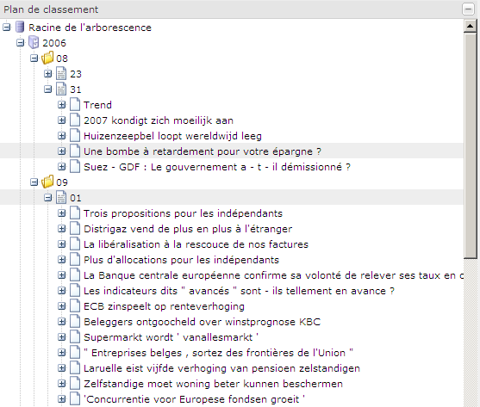
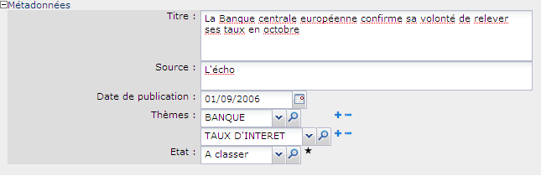

Structured Document Management 1/4
Hierarchy
Metadata

Slide 5
Structured Document Management 2/4
Metadata
  Enhance document with metadata (=properties/attributes/index card).
  IRISNext uses structured metadata. The structure of the index card is controlled by « Index Models ».
  Index models are created and configured according to the business needs:
    Group of fields: organize fields in groups
    Type of fields:
      Basic: string, integer, decimal, date, time, timestamp, mail, url.
      Reference: users, user groups, …
      Pick lists: list of localized values, thesaurus,…
      Custom type: requires programming.
    Cardinality of fields : single- or multi- valued.
    Constraints: Minimum, maximum length/value, regular expression, …
    Advanced metadata check: Validation & transformation script.
    Edition mode: free, creation only, write once, computed.
    Database indexes to create.

Slide 6
Structured Document Management 3/4
Hierarchical: like Windows Explorer ? No !
  Define constraints, enforce rules on the hierarchy by using the
  « Object Type » concept.
  Objects types are created and configured according to the business needs:
    Nesting rules define the structure of the hierarchy
    Binary content (storage mode ?, version management ?, localized ?)
    Index model
    Security
    Retentions (required, optional, forbidden ? rule ?)
    Presentation, look and feel (icon, labels, viewer, children list…)
    Additional features: tasks, notes, cross links, audit trail…
    Lifecycles
  Scripts can customize or enforce a business behavior at the server level.

Slide 7
Structured Document Management 4/4
« Root » object types.
  Useful when hierarchy is too flat
  Only findable via searches
  Can have a complete hierarchy
Designed for multilingual support
  All information can be localized in several languages (1→n).
  User interface language (FR, NL, EN, DE) is independent of language of data
  Automatic language detection based on extracted textual content.
Cross links between objects in the hierarchy
  Configure your own link category
  Configure the rules for cross linking

Slide 8
Document consultation 1/3
Full text search on document content
  Powerful search engine: Ranking, wildcard, fuzzy, proximity, term boost.
  Indexes common formats: pdf, doc, xls, ppt, eml, html, xml, txt, …
Predefined (= configured) structured searches
  Combine AND/OR criteria at multiple levels
  Perform hierarchical searches
  Perform transversal searches (crosslinks)
  Use index model type information to provide relevant operators
  Combine metadata searches with full text searches
Personal structured searches
Search on object label
Browsing (using the hierarchy)

Slide 9
Document consultation 2/3
Email notification
  Notification based on hierarchy and operation type
    Notify me when something happens under this ‘dossier’
  Notification based on metadata
    Notify me when a document of type xxx is created/updated/deleted.
  Notification of tasks to complete

Slide 10
Document consultation 3/3
Viewing documents, several options:
  Use the browser and native programs
    Use the built-in rendition mechanism
      Perform on-the-fly transformation of document formats
      Perform automatic background OCR on images
      Perform automatic background conversion of office, open office, legacy formats to PDF
    Annotate documents with ‘post-it’-like functionality.
  Use an universal viewer
    No conversion required for web display
    Annotate documents and draw directly on top of the image

Slide 11
Security 1/3
Base security (for all objects)
  Based on « Users & Users Groups » .
  Can be synchronized with an LDAP or Active Directory.
  Each user group (or user) has security rules. Security rules can target:
    All administration resources or a specific resource.
    All object types.
  Create/Read/Update/Delete/Move/Execute.
  Trivalued logic: Allowed, Forbidden, Not specified.
  Rules are combined using the most secure semantics.

Slide 12
Security 2/3
Object specific security
  « Access Control List » can be defined.
  ACLs are put on objects and specific security rules are applied.
  Business roles can be defined on an ACL
    Enforce rules
    Very easy for the users
Security evaluation order:
  Local role
  Local user
  Local groups
  Global user
  Global groups

Slide 13
Security 3/3
Check In / Check Out support.
Binary data storage
  Managed, partially managed or unmanaged.
  Can compute/check CRC / MD5 / SHA256
  Consistency and disk corruption checks can be asked
  Store on local disks / mounted disks / smb / ftp / sftp / http / webdav.
  Store on TSM or DR-550.

Slide 14
Retention management 1/5
Simple retention management mode is built-in.
  Retention model
    Minimal retention time after initial event (retmin)
    Minimal retention time after custom event (retver)
    Support retention hold/release
  Retention expiration action:
    Allow deletion
    Automatic deletion
  Retention policies can be enforced at the server level.

Slide 15
Retention management 2/5
Event
RetMin
RetVer
RetMin = Y
RetVet = X
Event occur at T > Y
DC: Data Creation
DC + Y
DC + T
DC + T + X
time
Event
RetMin
RetVer
RetMin = Y
RetVet = X
Event occur at T < Y and T+X <Y
DC: Data Creation at DC
DC + T
DC + T + X
DC + Y
time

Slide 16
Retention management 3/5
Event
RetMin = 0
RetVet = 0
Event occur at T
DC: Data Creation at DC
time
T
Hold
Event
Release
RetMin
RetVer
Hold and Release can occur any time during retention.
DC: Data Creation at DC
DC + Y
DC + T
DC + T + X
time
Hold
Event
Release
Hold and Release can occur any time during retention.
RetMin
RetVer
DC: Data Creation at DC
DC+Y
DC+T
DC+T+X
time

Slide 17

Retention management 4/5
Storage Engines Manager
V.F.S.
TSM/DR550
Java Connector
TSM Connector JNI/C
LFS,
DAV,
FTP,
…

Slide 18

Retention management 5/5
Binary content archiving
Update and deletion protection.
Supports: hard disks, tapes, worms.
224Tb with hard disks only, more with other mediums.
Data encryption.
Data shredding.
Remote mirroring .
COMPLIANT

Slide 19
Outlook, Office, Open Office plugins
Search / Load / Save documents from
  MS Office 2003 & 2007
  MS Outlook
  Open Office
If you do not use these products,
  Send2IRISNext : forward your mail to IRISNext.
  Standard Upload/Download from web application.
  Develop your addon using the SDK.

Slide 20
IRISNext Exporter
Extract / Print
  documents (native formats or pdf)
  metadata
  notes
Extract on external media
  CD
  DVD
  Blue-Ray
  USB MS / HD
« autorun », royalty free
Compatible Windows, Mac, Linux (runtime is Java based)
Full text search

Slide 21
Task management
Task management
  Visualize tasks to do
  Visualize tasks your asked to someone else
  Visualize tasks you supervise
  Stay notified by email
  Scripting
    Automatically combine tasks
    Modify metadata
    Anything, as long as you can write it in java.
Notes on documents
  Textual notes along the document
  Graphical notes on the document (use universal viewer)
Home/personal space and shared spaces

Slide 22
Tasks
A simple reminder of one action to perform on one document.
Collaborative mechanism.
Scripting is possible.
No custom form design.
No business process & process enforcement (except by using scripting).

Slide 23
Life Cycles
Describes the life of one IRISNext object as a state diagram.
  Describes the various states
  Describes for each state the various transitions
    Standard IRISNext operations (check in, check out, update, delete).
    Custom, used-defined, operations.
    Permissions
  Allows to enforce business rules
Administrator can assign forms & scripts to user defined operations.
Interaction is mostly triggered by user interaction or scripting.
No deadlines, no timeouts, actions do not appear in tasks lists (except if programmed by scripting).

Slide 24
Document flows
Linked to 0->n IRISNext objects.
Process is described and enforced.
  Process variables
  Strict adherence to process
Process steps can describe:
  An user interaction (forms & scripting) configurable from document flow modeler
    Possibility of performing timeout actions
    Possibility of performing backtracking (if allowed in definition)
    Will appear in the “to do” task list
  An standard automatic action (create object, resolve barcode, perform OCR, transform…) configurable from document flow modeler
  A custom action (scripting), can be used to notify external systems
  A wait of notifications from external systems

Slide 25










Document tracking
?
+

Slide 26







Scan On Web
Scan from the web application
Support Twain scanners
Not for mass scanning (use PowerScan !)
Java applet based
Notes:
L’application est un applet téléchargé sur le poste du l’utilisateur par le navigateur.
L’applet est exécuté sur le poste de l’utilisateur (par le navigateur).
L’applet gère l’acquisition d’images (interaction avec le scanner).
L’applet envois les images au serveur (qui les stocke temporairement) à la demande de l’utilisateur (ou quand celui-ci ferme la fenêtre)
Quand l’utilisateur « enregistre » le document dans l’application web, les fichiers stockés sur le serveur son rassemblés dans un PDF et tout continue comme si l’utilisateur avait « téléchargé » ce PDF.

Slide 27
IRISNext Architecture

Slide 28
Software architecture
Applications can be interfaced with API
(java & .net)
IRISNext
Exporter
Internet
Explorer
Firefox
Opera
CD Creation application
Model /View / Controller Layer
Web Tier
CD engine
.Net Winforms
UI components
Java Web UI components
API
.Net API
Java API
Remoting Layer (Web or socket based)
Security Layer (authentication, acls, access classes)
Transaction managment Layer
Indexation
Service
Task
Management
Service
Audit
Service
Business Tier
Data Access Layer
LDAP
RDBMS
File System

Slide 29
Integrating IRISNext
Two scenarios:
  Calling IRISNext from another application
    Use the (free) SDK to access IRISNext remotely.
    Use URLs to display specific information
  Customizing IRISNext
    To link it to another application
    To customize the behavior according to business requirements
    To ease the life of the end user
    To enforce business rules, constraints
    To support & transform legacy data formats
    To add functionalities & screens

Slide 30
Application Programming Interface
Service Oriented Architecture (SOA API)
API covers all visible functionalities of the web application.
Security and business rules are enforced on the server.
Available for:
  Java 5 → Java 6
  .Net 2.0 →.Net 3.5
  Other programming languages can easily be added…
Can be used to access the server from outside
  Web Services
  Proprietary (.net & java)
  HTTP Invoker (java only)
  Other protocols can easily be added…

Slide 31
IRISNext customization
Extensions and scripts:
  Considered as integral part of the server:
    can access low-level services (for instance DAOs, database, file system)
    can bypass security
    must be carefully designed, tested before deployment
  Can be written in java or in BeanShell (java interpreter)

Slide 32
Extensions points
Authentication systems
  Ex: Authenticate the users to a legacy system
On-the-fly renditions
  Ex: Transform a XML/EDI invoice to a PDF invoice
Background transformations
  Ex: Transform tiff to pdf with ocr
Contextual menus in web interface
  Ex: Add business specific operations
Custom field types in index card
  Ex: Link to your database, don’t duplicate information

Slide 33
Scripting points
Index Models
Object Types
Tasks
Import Jobs
Scheduled Jobs

Slide 34

IRISNext
Visit our booth for a live demo

