Slide 1



“Health Insurance Providers -
Improving Customer Service through Access of Information & How to Take Advantage of each Platform”
Alain Grijseels
(INAMI-RIZIV, National Institute for Health and Disability Insurance)

Slide 2
About INAMI-RIZIV
INAMI-RIZIV is a federal institution with following missions assigned by law :
  Governance of health care Belgium through laws and regulations
  Control and audit of the alignment of health care partners to laws and regulations
  Financing and reimbursement of healthcare : 2008 = ca 28 billion €

Slide 3
INAMI-RIZIV facts
Partners ans clients
  RIZIV/INAMI
    1400 internal collaborators
    >500 external direct collaborators
  Belgium
    7 insurance companies : mutualities
    Ca 220.000 care givers and institutions
    Ca 10.7 mio Belgians
  European Community – World
    Medical acts : Bilateral exchanges with ca 45 countries
    Fraude : exchange of information on global level

Slide 4
INAMI-RIZIV facts (cont)
Raw data
  Ca 900.000 dossiers
  Ca 1.2 billion elementary data items
  50 years of archives paper legacy as wel as digital
  7000 file exchanges / year
  4 mio mails
  > 500.000 outgoing postal mail
  > 15 mio crosspoint bank requests

Slide 5
INAMI-RIZIV & the Content Management challenge
Managing the wide variety of information to fulfill the defined missions leads to challenge in content management:
The huge volume and diversity of information (dossiers, rules, regulations, mailroom, customer files,…)
Getting information and process under control to enforce regulation and alignment
Collaborate, exchange and publish information with and for internal and external stakeholders
Integrating structured and unstructured content with legacy applications

Slide 6
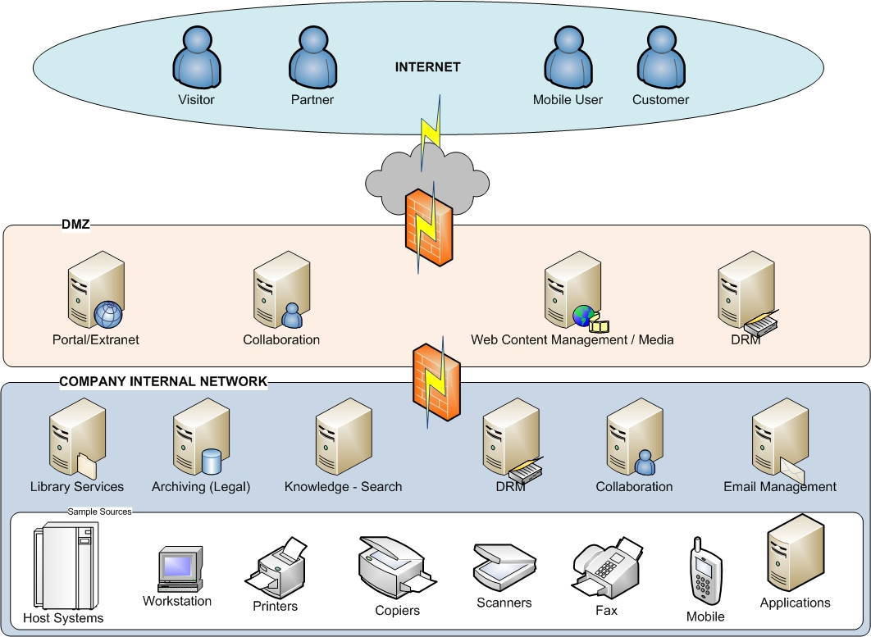

World of information
Notes:
Pino - 3 minutes:
In the world of information, both external actors and internal actors are dealing with information. All these information, structured or unstructured, are managed by different platforms.
Visitor can visit your website
Partners and customers could access extranet and collaborative spaces
Your mobile users could access their information through an external portal
External DRM could be used to protect key documents
Internally, Applications, ERP, Host systems, will produce information (spools, reports) that can be directly ingested in the archiving platform
Office and desktop applications can deal both in collaborative spaces for dedicated and short terms spaces or deal with library services content management platform that are more company wide repositories
All these informations could be searched and handled by a search server.
Internal DRM could be applyed for critical information

Slide 7

What do we mean by collaboration ?
Information sharing in dedicated secured or non-secured portal based frameworks
Sharing & elaboration of documents/info/archives
Exchange & thesaurus based search of Knowledge
Discussion (newsgroups, blogs, chats, …)
Presence & information awareness (web 2.0 3.x)
Thematic spaces (dossiers, projects, topics, interest groups, …)
Security and user access
User-role management
Short term (month/year)

Slide 8
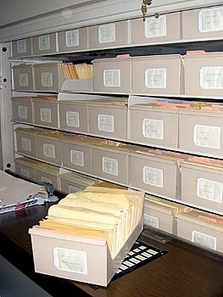
What do we mean by archiving?
Managed and selective information storage in managed secure scalable stores
Secure information/document storing
Sharing based on corporate access policies
Legal evidence for authenticity of document/info
Company wide thesaurus based search
Company wide topology
Company wide policies
Policy based ILM
Long term 30-100 years

Slide 9


Why a combination of solutions ?
Handling huge volume of information
Enforcing compliance
Long-terms retention of information
High-availability & consistence
Enterprise wide thesaurus based search
>> Enterprise scale repository
Document exchange : procedure/dossier based
Publishing
Living documents with lot of modification
Office integration
Easy secure user interface
>> Enterprise scale collaborative platform

Slide 10
Conceptual architecture
Search Engine with federation
Portal – Collaborative platform
Collaborative
Document Library
Portlets – WebParts on Archive
Portlets – WebParts on Content Management
Portal applications
Archiving Platform
Legal - Reports
Content Management
Platform
applications
Enterprise Service Bus / SOA

Slide 11
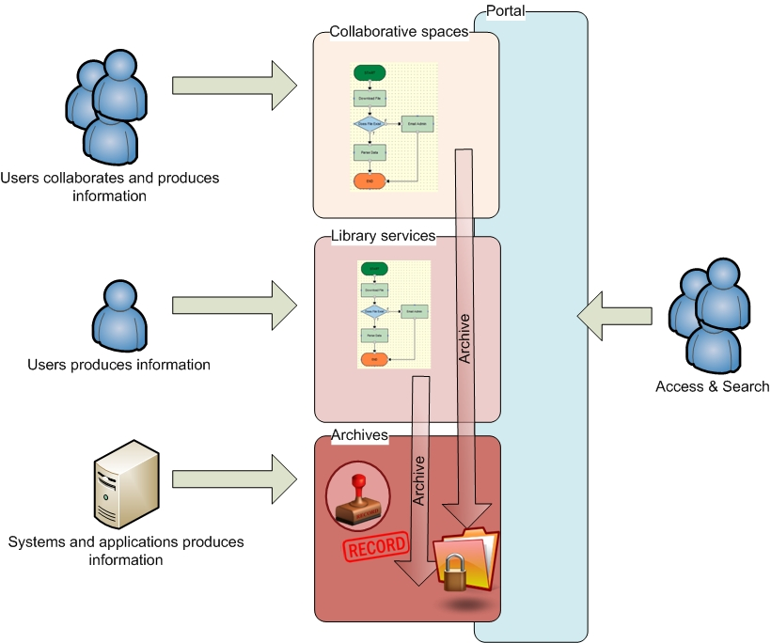
Information Lifecycle and repositories
Information are produced in the best context and archived for long-terms conservation
Legal policies will be applied on needed documents
Rules and workflow event could be the trigger to move a content
Notes:
Pino:
Use sample – contract building – collaboration -> workflow -> archiving + policies

Slide 12
Solutions in place @ INAMI-RIZIV
e-DID : disability dossiers
  Enterprise scale collaborative platform
    Microsoft Sharepoint Server & Reporting Services
  Additional collaborative modules
    .Net modules
    Biztalk connection to Social Security CrossRoad Bank
  Enterprise scale repository
    IRIS DocCenter

Slide 13



e-Did architecture
Web Service
DocCenter
DB
e-did DB
Synchronisation via e-did
Sharepoint
KSZ-BCSS

Slide 14
e-DiD geographical
Région
Brussels

Slide 15
Conclusion
Collaboration and ECM can be combined to offer an end-to-end solution for managing information
Thanks to a corporate management of information and a strong solution for collaboration, efficiency increased :
  Uniform and faster access to information
  Enabling collaboration and exchange of information with internal or external stakeholders
  Strong and reliable policy for archiving and long-term retention keeping day-to-day information with good performance and readability
  Enforced monitoring of the process and the audit of regulation applications
Notes:
Complémentaire et pas opposé
Collaboration doit aussi être abordé avec une analyse car tout aussi important pour éviter les problématiques

Slide 16


How to face your major challenge:
Do more with less, while reducing your carbon footprint
Thanks to this implementation we can think green
  Limit the number of paper copies of information thanks to a corporate repository and search
And…
  Do more SERVICES TO YOUR CUSTOMER with less TIME SPENT SEARCHING INFORMATION

Slide 17

Q&A
Thanks!

