Slide 1

Get hold on Generation Y in your ECM System
Pieter Offers
I.R.I.S. Netherlands

Slide 2
Agenda
Introduction
Web 1.0 vs Web 2.0
How does Generation Y use Web 2.0
What are their benefits
What could you achieve

Slide 3
Who am I
GENERATION x (1965-1976)
Pieter Offers (☺ 1967)
Accept diversity
Pragmatic/practical
Reject rules
Mistrust institutions
PC
Use technology
Latch-key kids
Friend-not family
Multitask
☺ Yes, but also I am Dutch
☺ Yes, let’s do it
😐 …… can’t tell
☺ Yes, but again I am Dutch
☺ Yes, my first at 14
☺ Yes, but I am also a man
☺ Yes, my mother worked
☺ No, both
☹ No, because I am a man

Slide 4
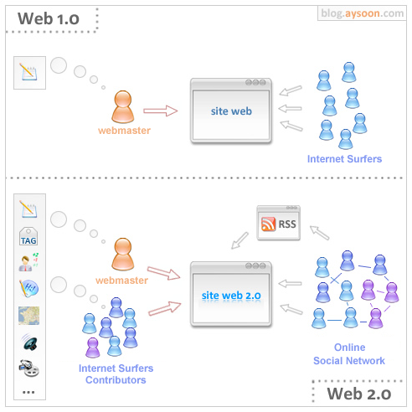
Web 1.0? Web 2.0?
(Wikipedia)
Web 2.0 is a clear and broad trend on the internet, and is called the second phase in the development of the WWW.
It a changes from a set of websites to a complete platform for interactive interactieve webapplications for end users on the World Wide Web.

Slide 5
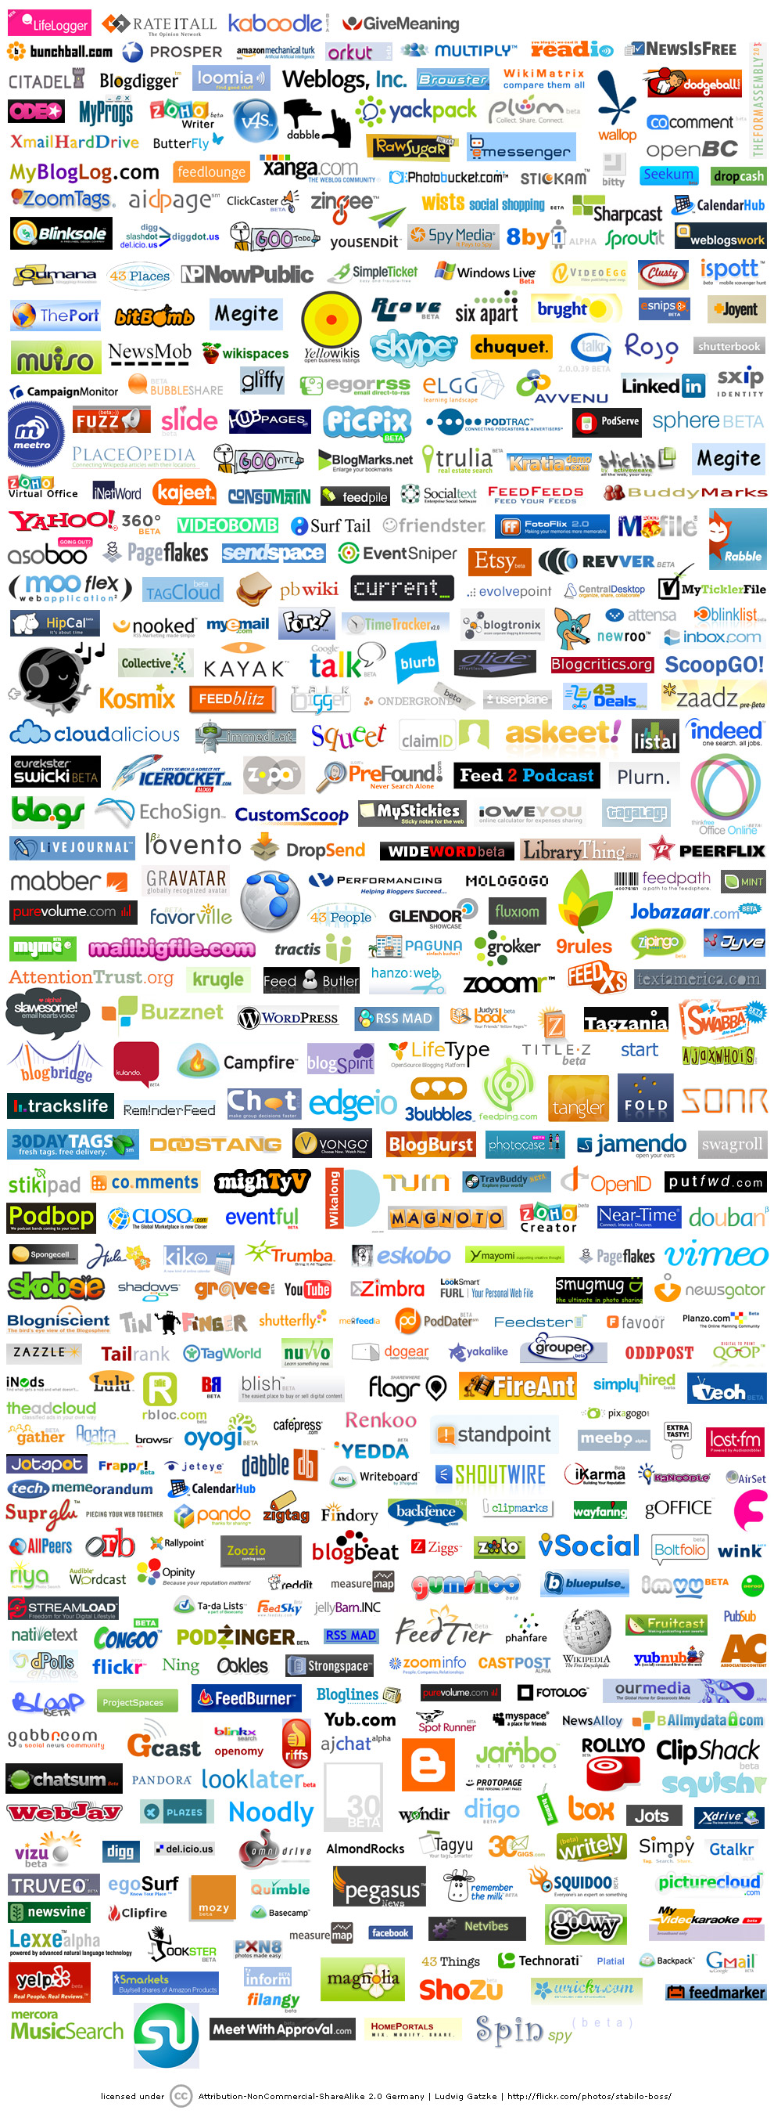
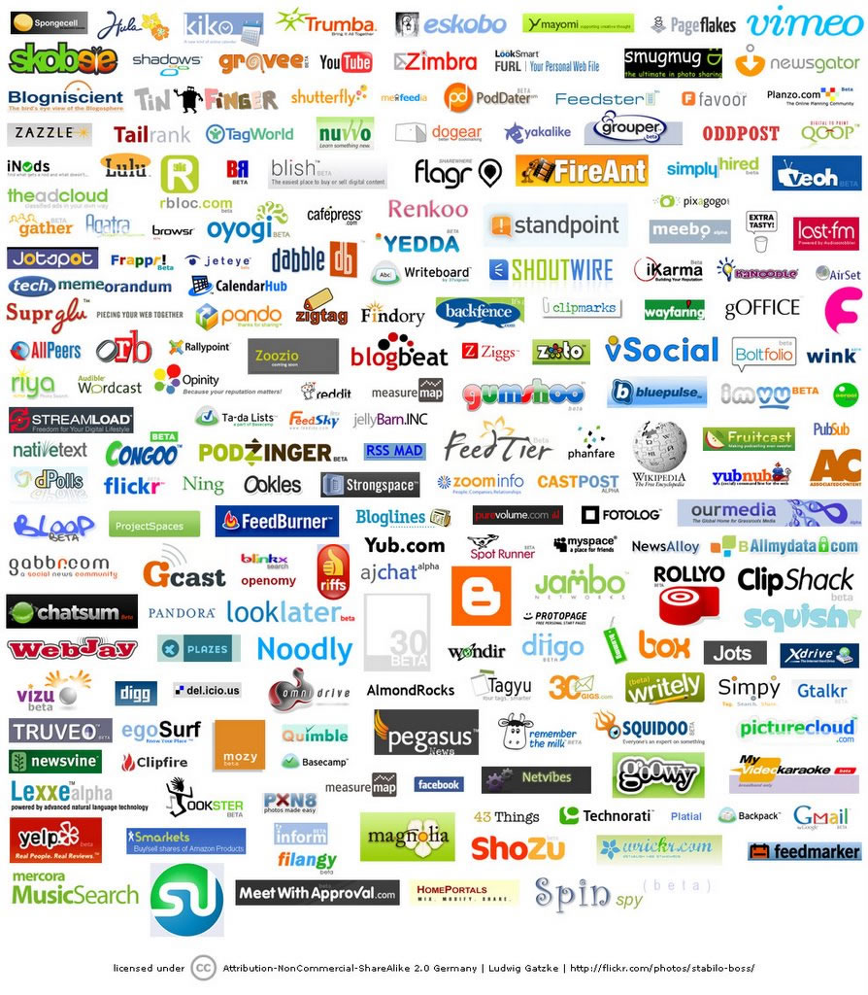

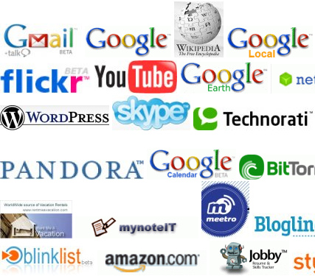







What do WE know?
And a
lot
lot
lot more

Slide 6
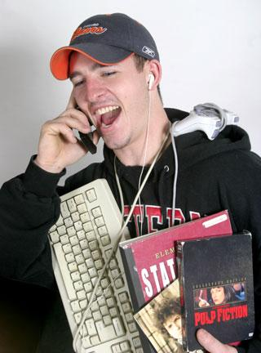
Who are they?
PROFILING
This is who I am!
This is what I know!
This is what I can!
THIS IS WHAT I USE
18 – 32 year, Millenials, Echo-boomers
Recognised by:
  Late proffesional start
  Stay longer at home
  I work at MY company
  Share everything
  Share with everybody
  Share at any moment
  Multividualist

Slide 7
Make up of Adult Internet Generation by Population
(does not include teens)

Slide 8






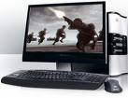
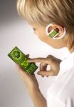




How do they do it?

Slide 9
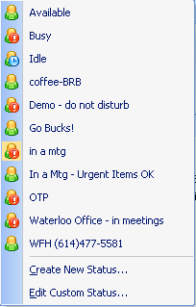


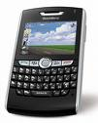

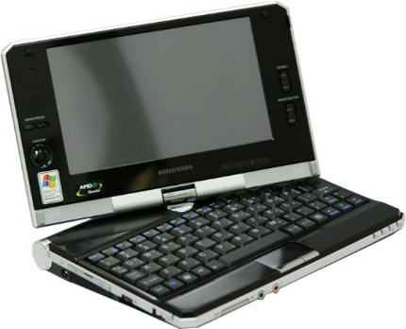



Contact each other
Knowing when and how
On every moment on every device
Where are you?
pssst!
Ring
Knock
Knock
hé

Slide 10
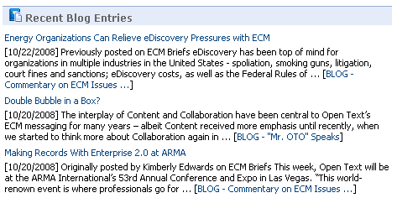
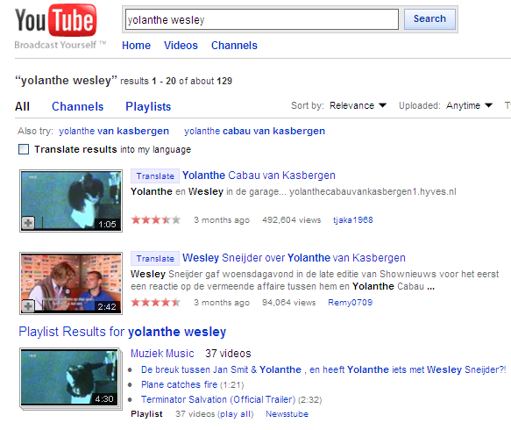
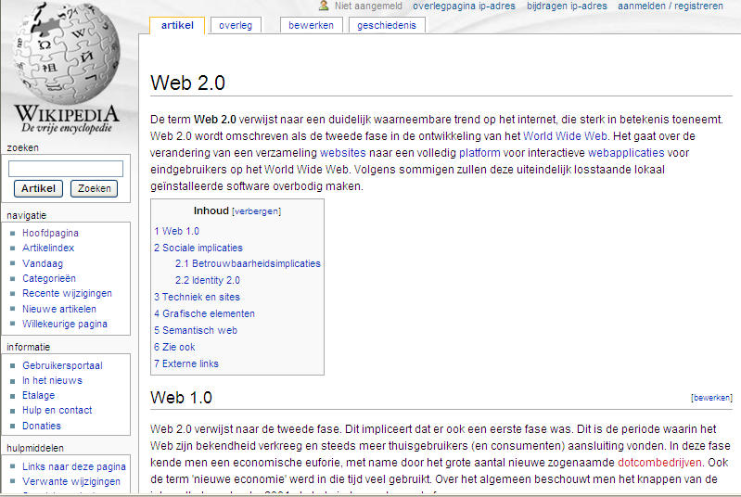
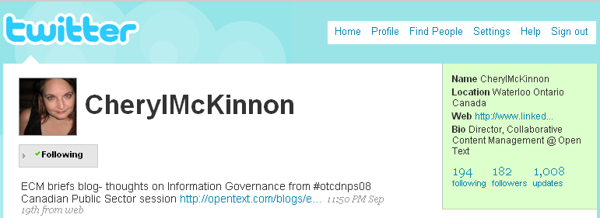
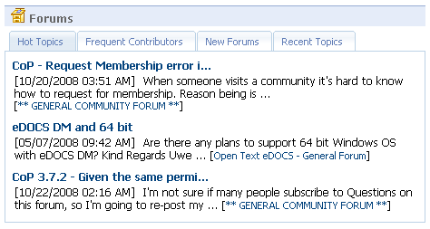
Information Sharing
  Blogs, Forums
  Wiki’s
  Capturing the moment

Slide 11
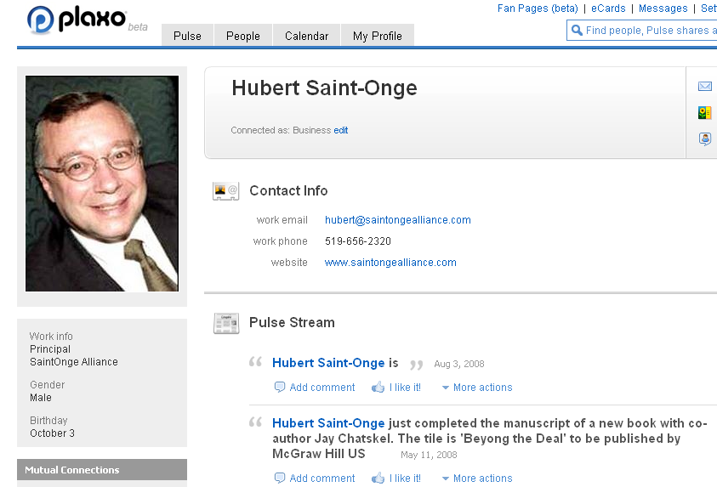
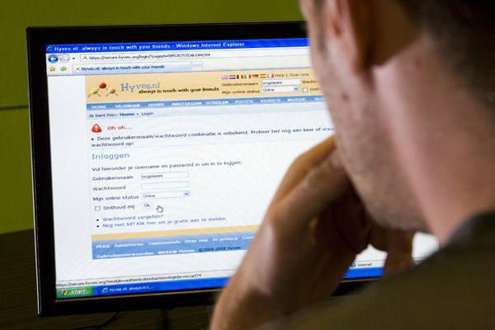
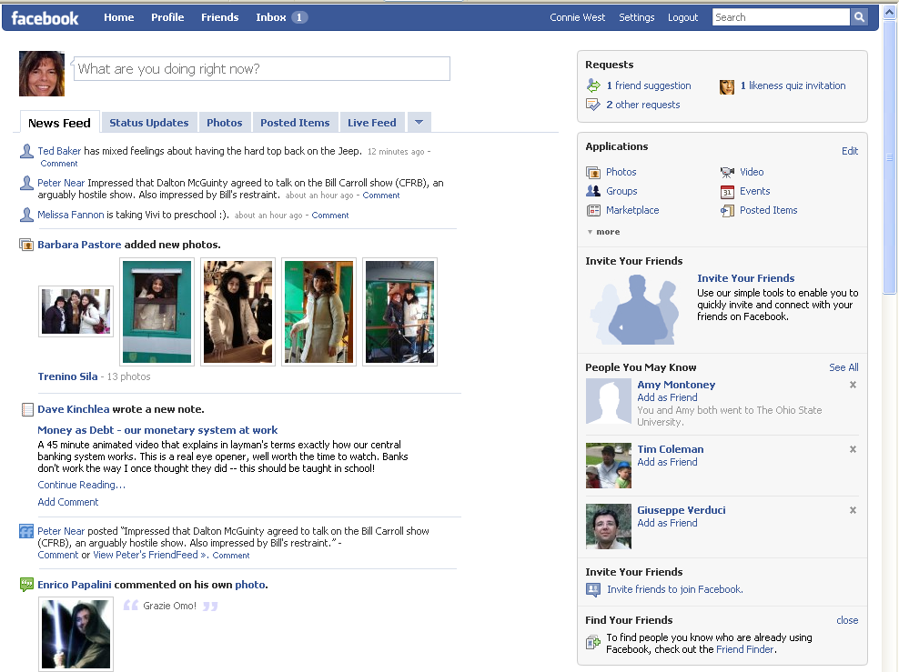
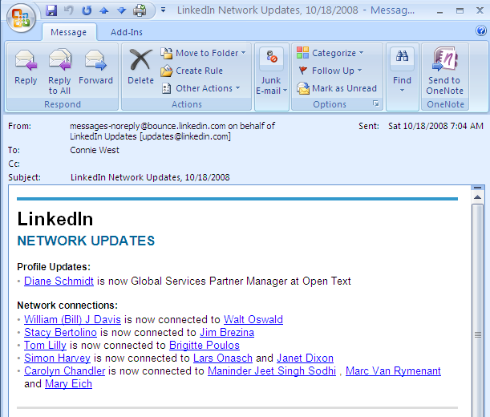
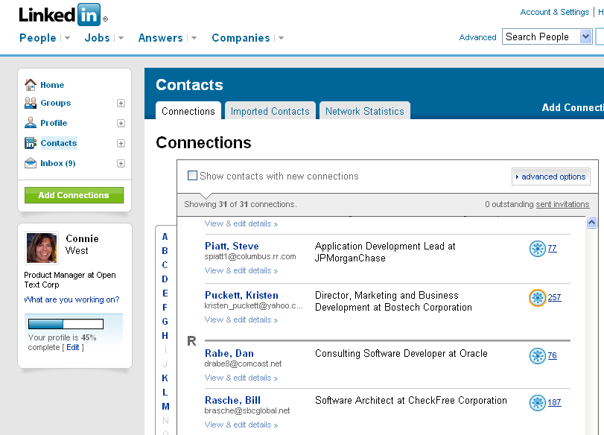
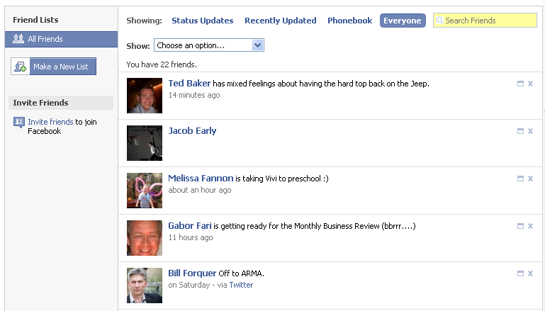
Maintain relationships
  Personal
  Professional

Slide 12
What do they achieve?
Faster communication => information
Get and keep in contact
Find old acquaintances
Share expierence with people they know
Unexpexted response and additions
Everywhere, allways and on any device
AND THEY ARE CONTINOUSLY AWARE

Slide 13
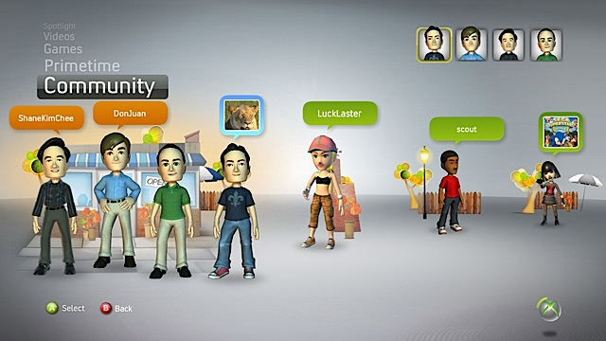
What do they achieve?
Hechtere banden
Sneller leven
Betrokken zijn en voelen
(ONLINE) SOCIAL TEAM

Slide 14
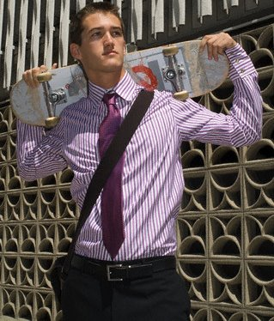
If this is what they want and can use
GIVE THEM A (ONLINE) PROFESSIONAL TEAM

Slide 15
Ok, that’s what I want ….
….but what about:
Information reliability
Privacy
Fakes
The Fake world becomes the real world
Impersonal
Security

Slide 16
If this is what they want and can use
GIVE THEM A (ONLINE) PROFESSIONAL TEAM
But internally managed, or else
... ..they have what they want
….. but you might loose it when they leave
….. and the risks can not easily be managed

Slide 17
HOW?
IMPLEMENT ENTERPRISE 2.0
….an internal system based on web 2.0 technology which can give your organisation, in a controlled environment, the following:
Fast and amendable cooperation
Information sharing
Pull information (trigger)
Integration possibilities
Know your organisation and your colleagues

Slide 18

What can you achieve with E2.0?

Slide 19
What can you give Gen Y
(some examples)

Slide 20
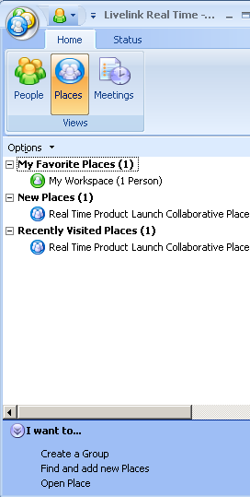
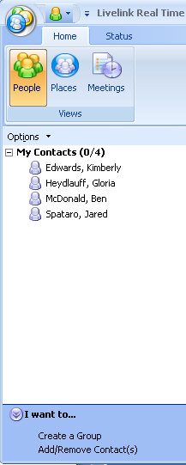
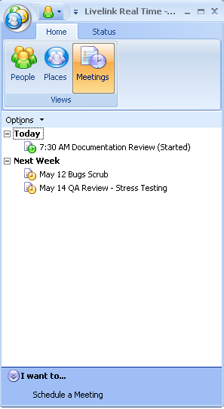
Internal Live communication
Who is online
Share and get input
Work together
Revise simultanously
Set-up ad-hoc online meetings

Slide 21
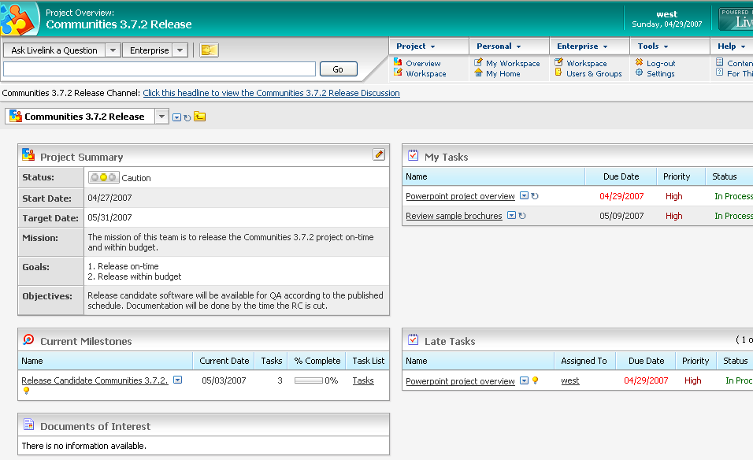
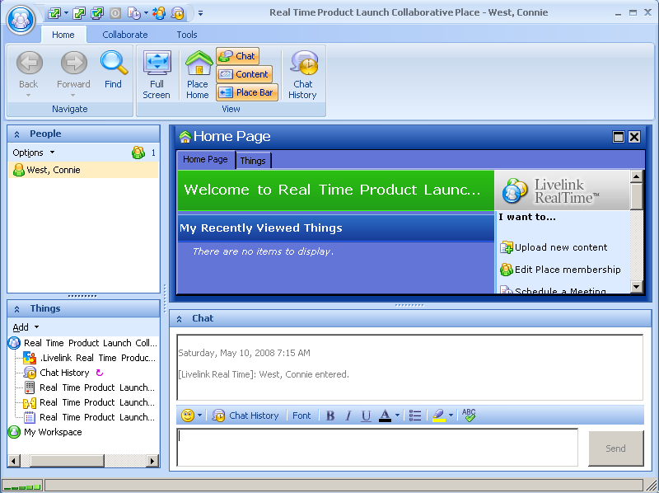
Virtual Collaboration

Slide 22
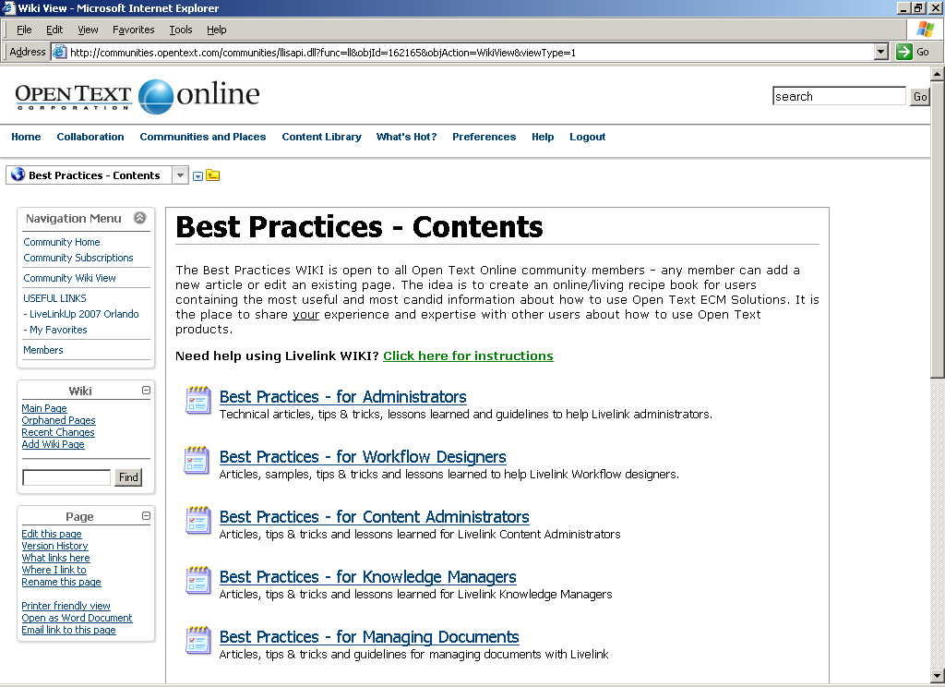
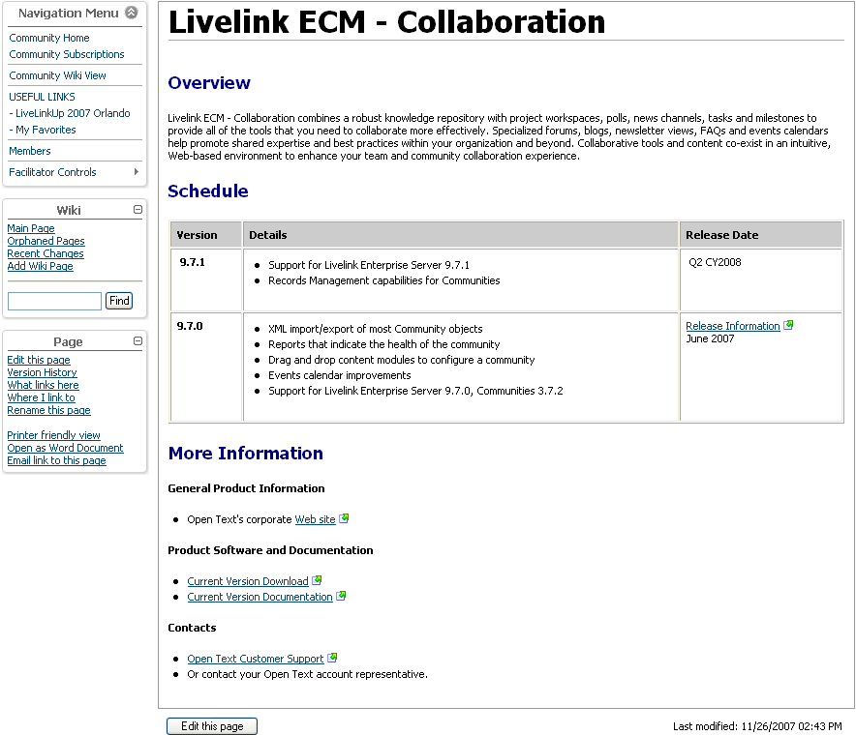
Internal Wiki’s

Slide 23
what about the risks?

Slide 24

Risk management
Organisational
Provide tools pro-active
Give all generations a role in implementation
Discuss risks companywide
Communication rules
Awareness
Let it be!!!
Technical
Audittrails
“recognition”
Rights
Logical environments
Give the people rights,
and they will use it!!
What would Google do?
Jeff Jarvis

Slide 25

What do we achieve?
Faster communication
Your people gets and keeps in contact
Share and find internal knowledge
Experiences from collegues we know
Unexpexted response and additions
Everywhere, allways and on any device
and it will stay in
our corporate memory

Slide 26


How to face your major challenge:
Do more with less, while reducing your carbon footprint
Productivity
New ways of communication makes people more productive
(faster communication in less time)
People finding and information finding / sharing is easier and faster
People are knowing what’s happening and give pro-active input
Environment
Actively support online collaboration with professional tools results in less travelling
Online meeting and sharing of documents prevents mass printing the same document(s) by multiple people

Slide 27
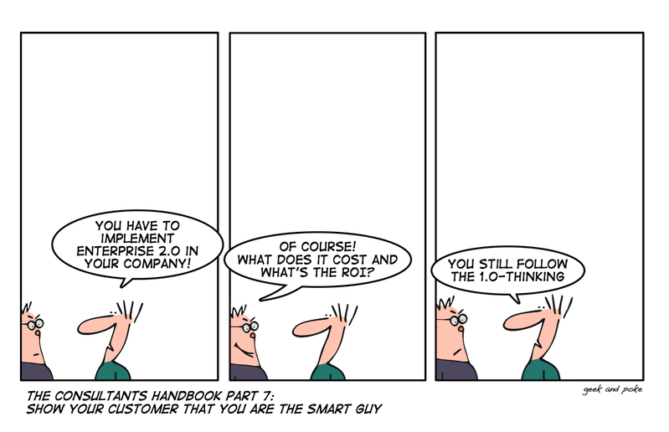

Slide 28

Questions?
More information
pieter.offers@iriscorporate.com

