Slide 1

How to Implement Content Management within an Enterprise Environment
Carol.VanderDonck@iriscorporate.com

Slide 2
Agenda
Top 5 reasons for failure of ECM projects
IRIS methodology
Some examples
Q&A

Slide 3

Nr 5 top issue
Underestimated effort of content migration
Electronic content:
  Shared folders
  Email
Paper content:
  Volume
  Condition

Slide 4
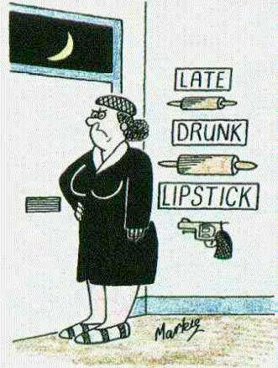
Nr 4 top issue
Uneven use - poor procedures and enforcement
Ways of working:
  Process
  People
Alternatives remain:
  Printer, email
  Personal storage

Slide 5
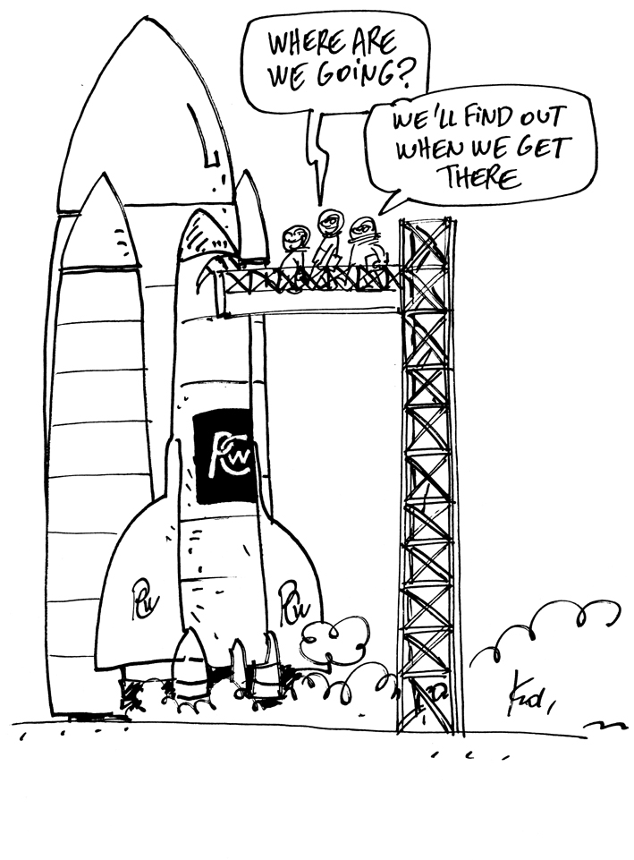
Nr 3 top issue
Internal politics
Lack of support:
  Senior management
  Peer groups
Changing priorities:
  Not business critical
  Little strategic value

Slide 6
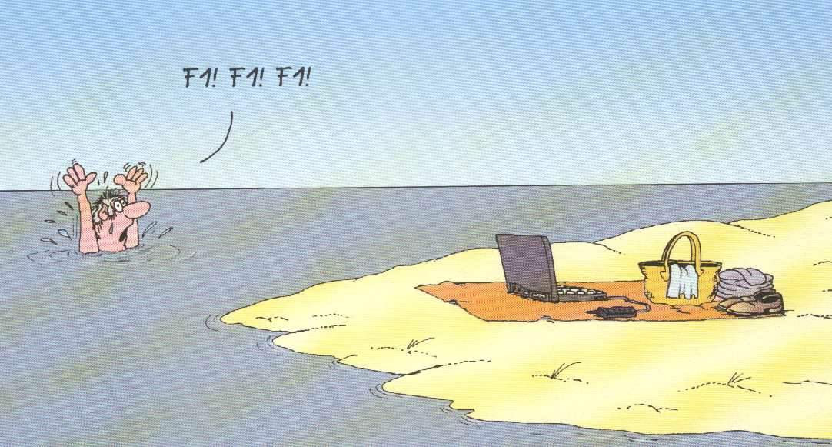
Nr 2 top issue
Lack of training
Users:
  Processes, policies
  Applications
Support:
  Helpdesk
  Administration, operations

Slide 7
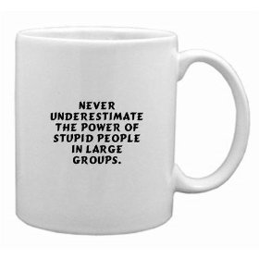
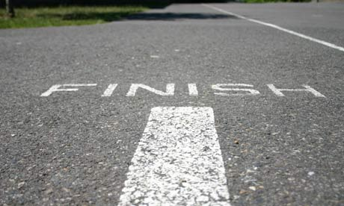
Nr 1 top issue
Underestimating the process – organisational issues
Processes:
  Impact
  Acceptance
Organisation:
  Readiness
  commitment

Slide 8
Why IRIS
20 years of specialized expertise
Clear focus on all aspects of ECM
Specialised consultants:
  ECM change management
  Documentalists
  Project management
  Technology specialists

Slide 9
Our metholodoly
Multidimensional approach
Alignment with other systems
Documentary focus
Scope control
Specific objectifs for document management
Specific business objectives
Generic functionalities
Conceptualisation and global vision
Top management support
Responsive and respectful of all players
Respect existing environment
Adoption
Decisions

Slide 10
Alignment with other systems
The ECM-BPM platform needs to be perfectly integrated with the other information systems of the organisation.
Integration and interaction is essential:
  Transparancy
  SSO
  Portal
  Webservices
  URLs
  …

Slide 11
Objectives for document management
Improve information retrieval (faster, more precise)
Creation of unique folders per project/customer/activity
Increase tracability (records management, legal archiving)
Improve security and access to documents
Reduce/eliminate paper flows
Reduce/eliminate paper archives
Reduce repetitive, low value tasks

Slide 12
Business objectives
Increase productivity (gain time or reactivity).
Increase quality (coherent answers, better decisions, internal watch, proactiveness…)
Agility and flexibility new way of working, quickly respond to changing needs
Reduce costs(consolidate infrastructure, extend existing investments)
Compliance (regulatory requirements, tracability)
Better customer service (faster response times, self service, …)

Slide 13
Multidimensional approach
Organisational aspects: actors, roles, information flows, procedures, change mangement, collaboration, best practices…
Informational aspects: documentary structure, metadata, document types, thesaurus, classification…
IT aspects: technical and functional specifications, software architecture, hardware, networking, storage, archiving

Slide 14
Organisational aspects
Collaboration, best practices, sharing experiences and change management are essential to the success of an ECM project
Definition of roles and responsabilities of systems that will interact with the ECM platform

Slide 15
Change management
Goals are to
End users understand and adherent to the new way of working
Each implicated party knows stakes
End users are autonomous to use the system
It operations integrated
Through:
Network of change: main sponsor, project team, local sponsors
Change management plan
Communication

Slide 16
Change management

Slide 17
Typical questions
What is the scope of the project?
What are the general objectives? Who is targetted? What are the priorities?
What are the regulations to respect?
What are the key success factors?
What are the expected benefits?
Who is the main sponsor of the project?
Are there power users that can be integrated early in the project?
Are there systems that should be integrated with?
What is the corporate culture?
Are different communication channels possible?
…

Slide 18
Informational aspects
About documents:
Different document objects
Links between objects
Identifiers, metadata
Indexation
Templates…
About the organisation in folders / structuring
About classification

Slide 19
About documents
Metadata
Templates / Indexation
Two categories:
  Relatif contentant
  Relatif contenu
Well known example : Dublin Core
Best practices:
  Link with document type
  10 metadata per doctype
  Automate indexation
  Closed choice lists
Manual indexation
Semi automatic through context
Automatic

Slide 20
Typical questions
What are the different content items?
How do you identify a document?
What are the different document types?
What is important information for each document?
How are documents linked?
How do you organise documents today?
What about versioning?
How do you know now what the latest version of a document is?
How do you search for information?
How is information classified now?
…

Slide 21
IT aspects
Addresses:
Functional requirements
Technical requirements
Storage
Records management
Workflow needs
Indexation
Needs for scalability and availability
Integration with scanning / protocols for data integration
…

Slide 22
IT aspects

Slide 23
Typical questions
What are the corporate software/hardware standards?
How to assure long term storage of content?
Is legal archiving necessary? Is fixed storage already in place?
What are the required security standards?
How can integration with LDAP be done?
How can integration be accomplished with existing systems (web services, API, …)
What are the desktop productivity tools in place?
Should existing content be integrated?
Should a migration be foreseen?
…

Slide 24

References
Befimmo
DeGroof
DeltaLloydLife
Ethias
Eurocontrol
FMSS (Liège)
INAMI
La Poste
MSHO
Parlement Luxembourgeois
PuilaetcoDewaay
UCM
SNCB (H ICT)
SNCB (HR)
Sogepa
STIB

Slide 25


How to face your major challenge:
Do more with less, while reducing your carbon footprint
IRIS engages in a true partnership to ensure the success of an ECM project and covers
Informational aspects
Organisationals aspects
IT aspects

Slide 26

How to Implement Content Management within an Enterprise Environment
Carol Van der Donck
ECM Practice

