Slide 1
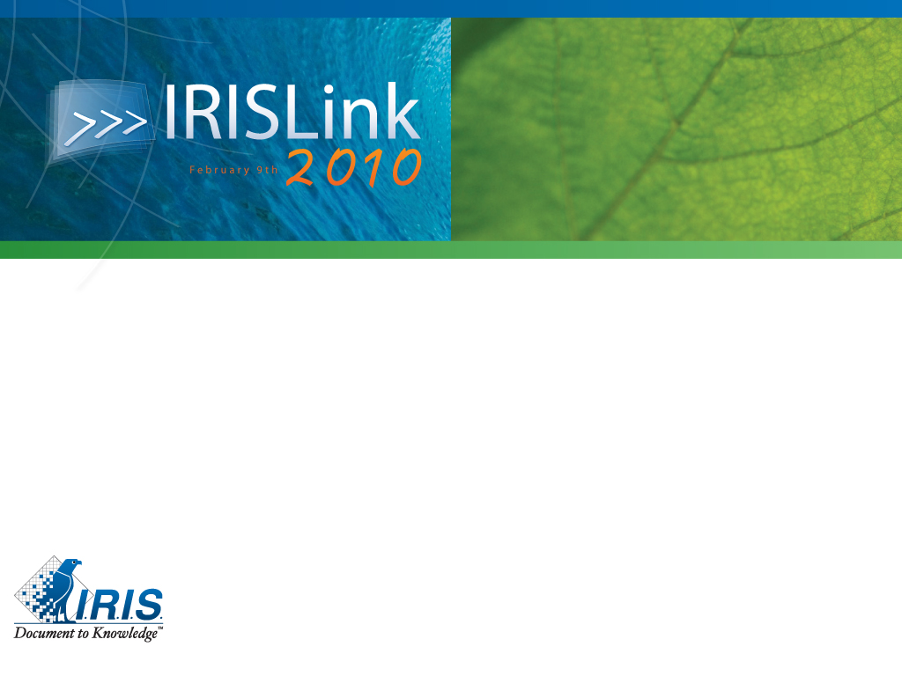

The Capture of European Large Archive Funds: the I.R.I.S. Global proposal for managing their specificities
Patrice BERTRAND (I.R.I.S.)
Georges GEURY (ADMV1)
Olivier ZANON (FEDASO)

Slide 2
Agenda
The needs:
  Political context: the Treaties of Maastricht and Lisbon
  Needs specific to the scanning and OCR process
The Publi-SCAN global approach
Presentation of each company
The process
  The global process
  Highlight of the I.R.I.S. added value
  Highlight of the ADM V1 added value
  Highlight of the FEDASO added value
The technical architecture
  The global architecture
  Highlight of the I.R.I.S. added value
Conclusion and questions & answers

Slide 3
The needs
Political context: the Treaties of Maastricht and Lisbon
Specific needs for the capture of documents (scanning and OCR processes)

Slide 4
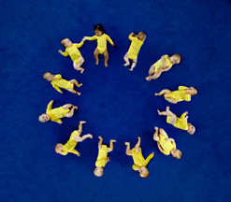
The Treaty of Maastricht
The Treaty on European Union (Maastricht) entered into force on 1st November 1993.
The Treaty of Maastricht responds to five key goals:
  Strengthen the democratic legitimacy of the Institutions
  Improve the effectiveness of the Institutions
  Establish economic and monetary union
  Develop the Community social dimension
  Establish a common foreign and security policy.
Notes:
With the Treaty of Maastricht, the Community clearly went beyond its original economic objective, i.e. creation of a common market, and its political ambitions came to the fore.
In this context, the Treaty of Maastricht responds to five key goals:
…

Slide 5
The Treaty of Lisbon
The Treaty of Lisbon entered into force on
1st December 2009.
It provides the EU with modern Institutions and optimised working methods to tackle both efficiently and effectively today's challenges in today's world.
The Treaty of Lisbon reinforces democracy in the EU and its capacity to promote the interests of its citizens.
A more democratic and transparent Europe.
Notes:
The Treaty of Lisbon defines what the EU can and cannot do, and what means it can use. It alters the structure of the EU’s institutions and how they work. As a result, the EU is more democratic and its core values are better served.

Slide 6
More transparency implies
Accessibility to archive documents:
  Online availability of archives (internal)
  Public access to documents.
Electronic information:
  Full-text search
  Physical storage reduction
  One electronic copy instead of multiple paper copies
  Satisfying legal archiving requirements
  Data extraction.
Notes:
Transparency implies that documents must be made available inside and outside of the commission. They must be available in intranets and public online libraries.
This online availability also bring several benefits, most notably:
a reduction in the physical storage requirements (we can keep only one electronic copy instead of multiple paper copies)
Easier compliance with legal archiving requirements
The ability to easily search on the full-text content of the documents or on extracted data and indexes
But these requirements are only generic ones. The EU has some specific needs for the digitisation of its archives => next slide!

Slide 7
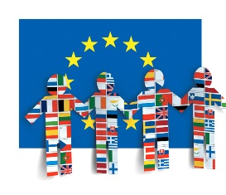
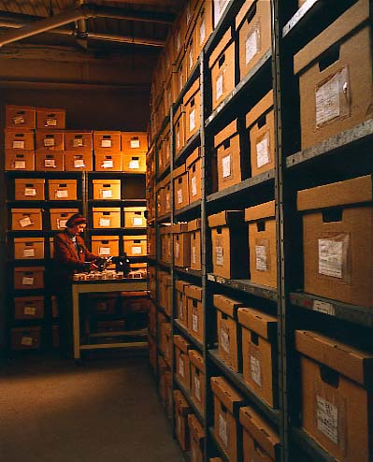
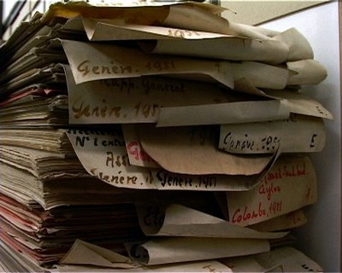
EU functional needs
OCR/ICR in 23 European languages
and potential requests for other ones
Large varying volumes
Various types of documents:
  Different sizes
  Bound, stapled, in binders,...
  Microfilms or microfiches.
Notes:
Regarding the functional aspects...

Slide 8


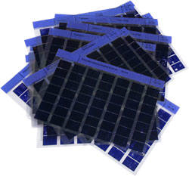

EU requirements
Quality:
  High quality images and text
  Reporting and traceability
  Security and integrity.
Technical:
  Publishing to repositories (Documentum, SharePoint, Open Source,...)
  Standardised output format (TIFF, FORMEX, PDF/A, XML, ...)
  Microfiches or microfilms.
Notes:
Of course, quality is of prime importance. The quality concerns:
…
Technically the requirements are varying but the most common requests include:
…

Slide 9
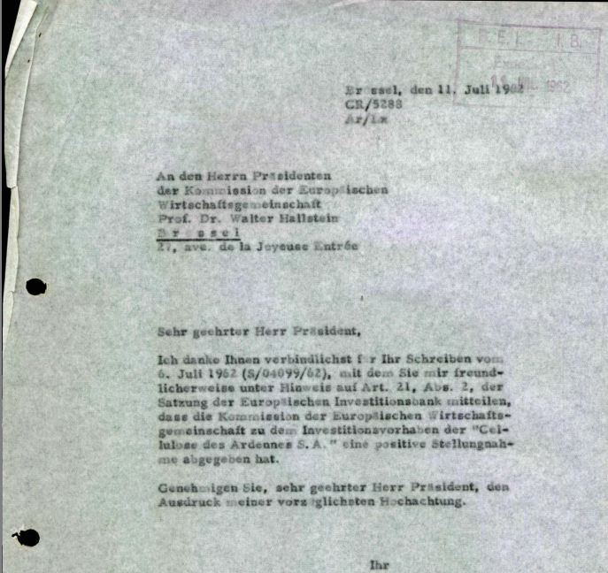
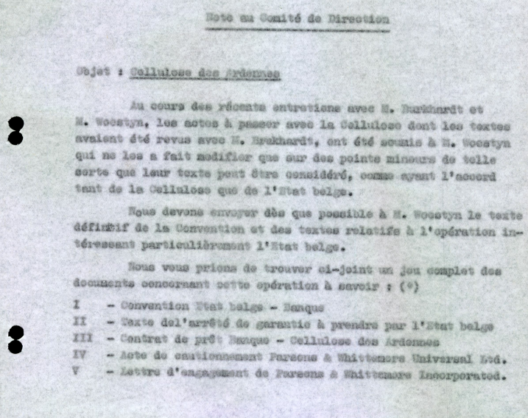
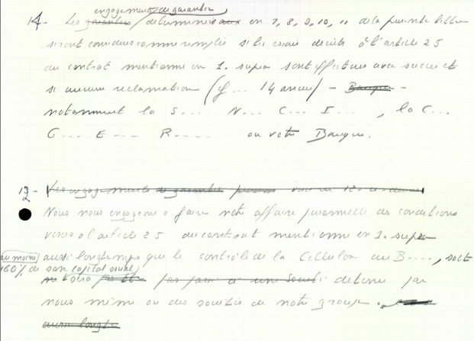
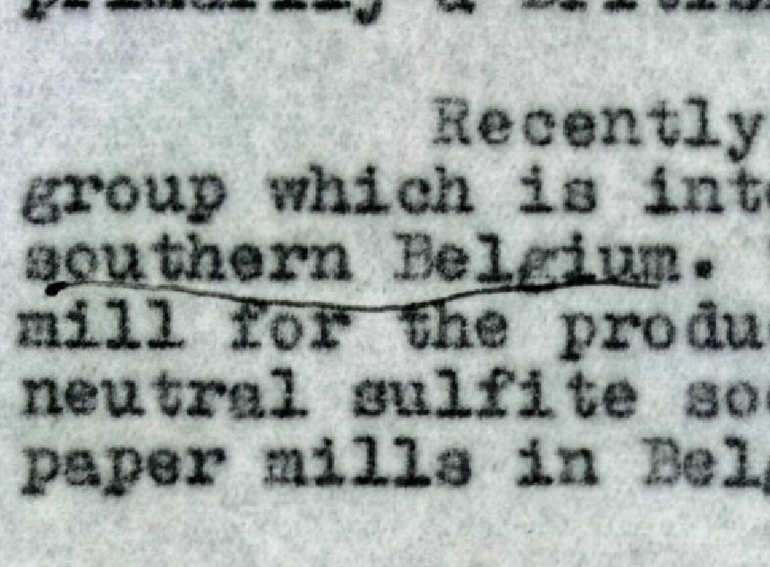
Complexity of archives
Notes:
Often archive documents (end 50’ies), including faxes on thermic paper, stencils, output from daisywheel or matrix printers
Forms with imposed structure and variable items (extra pages, fields of variable lengths, free text fields)
Sometimes grey zones
Documents of different formats and sizes (paper sheets, books, leaflets, …)
Different constraints (cut-off allowed or not)
Some documents are hand-written or manually annotated

Slide 10
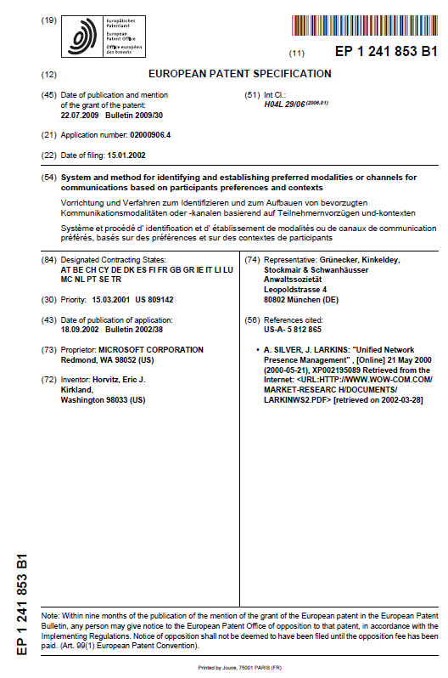
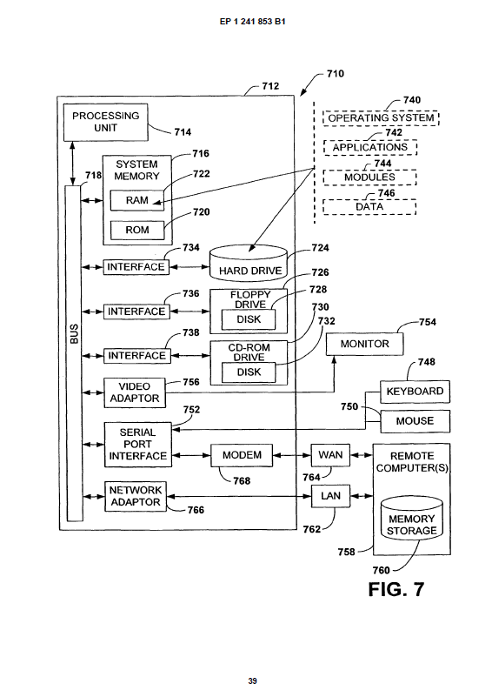
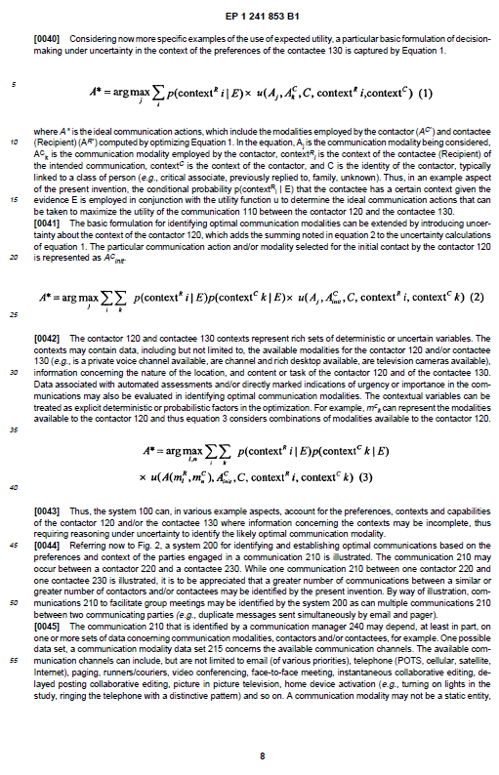
Complexity of documents

Slide 11



The Publi-SCAN global approach
Publi-SCAN
I.R.I.S.
FEDASO
ADM V1
I.R.I.S. for
  Sales and pre-sales
  Project and quality mgt
  Technologies
ADM V1 for
  Detailed preparation
  Complex and specific scanning
FEDASO for the
  Multilingual OCR
  Documents segmentation and manual validation
  XML transformation

Slide 12
Short I.R.I.S. presentation
I.R.I.S. Solutions & Experts is a subsidiary of the I.R.I.S. Group:
  Located in Louvain-la-Neuve, Belgium
  Revenue of 116M€ in 2008
  16,2M€ for International Organisations in 2009 (+/- 190 collaborators)
Main focus of I.R.I.S. includes:
  Documents oriented projects: data acquisition, ECM, workflow, archiving, …
  Selling of scanning, segmentation and multilingual OCR tools
  Selling of ICT (IBM) servers and storage

Slide 13
Short ADM V1 presentation
ADMV1 is a subsidiary of Village N°1, a social company, aimed to hire handicapped persons
Village N°1 figures:
  1,000 workers and 180 people living on site
  1 company with packaging as core business (« ETA »)
  1 service dedicated to welcome and location for handicapped people: Seresa
  3 social companies: B-team (building), ADMV1 & Arista France (scanning, coding, call centre) - ADMV1: created in 1995, today 60 FTE
  4 own sites (1 in Ophain Braine-L’Alleud, 2 in Wauthier-Braine, 1 in Valenciennes France)
  More than 10 customer sites.

Slide 14
ADM V1 focus: Document Logistic
Notes:
AJOUTER 2 PHOTOS : une de boîtes plastifiées, une d’Archives

Slide 15
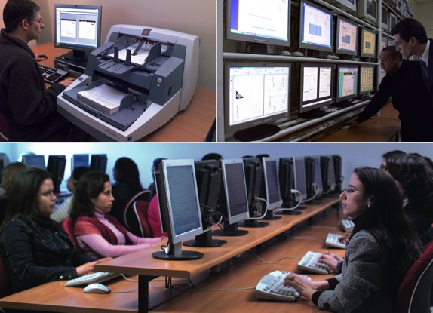
Short FEDASO presentation
FEDASO is specialised in:
  Documents’ Digitalisation
  Data capture
  Business Process Outsourcing (BPO)
Created in 1995 by Wegener group
Expertise deployed in 8 European countries
500 employees
Offices in:
  Paris & Brussels: Sales, Marketing, Project Management
  Fez: Production and R&D services

Slide 16
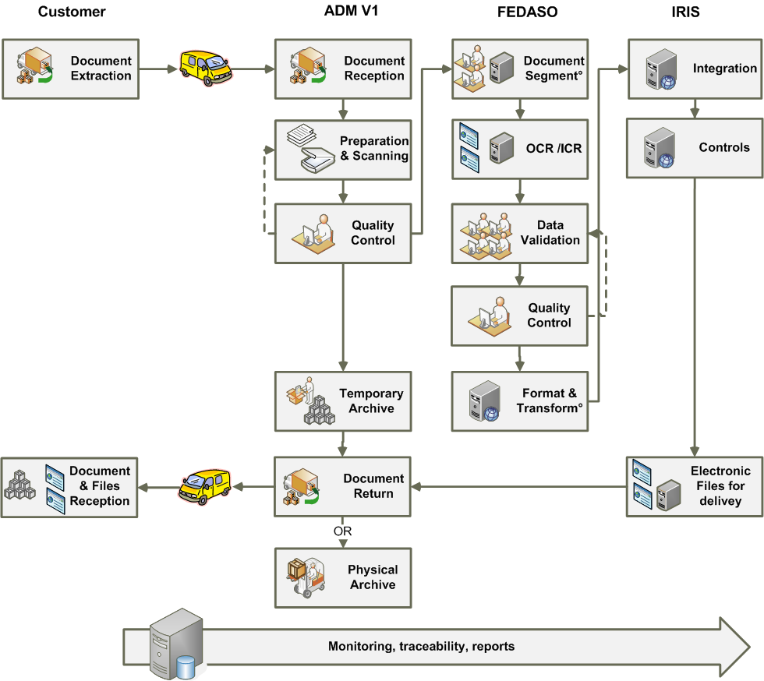
Scanning & OCR Global Process

Slide 17
Highlight on the I.R.I.S added value in the process
(Framework) Contract management
Global architecture of the solution
(in collaboration with the two members)
Global set-up of the project
Project management
Quality Assurance management
Relationship with customers
Strong R&D commitment.

Slide 18
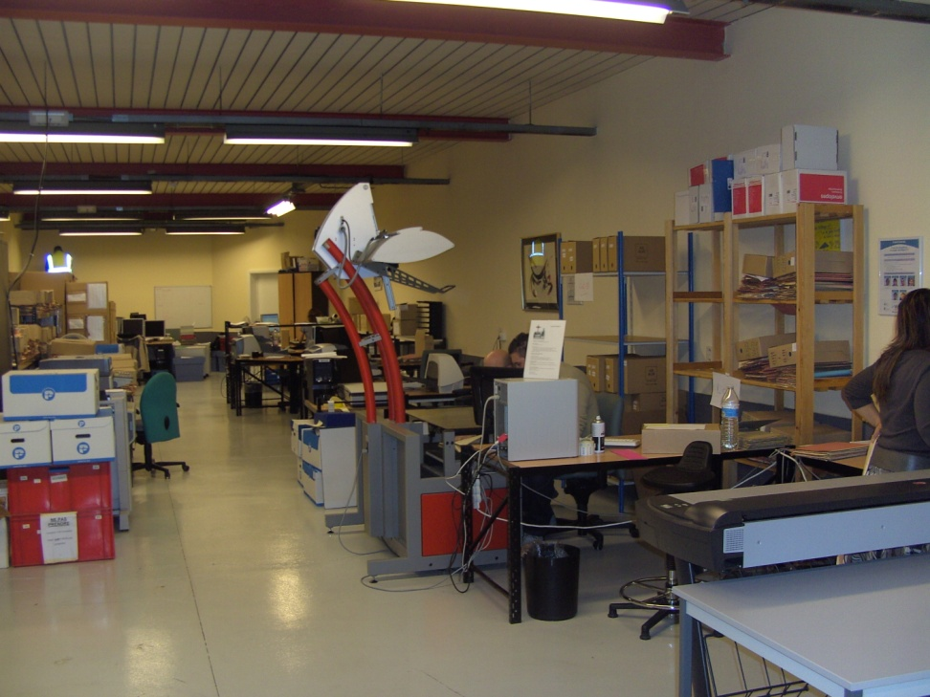
Highlight on the ADM V1 added-value in the process: the high-volume process
Transport
Storage
Sorting
Preparation
Scanning, Indexation, Control
Reconditioning or destruction
15 years experience in scanning (sorting, scanning, indexation, quality control,...)
Citizen role: integration of physical handicapped people into professional organisations.

Slide 19
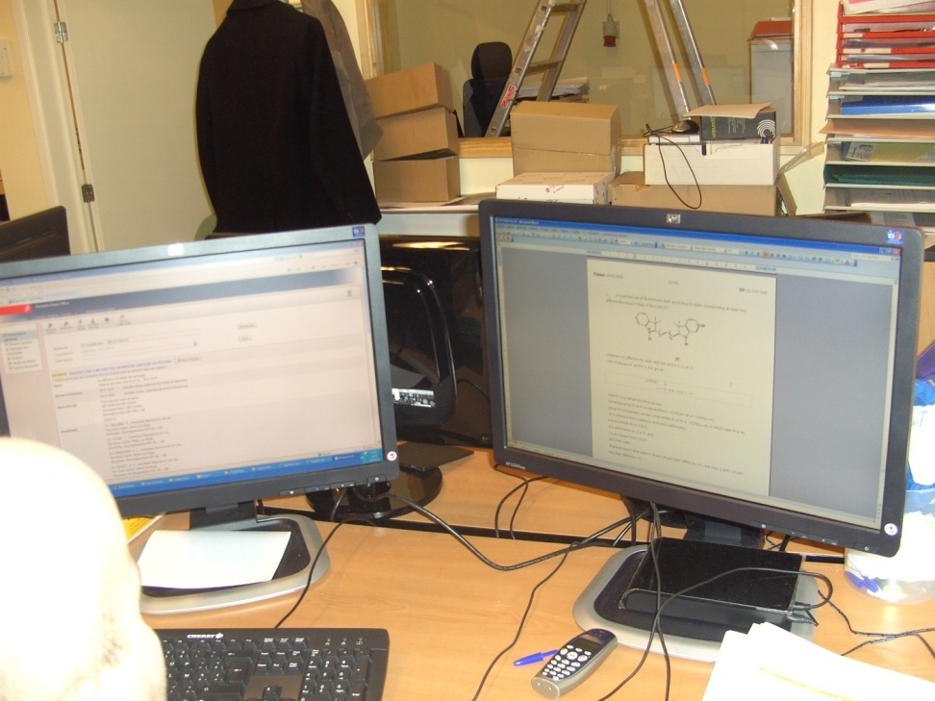
Highlight on the ADM V1 added-value in the process: Quality Assurance
Each step of the process => a dedicated control procedure defined in the operating procedures:
  Content before transportation
  List of documents before scanning
  Image control directly at the scan workstation (with rescan, if required)
  Index control on another workstation, ....

Slide 20
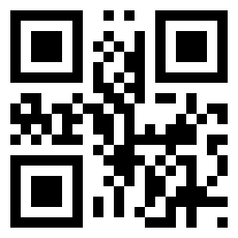
Highlight on the FEDASO
added value in the process
Document segmentation
OCR/ICR
Manual multilingual correction
Transformation (XML, FORMEX, …)
Preparation for data upload in DB.
15 years experience, in an industrial and secure environment, with latest technologies and quality management (ISO 9001)

Slide 21
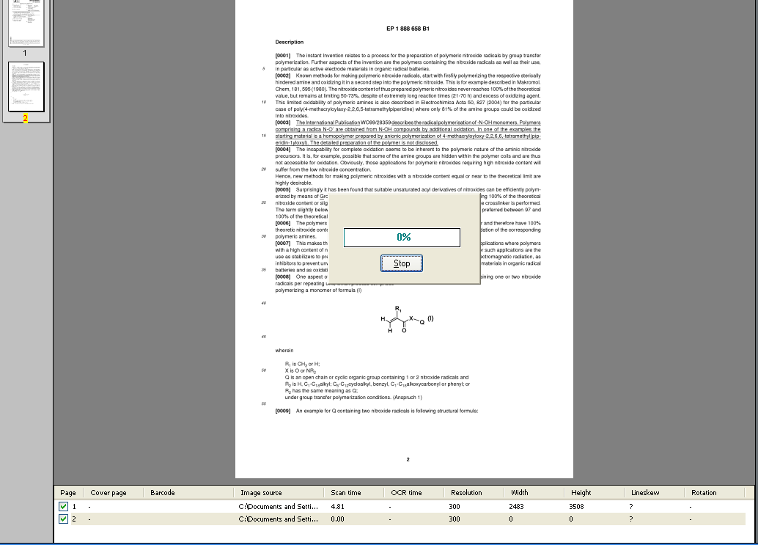
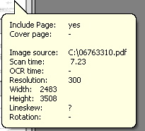
Highlights on the FEDASO added value in the process: OCR/ICR opening
Image analysis
  Resolution
  Size
  Color, B&W, ..
  Orientation
  …
Notes:
IRIS + FEDASO

Slide 22
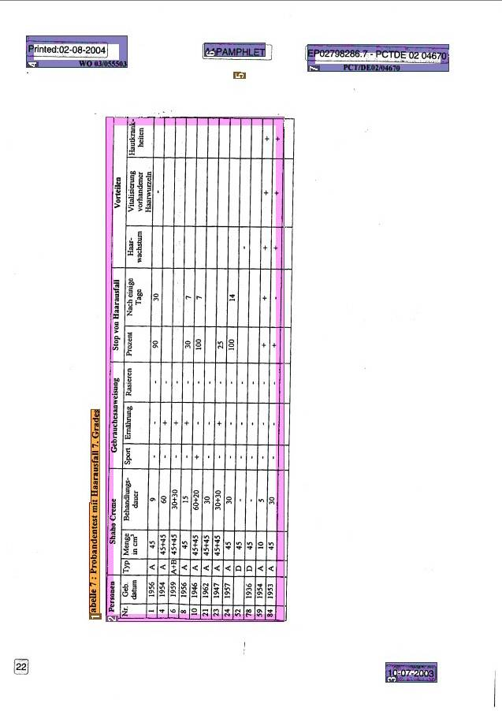
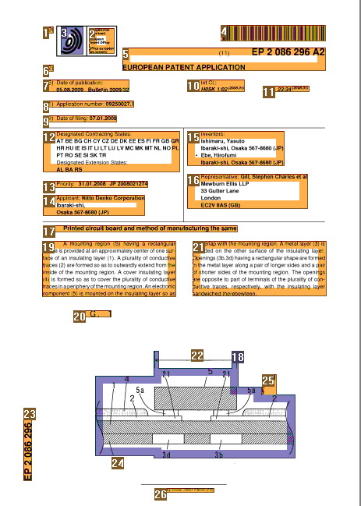
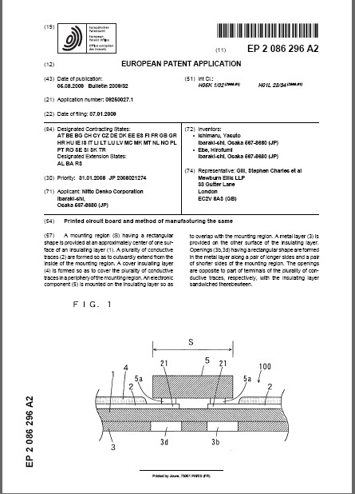
Highlight on the FEDASO added value in the process: OCR/ICR segmentation
Identification of:
  Text
  Picture
  Chart / Table
  Chemical / Mathematical formula’s
  Technical schema with legend
  Understanding the logical of the structure
Manual correction.
Notes:
IRIS + FEDASO

Slide 23
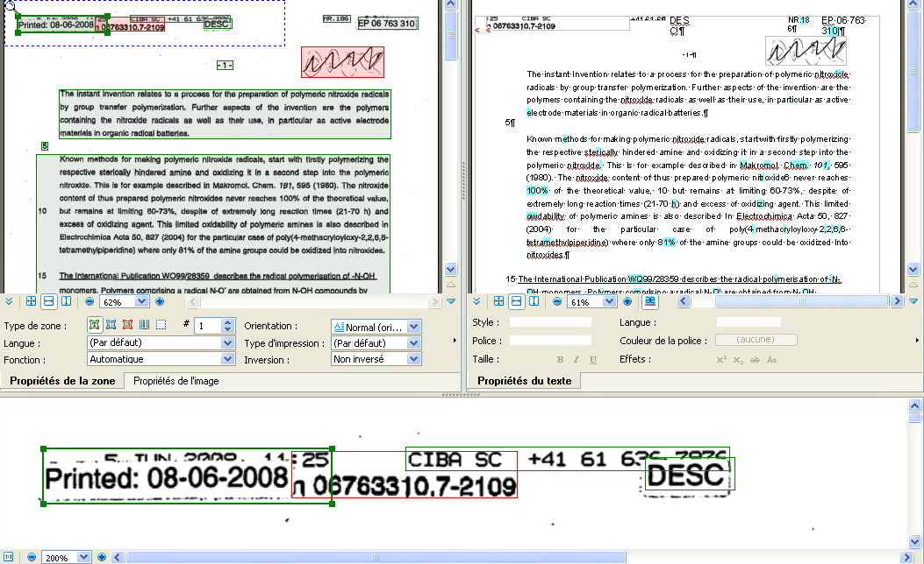
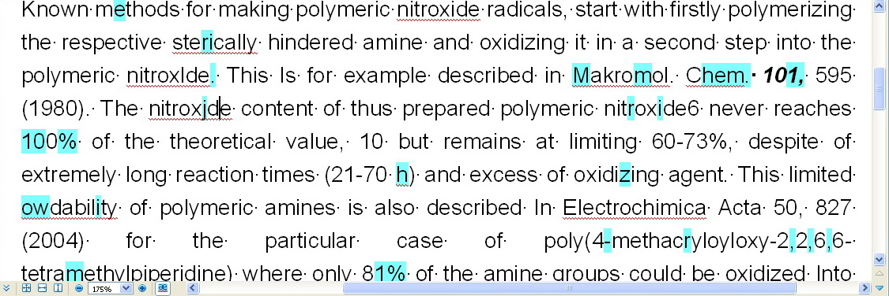

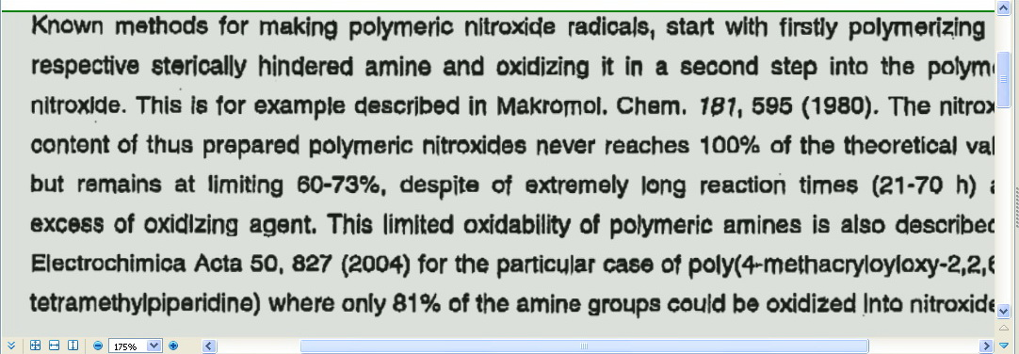
Highlight on the FEDASO added value in the process: OCR/ICR
OCR:
  Languages
  Automation (with dictionaries, lexicons, learning, external sources)
  Text + doubts
  Silences.
Notes:
IRIS + FEDASO

Slide 24
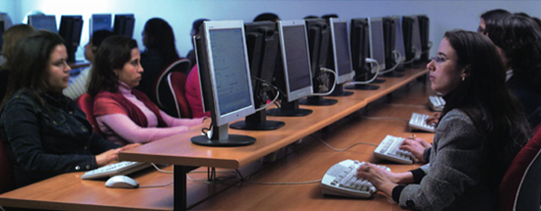
Highlight on the FEDASO added value in the process: OCR/ICR
Manuel correction to get the quality level required:
  Doubt correction
  Human reading to correct silences.
Notes:
IRIS + FEDASO

Slide 25
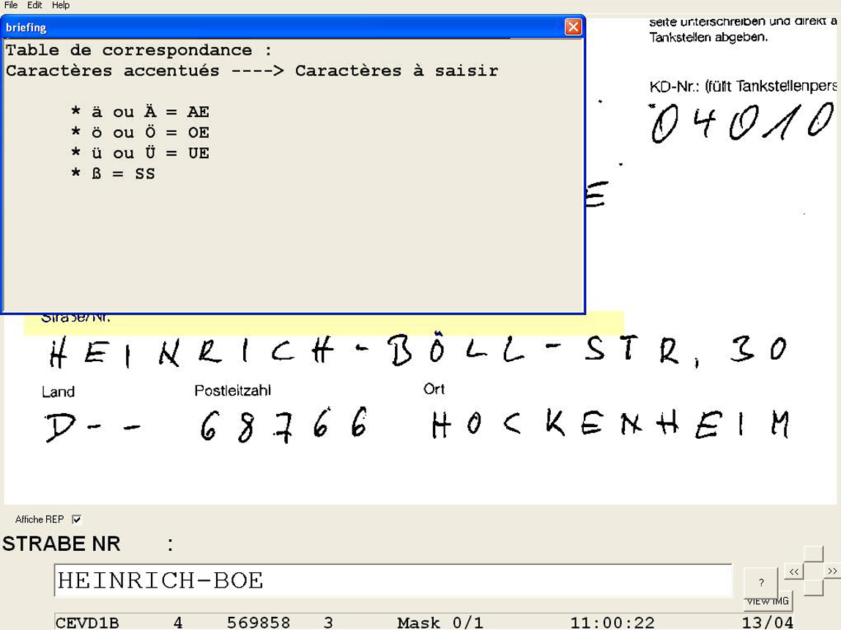
Highlights on the FEDASO added value in the process: OCR/ICR
Controls included in the data capture software
Briefing on-line.
Notes:
IRIS + FEDASO

Slide 26
The technical architecture
The global architecture
Highlights on the I.R.I.S added value.

Slide 27
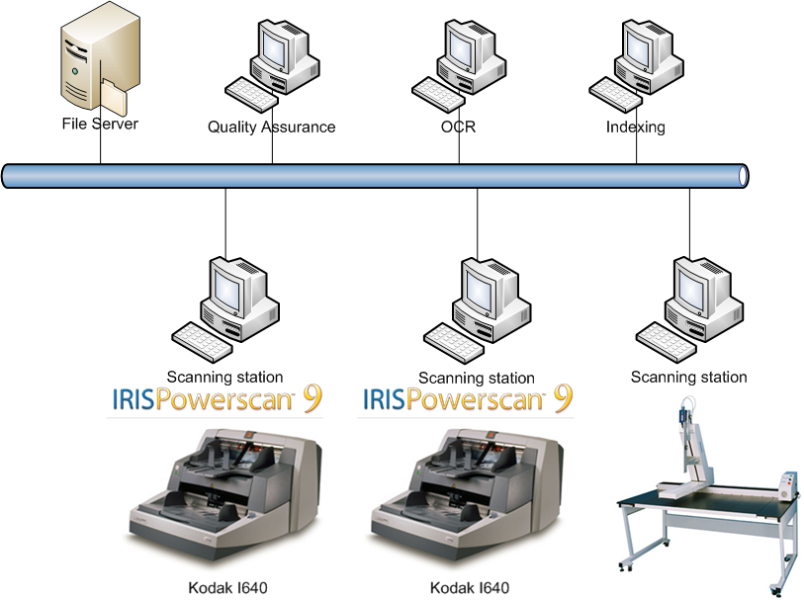
Scanning technical architecture
Available scanners:
Kodak i640 (3)
WideTEK 25 Image Access
Digibook i2S A0
Zeutschel OS 10000
Contex HD5450
Bell & Howell ADF 3000 D
Wicks & Wilson 8850

Slide 28
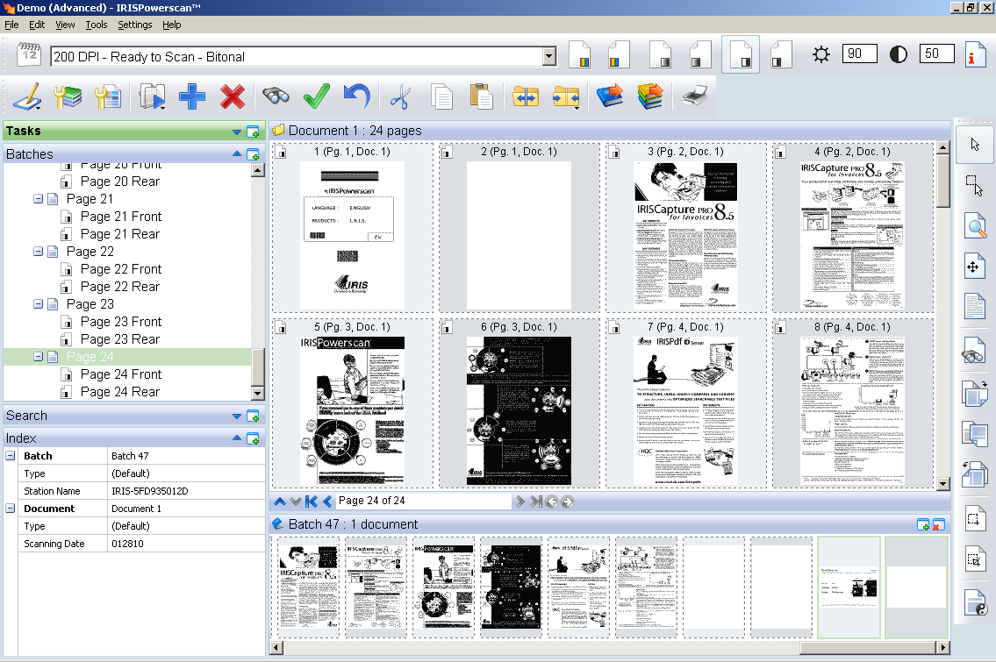
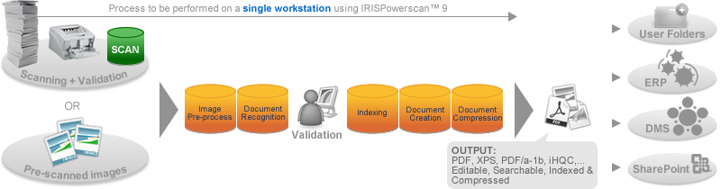
IRISPowerscan

Slide 29
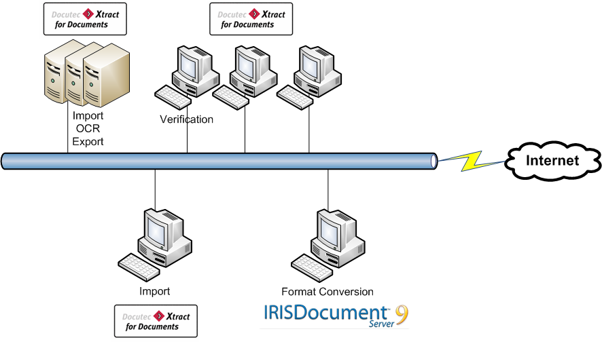
OCR technical architecture

Slide 30
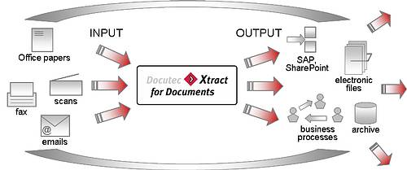
Xtract For Documents
With Xtract for Documents (X4D) documents can be sorted, into separate document categories and assigned to the various business processes. After the documents have been assigned, the automatic extraction of the data necessary for the respective business process is carried out by means of X4D and the collected data is then transmitted for further processing into the EDP system.

Slide 31
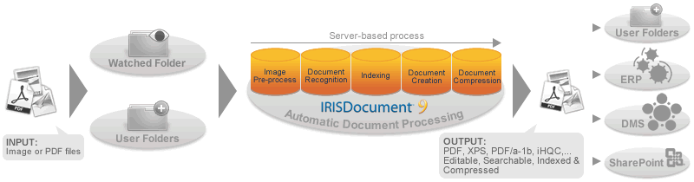
IRISDocument Server
Input, Watched folders, Batch folders & Image pre-processing
Sorting
Indexing
Automatic process
Recognition (OCR), Document Creation and Compression
Export Connectors.

Slide 32
Do more with less, while reducing your carbon footprint
Greater availability / accessibility of scanned documents
Saving on storage space / heating.
Notes:
IRIS

Slide 33
They already put their trust in our know-how …
European Commission
European Publications Office
DG HEALTH
DG TREN (EEA)
European Investment Bank

Slide 34
Questions and Answers

