Slide 1

Digital Mailroom Solutions
sort, classify, index and process with Xtract for Documents

Slide 2

Your Referee
Frank Tiedt
Director Partner Sales
Partnermanager I.R.I.S. AG
I.R.I.S. AG
Heussstrasse 23
52078 Aachen
Telefon +49 (0)241 92035 - 0
Telefax +49 (0)241 92035 - 50
Mobil +49 (0)172 2042130
E-Mail frank.tiedt@iriscorporate.com
Notes:
Moderation - Skript – Slide 2:
To give you an orientation why it will be a valuable presentation for you, I want to intruce myself shortly:
My name is Frank Tiedt and I am the indirect channel sales of I.R.I.S. AG: or shorter Partner Sales Manager
Responsible for all aspects around Intelligent Document Recognition (IDR) and classification formally known as data capture !
Today I am actual your referee, but after the presentation available around the IRISLINK mostly around our boothes, but of course everywhere if you can catch me.
Why we are here today ?
>>>Change to Slide 3

Slide 3
I.R.I.S. P&T – Facts for competence
Founded 1987, Louvain-la-Neuve, Belgium
Indirect oriented for professional solutions since 6 years, > 400 clients
Strong Software Developer core → All from one source
Products, Solutions components and big projects: I.R.I.S. is unique
(„Quote Canon“)
International company targeting the World-Wide market
More than 500 employees; 100+ developers
Notes:
3
Moderation - Skript – Slide 3:
Normalerweise wird jetzt immer von die eigene Firma gepreist, ich will nur auf folgendes fokussieren:
Dazu an dieser Stelle nur eins: Über 400 produktive gemeinsame Installationen mit unseren Partner.
Kein Spamfilter, sondern ganzheitliche Lösungen für unternehmenskritische Geschäftsprozesse.
Wenn es also nicht klappt mit der Produktion können relevante Schäden für die Unternehmen entstehen !
In diesem Bewusstsein stehe ich hier !
Worum geht es jetzt ?
>>>Change to Slide 4

Slide 4
Solutions around mailroom: Why ?
Digital mailroom is a term used to describe the automation of incoming mail processes
Using document scanning and document capture technologies companies can digitize incoming mail and automate the classification and distribution of mail within the organization.
Mail volumes continue to grow exponentially.
For example, medium sized companies now process 100,000 pieces of mail a month and service over 200 departments.
US businesses spend over £300 billion annually turning the information on the documents they receive every day into useful data that they can use to run their business
So let us take a piece of action !
Notes:
Moderation - Script – Slide 4:
Mail volumes continue to grow exponentially, stimulated by business growth and mobile work forces. For example, medium sized companies now process 100,000 pieces of mail a month and service over 200 departments. In addition, the corporate mailroom, a vital link in the corporate information system, is struggling to keep abreast of this paper flow. Meanwhile, today's organisations demand instant, accurate information; US businesses spend over £300 billion annually turning the information on the documents they receive every day into useful data that they can use to run their business
>>>Change to Slide 5

Slide 5
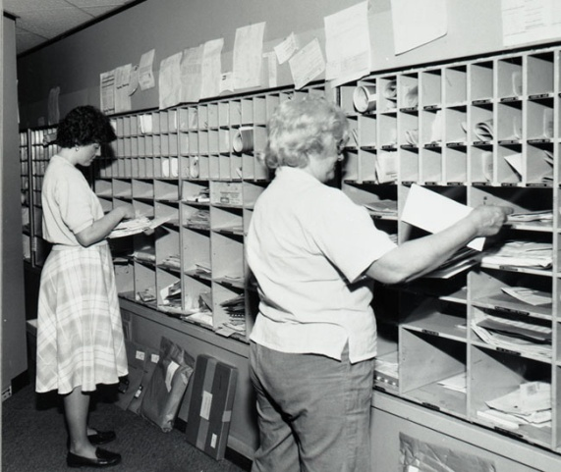



We provide Solution for digital Mailroom
Mailpost distribution
Electronic files indexation
Complete Business processes
I.R.I.S. Xtract Platform … one fits all!
Notes:
Moderation - Script – Slide 5:
Beleglesung stiftet Nutzen, lässt sich rechnen !
Der eine oder andere setzt solche Module schon ein, kennt Anwendungsbereiche.
Hier und jetzt ein Blick auf auch für sie weitere Anwendungsfelder.
A,b,c
Investitionssicherheit, eine Plattform.
Beliebiger Startszenarien möglich
A few impressive reference customers !
>>>Change to Slide 6

Slide 6



Digital Mailroom & Electronic Files - why?
There are many reason, here is another one:
I.R.I.S. solutions = „Anti-Spam“
Werner Schultheis
Director ICT
Randstad Deutschland
1000‘s of docs each day
10 %
- Configuration
Garnishment of
wages
- Dismissal
- etc...
100 %
Business
process
90 %
Electronic
files
With XClassify we now manage 70 000 employees in our HR departement
instead of 23 000 before with the same ressources!
Notes:
6
Moderation - Script – Slide 6: Randstad
xy
>>>Change to Slide 7

Slide 7
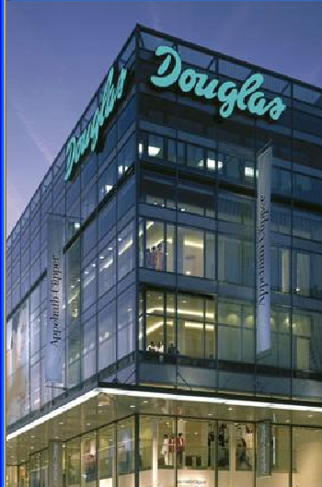

Digital Mailroom and automatic invoice processing
With growing maturity of the recognition products
there is gaining automatization
>65 % (Saving potential)
Central Post
Mailroom
Departmental
Mailroom
Pre-work for
processing
Data capture
and Check
Content
check
processing
Acceptance
Accounting
Following steps
>35 % (Saving potential)
„Today we have an internal service department that takes care for the correct capturing of 1.7 mio invoices a year.“
Petra Wagner, Douglas
Notes:
Moderation - Script – Slide 7: Douglas
xy
>>>Change to Slide 8

Slide 8


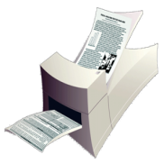
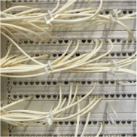






Practical Solutions - Mailroom
Letters
Digitalization
Electronic
Transmission
E-Mail
Other
Fax
Manual Operations
Automatic Recognition,
Classification and Indexing
Archiving and Processing
in ECM-Systems
Notes:
Moderation - Script – Slide 8:
Es geht um Beleglesung !
Einige Worte zur drunterliegenden Technik
>>>Change to Slide 9

Slide 9

Statistics on a gut level …
STATISTIK|LERNEN|ROCCHIO|XTOKENS|XFINGERPRINT|XCONTEXT|ARCHITEKTUR
„Statistics: If the huntsman misses the bunny twice – left hand and right hand, then, on average, the bunny is dead.„
[Unknown author]

Notes:
Moderation - Script – Slide 9:
Ich werde oft gefragt, wie macht Ihr das eigentlich technisch, was hebt euch auf dieser Seite vom Wettbewerb ab.
Die 250 Folien tief technisch erspare ich Ihnen, nur Folgendes möchte ich Ihnen mit auf den Weg geben:
…
2 Dinge ergeben sich daraus:
a.) Der Vortragende hat selber keine Ahnung, wie das im Detail geht.
b.) Das Beruhigende ist, auch sie müssen das nicht im Detail wissen:
- Es geht darum sicher, effizient und kontrolliert Klassifikationsaufgaben zu lösen. Nicht mehr und nicht weniger. Das haben wir in über 50 Klassifikationsprojekten nachgewiesen, und das möchte ich Ihnen zeigen.
Das virtuelle Unternehmen
>>>Change to Slide 10

Slide 10

Valuable Solution Packages
Pre-defined solution configurations
driven by
applications for business processes.
Highly optimized extraction rule set.
Integrated business logic in line with the business process.
Rule sets and business logic have been successfully
confirmed in great many previous implementations.
Can be modified or extended due to customer specific
requirements.
Notes:
Moderation - Script – Slide 10:
Xy
>>>Change to Slide 11

Slide 11



Digital Mailroom
- sort, classify, index and process with Xtract for Documents
Business Process Solutions
Digital Mailroom Solutions
Solution Package
Accounts Payable
Solution Component
Capture Plus
Solution Package
Factoring
Solution Component
Forms
Solution Package
Healthcare
Solution Package
HR (Human Resources)
Solution Package
Orders
Solution Package
Banking
Solution Package
Tax
Solution Package
Personalized Mail
NEW:
Solution Package
Supplier records
Notes:
Moderation - Script – Slide 11:
Xy
>>>Change to Slide 12

Slide 12


Solution Packages in Progress
Solution Package Immo
  Digital Mailroom for residential trade and industry
Solution Package Energy & Water
  Digital Mailroom for municipal energy supplier
Solution Package Member Record
  Digital Mailroom solution for Health insurances
Solution Package Patient record
  Digital Mailroom solution for hospitals
Solution Package Baan/Diamant
  Accounts Payable Packages for dedicated financial systems
… your individual solution module …
Notes:
Moderation - Script – Slide 12:
Xy
>>>Change to Slide 13

Slide 13





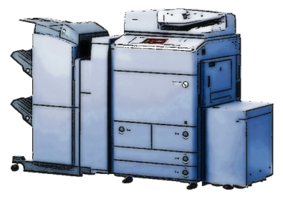

Mailroom solution with Solution Packages
CUSTOMER
CARE
Solution Package
Personalized Mail
Solution Package
Human Ressources
HUMAN
RESSOURCES
Solution Package
Supplier Record
Solution Package
Accounts payable
C
Solution Component
Forms
ACCOUNTING
DEPARTMENT
MAILROOM
PURCHASING
DEPARTMENT
Notes:
Moderation - Script – Slide 13:
Xy
>>>Change to Slide 14

Slide 14
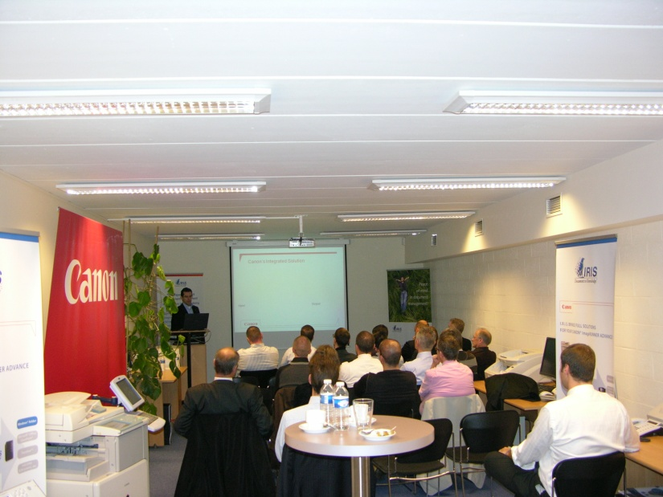
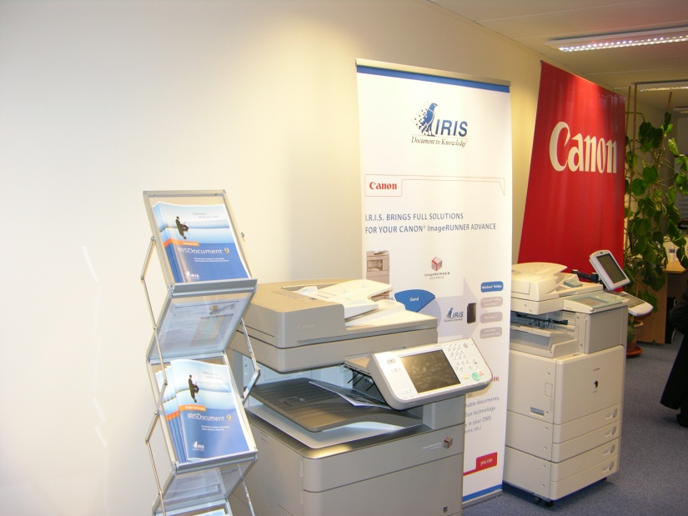
Visit us in the showroom area
All mailroom Solution available
I.R.I.S. products
  IRISPowerscan 9
  Xtract for Documents
  IRISDocument Server
Partner Technologies
  SAP Workflow
  InoTec Scanning Technology
  Canon: MFP, Scanners
Notes:
Moderation - Script – Slide 14:
Xy
>>>Change to Slide 15

Slide 15


Conclusion for 2010
Attack Mailrooms Processes – We are ready
Thank you for your attention !
Frank Tiedt
Director Partner Sales
tel. +49 (0)241 920 35 30
fax. +49 (0)241 920 35 50
mobil +49 (0)172 204 21 30
IRIS AG
Heussstrasse 23
52078 Aachen
Frank.Tiedt@iriscorporate.com
www.docutec.de
Notes:
Moderation - Script – Slide 15:
Xy

