Slide 1

Best Practice and Pragmatic Approach : Implementing Content Based Business Processes
Giuseppe Contino

Slide 2

About BPM Categories
Human-intensive processes
  People-intensive processes: processes that have a high degree of human interaction, need for human intuition or judgment, and a high rate of exception handling
  Decision-intensive processes: complex processes involving gathering information, automatic and manual scoring of customers or loans, and mission-critical decision-making with the help of a rules engine.
  Document-intensive processes: processes that require users to review documents for approval, enter data from those documents into a back-office system, and make decisions.
System-intensive processes
  Integration-intensive processes : processes involving transactions among systems on a straight-through basis with minimal human involvement.

Slide 3

What’s a good BPM implementation ?
BPM is Incremental
  no need to conquer everything at once; quick wins evolve into big results
BPM is Measurable
  metrics and measurements track a real impact on business performance & visibility
BPM is Repeatable
  delivers compound benefits & sustainable competencies

Slide 4

Step 1: Validate the Starting Point
Seek processes that are manual, paper-intense, ad hoc, inconsistent, etc.
Look for immediate & recognizable pain points
Ensure the process maps directly to a key organizational objective
Avoid overly complex or highly distributed processes
Confirm executive sponsorship for the selected process area
CHOOSE PROCESSES THAT
OFFER STRONG POTENTIAL
FOR VALUE
New customer intake
Contract management
Case management
Procurement
Product change reviews
Instilling control & visibility for compliance

Slide 5

Step 2: Benchmark the Current Process State
Examine the what, when, and by whom
Interview key stakeholders & process participants
Identify process origins and rationale behind how things are done
Focus on the “gaps” between activities, between people, and between systems – these are areas of opportunity for BPM
BE SURE TO ACCURATELY
DEFINE YOUR BASELINE
Identify key activities
Map out individual roles
Define flows of work
Ask questions such as: “What are you waiting on most often?” & “How could the process be improved without changing your job?”

Slide 6

Step 3: Define Performance Metrics
DEFINING METRICS IS THE MOST CRITICAL STEP IN BUSINESS CASE DEVELOPMENT
If you can’t measure it,
you can’t improve it.
And if the metrics you are measuring are not important to the business, the effort will likely fail.
Outline clear, well-defined goals for the BPM project
Define success criteria – how & when will success be measured
Ensure the success criteria are agreed to by all stakeholders
Identify specific metrics that are measurable and can be mapped to corporate objectives – you will need to capture and monitor these during the BPM implementation

Slide 7

Step 4: Develop a ROI Model
Look for measurable impacts – avoid tiny numbers
Blend “hard-euro” benefits with “soft” strategic and operational benefits
Understand the complete cost of BPM – it is not just software;
Leverage existing skill sets; prioritize in-house business expertise over in-house programmers
ROI models should show 3-5 year projections – discount cash flow using agreed to cost of capital
RETURN ON INVESTMENT (ROI) IS NOT JUST ABOUT CASH
Cost savings and revenue generation are important;
But visibility and agility offer greater strategic value – be sure to highlight these benefits.

Slide 8
Summary – first part
A strong business case is a MUST for justifying BPM.
This 4-step approach to building a business case provides a framework for focusing your efforts.
The first BPM project will require the most justification – incremental projects will be “mini” business cases, but each project should have a defined set of metrics for measuring success.
Your long-term, strategic value will come from a repeatable approach to process improvement that can be extended across the enterprise.

Slide 9
Implementing a content based process

Slide 10
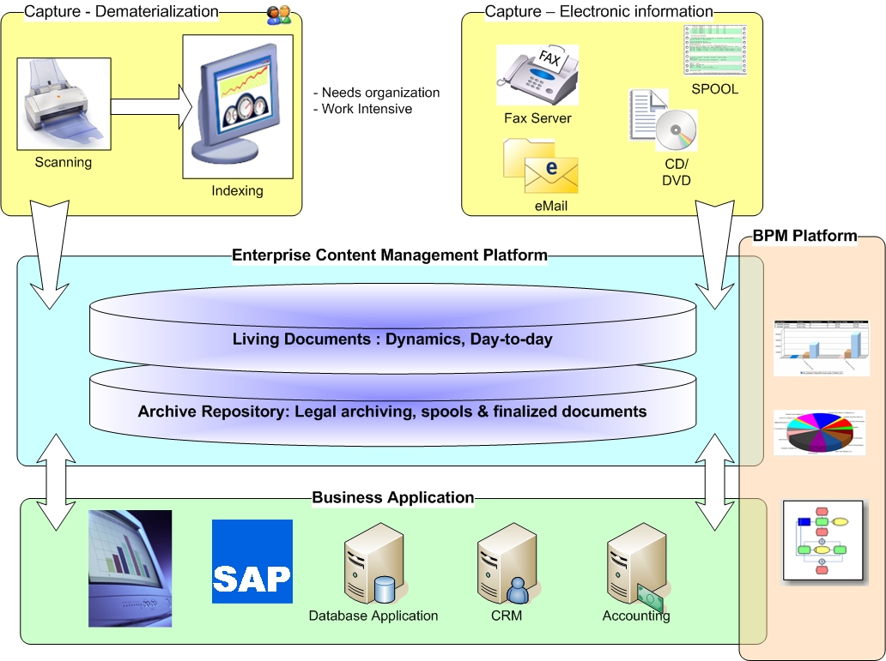
Sample overview

Slide 11


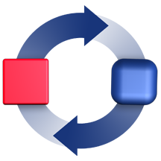




Most of Your Processes Involve Content
Web Pages
Forms
Electronic Documents
Reports
Paper Documents & Files
Photos, Graphics, Video
Business processes
Decision are based on information
Email
BPM &
Enterprise Applications
Fax
Notes:
Content is the information that drives business and enables better, faster decision-making. Content can be structured, semi-structured or unstructured information that can be “static” and/or “dynamic”. Content is everything from simple emails and instant messages to complex forms, contracts, reports and manuals. It also comprises scanned images and electronic documents, rich media, XML and even business processes.
Content is the information that drives your business and enables better, faster decision-making
Typically, this is unstructured information
Both “static” and “dynamic”
From simple emails and instant messages to complex forms, contracts, reports, and manuals
From scanned images and electronic documents to rich media, XML, and even business processes
But, more and more frequently, this includes structured and semi-structured information

Slide 12
Step 1 – Content matter
Define Content (Documents, Folders, Forms) involved during the process
Define what’s the main content element which trigger the start point
Identify what are the process metadata (vs Content Metadata) and how they are filled-in
You can see a content based process as a box containing different kind of content

Slide 13

Step 2 – Actors matter
Define how process steps are going to be processed
  One person
  One group existing in the company directory
  One business group which doesn’t exist in the company directory
  One work pool
  A system
  A script
Once it’s clear: check that actors has (or will have) the right to deal with the information concerned by the process

Slide 14

Step 3 – Component matter
Define what are the system/automatic operation and what are the human operation
Identify operation that could be generic in order to reuse them in other process
Create a shared process component library to place all generic action
Try to have service based system action in order to limit debug and process failure handling
Without using this approach, you’ll lose many benefits of BPM platform

Slide 15

Step 4 – Pragmatic assembling
Make a first version of the process involving only the system operation in order to test the back-end services (you’ll not have to explain to a system why your process is not working…)
Make a second version of the process in parallel involving only the human operation step in order to validate the chain in one interactive session with the key users
Finally make an assembly of both beta process in order to get a first functional version
This step will make you win a lot of time and avoid a lot of explanation

Slide 16

Step 5 – Production
Make a formal review with the key users once a month to identify production improvement or issues
Produce weekly report based on the KPI (defined by the business) and publish them to the users as well as the management
Monitor system performance to handle capacity overload or bottleneck in the process engine
Make a first ROI estimation after 6 month

Slide 17

Summary
Once the strong business case is made, you should involve the key user to deliver pragmatic process thanks to few steps before going in production
Communication with the business is key to success
Reporting on the KPI is very important for all stake holders
The most important and the more difficult:
  FIND THE BEST WAY TO MAKE IT SIMPLE
Spent time finding a simpler way to achieve a business process

Slide 18

Thanks!
Q&A
Giuseppe.contino@iriscorporate.com
+352 691 497 535

