Slide 1

A Business solution for your account payable capture process
David Dejean

Slide 2

1 Mission
“providing the solution”
Our Mission is to provide you with an end to end business solution for your account payable process…
From paper to archive

Slide 3
Goal of this presentation
The goals of this presentation are
  to help you to understand the meaning of the terms “Accounts Payable Business Process”
  to help you by positioning an end to end business process instead of just some parts of the puzzle
  to help you help your customers to feel the pain of their current process and provide them with “the” solution
  to share with you 15 years of successful selling of this solutions
  But most important is to show you what the advantages can be....

Slide 4

Business Process Solution

Slide 5
Common understanding
A business process solution is a mix of several stand alone products that fits all in one but it is the solution that makes the puzzle completed and not only products…
A business process solution gives to you, to your customers the possibility to increase their productivity by decreasing their manual work.

Slide 6

Common understanding

Slide 7
Your customers pains
Today how does it work without this solution …
  Paper-based invoice verification takes time, especially with a decentralized structure
    Time saving
  Invoices disappear in drawers – causing cash discount
    Visibility
  Accountants kept busy with simple work – manual capturing of invoices
    Employees satisfaction
  Problems at quarterly & annual closings / liquidity planning
    Transparency
  Today high costs for personnal, paper archive, etc...
    Expensive
  Searching for specific invoices takes a long time
    Time Saving
  „paper tourism“ – many copies of invoices
    Efficiency
  Fast and accurate responses to invoices inquiries
    Efficiency and money saving
  Fast and simple access to any invoices
    Better control of the process
  many more…

Slide 8
Your customers needs
Today how could it work with this solution …
  Time Saving
    After Scanning all the invoices goes in an automated system even with decentralized location
    Automatic invoice retrieval
  Visibility
    Your customer has a continue access to his invoices data (before and after the workflow)
  Employee satisfaction
    With the automatic data extraction the accountants works is much more easier and convenient way
  Transparency, Efficiency and money saving
    The user gets an invoice and process status overview. (Reports and Monitoring)
    Once the invoice has been scanned no need in print it anymore. All goes through a digital screening ...... Space and cost savings....Digital vs Hardcopy
  Better control of the process
    Your customer will improve his supplier relationship and benefits from early pay discounts and eliminated late payments penalties

Slide 9
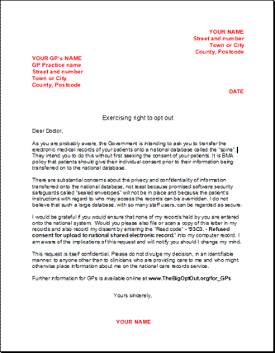
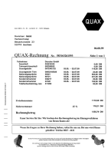



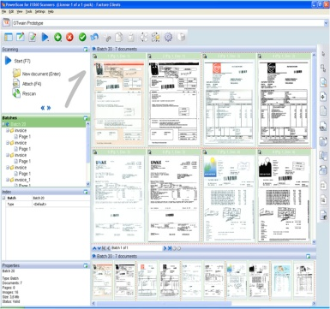









Our Business process solution
Send as PDF to archive
Scan pilot:
IRISPowerscan
Invoices
from scan
Automated integration in any ERP, CRM, workflow systems
Invoices
from Mail
Xmail Fetcher
Solution Package Accounts Payable
Invoices
from other sources
Data base matching and coherencies
Invoice

Slide 10
Xtract for Documents Solution Package Accounts Payable
Ad hoc fully automated recognition of electronic and paper-based invoices (no individual creditor learning mechanism) – No Template
  Deterministically training guaranties a continuous improvement of automation
  Automated orientated to local legal compliance rules
Individual country configuration in one Xtract system
  Dependent from country code analyze/extraction is adapted
  Country settings of the operating systems controls the language of the verify view (Dialogs, error messages, functions).
  Easy adaptable in various customer environments
  Life DB matching...
    Vendor recognition based on VAT number, bank number, IBAN,...
    Line items matching with your order
    Company code identification for multi-Company organisation
Xtract knows how an invoice looks like but also knows what informations are necessary for your invoice workflow system

Slide 11
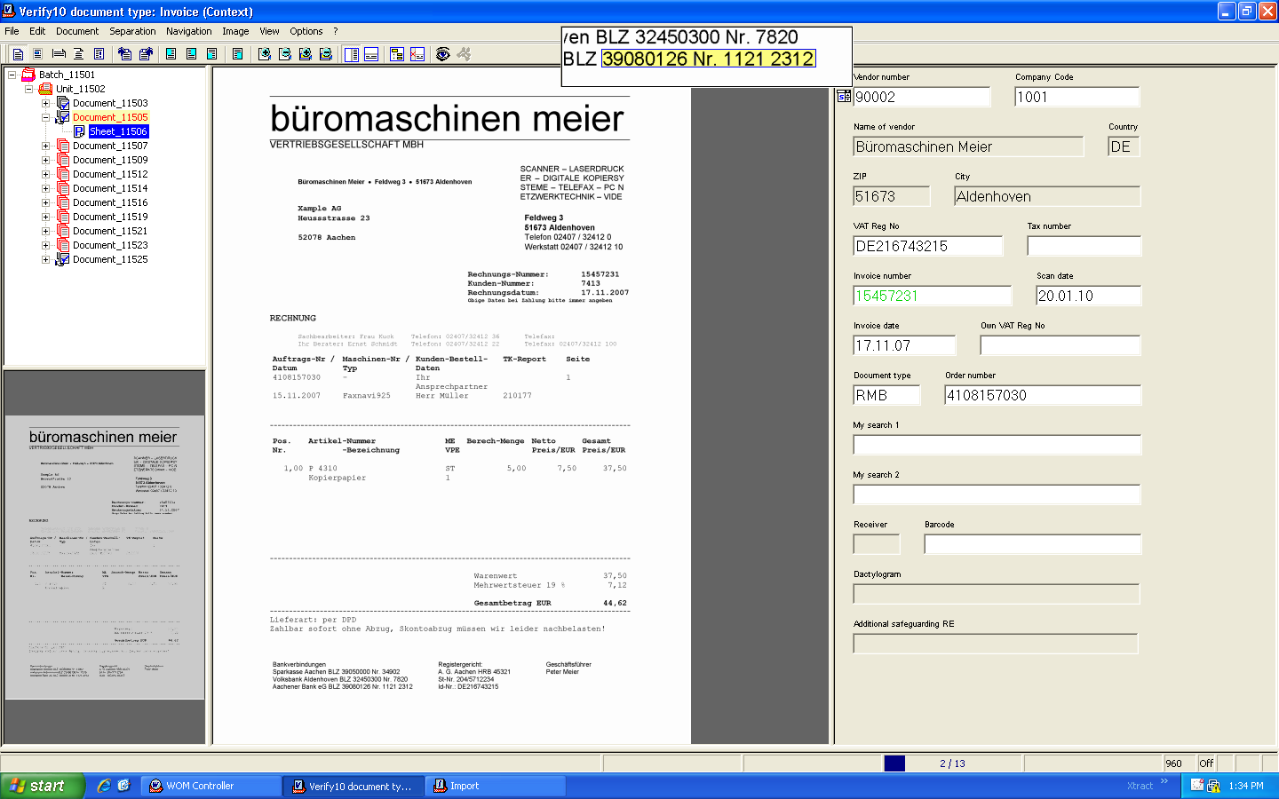
Recognition of a vendor number based on Bank Number
Automatic extraction of VAT, Invoice number, Invoice Date, order number

Slide 12
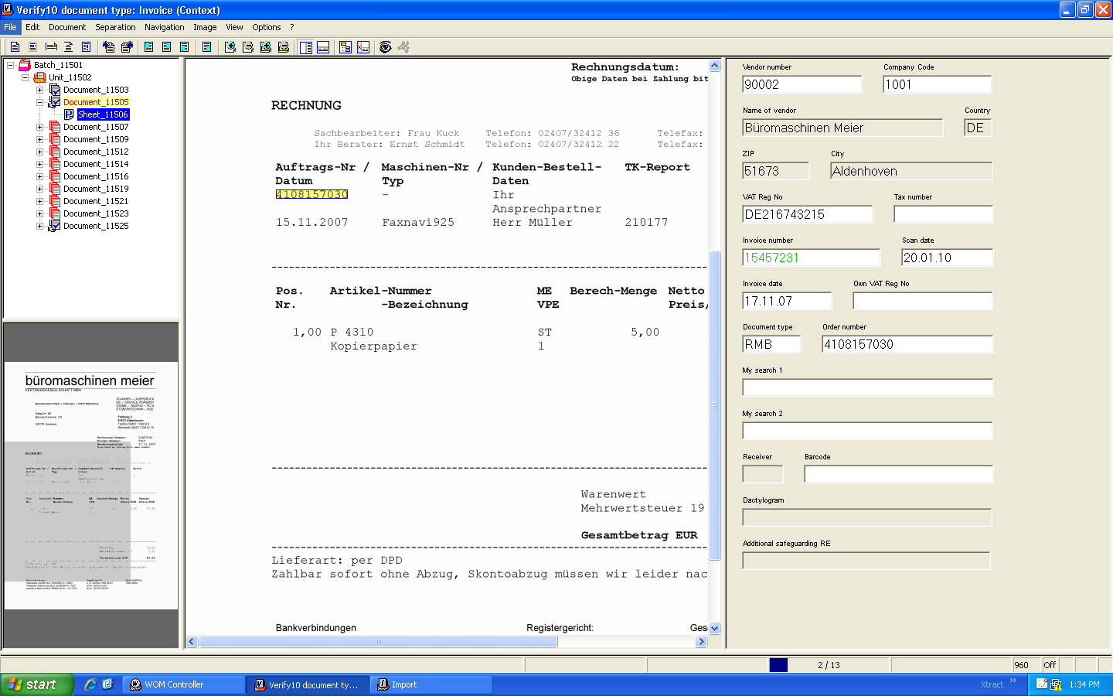
Order Number is extracted and checked with the ERP database for correspondence

Slide 13
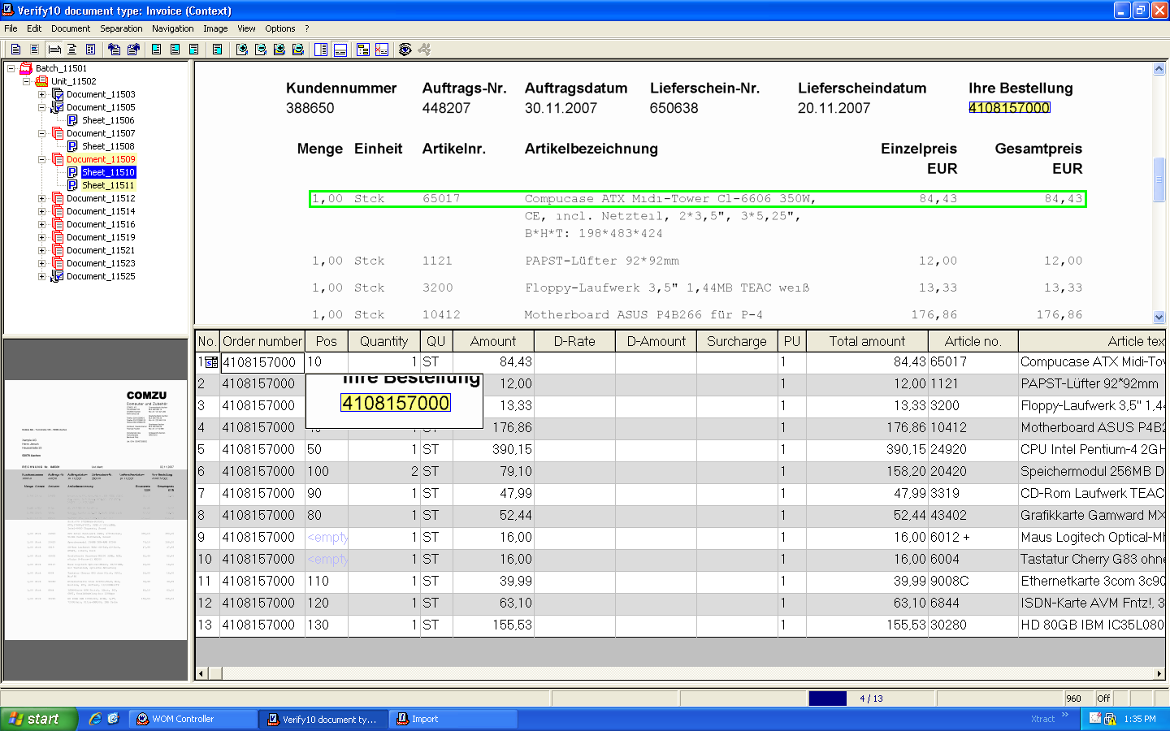
Line items are extracted from the invoice
Systems trainings are done directly by the user. (E.g. Article no and article text)

Slide 14
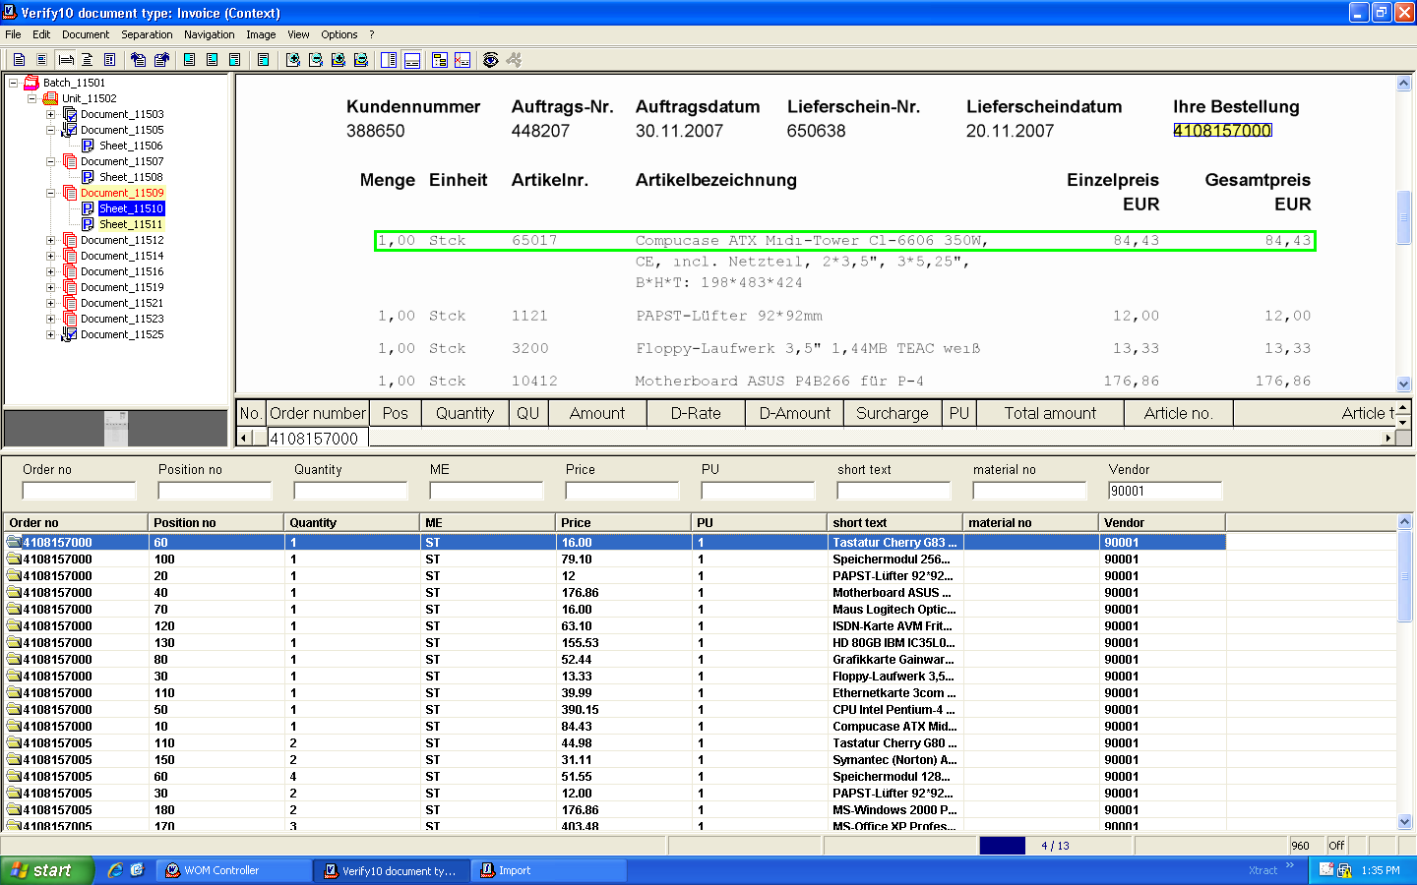
Data base matching can easily be done via the verification screen
Several order number can match for the same vendor

Slide 15
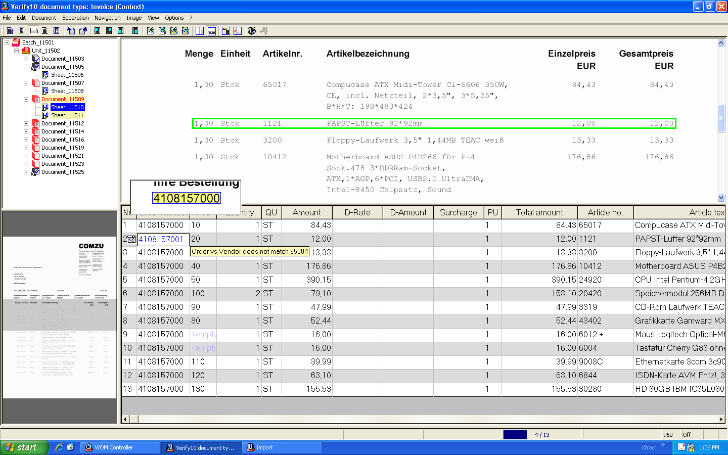
The system gives alerts when an extracted field doesn’t match with the Invoice workflow system information.

Slide 16
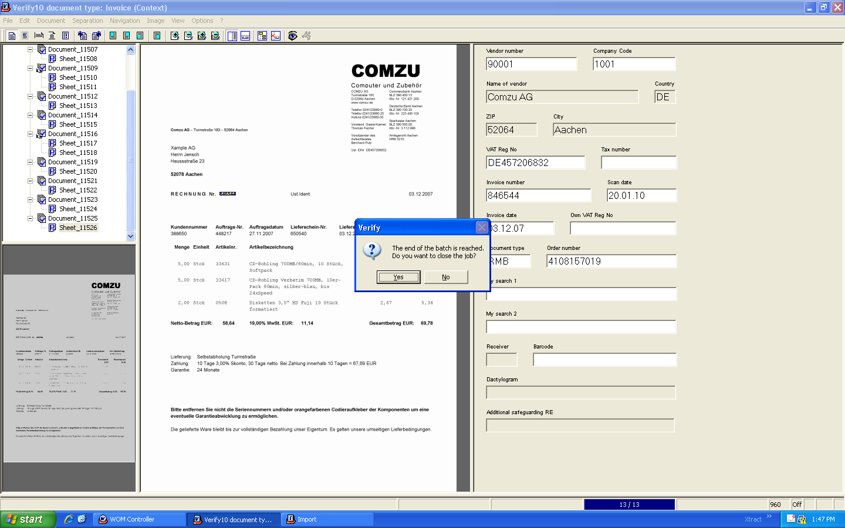
Once the batch is processed the system send automatically the metadata to the workflow. (including the image)

Slide 17


How to face your major challenge:
Do more with less, while reducing your carbon footprint
Decrease you manual work while processing your incoming invoices with a full automated system
Each incoming invoice is printed at least 5 times in a company without automated invoice processing….
think of the amazon deforestation…

Slide 18



So if you want to be...
,
and

Slide 19

Join us for a...
Invoice Business Process Solution

Slide 20
Thank you for your attention
And see you at our booth for a life demo

