Slide 1
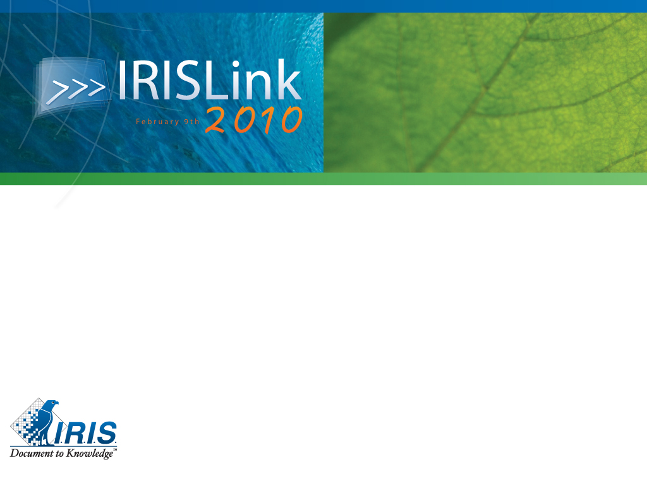
Storage Virtualization-
Storage as IT should be!

Slide 2
Agenda
What is Storage Virtualization
Why Storage Virtualization
What is SVC

Slide 3
Agenda
What is Storage Virtualization
Why Storage Virtualization
What is SVC

Slide 4




Storage Virtualization is . . .
Technology that makes one set of resources look and feel like another set of resources, preferably with more desirable characteristics…
A logical representation of resources not constrained by physical limitations
  Hides some of the complexity
  Adds or integrates new function with existing services
  Can be nested or applied to multiple layers of a system
Logical Representation
Virtualization
Physical Resources

Slide 5
Agenda
What is Storage Virtualization
Why Storage Virtualization
What is SVC

Slide 6

Why Storage Virtualization?
Not “just another way of helping manage SANs”
Storage virtualization complements server virtualization
  Both technologies help increase flexibility and speed responsiveness
Storage management used to be manually intensive, time-consuming and disruptive to the business
Storage virtualization with SVC can help change that to automatic, time-saving and non-disruptive to the business
Radically changes the way you think about and work with storage to make it fundamentally more flexible than just disk boxes alone

Slide 7
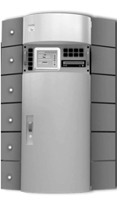

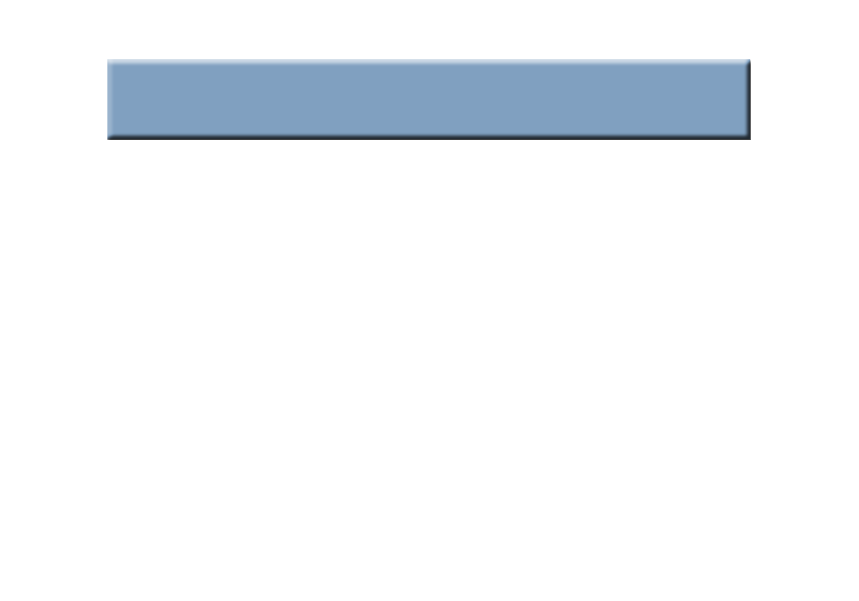



Infrastructure Simplification with SAN Volume Controller
Traditional SAN
Capacity is isolated in SAN islands
Multiple management points
Poor capacity utilization
Capacity is purchased for, and owned by individual processors
SAN Volume Controller
Combines capacity into a single pool
Uses storage assets more efficiently
Single management point
Capacity purchases can be deferred until the physical capacity of the SAN reaches a trigger point.
55%
capacity
25%
capacity
50%
capacity
SAN
SAN
95%
capacity
SAN
Volume Controller

Slide 8






Non-disruptive Data Migration with SAN Volume Controller
Traditional SAN
Stop applications
Move data
Re-establish host connections
Restart applications
SAN Volume Controller
Move data
Host systems and applications are not affected.
SAN
Virtual
Disk
SAN
SAN
Volume Controller

Slide 9

Business Continuity with SAN Volume Controller
Traditional SAN
Replication APIs differ by vendor
Replication destination must be the same as the source
Different multipath drivers for each array
Lower-cost disks offer primitive, or no replication services
SAN Volume Controller
Common replication API, SAN-wide, that does not change as storage hardware changes
Common multipath driver for all arrays
Replication targets can be on lower-cost disks, reducing the overall cost of exploiting replication services
FlashCopy®
PPRC
SAN
TimeFinder
SRDF
SAN
SAN
Volume Controller
SVC
IBM
DSx
IBM
DSx
EMC
Sym
EMC
Sym
IBM
DS8000
IBM
DS4000
EMC
Sym
HP
MA
IBM
S-ATA

Slide 10
Agenda
What is Storage Virtualization
Why Storage Virtualization
What is SVC

Slide 11
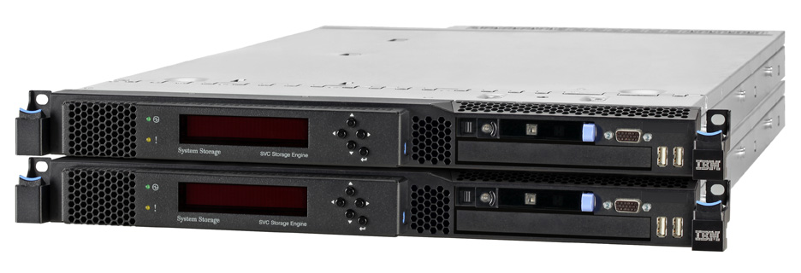
New SVC 2145-CF8 Storage Engine
New SVC engine based on IBM System x3550M2 server
  Intel® Xeon® 5500 2.4 GHz quad-core processor
  Triple cache size to 24GB (with future growth possibilities)
  Four 8Gbps FC ports
Bandwidth twice that of the Model 8G4
  Expect double MB/s and up to double IOPS of Model 8G4
  Significant price/performance improvement
  Enables support of more demanding and larger configurations with fewer SVC engines
Support for Solid State Drives (up to four per SVC node) enabling scale-out high performance SSD support with SVC
New engines may be intermixed in pairs with other engines in SVC clusters
  Mixing engine types in a cluster results in VDisk throughput characteristics of the engine type in that I/O group
Cluster non-disruptive upgrade capability may be used to replace older engines with new CF8 engines
Replaces the SVC 2145-8G4 engine as premier offering;
2145-8A4 Entry Storage Engine also available
Supported only by SVC software Version 5
2145-8G4 will be withdrawn December 11, 2009

Slide 12
SVC 2145-8A4 Storage Engine
More affordable SVC engine based on IBM System x3250 server
  Intel® Xeon® E3110 3.0 GHz 6MB L2 Cache Dual-Core processor
  8GB of cache (same as model 8G4)
  Four 4Gbps FC ports (same as model 8G4)
Throughput approximately twice that of Model 4F2 and about 60% the throughput of Model 8G4
  At about 60% the price of the Model 8G4
Primarily designed for use with new SVC Entry Edition software
2145-8A4 engine supports both SVC EE and regular SVC software
  Enables SVC EE customers to convert to regular SVC software to support growth but without replacing hardware
  Provides lower cost upgrade for current 2145-4F2 customers

Slide 13
Scale-Out SSD Support
Builds on IBM Quicksilver scale-out SSD demonstration
  Demonstrated feasibility of very high throughput, very fast response time system built on SVC
SSDs supported only in new Storage Engine
  May be factory or field installed
Up to four 146GB SSDs per SVC engine
  Control costs: buy only as many SSDs as required
    Minimum purchase: one SSD
Virtual disk mirroring used to protect SSD data
  Designed to protect against SSD or storage engine failure
  Up to 584GB mirrored capacity (1.2TB total) per I/O Group
  Up to 2.4TB mirrored capacity (4.8TB total) per SVC cluster
SSD fully integrated into SVC system
  Replication, data movement, management operate as for other storage
  Move data to/from SSD without disruption; make copies of SSD data onto HDD
  SSDs in one I/O Group (pair of Storage Engines) may be accessed through any I/O Group in SVC cluster
Tivoli Storage Productivity Center Intelligent Performance Optimizer can help identify candidate data for SSD

Slide 14
SVC: Innovative Scale-Out SSD Implementation
Add SSDs to scale capacity
Add SVC I/O Groups to scale throughput and add capacity
Add SSDs to SVC engines for more capacity
  SSDs may be added without disruption to engines
Add SVC engines for more capacity and throughput
  Additional engines provide more processing power, more bandwidth, more SAN attachments
  SVC designed to deliver maximum I/O capability of SSDs
  Up to 50,000 read IOPS per SSD
  Up to 200,000 read IOPS per SVC I/O Group
  Up to 800,000 read IOPS per SVC cluster

Slide 15
Innovative SVC SSD Protection Options
Mirroring between SSDs
in SVC Storage Engines
  Suitable for use with any workload
  Recommended general-use protection option
Mirroring between SSDs and magnetic disk
  Unique SVC protection option
  Maximizes available SSD capacity
  Suitable for workloads with primarily read I/Os
    Write I/Os are cached but write throughput ultimately limited by HDD ability
  Should be used only with well-understood workloads
Unmirrored SSDs also an option
  No protection against SSD or storage engine failure
  Maximizes available SSD capacity
  Not recommended
  Should be used only for easily recreatable data

Slide 16

Space-Efficient Virtual Disks (SEV)
Space-Efficient Virtual Disks function is the SVC implementation of “thin provisioning”
Traditional (“fully allocated”) virtual disks use physical
disk capacity for the entire capacity of a virtual
disk even if it is not used
  Just like traditional disk systems
With SEV, SVC allocates and uses physical disk
capacity when data is written
  Can significantly reduce amount of physical disk capacity needed
Available at no additional charge with SVC base virtualization license

Slide 17
SVC 5 Thin Provisioning Enhancements: Zero Detect
When using Virtual Disk Mirroring to copy from a fully-allocated virtual disk to a space-efficient (thin provisioned) virtual disk, SVC will not copy blocks that are all zeroes
  Disk space is not allocated for unused space or formatted space that is all zeroes
When processing a write request, SVC will detect if all zeroes are being written and will not allocate disk space for such requests
  Helps minimize disk space used for space-efficient virtual disks
  Helps avoid space utilization concerns when formatting vdisks
  Supported only on Model CF8 storage engines

Slide 18
iSCSI Server Attachment
SVC Storage Engines have two 1Gbps Ethernet ports
  Until now, one port per cluster used for management interface
SVC 5 enables use of these ports for iSCSI server connections
Storage attachment, intra-cluster communication and remote replication still use Fibre Channel
One port per cluster still used for management interface but not dedicated to this function
Helps reduce cost of server attachment
  May be especially helpful for BladeCenter configurations
    Eliminates need for HBA in blades
  Helps reduce number of FC switch ports required

Slide 19
iSCSI Server Attachment (continued)
All SVC function available to iSCSI-attached servers
Virtual disks may be shared between iSCSI and FC servers
Initial iSCSI server support
  RHEL SP 5.3, RHEL 4 update 6 (32 and 64-bit)
  SLES10 SP2 (32 and 64-bit)
  Windows 2003 SP1, SP2
  Windows 2008 SP1, SP2
  AIX 5.3, 6.1
  Sun Solaris 10
  HP-UX 11i V3

Slide 20



SVC FlashCopy® Function
Volume-level local replication function
Designed to create copies for backup, parallel processing, test, …
Copy available almost immediately for use
Background copy operation or “copy on write”
Up to 256 copies of a single source volume
Source and target volumes may be on any SVC supported disk systems
Up to 256 targets
FlashCopy relationships
Source vdisk

Slide 21


Incremental FlashCopy
FlashCopy capability where only changes from either source or target data since last FlashCopy operation are re-copied during a target refresh
Up to 256 incremental and non-incremental targets can exist for same source
Consistency groups can include both incremental and non-incremental FlashCopy targets
Helps increase efficiency of FlashCopy operations and can reduce time to refresh copies
Designed to allow completion of point-in-time online backups much more quickly, thus the impact of using FlashCopy is reduced
  May enable more frequent backups so enabling faster recovery
  More frequent backups could be used as a form of “near-CDP”
Start incremental FlashCopy
Data copied as normal
Later …
Some data changed by apps
Start incremental FlashCopy
Only changed data copied
by background copy

Slide 22

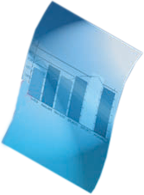

Cascaded FlashCopy
FlashCopy capability to create “copies of copies”
  Mappings can be incremental or non-incremental
Allows a vdisk to be both source and target in concurrent FlashCopy mappings
  See diagram: Map 2 can be defined and triggered while Map 1 relationship exists
Maximum number of targets dependent on a single source disk is 256. The example shows 4 targets from source disk 0
Enables backup of target disks to be made
without having to disrupt existing FlashCopy
relationships with original source
Helps reduce time to establish copies of targets,
since there is no need to await copy complete of
target disk before triggering cascaded copy
Designed to increase flexibility in use of FlashCopy
Map 1
Map 2
Disk2
FlashCopy
target of Disk1
Disk0
Source
Disk1
FlashCopy
target of Disk0
Map 3
Map 4
Disk4
FlashCopy
target of Disk3
Disk3
FlashCopy
target of Disk1

Slide 23



Reverse FlashCopy
FlashCopy capability to reverse relationships and enable rapid data recovery
Create disk backup copies of production data
(up to 256)
If backup required because of damage to production data
  Unique capability to create copy of damaged data for diagnosis
  Reverse FlashCopy relationship and copy backup to recover production data
    No need to wait for physical data movement to complete
  Backup or other tasks using disk backup copies not affected
Designed to speed recovery from damaged data
Create disk backup copies
source
target
target
Later …
Backup to tape can continue unaffected
1. Preserve damaged data
target
source
OR
target
2. Reverse FlashCopy operation
source

Slide 24

Space-Efficient FlashCopy (SEFC)
Combination of using SEV and FlashCopy together
Helps dramatically reduce disk space when making copies
Two variations
  Space-efficient source and target with background copy
    Copies only allocated space
  Space-efficient target with no background copy
    Space used only for changes between source and target
    Generally what people mean when they talk of “snapshots”
Space-efficient copies may be updated just like normal FlashCopy copies
SEFC may be used with multi-target, cascaded, and incremental FlashCopy
  Can intermix space-efficient and fully-allocated virtual disks as desired

Slide 25











Introducing Tivoli Storage FlashCopy Manager
IBM Tivoli Storage FlashCopy Manager provides replication integration between major server software and IBM disk systems and virtualized storage environments
Comparable with NetApp SnapManager and SMBR
  Operates with any storage supported by SVC
FlashCopy
Create instant application copies for backup
or application testing
Many replication options including
incremental (only changed blocks) or
space-efficient copies (“snapshots”)
DS8000
XIV
DS3/4/5
SVC
FlashCopy features differ between devices
FlashCopy Manager*
Integrated, instant copy for critical
applications
Virtually eliminate backup windows
Rapidly create clones for application testing
View inventory of application copies and
instantly restore
* Planned availability 4Q09

Slide 26
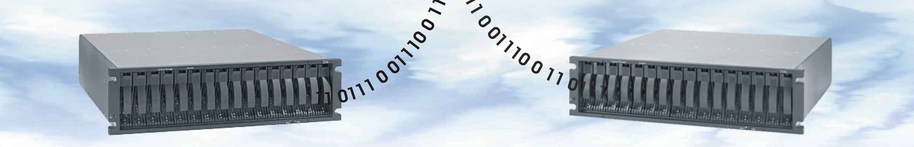
Virtual Disk Mirroring
SVC stores two copies of a virtual disk, usually on separate disk systems
  SVC maintains both copies in sync and writes to both copies
If disk supporting one copy fails, SVC provides continuous data access by using other copy
  Copies are automatically resynchronized after repair
Intended to protect critical data against failure of a disk system or disk array
  A local high availability function, not a disaster recovery function
Copies can be split
  Either copy can continue as production copy
Either or both copies may be space-efficient

Slide 27

SVC Metro Mirror Function
“Metropolitan” distance synchronous remote mirroring function
Up to 300km between sites for business continuity
  As with any synchronous remote replication, performance requirements may limit usable distance
Host I/O completed only when data stored at both locations
Designed to maintain fully synchronized copies at both sites
  Once initial copy has completed
Metro and Global Mirror delivered as single feature
  Offers great implementation flexibility
Operates between SVC clusters at each site
  Local and remote volumes may be on any SVC supported disk systems

Slide 28

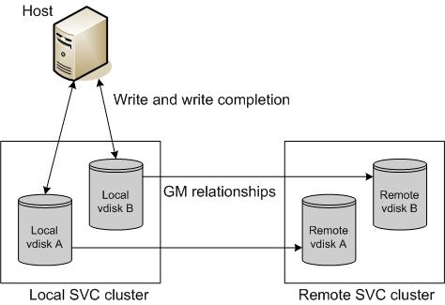
SVC Global Mirror Function
Long distance asynchronous remote mirroring function
Up to 8000km distance between sites for business continuity
Does not wait for secondary I/O before completing host I/O
  Helps reduce performance impact to applications
Designed to maintain consistent secondary copy at all times
  Once initial copy has completed
Built on Metro Mirror code base
Metro and Global Mirror
delivered as single feature
  Offers great implementation flexibility
Operates between SVC clusters at each site
  Local and remote volumes may be on any SVC supported disk systems

Slide 29





SVC Multiple Cluster Mirror Function
Enables Metro and Global Mirror relationships between up to four SVC clusters
  Any virtual disk is in only one MM/GM relationship
One possible scenario: consolidated DR site
  Up to three locations supported by one DR site
  Other scenarios possible
Max MM/GM relationships increased to 8192
Designed to support more flexible DR strategies
Helps reduce cost of DR
MM or GM Relationship
Consolidated
DR Site
MM or GM Relationship
MM or GM Relationship

Slide 30
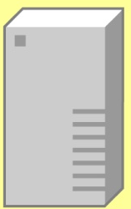
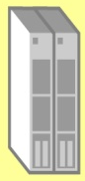
SAN Volume Controller Version 5
Supported Environments
IBM N series Gateway
NetApp
V-Series
IBM TS7650G
Microsoft
Windows
Hyper-V
IBM AIX
IBM i 6.1
HP-UX 11i
Tru64
OpenVMS
Linux
(Intel/Power/zLinux)
RHEL
SUSE 11
IBM
BladeCenter
IBM
z/VSE
Novell
NetWare
Sun
Solaris
SGI IRIX
Apple
Mac OS
1024
Hosts
VMware
vSphere 4
New
New
New
New
Point-in-time Copy
Full volume, Copy on write
256 targets,
Incremental, Cascaded, Reverse
Space-Efficient, FlashCopy Mgr
Native iSCSI
8Gbps SAN fabric
SAN
New
Continuous Copy
Metro/Global Mirror
Multiple Cluster Mirror
New
New
SAN
Volume Controller
SAN
Volume Controller
Entry Edition software
SSD
Space-Efficient Virtual Disks
New
New
New
New
New
Virtual Disk Mirroring
IBM
ESS,
FAStT
IBM
DS
DS3400
DS4000
DS5020, DS3950
DS6000
DS8000
IBM
XIV
DCS9550
DCS9900
IBM
N series
HP
MA, EMA
MSA 2000, XP
EVA 6400, 8400
EMC
CLARiiON
CX4-960
Symmetrix
Sun
StorageTek
NetApp
FAS
NEC
iStorage
Pillar
Axiom
Hitachi
Lightning
Thunder
TagmaStore
AMS 2100, 2300, 2500
WMS, USP
Fujitsu
Eternus
3000
8000 Models 2000 & 1200
4000 models 600 & 400
Bull
StoreWay
For the most current, and more detailed, information please visit ibm.com/storage/svc and click on “Interoperability”.

Slide 31
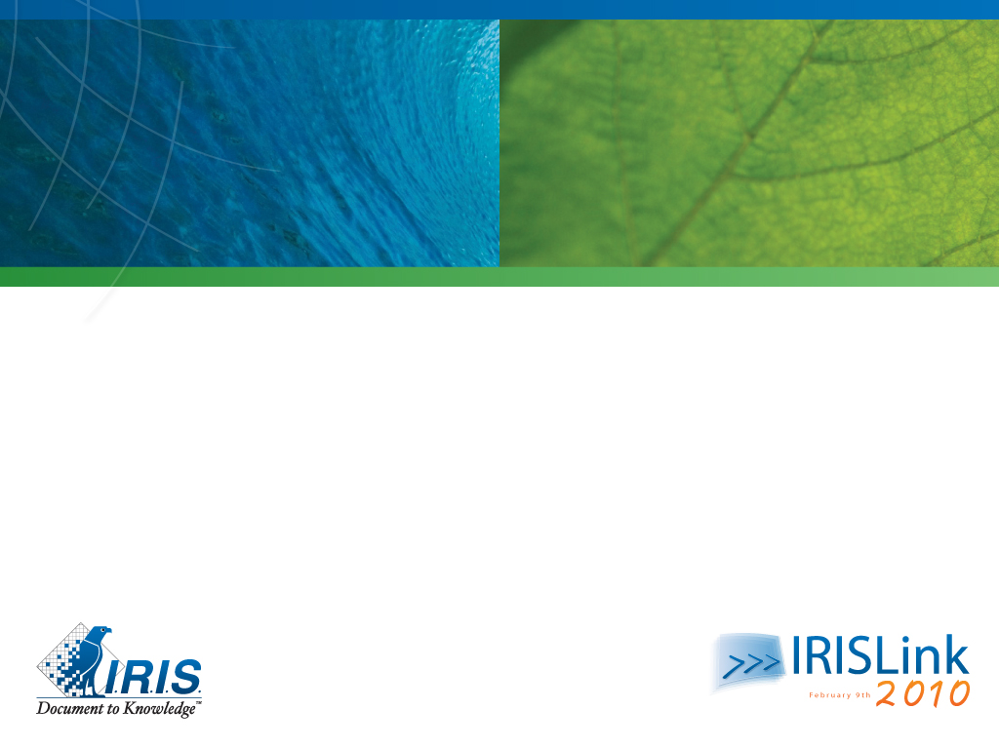

Questions?
Thank you

