Slide 1

Added-Value Entreprise Content Management
SaaS Offering

Slide 2

Eric BALZER
Business Developer ECM Verticals & SaaS
Esther NEFF
Key Account Manager
I.R.I.S. Financial Services S.A.
I.R.I.S. (Luxembourg) S.A.
11, route des 3 cantons
Bâtiment Alto
L-8399 Windhof Luxembourg
www.irislink.
Tel: +352 39 03 26 1
Fax: +352 39 03 26 99
Eric.Balzer@iriscorporate.com
CETREL S.A.
10, parc d’Activité Syrdall – L-5365 Munsbach
Tel : +352 355 66 225 • Fax : +352 355 66 7313 • GSM : +352 621 328841
E-mail: esther.neff@cetrel.lu www.cetrel.lu

Slide 3
Agenda
Setting the Scene
Today’s challenges
CETREL S.A.
Why CETREL and IRIS?
Why Saas?
Our Vision and Values
Our Offering
Functional Components
Technical Infrastructure
Pricing Strategy
Conclusion
Q&A

Slide 4

Today’s challenges
Intelligent management of constantly increasing information to be received, processed and archived
Increasing regulatory pressure and risk management requirements to make documents and workflows available upon request
Cost and productivity management to focus on core business
CETREL and IRIS have set up an ECM system to offer to local and international institutions a sustainable leveraged solution.

Slide 5
Introduction - CETREL S.A.
Founded in 1985, Turnover of 35 Mil. EUR in 2008, 180 employees
Ownership: 50% by SIX Group and 50% with the original founders of CETREL such as BCEE, BGL-BNP-Paribas, Dexia, Entreprise des Postes et Télécommunications, Banque Raiffeisen, ING et Banque de Luxembourg
Status PSF (Professionnel du Secteur Financier) granted by the CSSF (Luxembourg Financial Markets Authority) guarantees a secure and confidential processing of outsourced services and commitment (Discrepancies to SLAs brings to a tailored action plan, and eventually penalties)

Slide 6



Introduction - CETREL S.A.
Full Business Process Management for Payment Cards
Issuer and Acquirer Processing for Major Payment Cards
Specialized Premium Card Processor for Private Banking
Merchant service provider for Card Acceptance and POS Terminals
Collection and filing of legal reporting
Integration of Financial Data
Specialized IT services
Technical operator and user contact center for Multline and LuxTrust
Service provider for National and International Direct Debit solutions
Service provider for e-Archiving and e-Invoicing solutions

Slide 7


Why Cetrel and IRIS ?
CETREL
IRIS
Security of systems
Confidentiality of information
State of the art IT infrastructure
Sophisticated support and help desk services
Enforceable SLAs
Key player in the field of ECM and IDR in different industry sectors
Combination of Software Editor
and Integrator competencies
Strong local and international presence for consulting and delivering technical support
Dskalfjalfjdkasl
PSF Status: Establishing and maintaining a high-level standard of service quality, security and confidentiality.
A strong partnership combining complementary strengths.

Slide 8
Why SaaS ?
Software as a Service (Saas) is a model of software deployment whereby a provider licenses an application to customers for a use of service on demand.
Focus Budget on competitive advantage rather than infrastructure
Pay as you go – predictable costs
Add modules based on your requirements
Save money and time through Flexibility and scalability

Slide 9
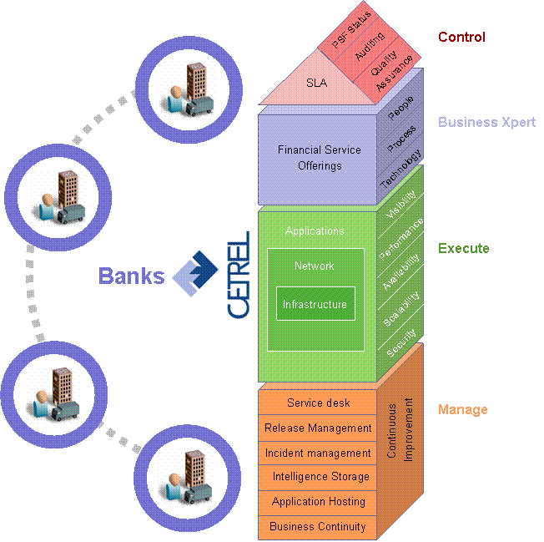

Our Vision and Values
Our vision: One stop shop application with modular and evolutive ECM environment in SaaS mode.
Our values:
    Optimization and industrialization of our clients’ non core activities
    Standardization
    Economies of scale
    Security and High availability
    (24x7 culture)
    Flexible pricing structure

Slide 10
Our offering
Much more than a technical solution
SUPPORT
Helpdesk
Monitoring
Service Level Management
Statistics
Legal watch
Business
Process
DRP / BCP
Modelling
Capture
On
Maintenance
-
Site Support
Services
Technology
Training
E.C.M
Compliance
Technology
Storage
watch
Resumption of
documents
IRIS
Network
high
availability
Management
Delivery
of
Secured
physical archives
File Transfer
Mission
Provide to local and international institutions a highly secured
archiving solution, in line with all regulatory
requirements, based on a real business added value solutions

Slide 11
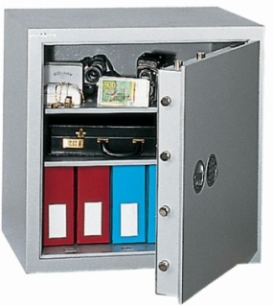


Functional Components –
3 levels of core services
Standard archiving
Content management and archiving
Content management and legal archiving
including records management

Slide 12
Our Offering – Functional Components
Standard Archiving
Content management and archiving
Content management and legal archiving including records management
Information that will not be subject to modifications.
Ability to archive multiple sources of information (COLD, email, scanned documents, archived collaborative spaces,…).
Secured (standard PKI certificates and signatures) and centralized archiving space with long-term storage management capabilities.
Search and browse through a classic web interface with full traceability and secured authentication.
Integration capabilities with your legacy application.
Reliable (24x24x7).

Slide 13
Our Offering – Functional Components
Standard Archiving
Content management and archiving
Content management and legal archiving including records management
Includes Standard archiving
Allow productive work with information (versioning, collaboration, reservation, document flow, annotations, dynamic file plan and more)
Integrated with desktop applications such as Microsoft office and open office
Allow storage of emails in business case with an added toolbar within Outlook
Enable export into self-running CD/DVD/USB Key to share information with third parties in a secured way
Offer multiple predefined set of vertical cases (HR, Customer files, etc) with associated workflows

Slide 14
Our Offering – Functional Components
Standard Archiving
Content management and archiving
Content management and legal archiving including records management
Includes Content management and standard archiving
Allow context linking with content for e-discovery and records management
Compliant with local regulation, norms and directives allowing you to destruct the physical version (coming in 2010)
Offer predefined set of retention/disposition rules
Store content on a legal storage space (compliant hardware and software)
Deliver certified processes for legal archiving and records management

Slide 15
Our Offering – Functional Components
Vertical ECM services
Standard Archiving
Content Mngt & archiving
Legal Archiving

Slide 16
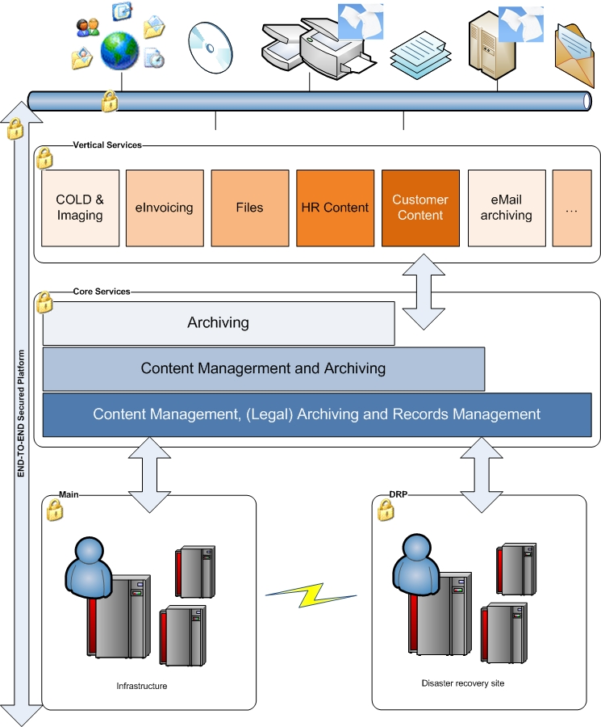
Our Offering – Technical Infrastructure
Fully segregated software infrastructure
ensures confidentiality of information
BCP/DRP infrastructure in cluster mode
Service 24/24 on two remote sites
High availability solution based on 2
applications running in parallel (BCL /Cetrel)
24/7 Monitoring and support and
dedicated service desk

Slide 17
Our Offering – Pricing Strategy
Monthly fee vs. Heavy investment (hard, soft, maintenance, internal costs)
Based on actual usage (document volume only) and not on user licenses
All level of services based on the same infrastructure warranties (DRP, clustered,…)
Client

Slide 18
Conclusion
CETREL & IRIS provide together a unique proposition in terms of SaaS ECM offering:
ECM and Business experience of IRIS
Infrastructure, security and reliability of CETREL
Comprehensive ECM services and offering
Reduced operational risk
Clear ROI and cost/productivity control
Increased Ease of Mind
Focus on your business, we take care of your information!

Slide 19


How to face your major challenge:
Do more with less, while reducing your carbon footprint
Do more with less by sharing a common ECM solution :
  Benefit from best-of-breed functionalities, highest level of service and security that you could not purchase and maintain on your own.
  Avoid investing in extra hardware, software and additional IT ressources.
  Reduce time-to-business for new functionalities or extra information volume.
…While reducing your carbon footprint :
  No need for extra hardware ressources this extra energy..
  Access information anytime, anywhere
  Save paper by optimizing electronic content management.

Slide 20

Thanks for your attention
Q & A

