Slide 1
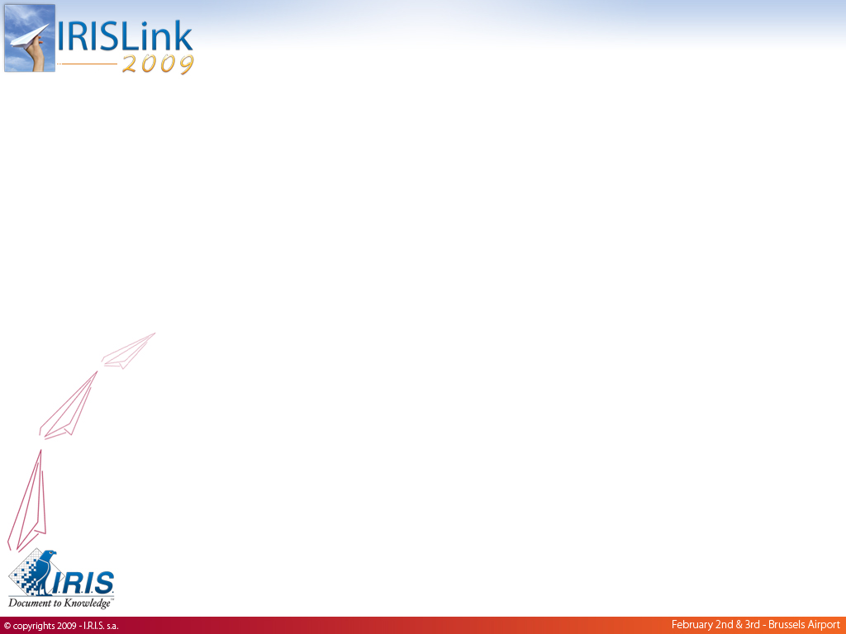
IRIS Virtual Desktop
Pieter Van den Abeele
Chief Architect
pieter.van.den.abeele@irislink.com

Slide 2
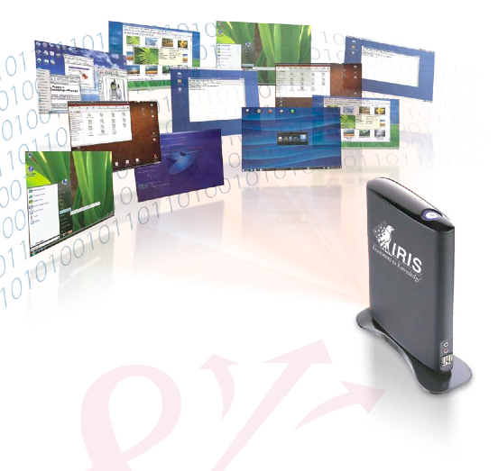
Agenda
Introduction
Announcements
Solution Roadmap
Services & Experience
Technical deep-dive
  Application management
  Desktop management
  Storage optimization
  Network optimization

Slide 3
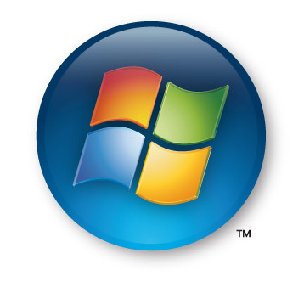

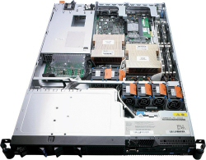
What is virtualization?
CPU:10%
CPU:10%
CPU:10%

Slide 4
What is virtualization?
CPU:10%
H
Y
P
E
R
V
I
S
O
R
VM
CPU:20%
CPU:30%
CPU:40%
CPU:50%
CPU:60%
CPU:30%
VM
VM
CPU:30%
VM
VM
VM

Slide 5
Virtualization: Value proposition
Hardware resources are typically underused.
Advantages of consolidating datacenter infrastructure:
  Make better use of server resources
  Increase performance per Watt (GREEN)
  Improve scalability, flexibility
  Reduce total cost of ownership
Virtualize to save money!

Slide 6

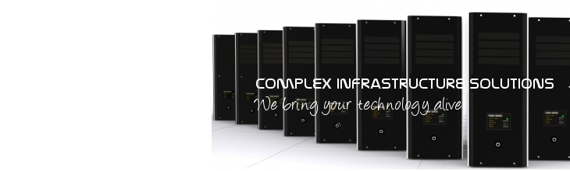





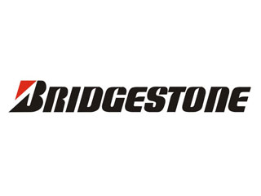



Virtualization: IRIS ICT
I.R.I.S. ICT was first to bring server virtualization to BeNeLux market in 2002, using the VMware ESX™ platform. We are a VMware VIP business partner.
We focus on Complex IT infrastructure e.g. Mainframe, UNIX, Linux, VMware, Storage. Virtualization is a core component of our business.
Several large customer accounts, success stories and awards.

Slide 7
Enterprise Desktop
As plenty of companies are virtualizing their server infrastructure, what is happening with the total cost of ownership of their IT infrastructure?

Slide 8
Enterprise Desktop
Server consolidation reduces total cost of ownership of entire IT infrastructure, but also increases share of the desktop.

Slide 9
Enterprise Desktop
The desktop has become the new focal point for efforts aimed at reducing Total Cost of Ownership.

Slide 10
Desktop Market Trends
Traditional PC
Thin Client
Desktop Virtualization

Slide 11
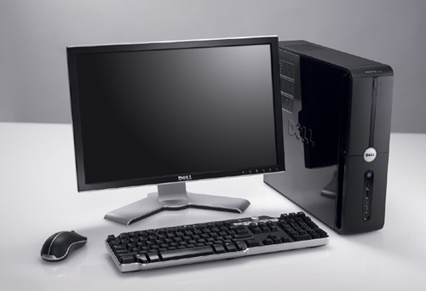
Traditional Workstation
Gigahertz race, Gigabyte race, Commodity
Tight coupling between Hardware and Operating System. (Vista migration issues)
Idle Power consumption >70Watt
3 year lifetime (Gartner)
Price Leadership strategy
Defines the “desktop” experience

Slide 12
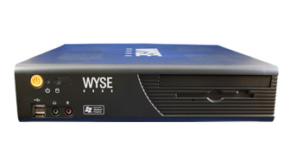
Thin Client
Thin Client market is hot, crowded and growing. Players include DevonIT, Wyse, Sun, IGEL and many others.
Vendor strategy: Price leadership with little or no differentiation going on.
Typically provides only a “limited” desktop experience.
Thin Clients are essentially commodity “mini-PCs”.

Slide 13
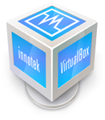



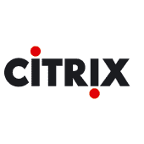


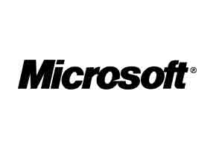
Desktop Virtualization
The virtualization market is hot, crowded and growing. Virtualization technology is becoming a commodity.
Players include VirtualBox, Citrix, VirtualIron, Vmware, Sun, Microsoft, Novell, etc.
Players providing only selected pieces of the virtualization “puzzle”

Slide 14


Desktop Virtualization
Several vendors provide a piece of the Desktop Virtualization puzzle.
When these pieces are combined, the resulting configuration typically faces a number of challenges:
  No multimedia support.
  No multi-monitor support.
  Limited desktop peripheral (USB, Serial, Parallel) support.
  Impact on the network.
  No single point of contact.
  Tight coupling to a specific Operating System
  Power consumption
  License cost
  …

Slide 15
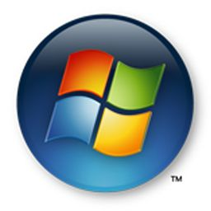


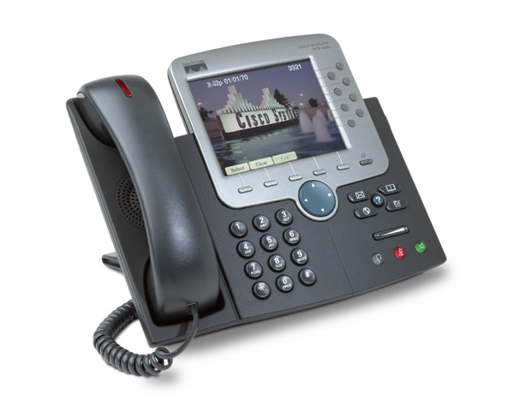
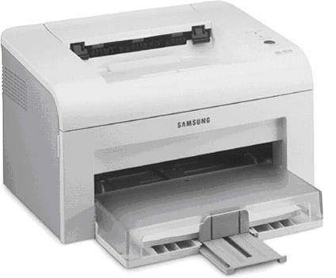
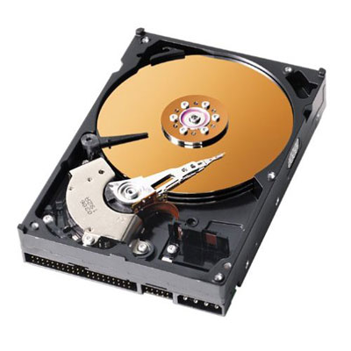
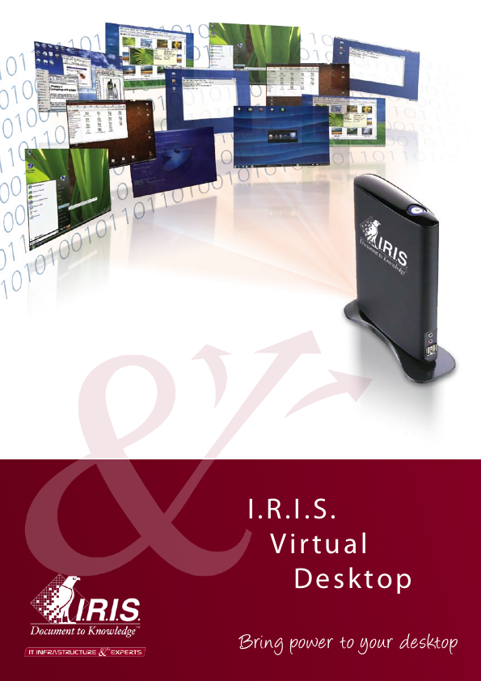
IRIS Virtual Desktop
IRIS Virtual Desktop (IVD) is an end-to-end solution for virtualizing the enterprise desktop.
IVD contains a substantial amount of IRIS Developed Intellectual Property aimed at solving the challenges IRIS Customers are faced with.
And more…

Slide 16




Reference Customers
Public Transportation:
Industry:
Education:
Government:

Slide 17
Ministry of Finances
All paper tax forms (personal & VAT) are interpreted using IVD.
100 Operators in Gent, Brussels and Namur.
WAN link
Tight integration with IRIS Capture Pro, FormIRIS, PowerScan.
Device support
Printing (3k pages/day)

Slide 18
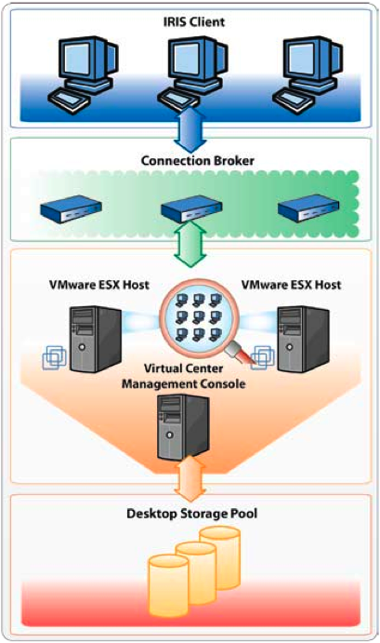
IVD Solution Architecture

Slide 19
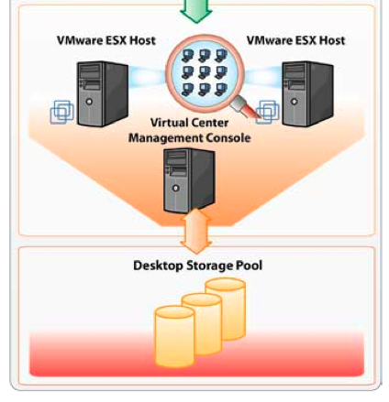
IVD Component: Centralized HW
Leverage proven IBM server virtualization technology.
Instead of server operating systems, we install desktop operating systems in the virtual machines.
Typically consolidation ratio is higher compared to server virtualization.
Shared storage Pool can be anything from NAS, SAN, SAS, FC to iSCSI.
Mixing storage types is possible (cost).

Slide 20
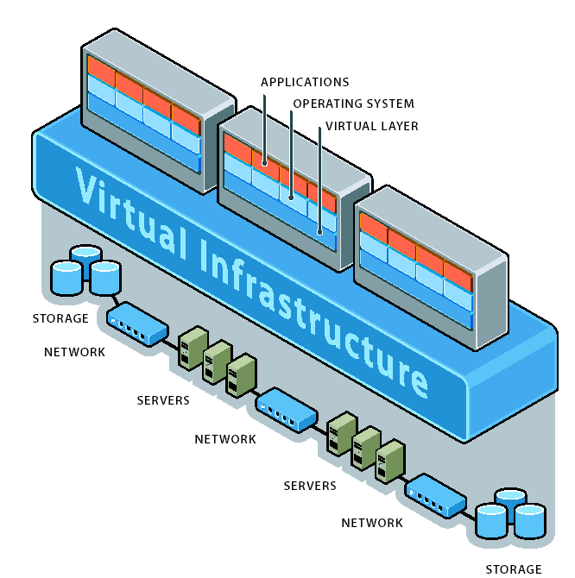
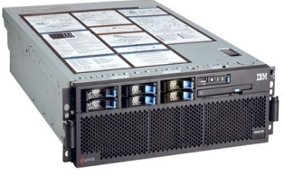
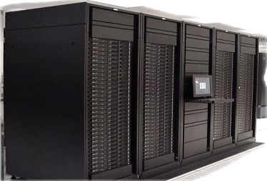
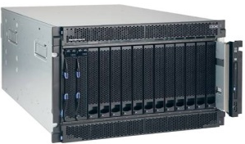
IBM System X - VMware
Scale Up
More efficient infrastructure
VMWARE & IBM
Joint development agreement
Best support offerings
Certified across entire family
Only solution with >4-way support
Scale-Out
Family of rack-mount in 1u or
2u World-class blade products
Scale out
More efficient infrastructure

Slide 21
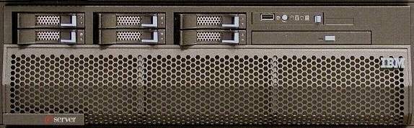

IBM scalability
16-way is realistic
Availability of six core cpu
Memory 256Gb
HW virtualization
Low Power consumption
OS Support
x3850 (4-way)
x3950 (4-way)

Slide 22

IRIS – Centralized HW
Storage: storage pool for the desktop environments – datacenter storage quality. Enterprise features available (replication, disaster recovery, thin provisioning, etc.)
Dedicated and certified servers for the IRIS Virtual Desktop Solution. Features such as memory, HBA, power supply, processors, etc. are configured to achieve an optimal consolidation ratio. (presales)

Slide 23
IVD Component: Storage
IBM nSeries – Storage Level de-duplication
IBM SVC – Thin Provisioning, Virtualization
Disk intermixing (SATA – SAS)
Fast, affordable storage DS3000 – D4000
Scalability (DS8000, XIV)
Tight integration with IVD (roadmap)

Slide 24
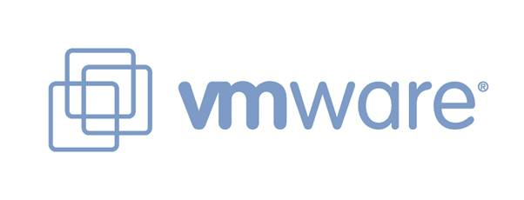
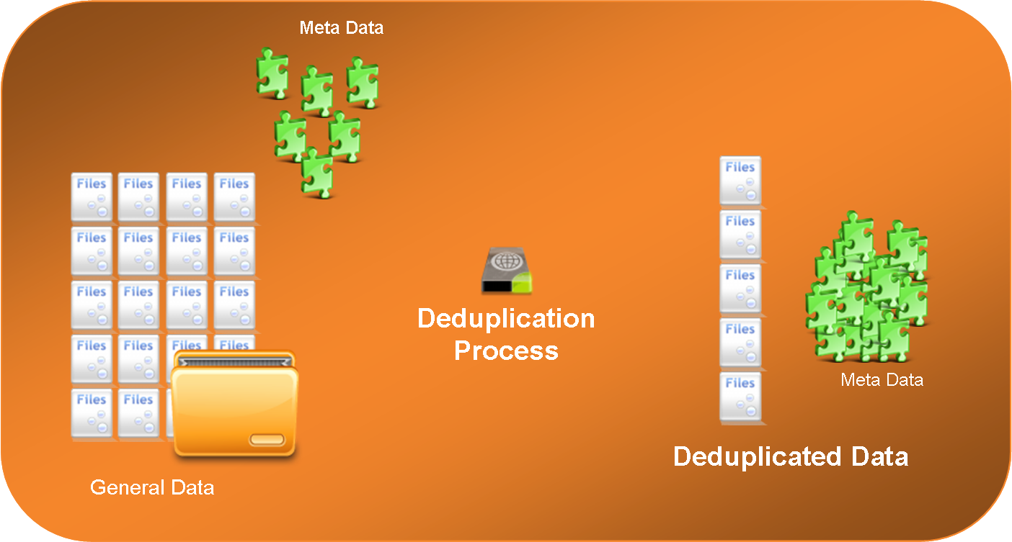
Announcing
IVD realtime OS De-duplication
De-duplication of Virtual Machines
Store only the delta versus a ‘master’ image
Based on proven VMware snapshot technology
Compatible with entry-level IBM storage

Slide 25
IVD Component: Virtualization layer
Also possible to connect Microsoft Terminal Server, IBM BladePCs,
3270 IBM zSeries, 5250 IBM iSeries, physical servers, LPAR,
Vmware ESX 3i, Server, etc.

Slide 26
Virtualization Layer Features
Memory Ballooning
Transparent page sharing
High Availability (HA)
Distributed Power Management (DPM)
Dynamic Resource Scheduling (DRS)
Vmotion

Slide 27
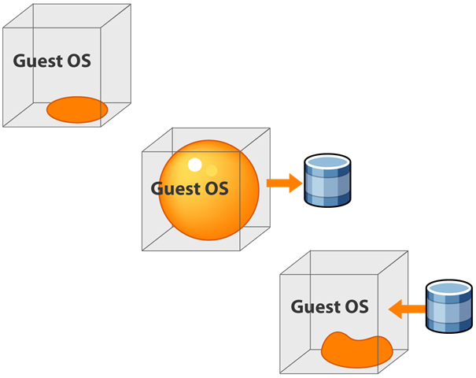
Memory ballooning
Operating systems tend to allocate all memory that is made available to them, even if they do not need it.
Vmware installs a memory management driver inside the OS.
Driver requests memory and gives it back to the hypervisor.
When the OS needs more memory, driver releases memory to the OS.

Slide 28
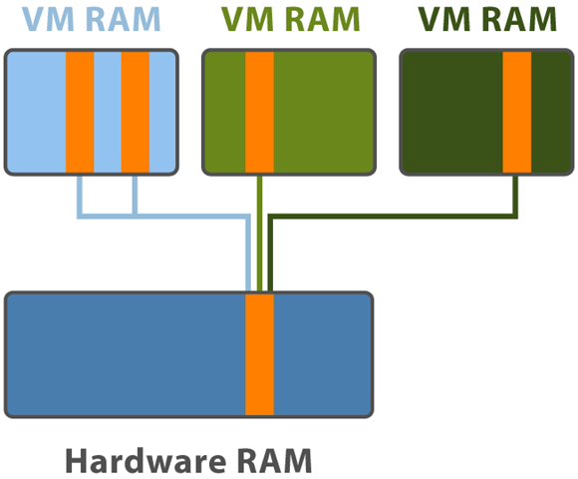
Transparent page sharing
Vmware hypervisor optimizes physical memory allocation at PAGE level.
Allows for a memory overcommitment. (i.e. more virtual ram in use than physical ram available)
The more VM’s on a server, the better the optimization.
No optimization across cluster.
IBM System X has several advantages : memory slots & scalability (E.g. 3950)

Slide 29
Vmware
Is the only virtualization layer on the market that allows for memory optimization / memory overcommit.
With Vmware you can have more virtual memory than physical memory.
Competing virtualization layers require you to have all the virtual memory as physical memory, which is expensive in a Desktop Virtualization context.

Slide 30
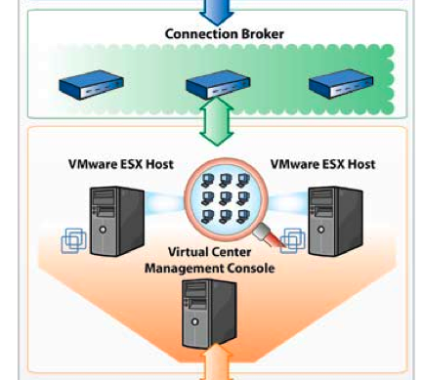

IVD Component: Desktop Broker
Virtual desktops need to be assigned to users.
User supplies username and password to the broker.
Broker points user to his/her virtual machine.
Broker is a virtual machine running Linux™ with a dedicated web application provided by LeoStream™.
Broker (optionally) talks to active directory and Virtual Machine management console

Slide 31
Broker facts
Vendor independent
Sold by IBM with BladePC
Appliance
Unparalleled scalability
No lock-in
Interchangeable
Cost

Slide 32
IRIS Virtual Desktop

Slide 33
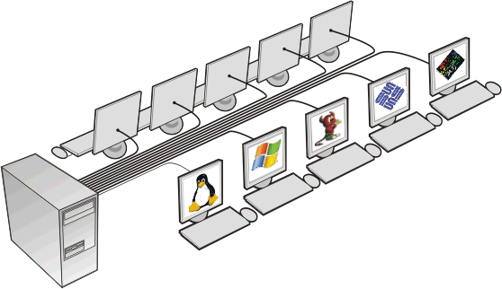
IRIS Client
A hardware appliance that presents a virtualized desktop to the user.
Standardized architecture – Any issues can easily be reproduced in our labs.
A platform that allows for differentiation at both HW and SW level
Two models: I.R.I.S. Client Pro and Express
    Pro: office environment
    Express: industrial environment

Slide 34
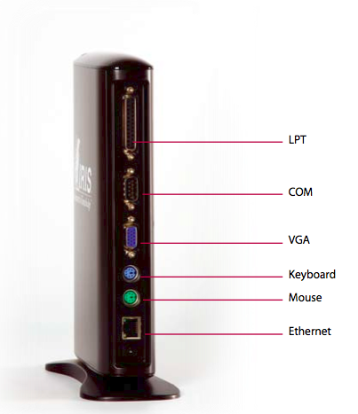
IRIS Client Pro

Slide 35
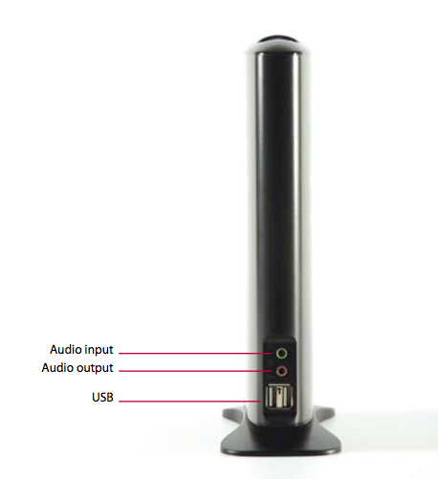
IRIS Client Pro

Slide 36
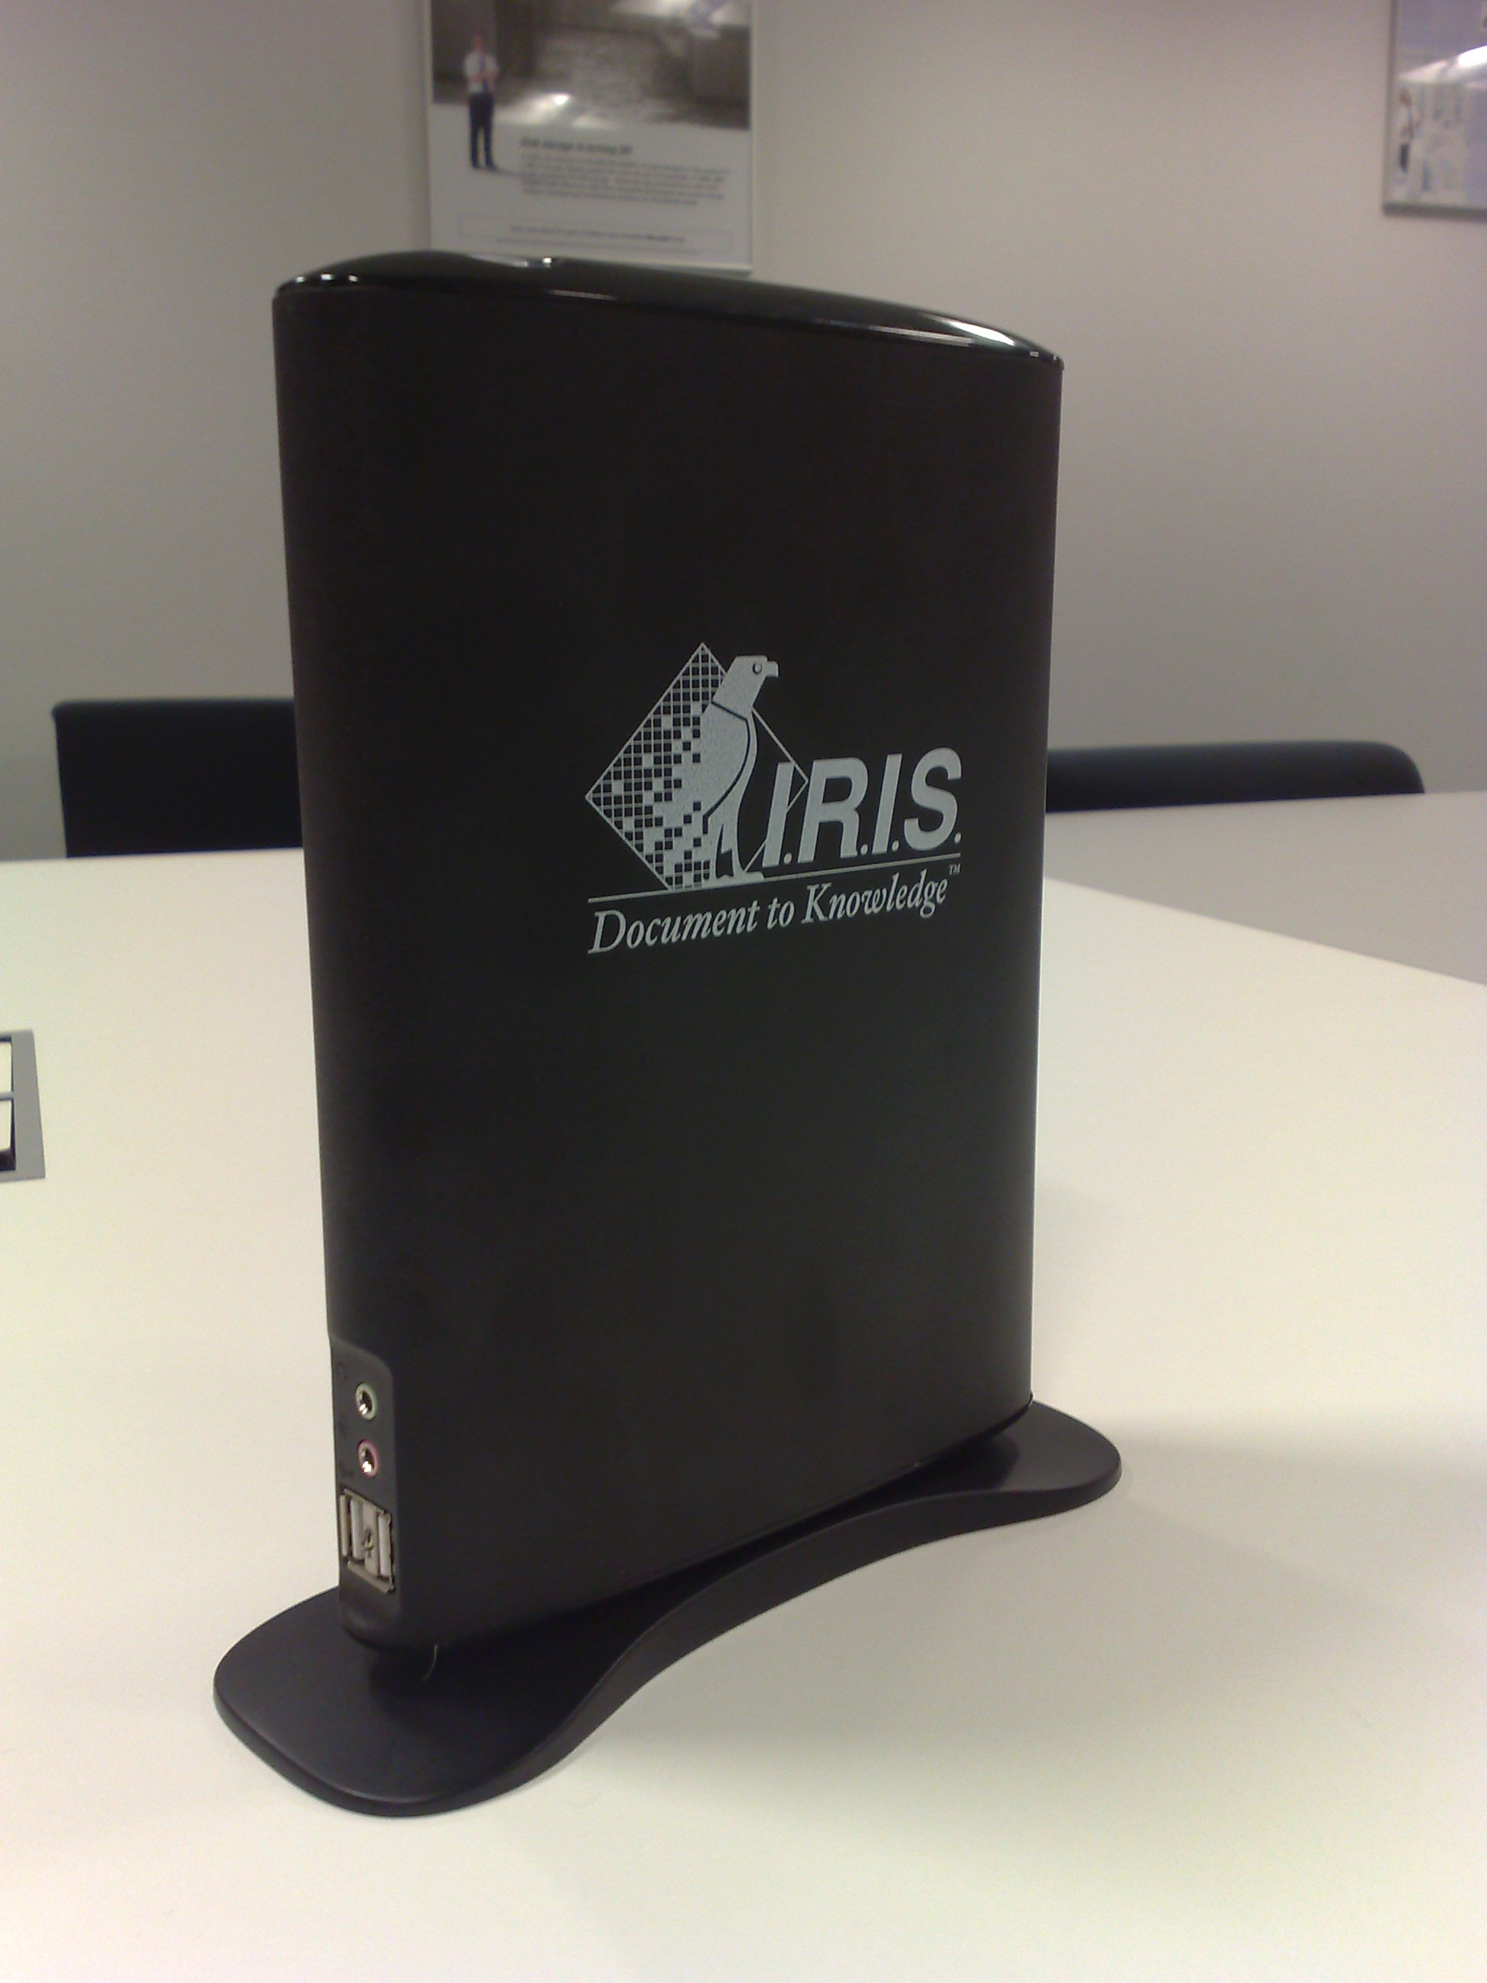
IRIS Client Pro
Features
  Low Power Consumption
  2 x front USB2 port
  1 x audio in
  1 x audio out
  1 x parallel port
  1 x serial port
  VGA display (1600x1200)
  PS2 keyboard and mouse support
  100 megabit network
  Solid state (no moving components)

Slide 37
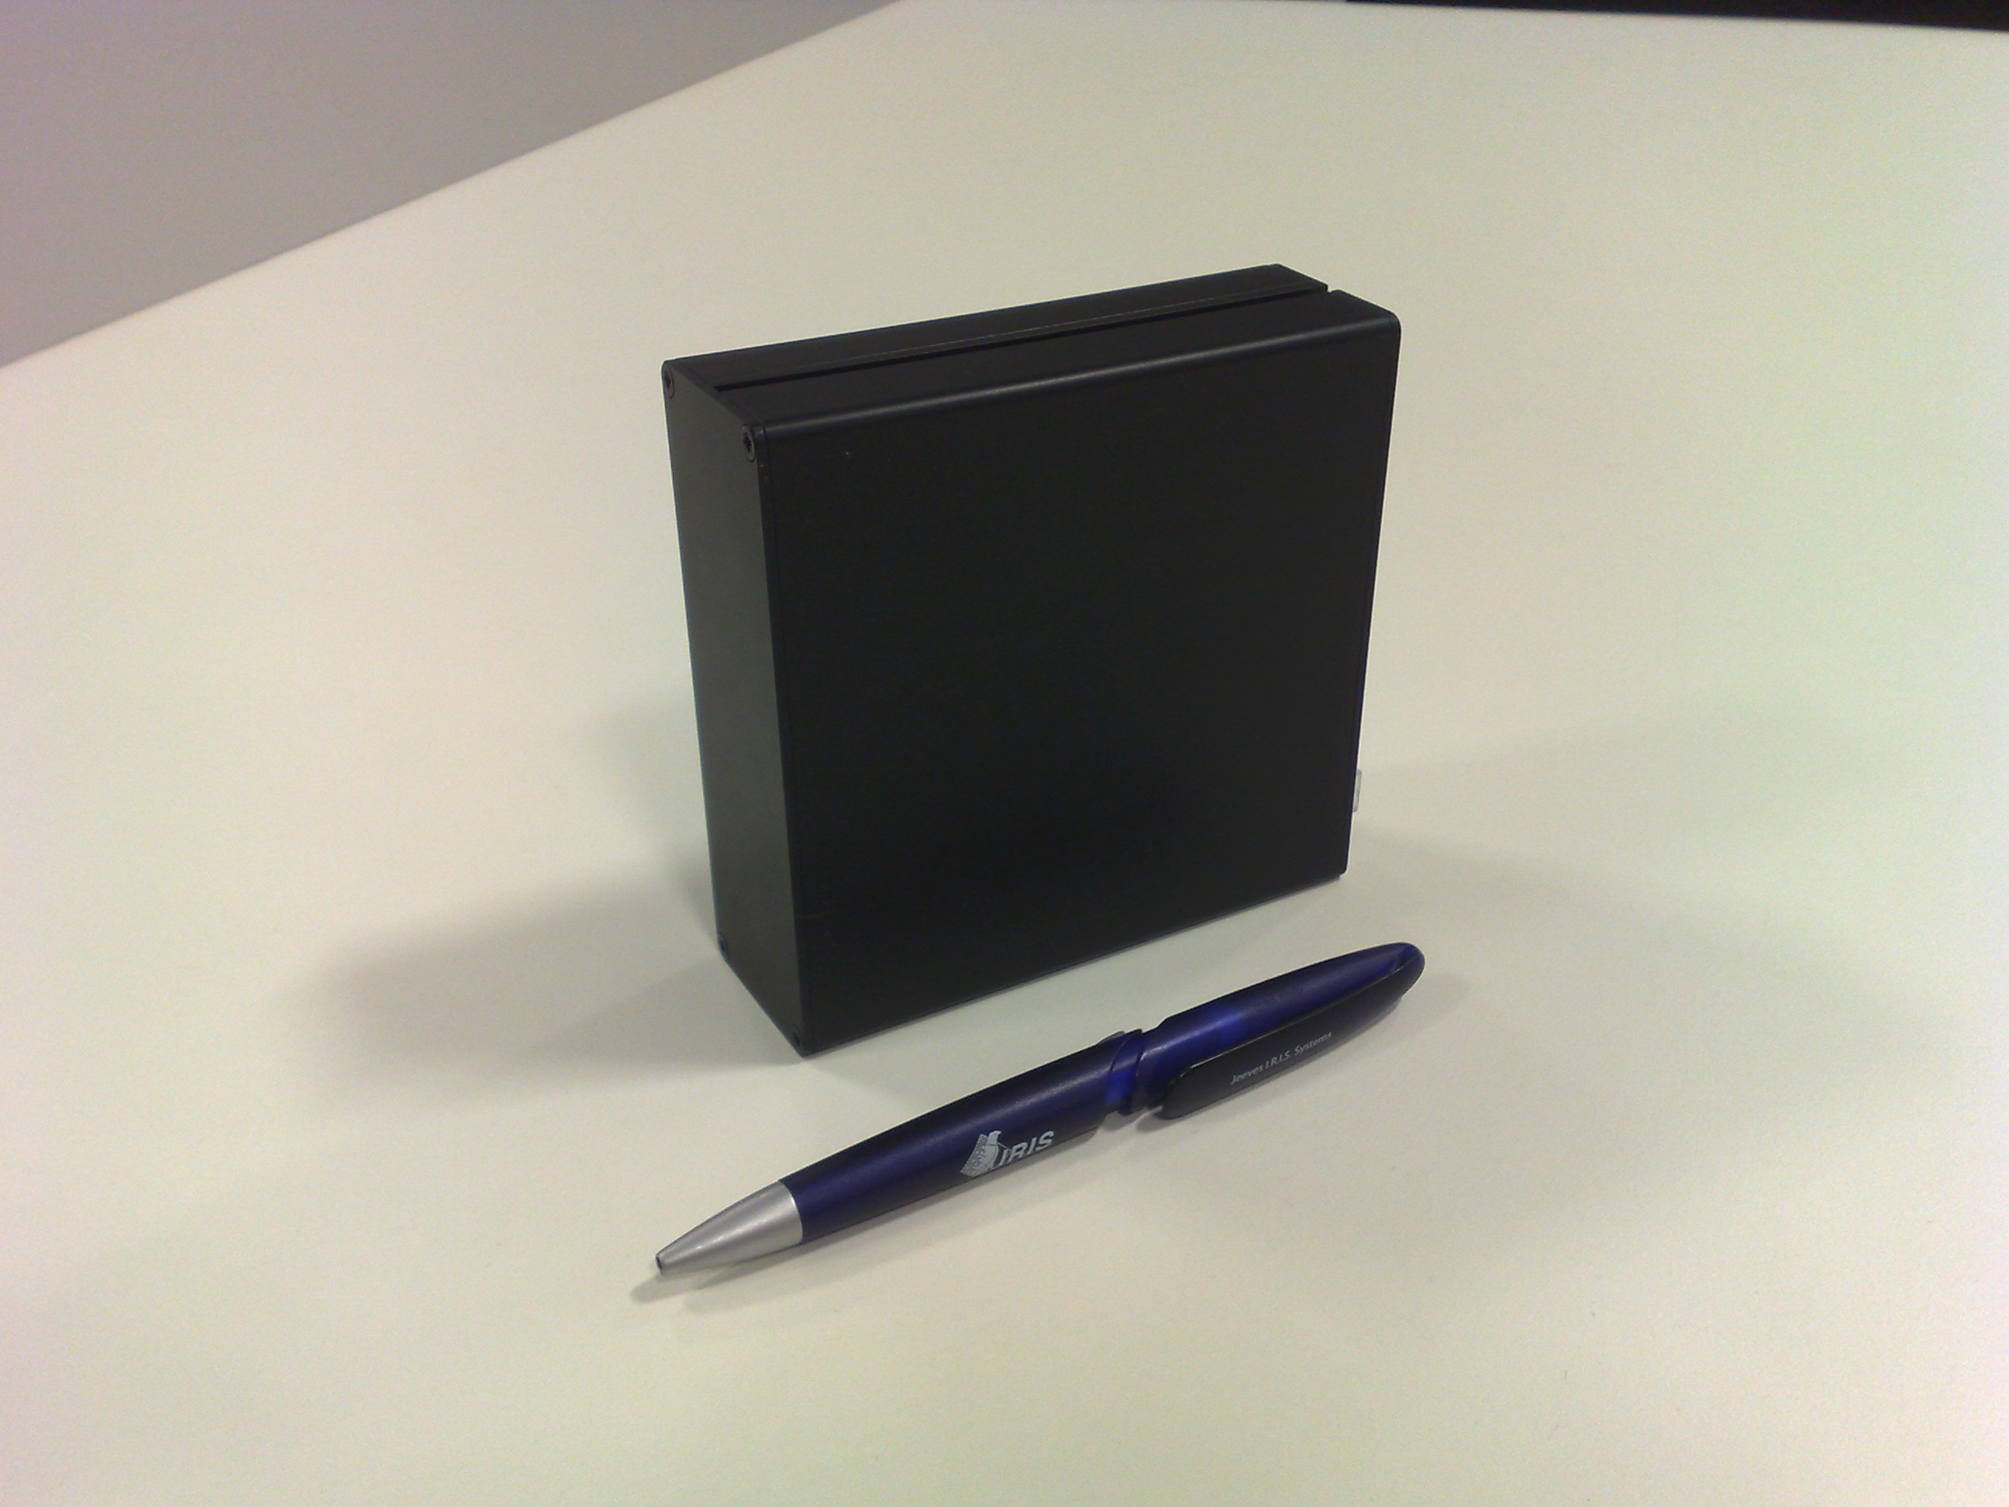
IRIS Client Express
Features
  Low Power Consumption
  2 x USB2 port
  1 x audio in
  1 x audio out
  VGA display (1600x1200)
  100 megabit network
  Solid state (no moving components)

Slide 38
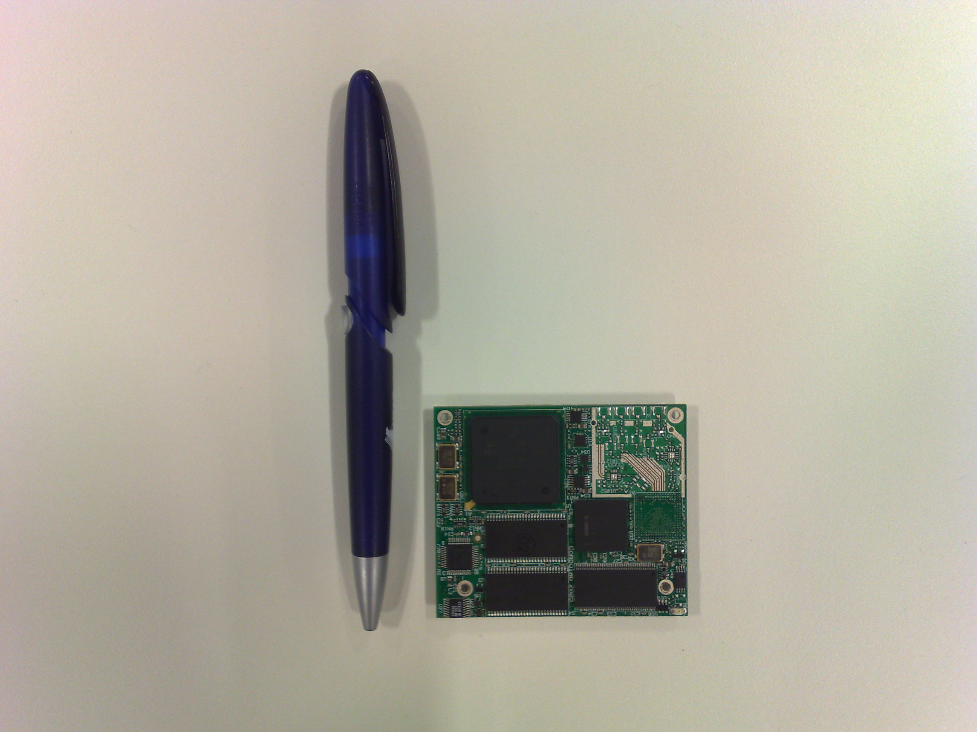
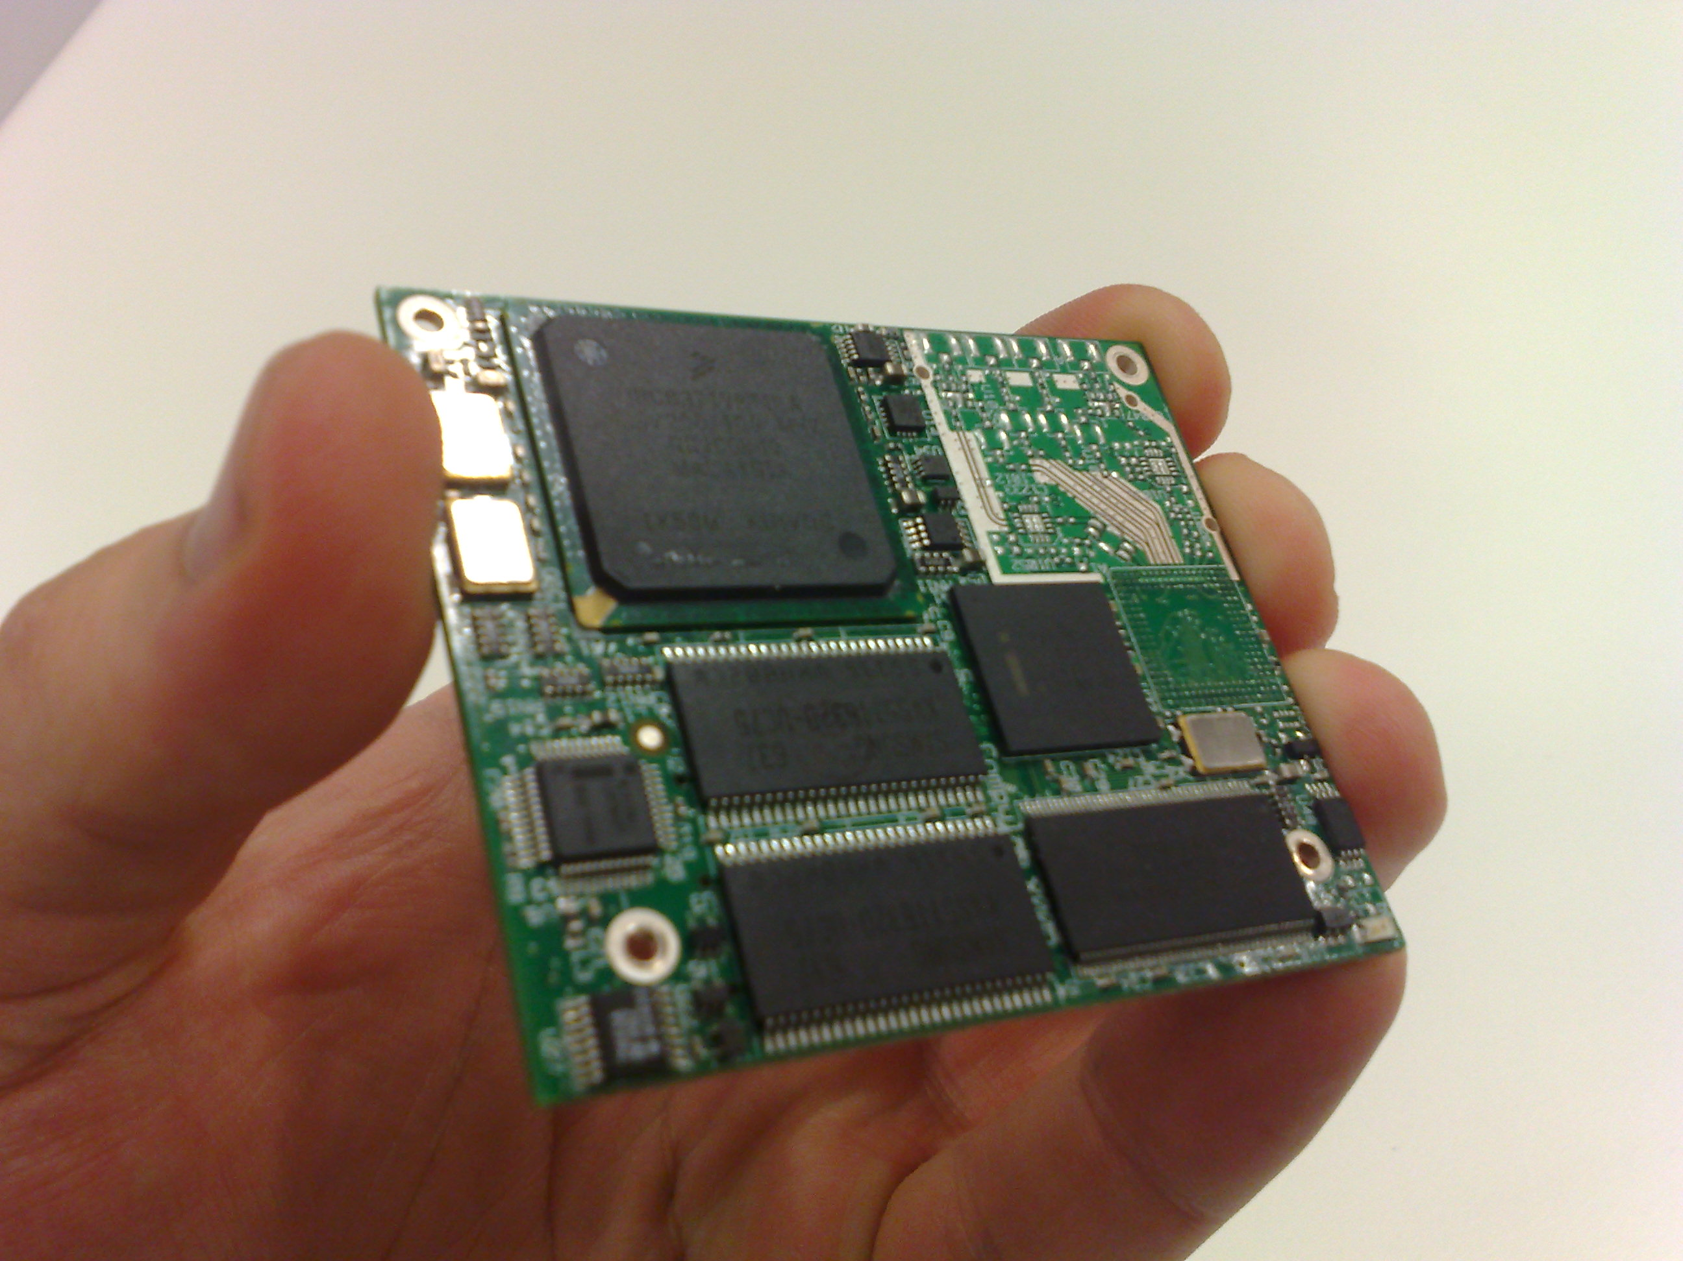
HW differentiation
Low power consumption.
  0.1 Watt to 1 Watt range (CPU)
Integrated motherboard: “system on a chip” microprocessor from automotive industry
Hardware accelerated encryption / compression
Virus free architecture
Fanless/sinkless
68 x 58 mm

Slide 39
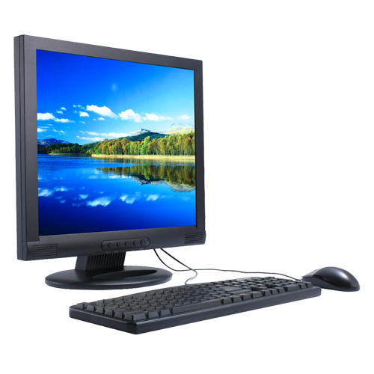
Announcing
IRIS Client Office
  Built into a 19” or 22” monitor
  Optional touch screen
  Same connectivity as
  IRIS Client Pro

Slide 40
Some Differentiators
Ability to restrict supported vendors and devices on a per client and per user basis. (filtering)
IRIS Virtual Desktop is Location-aware.
Ability to restrict bandwidth on a per client basis (QoS).
USB2 supported.

Slide 41
Some Differentiators
Up to 4 monitors supported. (Windows)
Up to 16 screens supported. (Linux)
Monitors detected by Virtual Machine as either one big monitor, or individual monitors.
Support for multi-VM session

Slide 42
Some Differentiators
Both Linux and Windows operating systems are supported.
Up to 4 Virtual CPU’s per desktop.
Up to 64Gb RAM per desktop. Thin provisioned.
Local Admin possible
Active Directory is optional
3270, 5250, MSTS, BladePC supported!

Slide 43
Some Differentiators
Central hardware can be put to sleep at night, reducing Power consumption even more.
Savings have been validated by our customers.
Return on investment possible in less than two years.

Slide 44
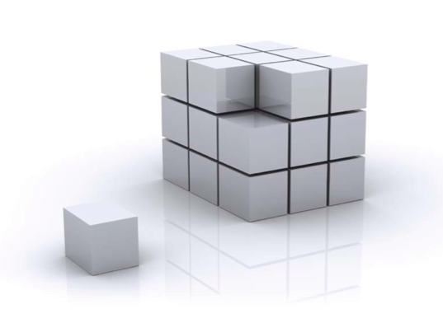
Differentiators
QoS
Encryption
Printing support
Realtime Storage de-duplication
Memory overcommit
Cost per VM
Location awareness
Auto-login
Smartcard / biometric authentication
Fully customizable
Per host vs. Per VM licensing
ESX 3i compatible
…

Slide 45
Roadmap
Protocol integration (graphics performance)
Tighter storage integration
Quality of Service / Encryption
WAAS, SaaS

Slide 46
Experience
Desktop Virtualization is not box moving!
We ALWAYS approach take a project approach.
Scope definition
Post-sales follow-up / support / MO

Slide 47
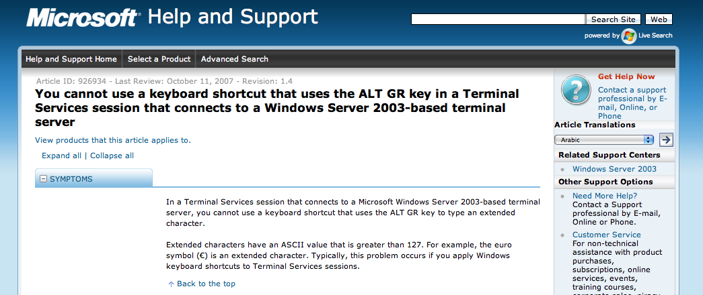
Keyboards

Slide 48
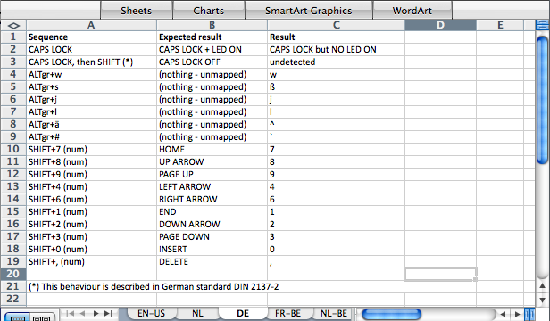
Keyboards
Our TEST team tested –EVERY- key combination and identified ALL mapping issues for most popular keymaps.

Slide 49
QoS
Only client available on the market with QoS, traffic shaping at the client side.
Partnership with Cisco
Cisco Nexus 1000 in VI4
Seamless integration between physical and virtual network world. (Vmotion <-> vlan)

Slide 50
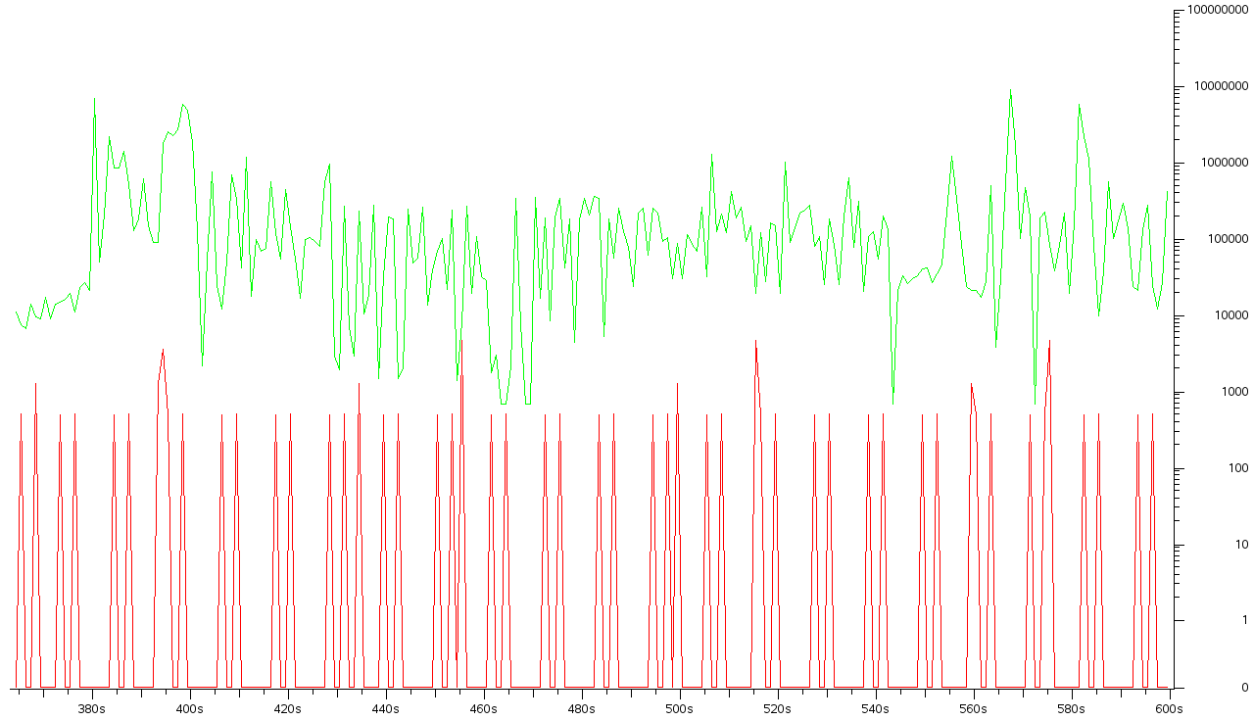
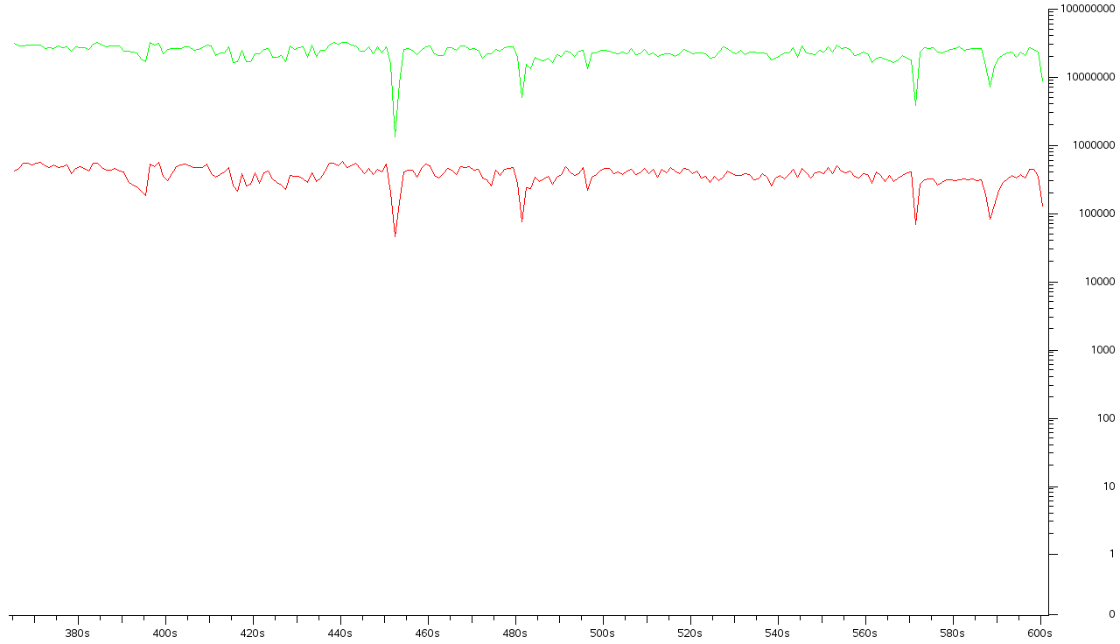
QoS

Slide 51
QoS
Copying a 500Mb file from an USB storage device to a VM
Without any limitation, USB-over-IP can consume up to nearly 27 Mbps
 | USB-over-IP on 500Mb file transfer
Traffic captured (MB) | 528.993
Average bandwidth (Mbps) | 26.7
Average packet size (bytes) | 1006.507
Average packet/sec | 3315.643

Slide 52
QoS
USB-over-IP scales up & down with available bandwidth and packet latency conditions

Slide 53

Deep-dive
Application Management
Desktop Management
Storage optimization
Network optimization

Slide 54
Thank you
Q&A

