Slide 1

From Paper to Document Management Systems
Just one line of code away !

Slide 2


Slide 3

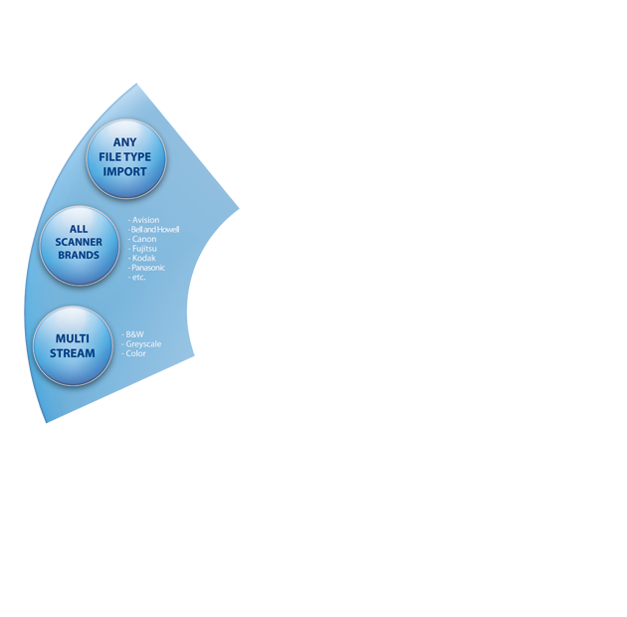






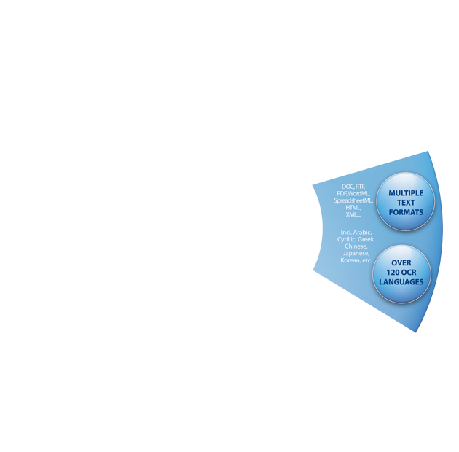








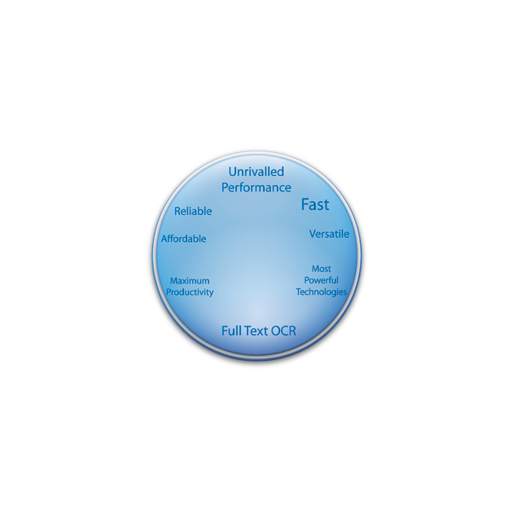


Slide 4
Scanning
Pre-Processing
Document Identification
Document Structuring
Document Indexing
Quality control
Export

Slide 5
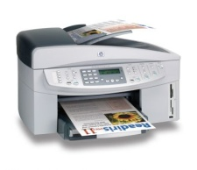
Scanning
Scanning
Scanner
Pre-Processing
TWAIN, TWAIN-VRS or ISIS-VRS
Native ISIS support will be available in v9
Multi-stream: generate colour and B/W or colour and greyscale images EVEN if the scanner does not support it
Document Identification
Document Structuring
File
Document Indexing
Scan from files: import pre-scanned images
No Watched Folder though…
Quality control
Export

Slide 6

Pre-processing
Scanning
Pre-Processing
Deskewing
Advanced binarization
Despeckling
Line Removal
Black border Removal
Colour dropout
Smoothening
Document Identification
Document Structuring
Document Indexing
Quality control
Export

Slide 7
Document Identification
Scanning
Document identification done using:
Pre-Processing
Zonal OCR
Zonal ICR
Zonal/Full page Barcode
IRISFingerprint™ : image layout analysis to determine the document type.
Document Identification
Document Structuring
Document Indexing
Quality control
Export

Slide 8
Document Structuring
Scanning
Document separation done using:
Pre-Processing
Zonal OCR
Zonal ICR
Zonal/Full page Barcode
Zonal/Full page Patch Code
Blank Page
Document Identification
Document Structuring
Document naming done using:
Document Indexing
Zonal OCR
Zonal ICR
Zonal/Full page Barcode
Zonal/Full page Patch Code
Combination with date, system values...
Quality control
Export

Slide 9
Document Indexing
Scanning
Document indexing using:
Pre-Processing
Zonal OCR
Zonal ICR
Zonal/Full page Barcode
Document Identification
Document Structuring
Indexing done according to document type !
Indexes can be customized through scripting => can even pick up data from an ODBC database
Document Indexing
Quality control
Export

Slide 10
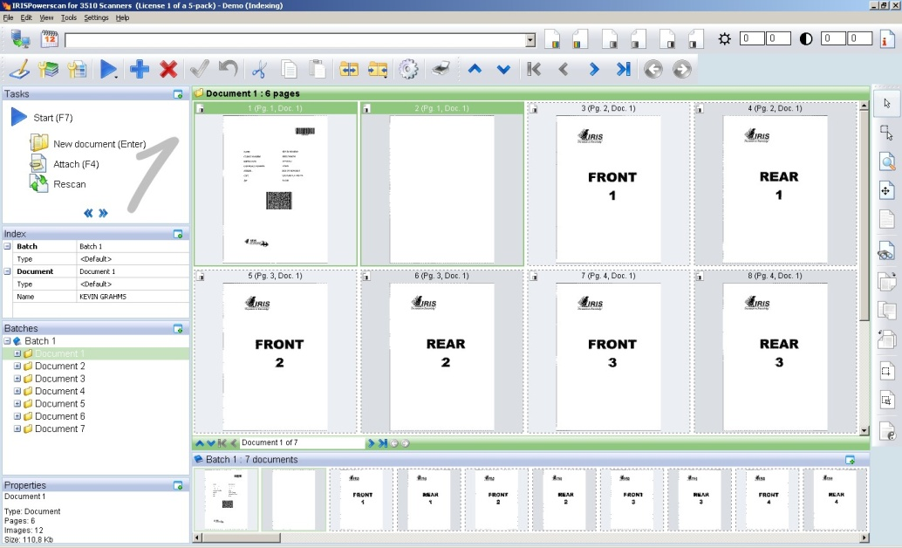
Quality Control
Scanning
Quality control via user interface. The user can modify:
Pre-Processing
Batch and Document ID
Document and Batch structure
All Indexes
Images ( rotation, binarisation…)
Document Identification
Document Structuring
Document Indexing
Quality control
Export

Slide 11
Export
Scanning
Export Connectors called Batch Output Formats
Pre-Processing
Standard list including:
  IRISCapture™ Pro
  IRISPdf™
  …
Can use Batch Output Formats from KCS => long list of possibilities. But need to be validated for use in IRISPowerscan™
C++ and .NET API available to create your own Batch Output Format
Export via Extended Batch Output Formats
Document Identification
Document Structuring
Document Indexing
Quality control
Export

Slide 12
Export - IRISPdf™
Scanning
Document creation done by integrated IRISPdf™
Pre-Processing
MANY document formats possible
Full page OCR
Renaming of document according to IPS Index or …
Document compression => iHQC
Can export data after to ANY application with index XML as argument
Can export to MS SharePoint both the documents and the indexes
including input indexes
Document Identification
Document Structuring
Document Indexing
Quality control
Export

Slide 13
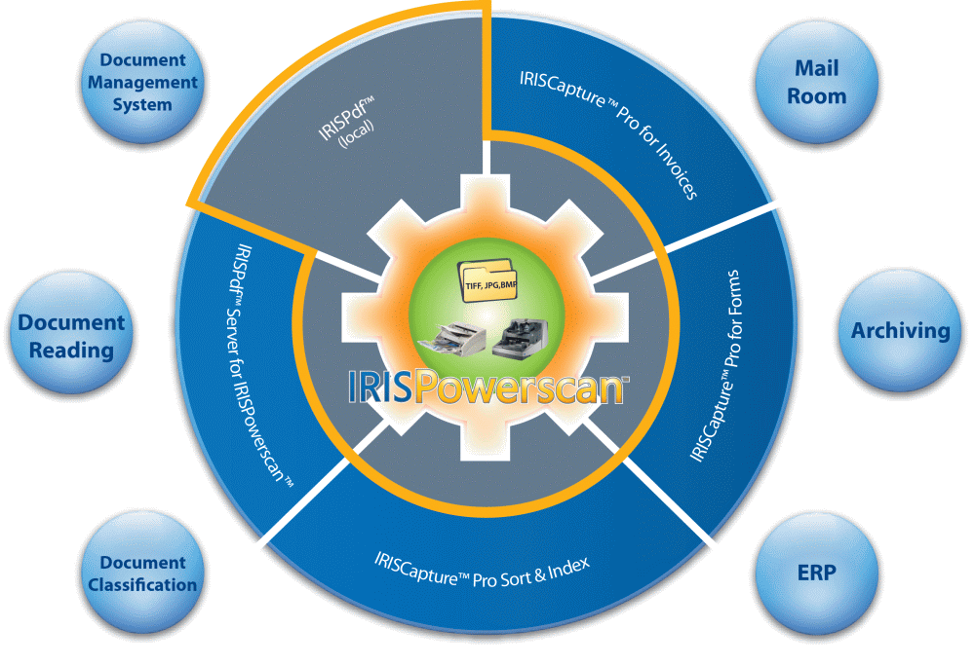

Slide 14


Slide 15

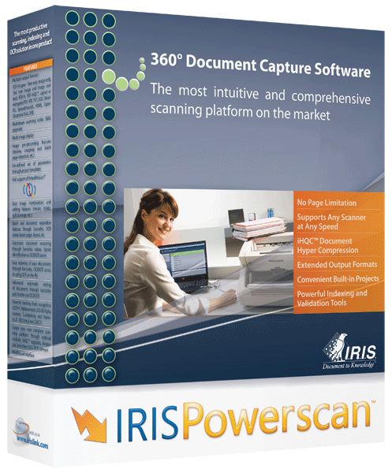


New features of IRISPowerscan™ 9
  IRISDocument™ 9 replacing IRISPdf™
  Calling IRISDocument™ before the BOFs (Connectors)
  SharePoint v2 Connector
  Booklet reordering
  Barcode voting
  ISIS support
  IRISFingerPrint™
  Event Handler SDK
  LDAP Authentication
  Multi-user centralized management
  Custom installation
  New Background processing
Release of IRISPowerscan 9 planned for 31st May

Slide 16

IRISDocument™ will replace IRISPdf™
IRISPdf™ is currently embedded inside of IRISPowerscan™
It will be replaced by IRISDocument™

Slide 17

How to send your documents from IRISPowerscan™ to your Application
Basic: get your application to pick up files automatically from a directory
Use an existing BOF (Connector)
Use the “Extended BOF” and get it to call an executable of your choosing
Use the “IRISPdf™ BOF” and get it to call an executable of your choosing
Create your own BOF (Connector) thanks to our SDK
Always check with I.R.I.S. if in doubt: some BOFs (Connectors) are not yet advertised but are available

Slide 18
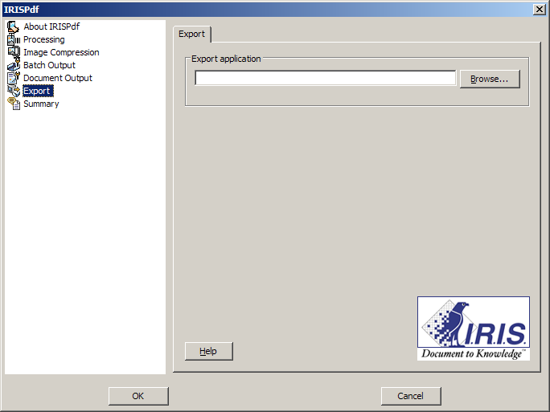
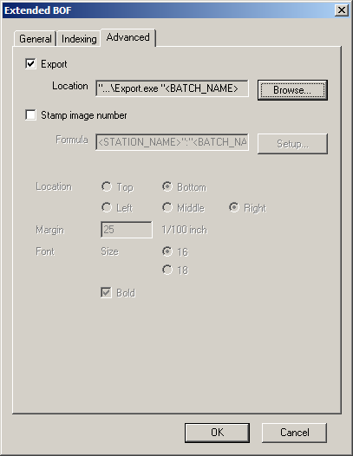
Using the Extended or IRISPdf™ BOFs
Get the “IRISPdf™” BOF to call your executable with the index.xml file as a parameter
Get an “Extended” BOF to call your executable with one or more parameters of your choosing

Slide 19

Creating your own BOF (Connector)
API available in C++ and .Net
Samples included
An evolution to the old Kodak Capture Software BOF SDK => If you have created a previous BOF for KCS, it just needs recompiling…
If you do create a BOF, inform I.R.I.S. since it can be of mutual commercial benefit
Programming resources are available if needed. Our suggestion is hiring an I.R.I.S. Pre-Sales Engineer to sit with your developer and create the BOF together. => Takes just one day instead of days and be sure it is written correctly
I.R.I.S. is aiming to make this BOF SDK the ‘Connector’ SDK for all I.R.I.S. products. If you write a BOF it will be compatible with other I.R.I.S. applications in the near future

Slide 20










  Calling IRISDocument™ before the BOFs (Connectors)
IRISPowerscan 9 will be able to call the embedded IRISDocument before calling another BOFs (Connectors)
This means you can send your BOF (connector)
a searchable + compressed document
BOFs (Connectors)

Slide 21
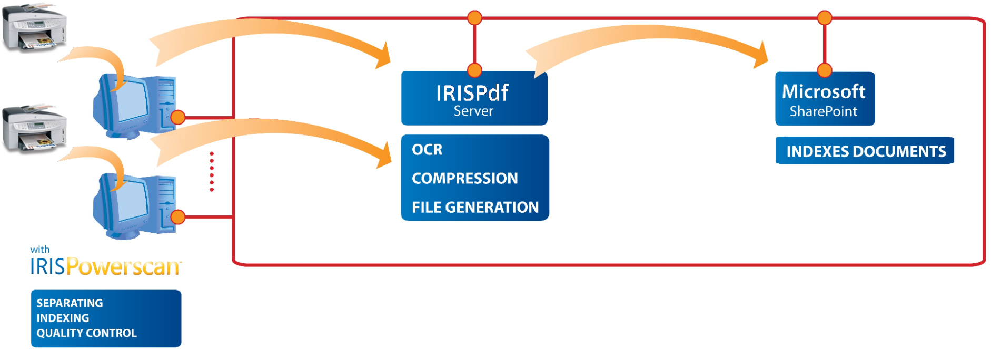
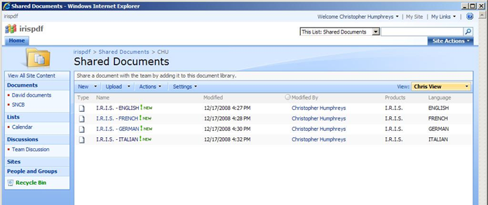
IRISPowerscan™ to SharePoint
IRISPowerscan™ IRISPdf™ Server Microsoft SharePoint
Documents
Indexes

Slide 22
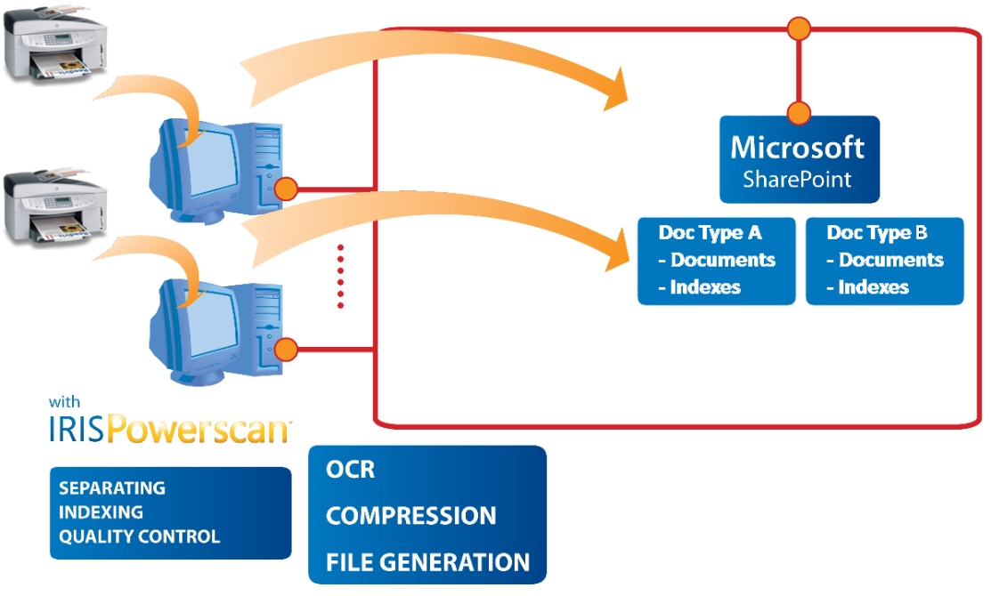
IRISPowerscan™ to SharePoint
IRISPowerscan™ Microsoft SharePoint
New: Different Document Types can be stored in different directories within Microsoft SharePoint
Documents
Indexes

Slide 23
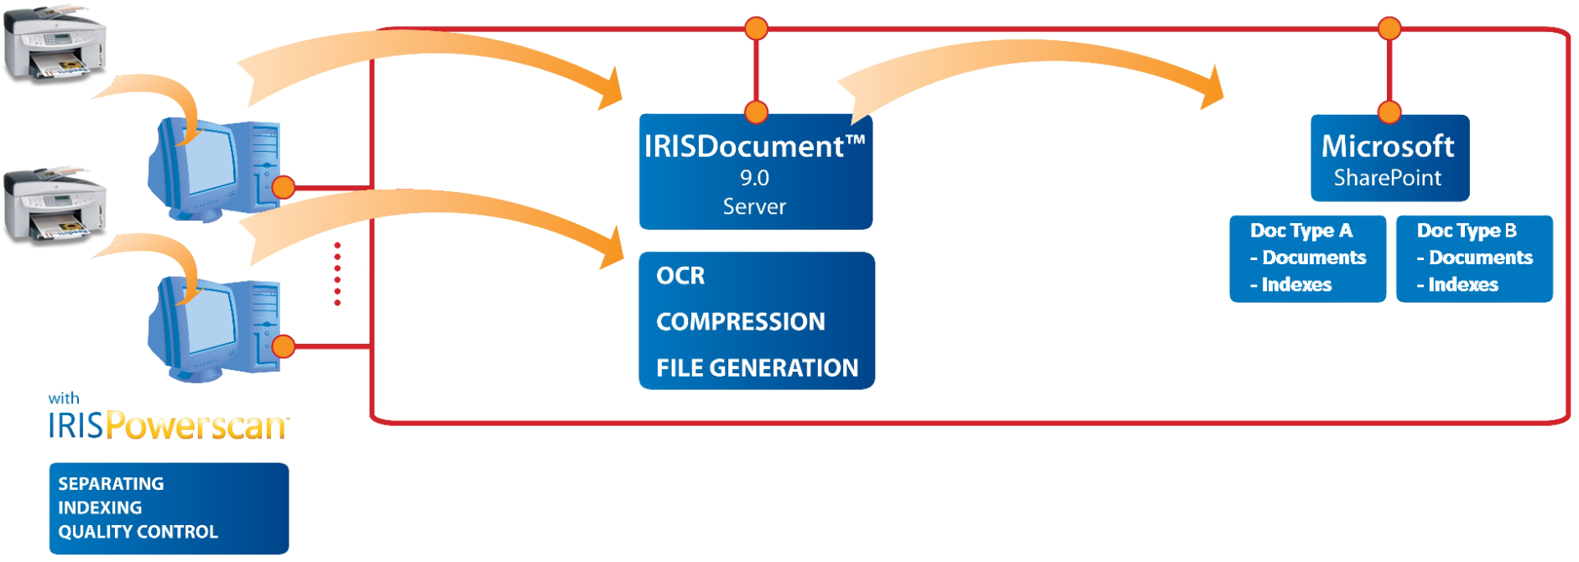
IRISPowerscan™ to SharePoint
IRISPowerscan™ IRISDocument™ Server Microsoft SharePoint
Documents
Indexes

Slide 24








  IRISPowerscan™
    Scans images and creates document indexes
    Computes a document type
  IRISPdf™
    Transforms the images into searchable files (with possible iHQC hyper compression)
    Sends the files with their indexes to a SharePoint document library, depending on the document type
Invoice 1
Supplier: AT&T
Date: 08.08.08
Mail 1
Subject: Vacation
Mail 2
Subject: Marriage
Invoice 2
Supplier: BT
Date: 07.07.07
Invoice 1.pdf
Mail 1.pdf
Mail 2.pdf
Invoice 2.pdf
Index.xml
Invoices
Supplier Date
Invoice1.pdf AT&T 08.08.08
Invoice2.pdf BT 07.07.07
Mails
Subject
Mail1.pdf Vacation
Mail2.pdf Marriage

Slide 25



Booklet feature
Imagine a booklet with 2 A3 sheets folded in 2 and stapled together. If you unstaple it and scan it, all the pages are in disorder.
The Booklet feature of IRISPowerscan™ will re-order the documents for you
Image 8
Image 2
Image 8
Image 2
Image 3
Image 4
Image 5
Image 6
Image 7
Image 8

Slide 26
Barcode Voting
Barcode voting takes the best results of both engine
Example: 90% (Engine 1) + 90% (Engine 2) => 99% (Voting)

Slide 27
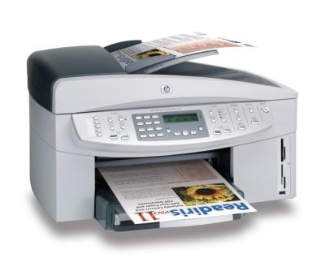
ISIS Support
IRISPowerscan™ supports natively TWAIN, TWAIN-VRS and ISIS-VRS
ISIS support will be available as an Add-On

Slide 28


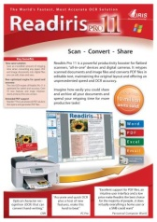
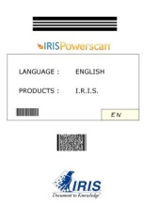
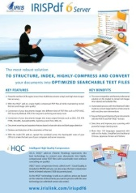

IRISFingerPrint™ is a Document Identification Technology based on the structure of the document
No OCR, No Barcode, No Patch Code…
Extremely fast
Extremely easy to set up
Available as an Add-On
No need to put barcodes on your separators !
Type A
Type B
Type C
Type D
Type E

Slide 29
Event Handler SDK
Add your own code within the workflow of IRISPowerscan™ thanks to our “Event Handler” SDK
API available in C++ or .Net
Create your dll and call it from IRISPowerscan™
Capture events such as the Batch creation, Batch updating… document events, image events, process events, scanner events, login…
Act on those events with a list of Actions
Access the batch data and possibly modify it

Slide 30

  LDAP Authentication
IRISPowerscan™ is a multi-user application and therefore has the notion of Users and Roles. This information can be stored on your Active Directory and accessed by IRISPowerscan™. This makes for much easier centralised security management.
2 Solutions:
Automatic login using the Windows User Credentials
Semi-automatic login where the Windows User Credentials are prefilled in the login window

Slide 31
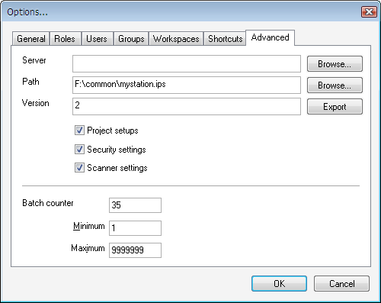
  Multi-User Centralized Management
Both the IRISPowerscan™ Settings and Data can be saved in a central network location
A manual or automatic push/pull system synchronizes the data
IPS Data
IPS Settings
  Project Setup
  Security Settings
  Scanner Settings

Slide 32
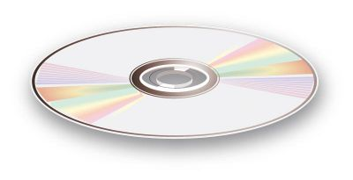
  Custom installation
You can easily be customise the installation
Put in your set of pre-configured projects
Put in your BOFs (Connectors) and Event Handlers
…
Make one CD with everything pre-configured and install the same on all PCs => no need to reconfigure all the PCs
Note that I.R.I.S. can also create custom packages for OEM bundling

Slide 33
Background Processing
You’ll no longer have to wait for your BOFs to stop processing before scanning again
Scan
Sorting, Indexing and validating
BOF
Scan
Scan
Sorting, Indexing and Validating

Slide 34

Thank you for your attention
Please visit our booths which demonstrate IRISPowerscan™ to various
other applications

