Slide 1



I.R.I.S. new OCR Software suite:
A full range for document conversion, for private and corporate users
Notes:
Couleur: Heading 1: R0, G 90, B 160 Taille: 44 Heading 2: R 0, G 66, B 116 Taille: 22

Slide 2





Agenda
New OCR software suite
Why a new range ?
What’s new ?
in
in
and in
Version 12 new features + live demonstration
Preview: IRISearch

Slide 3





New OCR software suite

Slide 4


Why a new range?
  Offer the custommer the OCR package that suits the best his needs
  Easy-to-use and user-friendly
  Features mostly used by home users
  OCR for 25 languages
  Give the possibility to the home user to do the whole job in just a single click!
  Additional features for professionnal users (Pdf, XPS, iHQC)
  OCR for over 120 languages
  Designed to enhance the document management process of Small Businesses
  Specific features to handle batch OCR, to separate batches of documents, archive efficiently and index documents
Designed for Home users
Designed for Professional users
Designed for Small Businesses

Slide 5
Why a new range ?
      Home : Designed for Home users
      Price : 49 €
      Pro : Designed for Professional users
      Price : 129 € (upgrade : 89 €)
      Corporate : Designed for Small Businesses
      Price : 399€ (upgrade : 199 €)

Slide 6


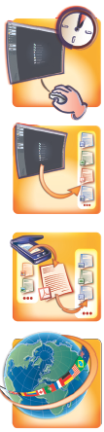
What’s New?
1. NEW Redesigned User Interface
2. NEW SmartTasks Buttons
3. NEW Output Formats (DOCX-ODT)
4. NEW User Interface languages
5. IMPROVED 28% accuracy increase

Slide 7

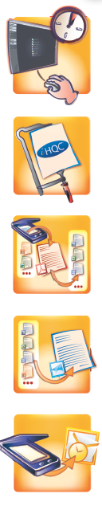
What’s New?
1. NEW Redesigned User Interface
2. NEW SmartTasks Buttons
3. NEW High-Quality Compression technology (iHQCTM)*
4. NEW Output Formats (DOCX-ODT-XPS)
5. NEW User Interface languages
6. IMPROVED 28% accuracy increase

Slide 8

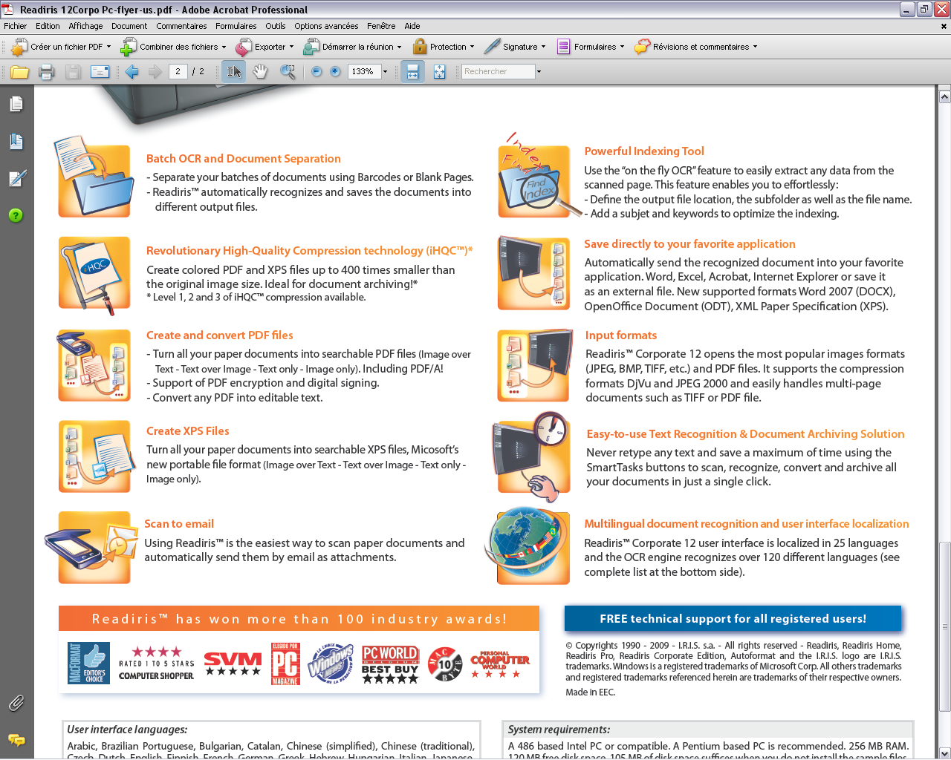
What’s New?
1. NEW Powerful indexing tool
2. NEW PDF/A file generation + PDF encryption + PDF digital signing
3. NEW SmartTasks Buttons
4. NEW High-Quality Compression technology (iHQCTM)
5. NEW Output Formats (DOCX-ODT-XPS)
6. NEW User Interface languages
7. IMPROVED 28% accuracy increase
8. IMPROVED Fast binarization for maximum compatibility with High end scanners

Slide 9
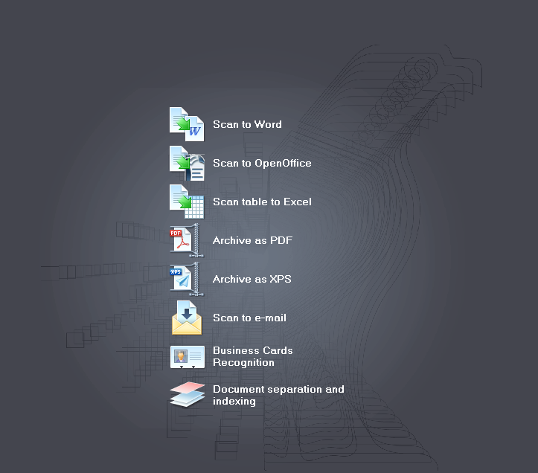


New feature : SmartTasks

Slide 10
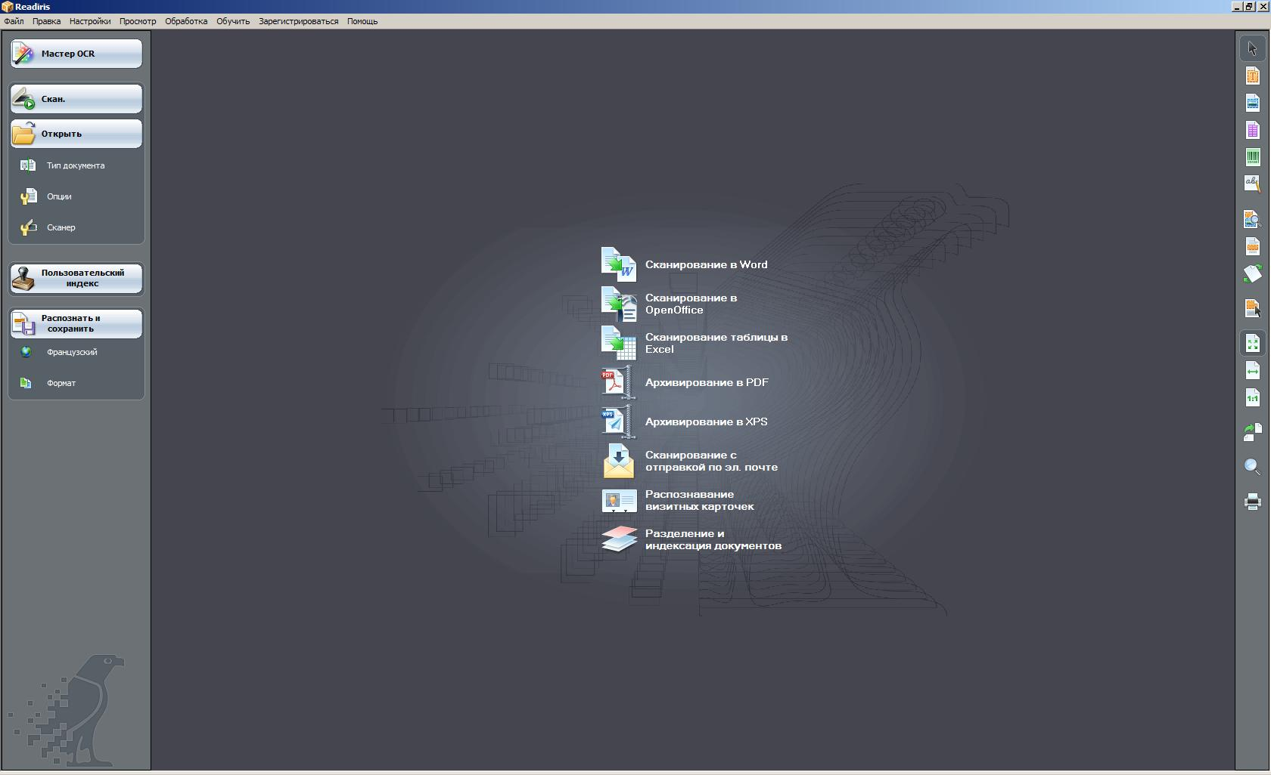
New feature : multilingual GUI
RUSSIAN

Slide 11

Greek

Slide 12
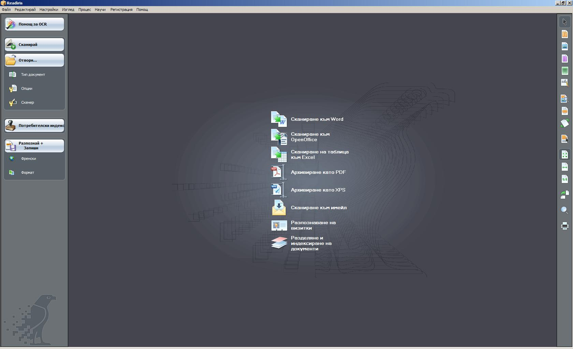
Bulgarian

Slide 13
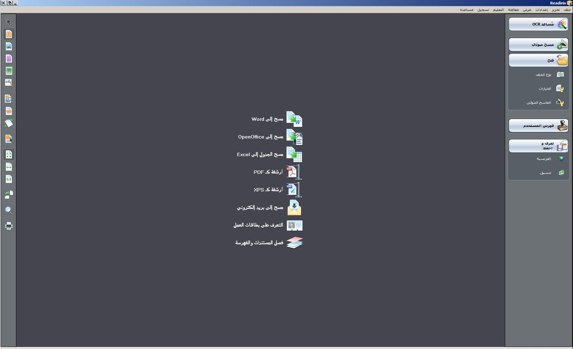
Arabic

Slide 14



New Output Formats
ODT (OpenOffice Document)
DOCX (Word 2007)
XPS (XML Paper Specification)
(Pro & Corporate only)

Slide 15



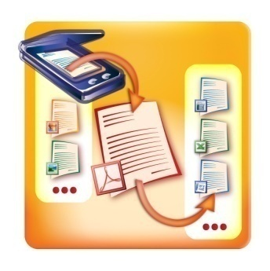

New feature :
3 levels of hyper-compression
Available for PDF and XPS
iHQC™ compression keeps the documents as legible as the original
The documents are much smaller:
  Output files are up to 400 times smaller
The documents reamain fully searchable thanks to I.R.I.S. OCR

Slide 16
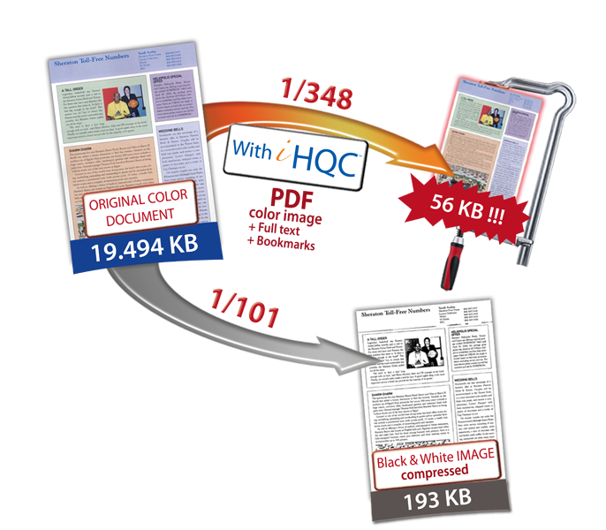
Level 1 (Pro + Corporate)
Level 2 (Corporate only)
Level 3 (Corporate only)

Slide 17
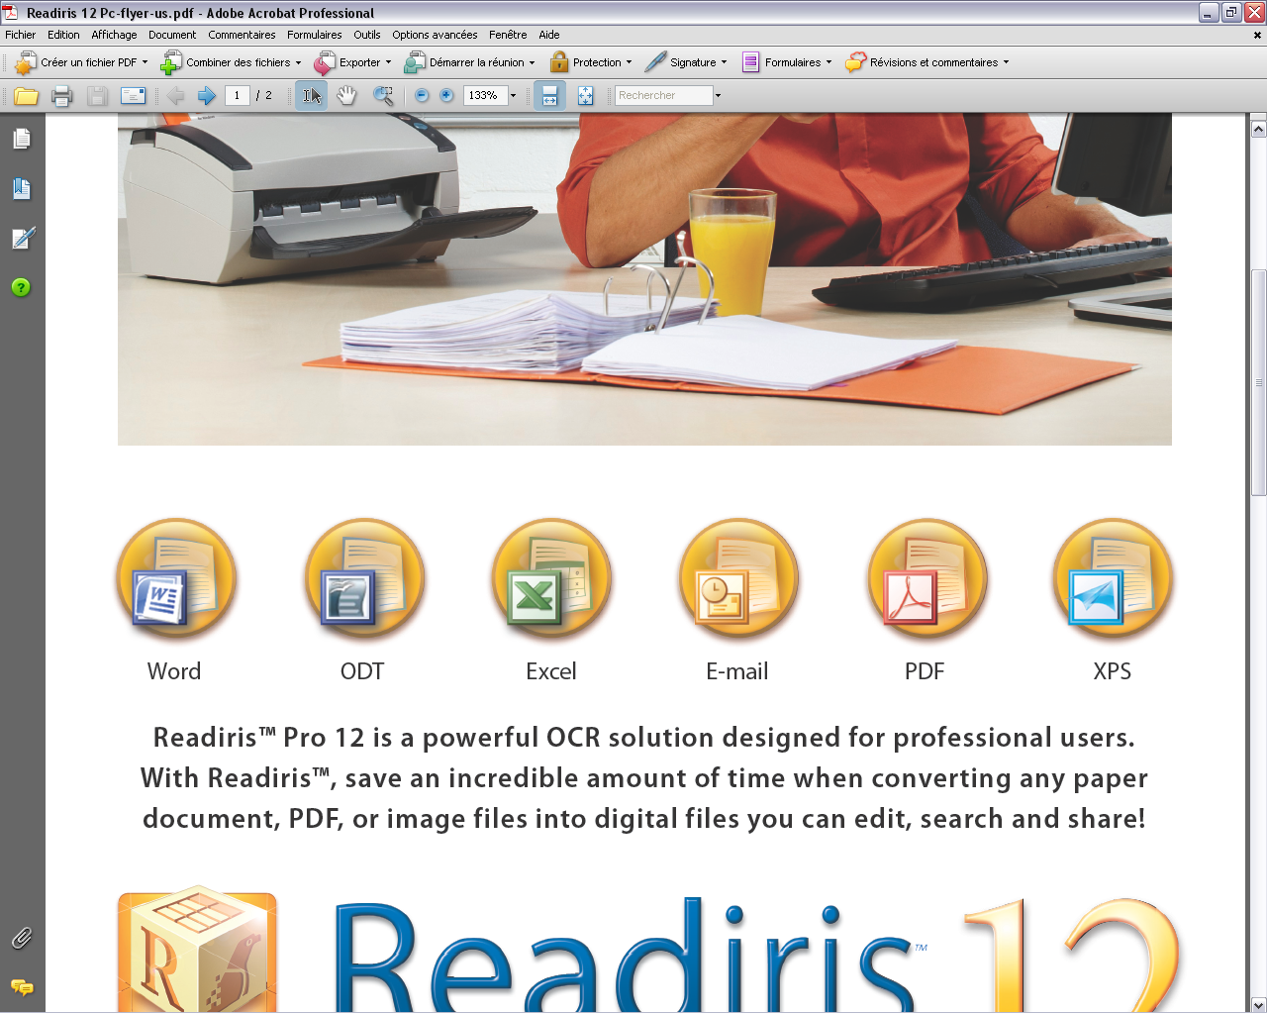
Extended support of Pdf and XPS
Home : Pdf image-text (Image in front + searchable text behind)
Pro : Pdf
    Image over Text - Text over Image - Text only - Image only
    iHQC level 1 : Create colored PDF and XPS files up to 200 times smaller than the original image size. Ideal for document archiving!
    Convert any PDF into editable text
XPS:
    Image over Text - Text over Image - Text only - Image only
    iHQC level 1 : Create colored PDF and XPS files up to 200 times smaller than the original image size. Ideal for document archiving!

Slide 18
Extended support of Pdf and XPS
Corporate :
  Pdf :
    Image over Text - Text over Image - Text only - Image only
    All levels of iHQC available:
    Create colored PDF and XPS files up to 400 times smaller than
    the original image size. Ideal for document archiving!
    Support of PDF/A (iHQC level 1 & 2)
    PDF encryption + PDF digital signing
    Convert any PDF into editable text
XPS :
    Image over Text - Text over Image - Text only - Image only
    iHQC level 1

Slide 19
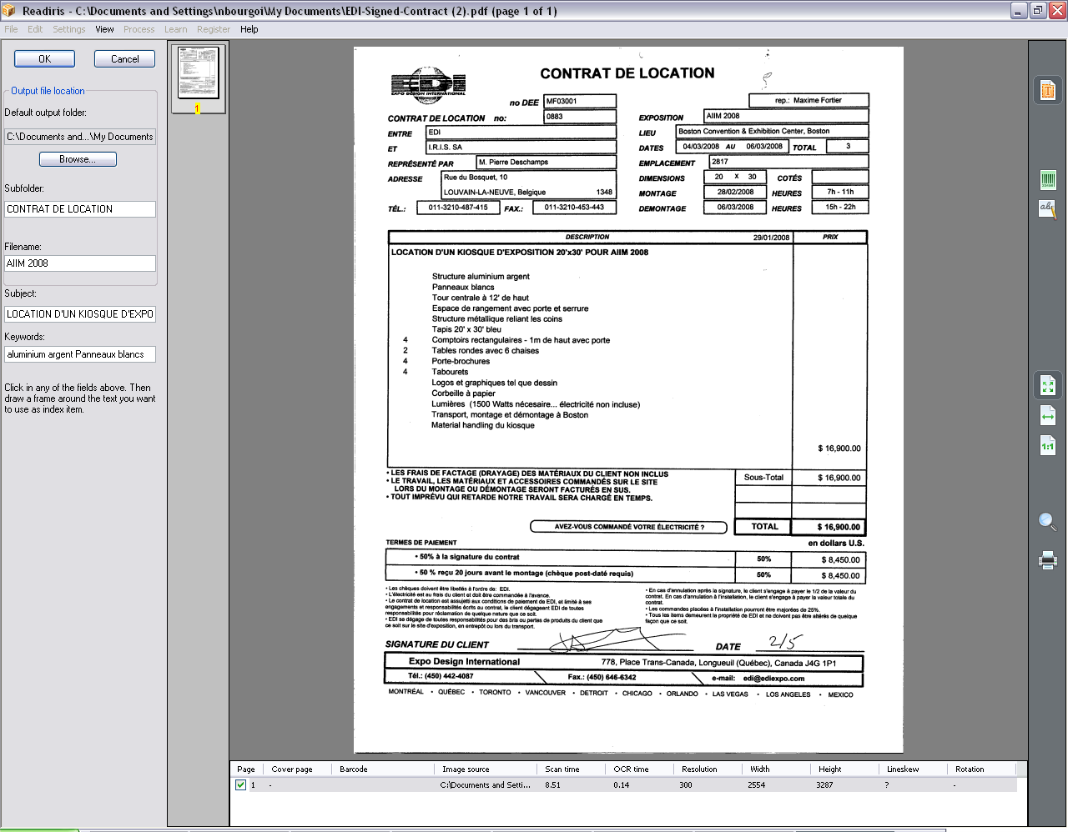
Document Separation & Indexing
On the fly OCR of the selected zone for easy document Indexing
Archive in the main output file + Subfolder
Use keyword + save the index in the output directory
Save the index in a PDF + XML file

Slide 20
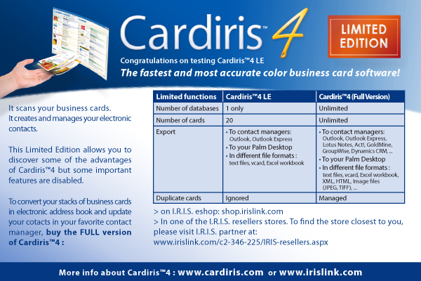
Business Card Recognition
+ Cardiris 4 Limited Edition

Slide 21



Comparison table
NEW Fast Binarisation |  |  |  | V
NEW PDF/A file generation* |  |  |  | V
NEW PDF encryption |  |  |  | V
IMPROVED Document indexing and separation tool |  |  |  | V
Digital signing of PDF |  |  |  | V
Batch OCR |  |  |  | V
NEW Intelligent High-Quality Compression technology iHQC* |  |  | V | V
NEW XPS file generation |  |  | V | V
IMPROVED Speed Mode |  |  | V | V
NEW 25 GUI languages |  | V | V | V
NEW Redesigned User Inferface |  | V | V | V
OCR Languages*** | Over 120 | 25 | Over 120 | Over 120
Searchable PDF Output | V | V | V | V
Convert PDF files to editable text | V | V | V | V
Number of PDF Outputs** | 4 | 1 | 4 | 4
Powerful Table Recognition | V | V | V | V
SpreadsheetML & WordML output | V | V | V | V
Autoformat Module | V | V | V | V
IMPROVED 28% accuracy increase |  | V | V | V
NEW SmartTasks for easy process execution |  | V | V | V
- Scan to Word |  | V | V | V
- Scan to Excel |  | V | V | V
- Scan to OpenOffice |  | V | V | V
- Archive as PDF |  | V | V | V
- Scan to email |  |  | V | V
- Archive as XPS |  |  | V | V
- Read Business Card |  |  |  | V
- Document Separation & Indexing |  |  |  | V
* iHQC: Pro version: Level 1 compression // Corporate Version : All compression levels available (except
for PDF/A, iHQC level 2 only)
** PDF image-text only

Slide 22
Preview

Slide 23
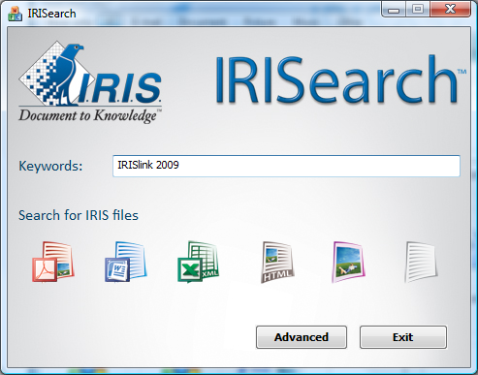

Slide 24
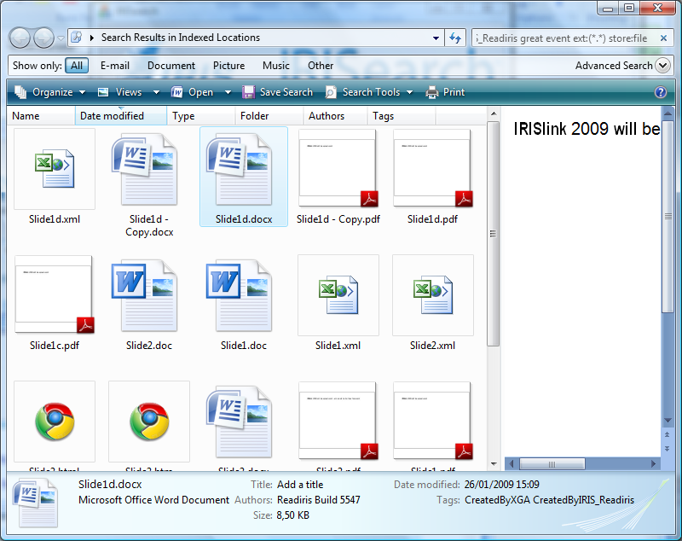
IRISearch

Slide 25

Will replace IRISDesktop Search in the short term.
Benefits for the user :
  Find files generated by Readiris, wherever they are
    In your system
    On the network
  SmartSearch buttons for easy and efficient file search
  Works with most file types generated by Readiris (WORDX, PDF, PDF/a, Excel-XML, images,…)
  Full text search
Will be included in Readiris 12 and many other I.R.I.S. products in september … stay tuned
Notes:
Find all files generated by Readiris, wherever they are
In your system
On the network
Enables files search based on the index generated by Readiris Corporate : to be confirmed (VRL,XGA)

Slide 26


For more information:

