Slide 1

A practical approach to Managed Operations
How I.R.I.S. ICT can facilitate your Business
Marnix Vrambout
Responsible Managed Services
Lode Vermeiren
Responsible Datacenter Operations

Slide 2
Managed Operations

Slide 3
Managed Operations

Slide 4

What happens when your infrastructure fails?

Slide 5

Managed Services?
According to Wikipedia:
Managed services (as defined by Dr. Gerard Macioce) is the practice of transferring day-to-day related management responsibility as a strategic method for improved effective and efficient operations.
The person or organization who owns or has direct oversight of the organization or system being managed is referred to as the offerer, client, or customer. The person or organization that accepts and provides the managed service is regarded as the service provider.

Slide 6
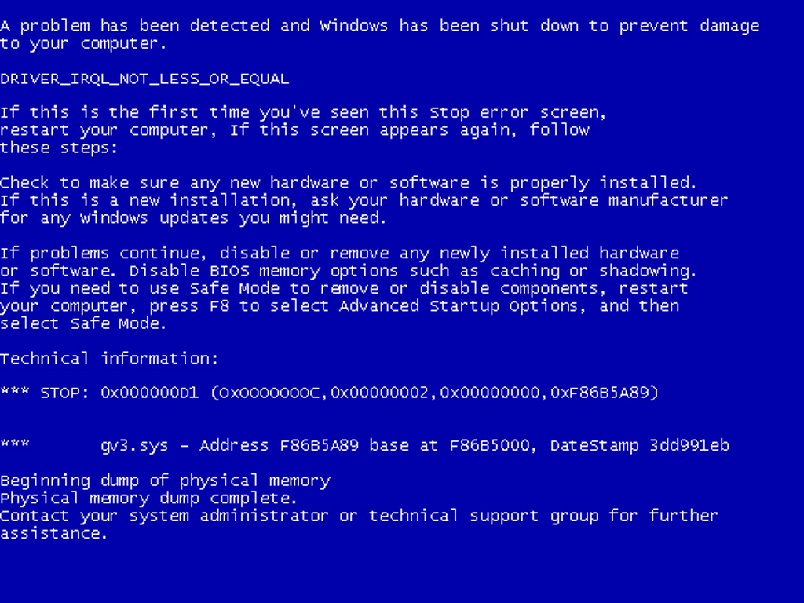
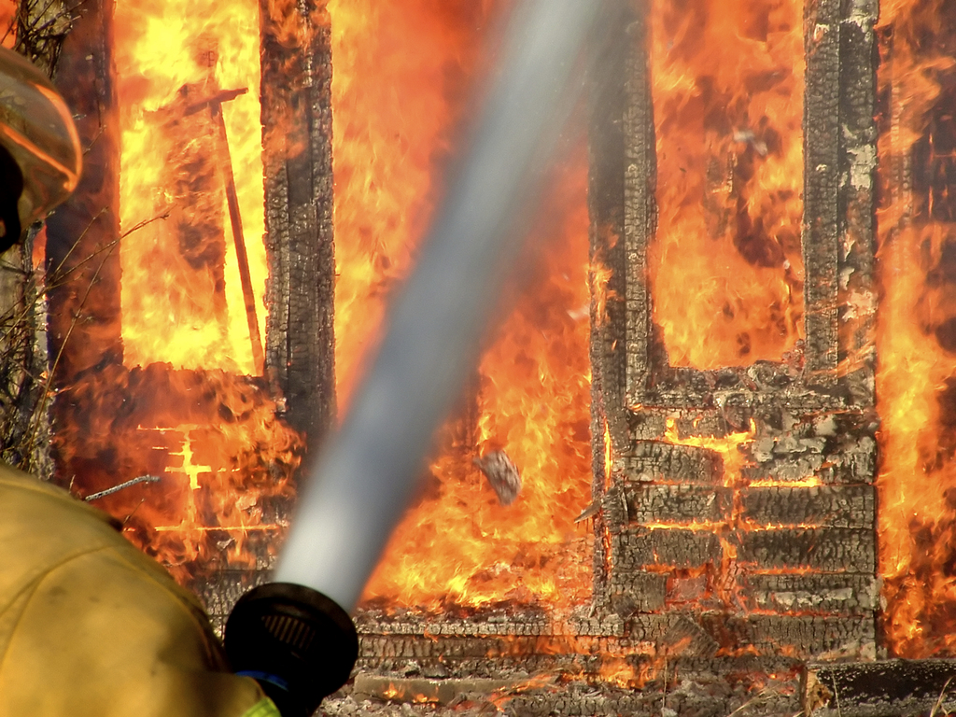



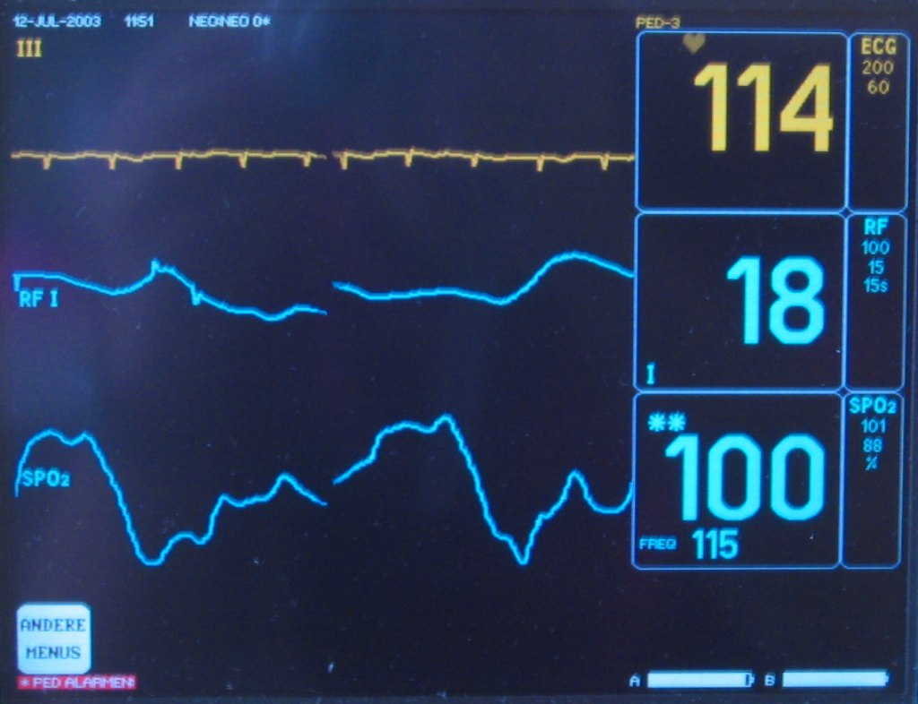
What will you do when:
Server Crash
Disaster
HW Failure
Additional Manpower
Help
Monitoring

Slide 7
The Solution? I.R.I.S. ICT RMS Offering!
“As one of the leading infrastructure optimization providers, I.R.I.S. ICT leverages its organization and substantial know-how in providing demanding customers with the appropriate service levels and services they need.”
(Remote) Monitoring
(Remote) Managed Services & Operations
2nd and 3rd Line Support
Services On Request
24/7 Standby Services & Support
“The I.R.I.S. ICT RMS contract is based on standard building blocks or modules. This makes it easy to provide a tailored solution to practically any needs!”

Slide 8
The I.R.I.S. ICT Value Proposition
Improved Management of IT infrastructure
Improved Customer Service
Reduced Operational Costs
Freed internal resources
Access to best IT experts
Leverage industry best practices
Decrease in Business Risk
Increase quality of Service

Slide 9

(Remote) Managed Services
(Remote) Monitoring and Management
(Virtual) Servers Status
Storage Components Status
Network Status
Status Backup Environment
Status Services
Status Applications
(Remote) Monitoring
allows I.R.I.S. ICT to anticipate or identify potential issues before they become actual problems
(Remote) Management
allows I.R.I.S. ICT to manage your complete (or predefined subset) of your IT environment,
based on defined service level agreements

Slide 10



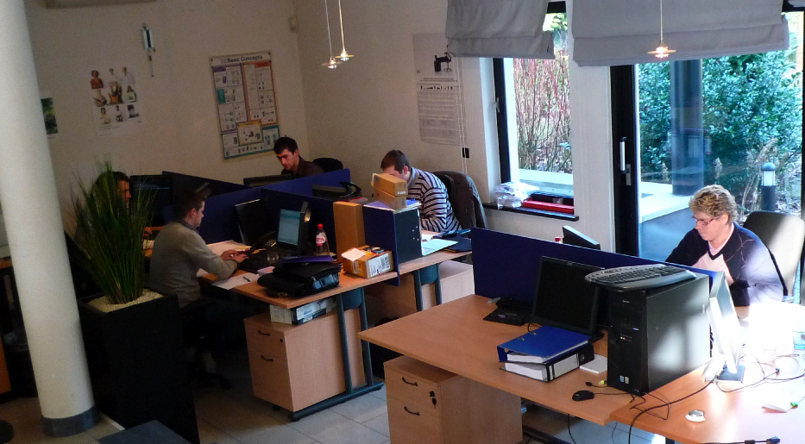




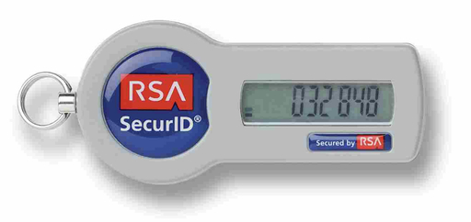

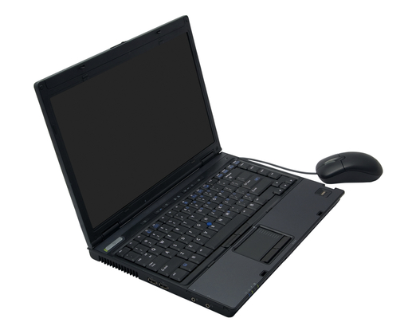
Remote?
VPN to customer
VPN to NOC

Slide 11
How is I.R.I.S. ICT organized?
Currently 3 Teams or knowledge groups

Slide 12


During the Day

Slide 13

During the Night/Weekends

Slide 14
SLA’s?

Slide 15
Managed Operations

Slide 16
Managed Operations

Slide 17
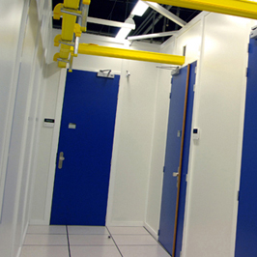
Data Center services
Eliminate the need for a dedicated computer room, air conditioning, backup power and redundant WAN connections by placing your equipment in our data centers. I.R.I.S. ICT operates private rooms in several datacenters.
This tailor-made environments ensure us of necessary capacity to house even high-end systems, and gives us the flexibility to design our network to the needs of our customers.

Slide 18

Data Center services
Multiple secure sites
Private rooms
Plenty of power, space and cooling
Access to multiple carriers and fibre networks
Backup supporting services (dns, mx, …) distributed geographically

Slide 19
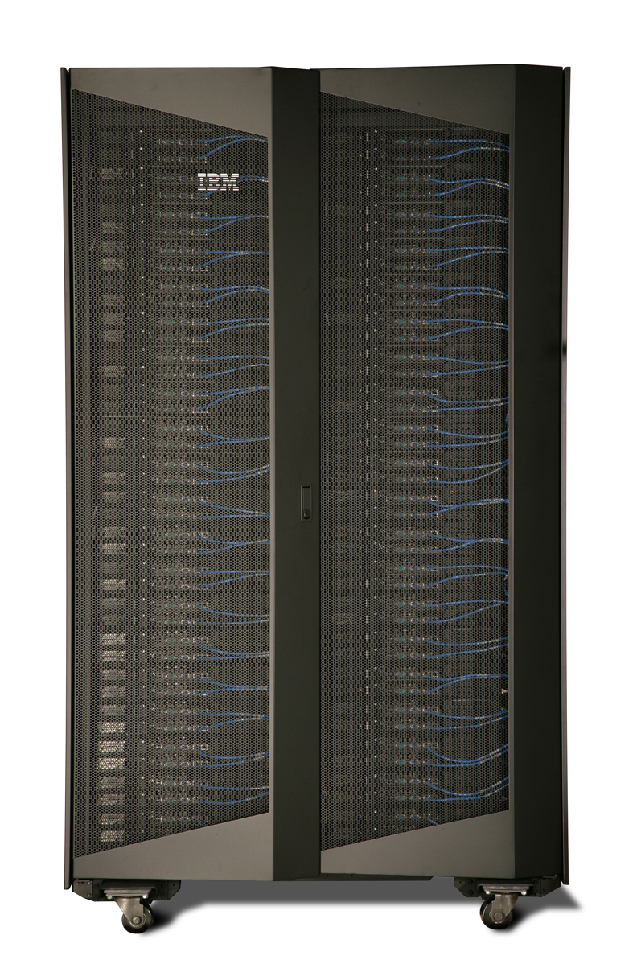
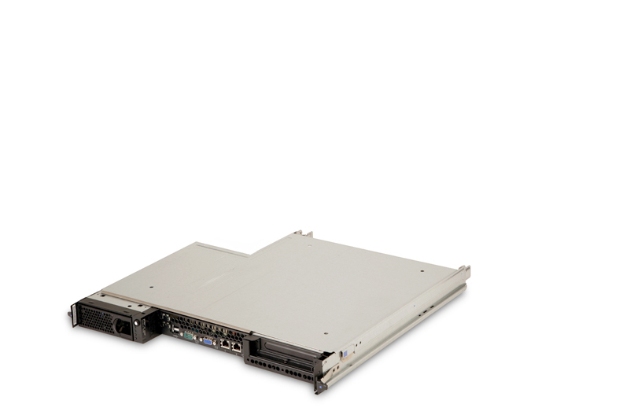
Data Center service: Housing
Pure co-location: servers, network devices, … are property of the customer.
Power, space and network provided by
I.R.I.S. ICT
From 1U to up to private rooms

Slide 20
Data Center service: Hosting
Capacity is provided on demand by I.R.I.S. ICT
Very flexible
No capital expenditures
Leverage economies of scale of our high-end environments

Slide 21
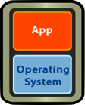


Hosting offer
Application hosting – SaaS
  We provide you with the capacity to host your application, and scale up as necessary. You don’t need to worry about upgrades, patches, backups
Dedicated virtual servers
  Get your own dedicated virtual machine(s), with dedicated cpu, memory and disk capacity. By using virtualization you achieve “better than physical” uptime, manageability and scalability
Dedicated servers
  Get your own, unshared physical server, according to your specifications, but without the up-front investment.

Slide 22
Specialized solutions: Business continuity & Disaster Recovery
Remote backup
  Remote storage copy, tape vaulting, …
Hot standby sites
  Backup capacity, ready to roll in. Eliminate downtime from days to hours or minutes by leveraging storage mirroring, VMware Site Recovery Manager

Slide 23
Specialized solutions: WAAS
Wide Area Application Services
leverages a hardware footprint (WAE) in the remote office and in the data center to overcome application performance problems in WAN environments
Remote Office
Data Center
WAN
Remote Office
Optimized Connections
Optimized Connections

Slide 24
The I.R.I.S. ICT added value
Specialized services
  The full RMS service portfolio is available in our datacenters
Carrier neutral
  Short, stable, affordable routes to your branch office
Focus on innovation to add value
  Continuous investment in education, skills, new technology

Slide 25
Copyright
Copyright © 2008-2009 I.R.I.S. ICT NV
Trademarks
I.R.I.S. ICT and the I.R.I.S. ICT logo are registered trademarks of I.R.I.S. ICT NV.
VMware, the VMware "boxes" logo and design, Virtual SMP and VMotion are registered trademarks or trademarks of VMware, Inc. in the United States and/or other jurisdictions.
For a complete list of VMware copyright, patent and trademark notices, please visit the VMware website.
Microsoft, Windows, and Windows NT are registered trademarks of Microsoft Corporation.
Linux is a registered trademark of Linus Torvalds.
IBM, the IBM logo and the IBM Premier Business Partner logo are trademarks or registered trademarks of International Business Machines, Inc. in the United States and in other countries.
All other product names, company names, marks, logos and symbols mentioned herein may be trademarks of their respective companies. The usage within this document does not constitute a claim on its ownership by I.R.I.S. ICT.
All announcements of future products, pricing and strategies are subject to change. Announcements by I.R.I.S. ICT are done under the terms of the partner agreements between I.R.I.S. ICT and its partners. Disclosure of confidential announcements should not be construed as a waiver of confidentiality by the original vendor.
Photo credits: slide 4: Anthony P; slide 6: Elvis Santana, Pepo, funkybego, steved_np3; slide 10: Marnix Vrambout

