Slide 1

Legal aspects of digital archiving

Slide 2
Agenda
Objectives of the conference
Archiving vs Legal Archiving vs Compliance
Legal archiving coverage and principles
Record Management definition
Legal and normative environment
Solutions

Slide 3
Objectives of the conference
As we are not jurists but IT integrator we want to give pragmatic information about how to approach Legal archiving and Compliance when implementing an Electronic Archive

Slide 4
Objectives of the conference
Also because I.R.I.S. provides solutions to manage unstructured information, the focus of the conference will only concern archiving of unstructured information, extended to all types et nature

Slide 5
Objectives of the conference
Give an answer to some questions :
  Why do people archive documents ?
  Why to implement an electronic archive ?
  Which documents are concerned by ‘Legal Archiving’ ?
  What is the ‘Legal Archiving’ framework
  Which constraints are associated with ‘Legal Archiving’
  What is the difference between ‘Legal’ and ‘Compliant’
  What about Records Management
  Are there technical solutions ?
  How I.R.I.S. may participate in implement ‘Legal’ and ‘Compliant’ environments

Slide 6
Reasons to archive documents
Preserve the history of the organisation
Make a knowledge base
Be compliant with internal rules
Be compliant with business or sector rules
Be compliant with standards
Be compliant with The Law
Be able to provide a probing force in case of juridic conflicts

Slide 7
Reasons to transpose paper archive to an Electronic Archiving system
Avoid multiple filing of the same information
Facilitate the transverse access to any type of document
Prevent from manipulating paper
Prevent from printing electronic information in order to archive it
Gain storage space by shredding paper

Slide 8
When are we talking about ‘Legal Archiving’
Reasons to archive documents
  Be compliant with the law
  Be able to provide a probing force in case of juridic conflicts
Reasons to transpose paper archive to an electronic archiving system
  Gain storage space by shredding paper

Slide 9
The difference between ‘Compliance’ and ‘Legal Electronic Archive’
Compliance define standards and norms to be applied for the management of information, including unstructured information, by industry and or by localization (ex: Sarbannes-Oxley Act, EMEA, ISO9001:2000, Moreq2) – to implement Compliance ‘Records Management’ is often needed
Legal Electronic Archiving is only possible when a Law describes the conditions of Electronic Archiving
For juridic probing force, jurisprudence may be applied but without certainty

Slide 10
Introduction to ‘Records Management’
The field of management responsible for the efficient and systematic control of the creation, receipt, maintenance, use and disposition of records, including the processes for capturing and maintaining evidence of and information about business activities and transactions in the form of records
A ‘Records Management’ solution must comply to one or many international, european or national standards (DoD5015.2, ISO 15489, PRO, Moreq2, Remano, …)
In Belgium we will talk about ‘Records Management’ for e-government, business sector compliances, e-mail archiving
‘Records Management’ is not needed to implement ‘Legal Archiving’

Slide 11



First Legal example : The ‘Proof of Evidence’
Belgian Social Security institutions
The proof of evidence is based on procedures
Document Management solutions sustain the execution of the procedures
The procedures must certify that :
  All concerned documents are stored in the system
  All documents are conform to the original
    Nr of pages
    Presentation & content
  Documents are never re-writable
  Long term storage is guaranteed
  Long term rendition is guaranteed
For each institution, each project, a certification is provided by the ‘Banque Carrefour / Kruispunt Bank’
A good example : the physical documents associated with the pension of all belgian citizens have been destroyed !
I.R.I.S.
Bar
Coder
Conversion
I.R.I.S.
DocCenter
Fig 1: Bewijskracht

Slide 12

Archiving of invoices
The situation before December 2006 concerning electronic storage :
  Limited to invoices produced and exchanged electronically
The reasons :
  authentication of the sender (digital signature)
  Integrity (encryption)
  Non repudiation (timestamping)
The law of December 2006 includes all types of invoices
Since the 13th of may 2008, there are clear recommandations about
  The process for capturing and storing the images
  Technical recommandations
This law could be the legal base to extend the law to other types of documents

Slide 13
Best practices : Techniques
Hashing : Integrity
Encryption : Confidentiality
Strong authentication : Rights management
Electronic signing : non repudiation by all actors in the process
WORM storage : no possibility to replace a document or a version with another
Timestamping : guarantee of the existance of the information a the moment of the signature / encryption / hashing
Tracing
Retention policies
Usage of universal formats (PDF, PDF-A, …)
+ organizational procedures !

Slide 14
Techniques applied to account payable invoices
Selection of a ‘integer scanning’ profile
Binary choice :
  Color Scanning 24 bits, 200 dpi, compression JPEG 2000
  B/W Scanning, 300 dpi
Batch scanning of all pages
  For each invoice, UID generation visible on the image of the invoice
TIFF or PDF convertion
Associate the document with structured metadatas : creation date of PDF file, name of the software, proove to have used the ‘integer scanning’ profile
Invoice by invoice, addition of an electronic signature to the image of the document and locking of metadatas with this signature
Association between the UID and the Invoice Nr in the ERP system

Slide 15
Particularities
All documents signed manually must be archived as ‘paper’
Extension to other types of documents (delivery notes, orders, contracts) – mandatory when identified on the invoices
Archiving of electronically produced AR invoices, even transmitted in paper (5 years)

Slide 16

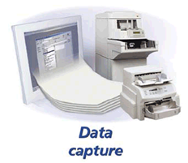









Solution : AP & AR Invoices
Capture
Invoices out, orders, BL,…
Automate
CAPTURE
ERP
CONVERT
Store
LINK
Expose
Java API’s
.Net API’s
WEB Services
URL’s

Slide 17
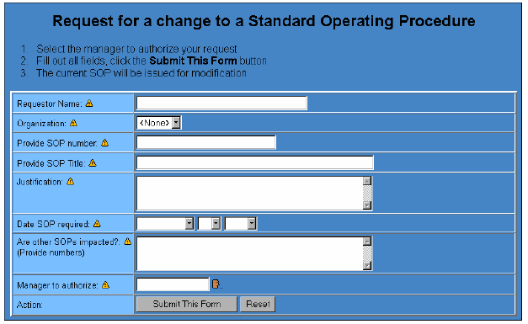
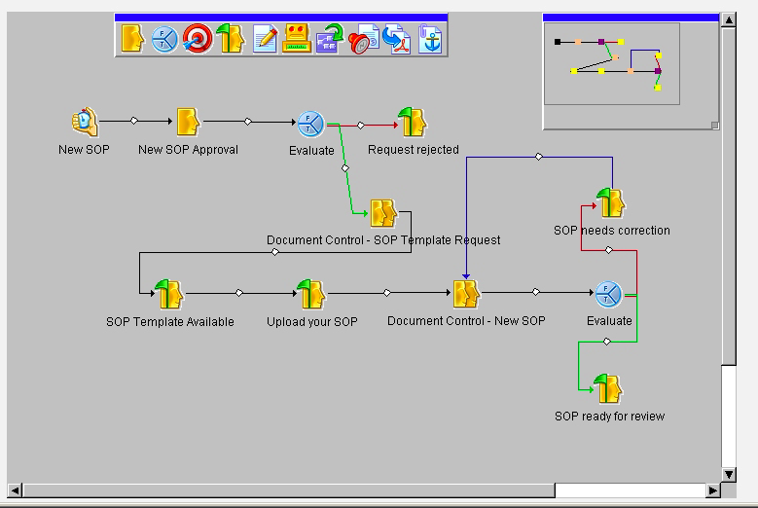
Solution : Regulated Documents
Livelink ECM – Regulated Documents
Coordinate effort at every stage of a regulated submission (e.g.eCTD, DTS)
securely manages documents for highly regulated industries, enabling the management of documents in a manner that satisfies regulations such as the U.S. Food and Drug Administration's 21 CFR Part 11 and the Environmental Protection Agency's 40 CFR Part 3 (CROMERRR).

Slide 18

Q & A

