Slide 1
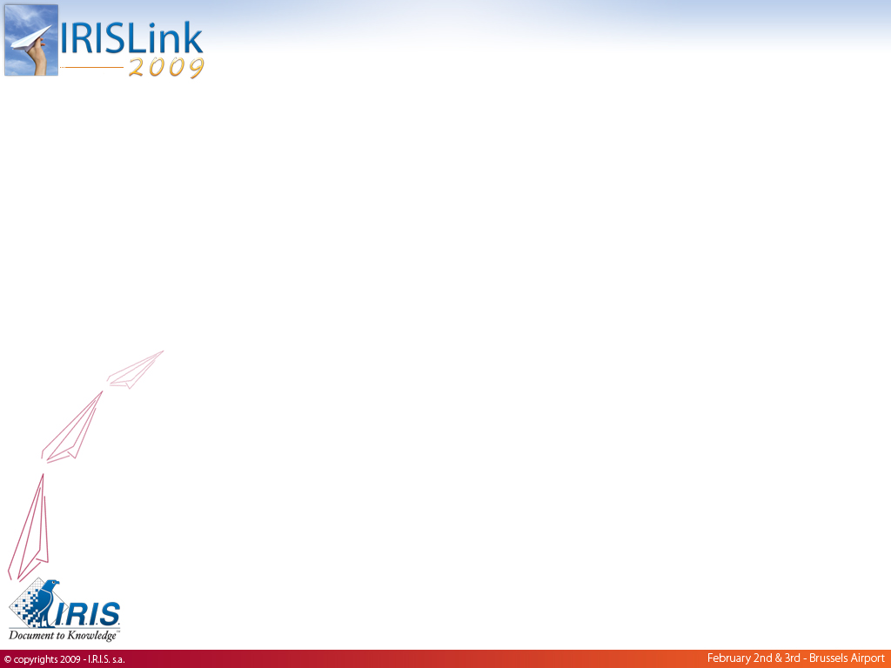
Information Management for
Financial Institutions
Experiences & Best Practices
Notes:
Ladies and Gentlemen, good afternoon
Welcome and Thanks for attending this breakout session
My name is …. And I’ve got about 30 mins to tell you about IRIS experience and best practices in the financial institutions.

Slide 2
Agenda
The Information Challenge.
3 Customer Cases
  Private Banking.
  Insurance.
  Financial Services.
Other Business Applications at a glance.
Best Practices Overview.
ECM Trends for 2009.
Notes:
During this presentation, I will :
explain you why managing the entreprise content is today a key challenge and how to address it.
Then I will present you 3 different projects conducted by IRIS in 3 different domains of the Financial activities : Private Banking, Insurance and Financial Services.
We will also see that IRIS experience covers a lot of other business applications that could be useful for your organisation.
Then we will try to define what a sucessful project is and what are the key points to keep in mind.
We will also spend a couple of minutes trying to figure out what are the key trends in ECM for 2009.
And I will be more than happy to answer your questions in a opened discussion.

Slide 3
















The information Challenge
Key Drivers
Needs
ECM “Solution Bricks”
Strategic :
Improve client communication
Race against competition
Capitalise on Knowledge / Exp.
Guaranty security/confidentiality
PERFORMANCE
SCALABILITY
AVAILABILITY
SECURITY
Scanning & Imaging
Deliver
Capture
EDM
Business / Operational :
Process more complex info.
Access Anytime / Anywhere
Avoid information loss
Reinforce productivity
Share Knowledge and Exp.
Document Workflow & BPM
Search
Information
Organise
Collab
oration
WCM
Legal / Compliance :
Ability to proove
Long-term info. storage
Improve Traceability
Feed-up Reportin
Store / Preserve
Secure
REPORTS MGMT
Manage
Environmental awareness :
Less-paper office
Energy savings
LEGAL
ARCHIVING
RECORDS
MGMT
FORMS
PROCESSING
Services for
ERP
Notes:
Managing the Entreprise Content in a efficient manner has become one of the key challenges for the organisations, whatever your activity is. It’s especially true in the financial sector.
There are a lot of reasons behind this challenge, what we could call « key drivers » .
Information is the organisation’s main asset : managing it efficiently is critical for the organisation strategy : Mastering the information will help in your race against the competition by : helping you to communicate better and faster with your clients, capitalise on your organisation’ experience and know-how, guaranty a proper level of security and confidentiality → Trust.
From the day –to-day business point of view, you must face with an increasing volume of information from heteregeneous sources, you need to access this information 24/7 whatever the place you are. This volume of information needs to be organised and securised to avoid losses and misplacing. As team working is taking more and more importance, information needs to be shared and distributed easily.
The world is more and more complex and dangerous. Regulation and legal pressure is increasing dramatically. Organisation must be able to find and produce the information quickly facing a dispute or in order to feed up the reporting to authorities auditors or simply the management. Traceability is today mandatory, there is need to trace the information (who’s using it, who’s updating it).
Do not forget the environmental aspect.

Slide 4
Customer Case #1 (Private Banking)
Client & Context :
Private Bank.
Located in more than 10 countries.
ca. 3000 employees.
Achievements (2003 to 2009) :
Development of the group-wide portal.
Development of public website (with WCM technologies) - Integration with internal applications.
Subsidiaries and departement-specific Intranet sites : collaborative spaces, project spaces, document sharing, discussion groups).
Electronic Document Management for client folder management : scanning/imaging, indexation, search/retrieve via a web interface, link with internal applications, securised archiving of documents.
Email and SAP archiving.
Next steps :
Legal archiving and paperless office : records management and long-term archiving on specific hardware.
Document-centric Workflow.
Business Needs & Pains
Mutualise IT services to control/reduce costs → Include CM in « Hub of IT Services ».
Increase interoperability with heteregenous Content Applications (subsidiairies). Capitalise on existing applications through the hub / Reduce need for cost and time-heavy migration.
Information-centric needs : reduce paper flow, increase security, automate information flows, develop information sharing.
Scope
The Group, Subsidiairies, Clients (Intranet), Public.
ECM Domains
EDM, Collaboration, WCM, Portal, Scanning / imaging, Email & ERP archiving, Client Folder mgmt.
Key Benefits :
Increased productivity (Reduced working time, improved collaboration and knowledge sharing).
Improved / quicker service to client.
Recuded cost / Improved risk control.
Notes:
First case relates to Private Banking

Slide 5
Customer Case #2 (Insurance)
Client & Context
Large Lux. Insurance Company (Life and non-Life)
450 employees
Achievements :
Dedicated scanning/imaging department (ca. 80000 pages / month).
Electronic Document Management for client folder – Search / retrieve interface through web interface (double-screen : EDM / Core Insurance Application).
Link with Core Insurance Application : EDM triggers actions to the application.
Next steps :
Extend developed CM services to other departements.
Extend to external users (« courtiers »).
Business Needs & Pains
Growing paper flow : complex and poor productivity.
Time-consuming management and distribution of incoming documents.
Reduce paper archiving : space-consuming and cost
Accelerate and control access to the information
Scope :
1st step : « Service Sinistre »
2nd step : « Healthcare »
Extension to every departments
Key Benefits :
Information is centralised : better and quicker access to all documents.
Improved quality of service for client
Improved security and risk control
Costs and workload reduction through paper volume decrease.
ECM Domains :
Scanning/imaging, EDM, Workflow, Email archiving, link with 3rd party applications.

Slide 6
Customer Case #3 (Financial Services)
Client & Context :
Lux. Company specialised in setting-up, domiciliation and management of companies.
subsidiairies in several countries
Achievements :
Remote scanning/indexing platform allowing paper scanning from various locations (distributed scanning).
Collaborative solution to provide each subscribing client with a personnal easy-to-use web-based workspace with high level of security and confidentiality.
Maintenance and support and specific development of the solution (software).
Maintenance of a complex IT infrastructure (servers, network, high availability, backups).
Business Needs & Pains :
Setup a commercial offer providing clients with remote hosting and access to their personnal documents through an easy-to-use interface.
Externalise the hosting and management of the solution (software, platform).
Key Benefits :
Acquire advantage on competition by proposing a specific high-technology service.
Increase revenues.
Improve level of service and communication to client.
Scope :
Subscribing clients (currently 50)
ECM Domains :
Scanning/indexation, EDM, Collaboration.

Slide 7
Other Business Apps at a glance
Legal / Compliance :
Legal Archiving
Customer Records Management
Disclosure Automation to regulatory authorities → CSSF
Sales / Marketing
Contract Management
Marketing brochures
Funds Description brochures
Policy Manual
Administration / Accouting :
Account Payable / Receivable Management.
Human Resources Management (Specific Module ABBL)
Policies and Procedures

Slide 8
Best Practices Overview
What is a successful project ?
A Project that is utilized !!!!
Pay a particular attention to :
conducting a strong and exhaustive preliminary analysis : identify and assess content and flows, information organisation, business rules, key actors.
building « easy-to-use » interfaces that preserve or improve the existing way of working : « No big bang, no revolution but smooth transition ».
smoothly accompanying the change.
identifying and measuring the risks.
keeping always the future in mind : long-term information accessibility, capacity planning and solutions evolution, standard (non-exotic) technologies.
getting the users involved in a very early stage of the project.

Slide 9








ECM Trends
Increasing Compliance Pressure
Gain Productivity / Reduce Costs / Quick ROI
Race against competition
“Crisis Environment”
Environmental Awareness
Reduce paper consumption
Preserve Nature / Save Energy
“Green ECM”
New collaboration tools
Mobility / Comms / New content
Networking Spaces (Facebook)
Project / Team Spaces
Blogs, Wikis
Instant Messaging
Conferencing Video/Audio/Web
Phone / Email

Slide 10























IRIS’ References (1/2)

Slide 11



























IRIS’ References (2/2)

Slide 12
IRIS’ References (1/2)

Slide 13
IRIS’ References (2/2)

Slide 14
IRIS’ References (1/2)

Slide 15
IRIS’ References (2/2)

Slide 16
IRIS’ References (1/2)

Slide 17
IRIS’ References (2/2)

Slide 18
IRIS’ References (1/2)

Slide 19
IRIS’ References (2/2)

Slide 20
IRIS’ References (1/2)

Slide 21
IRIS’ References (2/2)

Slide 22
IRIS’ References (1/2)

Slide 23
IRIS’ References (2/2)

