Slide 1


Pierre Deschamps
Sales Engineer OEM/VAR

Slide 2
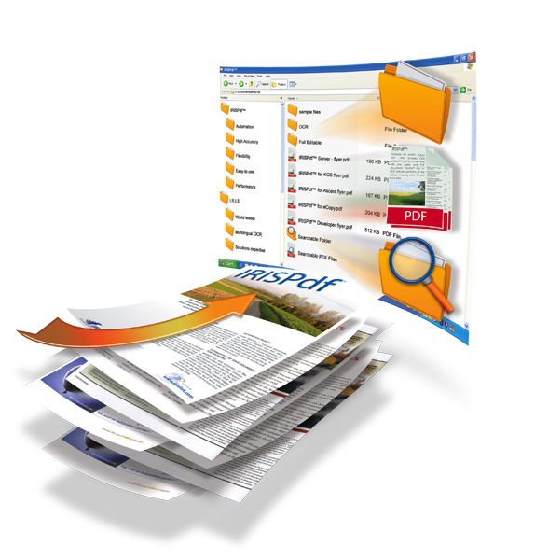
Are you looking for a competitive Recognition Server ?
Discover…
The most robust solution to structure, index, compress and convert all your documents into optimized text files

Slide 3
The issues…
PAPER
Despite the importance of electronic exchange, document sorting and archiving are still paper-based
A very important waste of time to retrieve and access paper documents
  … professionals spend 50 percent of their time looking for information … (Gartner Research)
A lot of documents get lost
  … Companies typically misfile up to 20 percent of their records forever… (ARMA International)
The manual encoding of the information leads to a waste of time and an important risk of mistakes
…resulting in an uneconomic storage of your scanned documents!
SEARCH
LOSS
ENCODING
MONEY

Slide 4
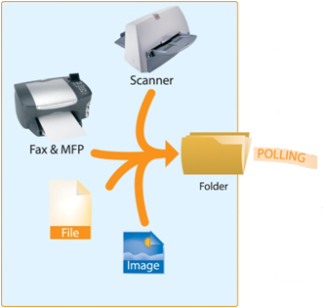


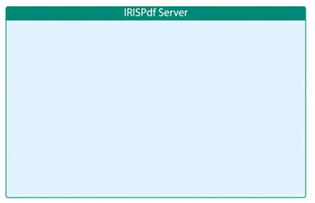


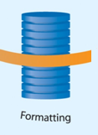
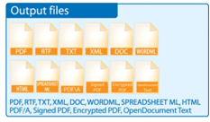
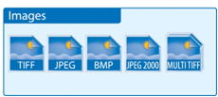
Our Solution…
Automatic data processing of all your documents
IRISDocument 9 Server

Slide 5




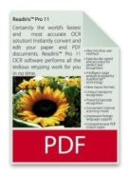

Our Solution…
Major Benefits
Up to 60,000 documents a day!
  Multi-CPU add-on
  24/7 processing
  Service mode
iHQC™ add-on
  convert standard color images into highly-compressed
  PDF or XPS files with searchable text while maintaining
  the same image quality
Large number of output formats!
  PDF Image, Image-Text, Text, Text-Image, with many options: PDF/a compliance, certification, encryption), PDF-iHQC™,
  XPS Image, Image-Text, Text, Text-Image + XPS-iHQC™
  Text, RTF, Word, OpenDocument text, HTML, XML, WordML, SpreadsheetML, Image files (TIFF, BMP, JPEG, JPEG2000)
SPEED
COMPACT
# OUTPUTS

Slide 6
Our Solution…
New Features
New iHQC
  Enhanced iHQC formatting for low resolution images
New Sharepoint Add-on v.2
New output formats
  PDF/A iHQC at level I and II
  XPS & XPS iHQC
New Export possibilities in Watched Folder mode
Improved Arabic recognition
Improved recognition for low resolution colour and greyscale images

Slide 7
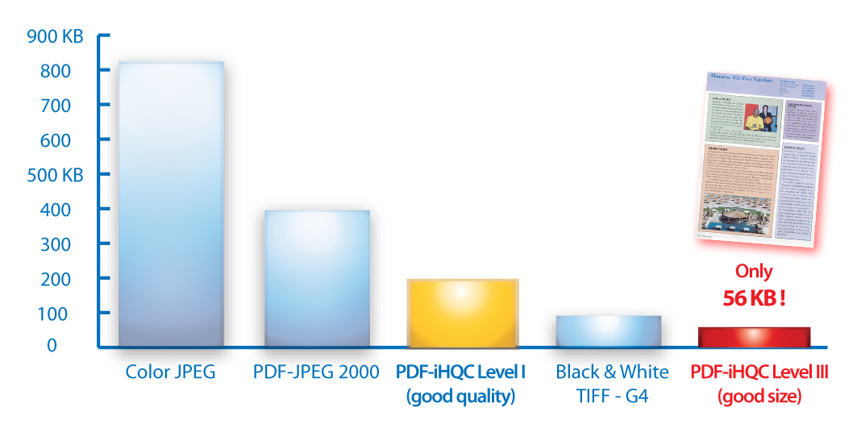

Our Solution…
New iHQC™ Technology
  The legibility of the text is exceptional (same as the original document)
  Need less bandwith to share your documents
  Need less storage space to archive all your files
    The size of a PDF-iHQC™ file is a fraction of the size of a B&W Tiff Group IV file

Slide 8








Our Solution…
New MS Sharepoint Add-on
  IRISPowerscan™
    Scans images, separates them and creates document indexes
    Computes a document type
  IRISDocument 9 Server™
    Transforms the images into searchable files (with possible iHQC hypercompression)
    Sends the files with their indexes to a SharePoint document library, depending on the document type
Invoice 1
Supplier: AT&T
Date: 08.08.08
Mail 1
Subject: Vacation
Mail 2
Subject: Marriage
Invoice 2
Supplier: BT
Date: 07.07.07
Invoice 1.pdf
Mail 1.pdf
Mail 2.pdf
Invoice 2.pdf
Index.xml
Invoices
Supplier Date
Invoice1.pdf AT&T 08.08.08
Invoice2.pdf BT 07.07.07
Mails
Subject
Mail1.pdf Vacation
Mail2.pdf Marriage

Slide 9
Our Solution…
New output formats
  PDF/A, PDF/A-iHQC™: the perfect format for long term archiving, now including I.R.I.S. iHQC™ technology
    PDF Security Method : apply restrictions to protect your PDF or PDF-iHQC™ documents
  XPS : stands for XML Paper Specification. It is the new format developed by Microsoft, with a fixed-layout document format like PDF. (XPS has a viewer by default in Windows VISTA, one available in Windows XP, and is hosted in Internet Explorer 7
  OpenDocument Text: open format based on XML that can be read by OpenOffice, StarOffice and MS Office with add-on

Slide 10
Our Solution…
New export options for the
Watched Folder mode
  The export option is the API of IRISDocument Server
  After each process IRISDocument Server will call the exe that you have indicated in the export tab
  The index.xml file is passed as parameters to the executable
  The executable is launched after each task has been processed
Smooth export to other applications

Slide 11
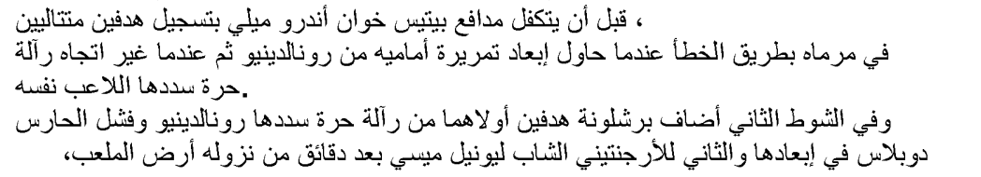


Our Solution…
Improved Arabic recognition
  Arabic is the latest added language to our OCR engine
    Lots of effort on R&D
  New recognition method based on fonts
  Internal voting between two settings of our OCR engine
Omni Font
Multi Font

Slide 12



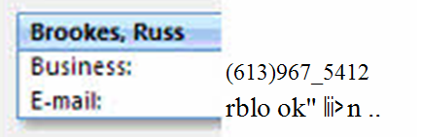
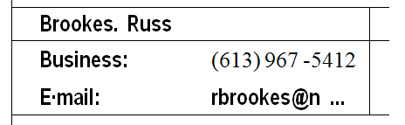
Our Solution…
Improved recognition for low resolution colour
and greyscale images
  Ideal for screenshots or faxes
    Usually 72 dpi
  Interpolation is done to submit a virtual 300 dpi image to the engine
  Very small speed reduction and high accuracy increase
BEFORE
NOW

Slide 13



Our Solution…
Main features (1/3)
Optimized OCR engine:
  More powerful for the analysis, the recognition and
  the formatting of your documents…
  Possibility to choose between speed and accuracy
Recognition:
  Barcodes (more than 28 different types are supported)
  Partial recognition of a batch of documents
  137 languages supported with add-ons for Arabic, 4 Asian languages and Hebrew
  Documents Renaming
  Blank pages detection
  Up to 5 languages recognized on the same document

Slide 14
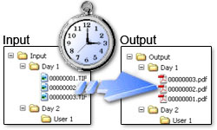
Our Solution…
Main features (2/3)
Picture enhancement:
  Text/picture deskew
  Automatic page orientation
  Despeckle : cleaning of the image noise
  Smoothen : improvement of the image colors
Input formats:
  All the most common formats: *.img, *.gif, *.jpeg, *.jpg, *.j2c, *.j2k, *.jp2, *.psd, *.pct, *.pbm, *.png, *.tif, *.tiff, *.bmp, *.pcx, *.dcx
  PDF files
  JPEG2000 files
  DjVu files

Slide 15
Our Solution…
Main features (3/3)
Output formats :
  PDF (4 different file modes: Image, Image-Text, Text, Text-Image, with many options: PDF/A compliance, certification, encryption), PDF-iHQC™ (3 different compression levels, many options: PDF/A compliance, certification, encryption)
  XPS (4 different file modes: Image, Image-Text, Text, Text-Image), XPS-iHQC™
  Common files such as RTF, Word, Open Document text, , HTML, XML, WordML, SpreadsheetML, Image files (various types of TIFF, BMP, JPEG, JPEG2000)
XML Index Creation
Keep the structure of your files
Dualstream pictures support
E-mail notification when process is stopped
Numerous formatting options:
  Keep the colors of the text
  Keep the colors of the picture’s background
  Add a picture as background

Slide 16
Our Solution…
Sales Arguments
No pages limitation
Incredible price (2.990 € ... 13.000 €)
100% I.R.I.S. technology
137 languages supported + add-ons (Asian languages, Middle-east languages)
Ideal formats conversion for archiving and sharing (PDF-iHQC™, PDF/A, XPS, XPS-iHQC ™)
Open platform for an easy integration into your own application
Very easy to install and to use
=> The perfect solution to supply efficiently your Document Management application!

Slide 17
Our Solution…
Success Stories
SERVICE BUREAU
What: Records for legal processing Before: Records saved on microfilm Now: 40,000 searchable PDF files per day Testimonial: “The speed of the IRISPdf Server allowed us to make this project cost-effective. We could provide searchable records that nobody else could.”
INDUSTRIAL
What: Legal archives Before: 5 Mios TIFFs + 10 Mios paper doc Now: Searchable PDF files Testimonial: “I was worried about the TIFF images… I must say it went amazingly smoothly. All the credit goes to IRIS. It performed as expected.”
INSURANCE
What: Mortgage files Before: Saved as DjVu files Now: Searchable PDF-iHQC files Testimonial: “A 180-page document that used to take about an hour or 2 to download on DSL now takes only minutes… If we didn’t implement the I.R.I.S. iHQC™ software solution we would’ve spent close to $40,000!”
SCHOOL
What: Students records Before: Paper copies or microfilm Now: Searchable PDF files Testimonial: “With IRISPdf Server we’ve saved a lot of time… the whole process including printing out a 40-page document, which used to take an hour, now takes only 5 minutes.”

Slide 18
Our Solution…
Pricing
IRISDocument Server: 2.990€
Multi-CPU Add-on: 2.990€
iHQC add-on: 990€ .. 6.990€
IRISDocument Server Asian: 3.145€
IRISDocument Server Middle-East: 3.490€
IRISDocument Server Demo FREE
IRISDocument Server Page Limited 1K: 249€
IRISDocument Server Page Limited 3K: 495€
IRISDocument Server Page Limited 10K: 990€

Slide 19
Our Solution…
Schedule
Beta : April 2009
Release Candidate : April 2009
Shipping Approval : May 31st, 2009

