Slide 1

IRIS
IDR Toolkit
Document classification and document recognition for partners based on highly optimized free text and layout analysis
Manfred Traeger,
Head of Research & Development IRIS-Docutec AG
Welcome at Brussels Airport

Slide 2
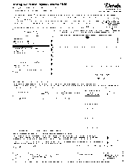
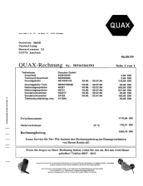
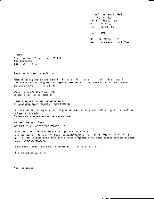

IDR Intelligent Document Recognition
- a substantial application range -
One engine.
Forms recognition
(structured docs)
20 years
experience.
Free text recognition
(unstructured docs)
100% IPR.
Content classification
(structured & unstructured docs)
Latest
technology.

Slide 3
IDR Toolkit’s vital parts
Analyze kernel
Easy-to-use API (C, COM, .NET, WEB).
Fully encapsulated configuration
speeds up integration scenarios.
Highly productive object- and event-
modell for individual solutions.
Integrated customizing based on VBS
and Microsoft VSTA.
Provides unsharp data matching.
Fully compatible to IRIS
Xtract for Documents.
Analyze kernel

Slide 4
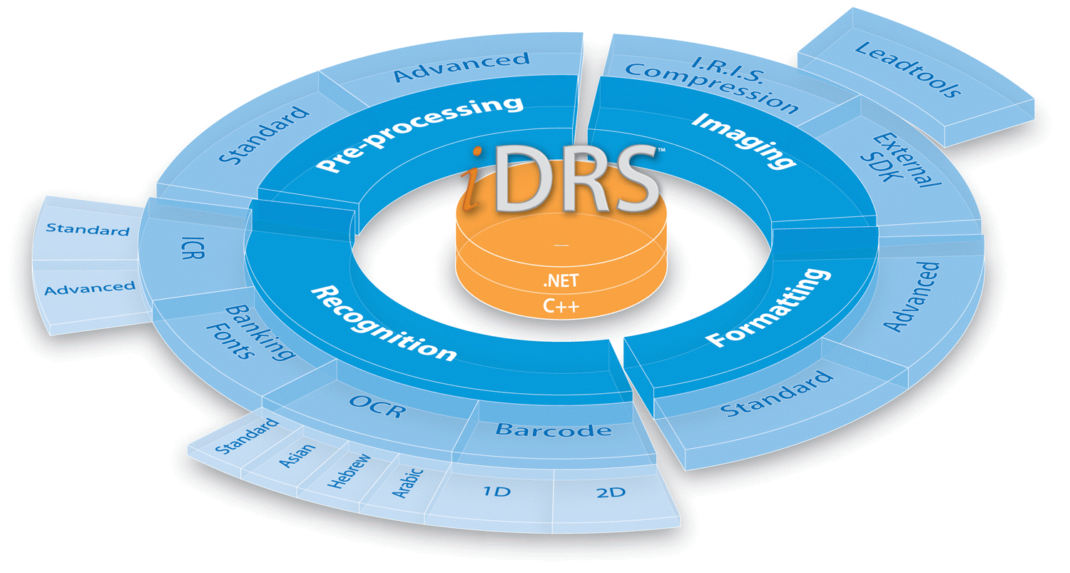
IDR Toolkit’s vital parts
Context
Provides powerful and unique OCR
technology: IRIS iDRS
Various specialized engines
pluggable (e.g. handwriting).
Supports high-level OCR
enhancement and voting.
Features language independent high-
level recognition-operators.
Facilitates unrivaled IRIS
„Solution Package“ approach.
Context
Analyze kernel

Slide 5
IDR Toolkit’s vital parts
Fingerprint
Finger-print
Provides very competitive layout-
based recognition.
Extremely fast and highly reliable
layout analysis enables real-time
processing (e.g. during scanning).
Easy-to-use, „self-configuration“
functionality keeps users from
manually set-ups.
Unique technology, well-known in
the market since years.
Context
Analyze kernel

Slide 6
IDR Toolkit’s vital parts
Classify
Finger-print
Represents state-of-the-art content
classification technology.
Provides fast, highly reliable and
language-independent statistical
content and layout analysis.
Easy-to-use, training keeps users
from complex configurations.
Supports rapid adjustments due to
flexible digital mailroom scenarios.
Provides quality assurance functions.
Classify
Context
Analyze kernel

Slide 7

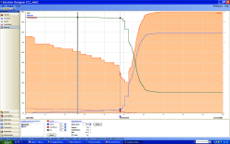

IDR Toolkit‘s vital parts: Classify
Classify
1
„B“
„?“
A
B
C
D
E
F
Information aggregation
Labeling
2
Rules
Multi-statistical
evaluation
y/n
f
a
b
d
c
symbolic
Features
Adjustment
raw
XFingerprint
XContext
3
„A“
„B“
„C“
„D“
„E“
„F“
A-priori-knowledge

Slide 8

Interlocking technologies
Finger-print
You may rest assured:
the whole is greater than
the sum of the parts!
Classify
Context
Analyze kernel

Slide 9

Precious: „Solution Packages“
Pre-defined Toolkit configurations driven
by solutions for business processes!
Highly optimized extraction rule set.
Needless to say.
Integrated business logic in line with the business process.
Rule sets and business logic have been successfully
confirmed in several previous implementations.
Can be modified or extended due to new requirements.

Slide 10


Example: Solution Package
Accounts Payable
Basically language independent.
Processes invoices with line items.
58 optional single data fields and 16
optional line item fields.
Utilizes creditor-, sales tax, order-
and VAT-data.
Over 45 complex constrains form the business logic.
Can be, but typically must not be, modified or extended
due to new requirements.

Slide 11


Solution Packages for the IDR Toolkit
Digital Mailroom Solutions
Business
Processes
Solution Package
Personalized Post
Solution Package
Accounts Payable
Solution Package
HR (Human Ressources)
Solution Package
Factoring
Solution Package
Banking
Solution Package
Healthcare
Solution Package
Orders
YOUR
business process?
Solution Package
Tax

Slide 12



Easy-to-use API, an example
Data transfer utilizes
XML structures.
paramOut needs attention …
Set idr = CreateObject(„IDR.Kernel")
Call idr.Init("D:\Example\Data", "")
Call idr.LoadEnvironment("D:\Example\Cfg", „Invoice")
Dim resultOut, paramOut
Call idr.InitializeDocument(1, vbNullString)
Call idr.LoadPageV(LoadFile("D:\Example\Docs\Doc.tif"))
Call idr.ProcessDocument(resultOut, paramOut)
Call idr.CloseEnvironment("D:\Example\Cfg", „Invoice")

Slide 13
Typical example for dynamic interaction: training
…
Call idr.ProcessDocument(…)
XFinger-print
XClassify
training data
IOIIOIII
Training
(host)
XContext
Analyze kernel
Call
idr.ExecuteCommand(paramOut, …)

Slide 14
IDR Toolkit control data
IOIIOIII
Call idr.ExecuteCommand(…)
Training data
XFinger-print
Host
XClassify
IOIIOIII
(Unsharp)
Master data
Call idr.LoadMasterdata(…)
Call idr.CompileMasterdata(…)
XContext
Analyze kernel
Solution Package
IOIIOIII
Solution Designer
Configuration

Slide 15
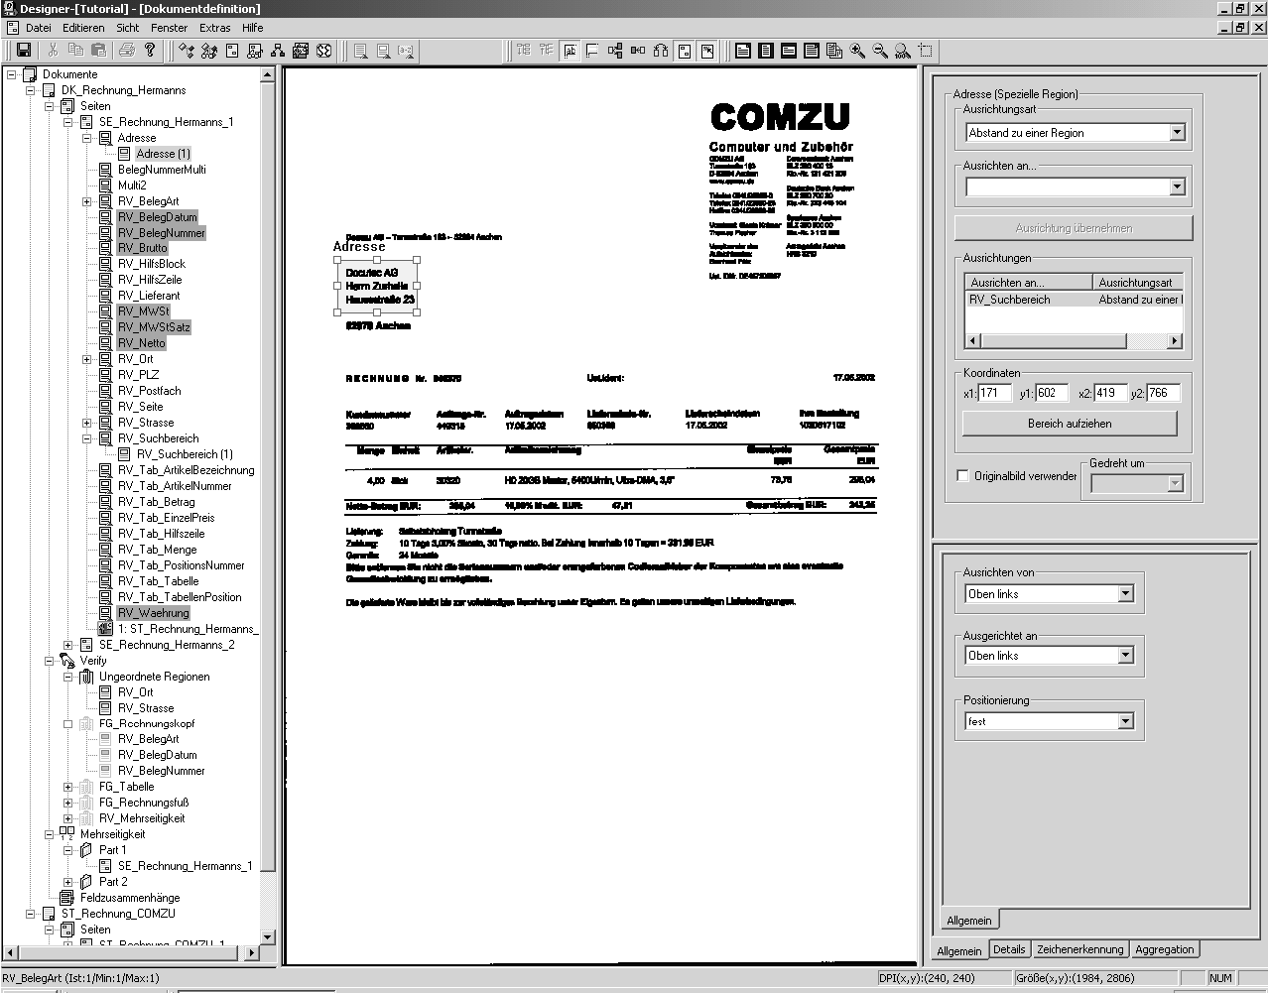
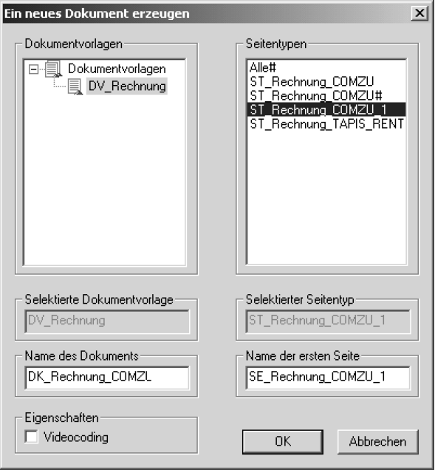
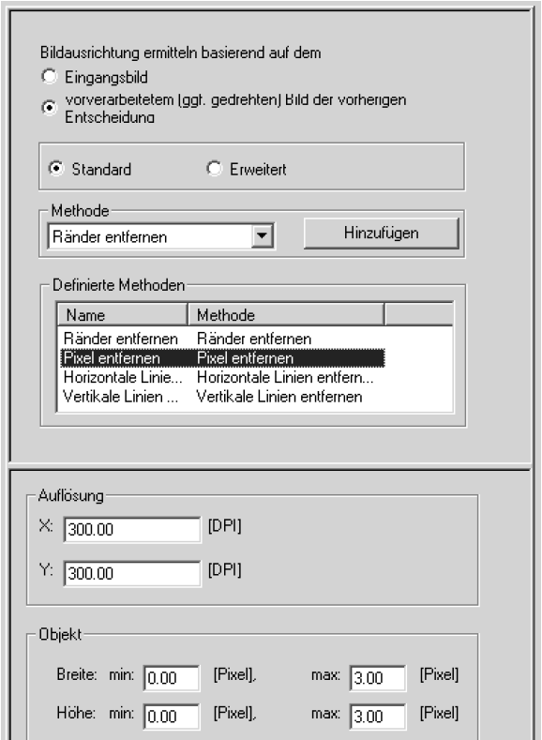
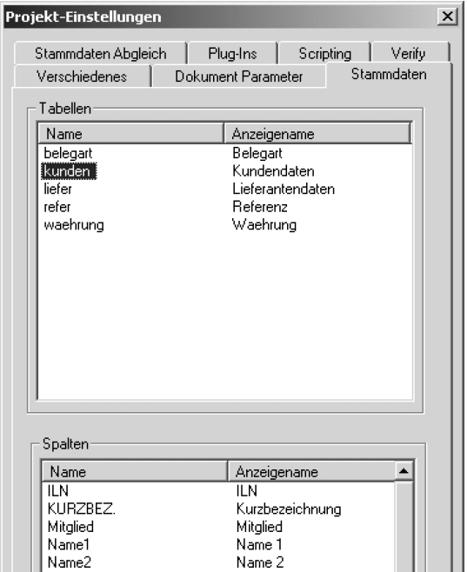
IDR Toolkit configuration with the
Solution Designer
Configuration possibilities based on two work benches:
Form oriented processing (Fingerprint, VBS support)

Slide 16
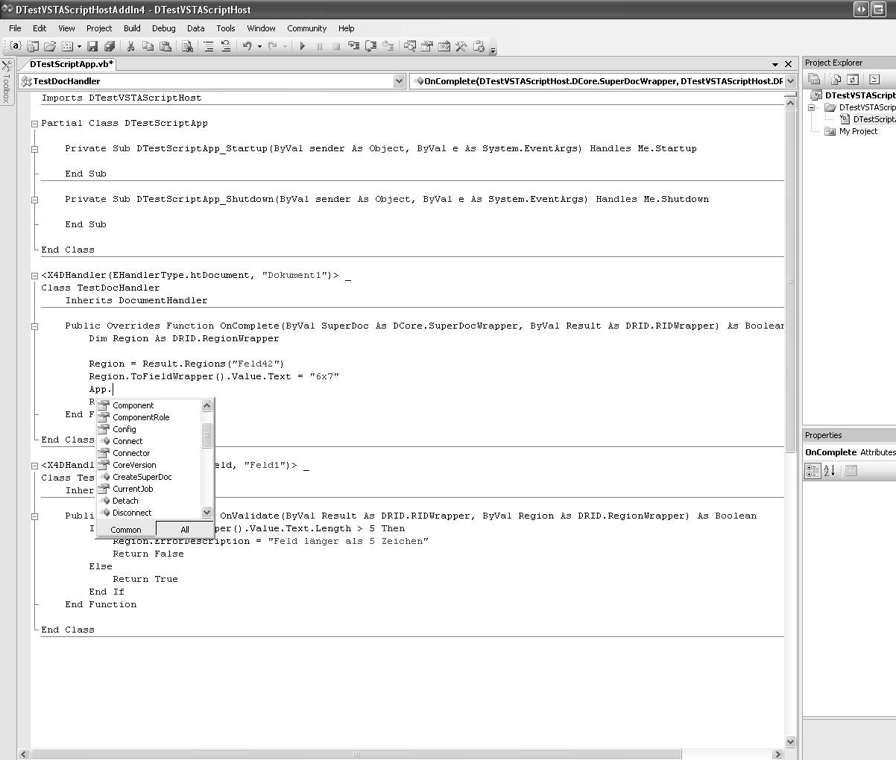
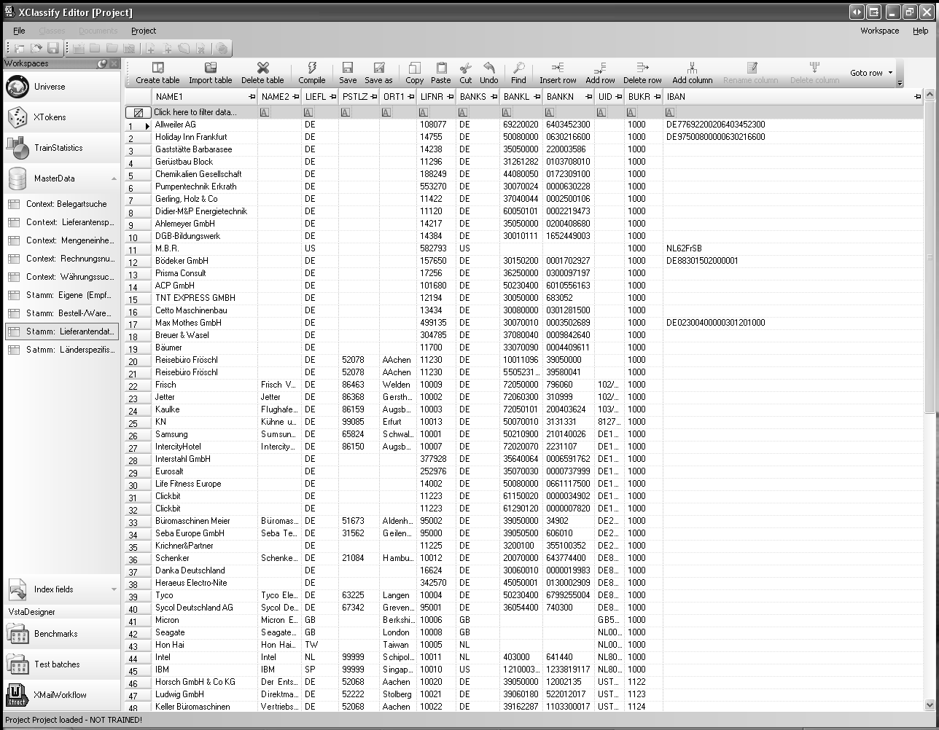
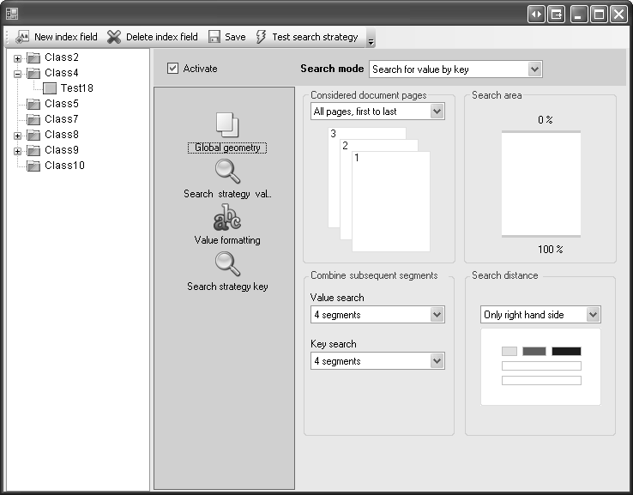
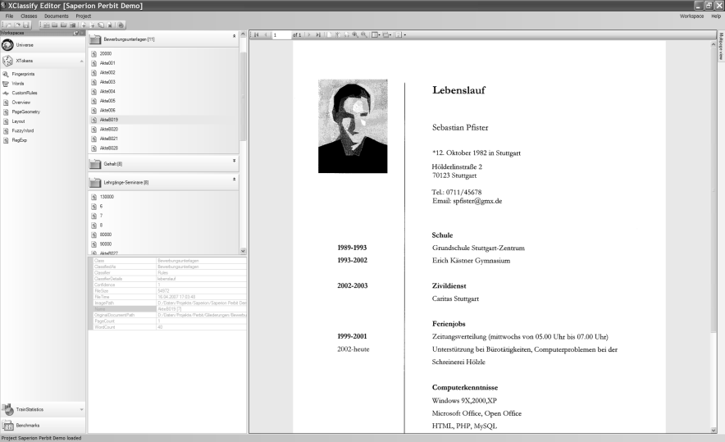
IDR Toolkit configuration with the
Solution Designer
Configuration possibilities based on two work benches:
Free form oriented processing (Context, Classify,
optionally VSTA support)

Slide 17

Operating systems supported by the IDR Toolkit
Microsoft Windows XP SP2/SP3
Microsoft Windows Server 2003 SP2
Microsoft Windows Server 2003 R2 SP2
Microsoft Vista Business SP1 x86/x64
Microsoft Windows Server 2008 x86/x64
Needless to say, we‘re following
Microsoft‘s roadmap instantaneously.

Slide 18




Flexible licensing mechanisms for our partners
Hardware dongle per instance (USB)
Software activation per instance (live key)
Software activation via license server
Customer specific …
We match the integrator‘s business model.

Slide 19



IDR Toolkit deliverable and performance
One MSI installer package including all
modules (particularly IRIS iDRS).
Pre-defined rule sets (Solution Packages).
Needless to say: proper documentation.
Ready-to-go demo integration examples.
Demonstration licenses.
Integration workshops.

Slide 20
IDR Intelligent Document Recognition
- the I.R.I.S. way -
One engine.
Forms recognition
(structured docs)
20 years
experience.
Free text recognition
(unstructured docs)
100% IPR.
Content classification
(structured & unstructured docs)
Latest
technology.

Slide 21
IDR Toolkit
Sort, classify and index all kind of documents based on
unique and highly competitive I.R.I.S. technologies.
Use not only technologies, but also powerful solutions
based on the unrivaled „Solution Package“ approach.
Count on professional and experienced services – world wide.
Challenge our flexibility, 100% IPR build a trustful base for
OEM and VAR partners.
At last an interesting question:
Would you agree?

Slide 22
Thank you very much for your attention.
Enjoy your visit.

