Slide 1

Capture, sort and identify all types of documents and forms, with IRISCapture Pro
Jean-Pierre Ksenicz
IRISCapture Pro Product Manager – R&D
Brigitte Lehmann
IRISCapture Pro Development Team Manager – R&D

Slide 2
Introduction
Applications
Document Archiving and Retrieval
Automatic Document Reading (ADR)
Digital Mailroom
Identification / Classification
A Little Story…
Techniques
Separation
The Sorting Tree
From structured forms to unstructured documents
Combination of techniques
Notes:
IRISCapture is intended to process documents, separation, identification, data extraction, validation and manual verification. When sorting documents, IRISCapture benefits from powerful technologies combining automatic classification and identification by descriptive criteria.

Slide 3

Identification, why ?

Slide 4
Document Archiving & Retrieval
Capture a document
Identify the document type
Extract indexes
manually or automatically (ADR)
Notes:
Screenshot of IPS

Slide 5
Automatic Document Reading
Capture a document
Automatically
extract the data
(“indexes” or “fields”)
Export
Identify the document type
The document type must be identified, to apply the adequate data extraction
by OCR, ICR, OMR (tick marks), barcodes, for structured documents (forms with fixed regions of interest)
by full text OCR with contextual analysis, for semi-structured documents (invoices, contracts,…) or unstructured documents (letters, reports,…)

Slide 6
Digital Mailroom
Capture a document
Identify the document type
Extract the routing data
Addressee, department,…
Manually or automatically
Notes:
Screenshot of IPS

Slide 7
Techniques

Slide 8
Document Separation
Detection of a Separation Sheet
A sheet with a patch code or a barcode can be used as a trigger for the detection of a new document
The barcode usually contains additional information like the document type, or document indexes
A white page is often used as a separation sheet
First Page Identification
By several techniques, that can be mixed:
Fit with anchor points, text in a zone, titles, fingerprint, barcode, classification results, … (see further slides)
Notes:
Before document can be identified, they need to be separated.
Separation and Identification are closely linked

Slide 9
Document Identification
Fast Identification with Descriptive Criteria
Descriptive criteria are defined to identify the document, like :
anchor points
Titles, text in a region, keywords
barcode
Fast Identification with image fingerprints :
A “fingerprint” of each page to be identified is stored in a library
Fuzzy search, regular expressions
…

Slide 10
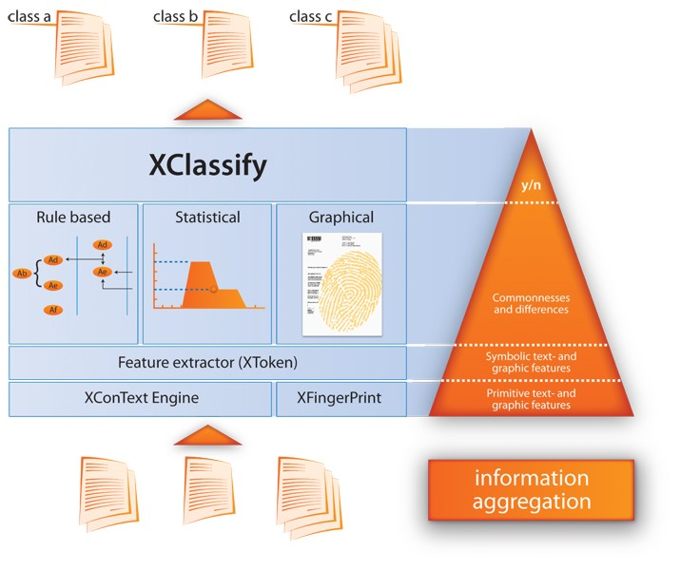
Document Classification
IRISClassify
Document Classification
without pre-definition (self-training)

Slide 11
A Little Story…
From Structured Forms to Unstructured Documents

Slide 12
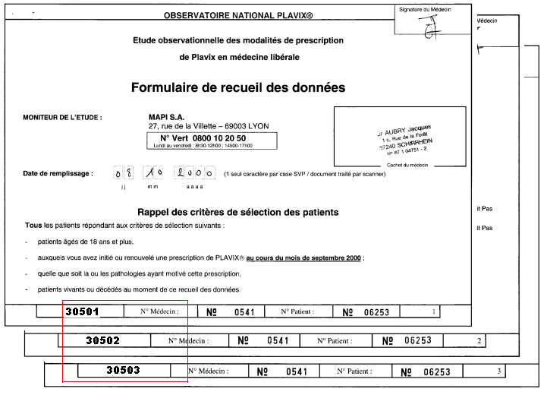
Fixed Layouts (1)
Form identification with descriptive criteria
  A unique value is printed to identify precisely each document type
  High Speed (about 20 images /sec, independent of the number of document types)

Slide 13
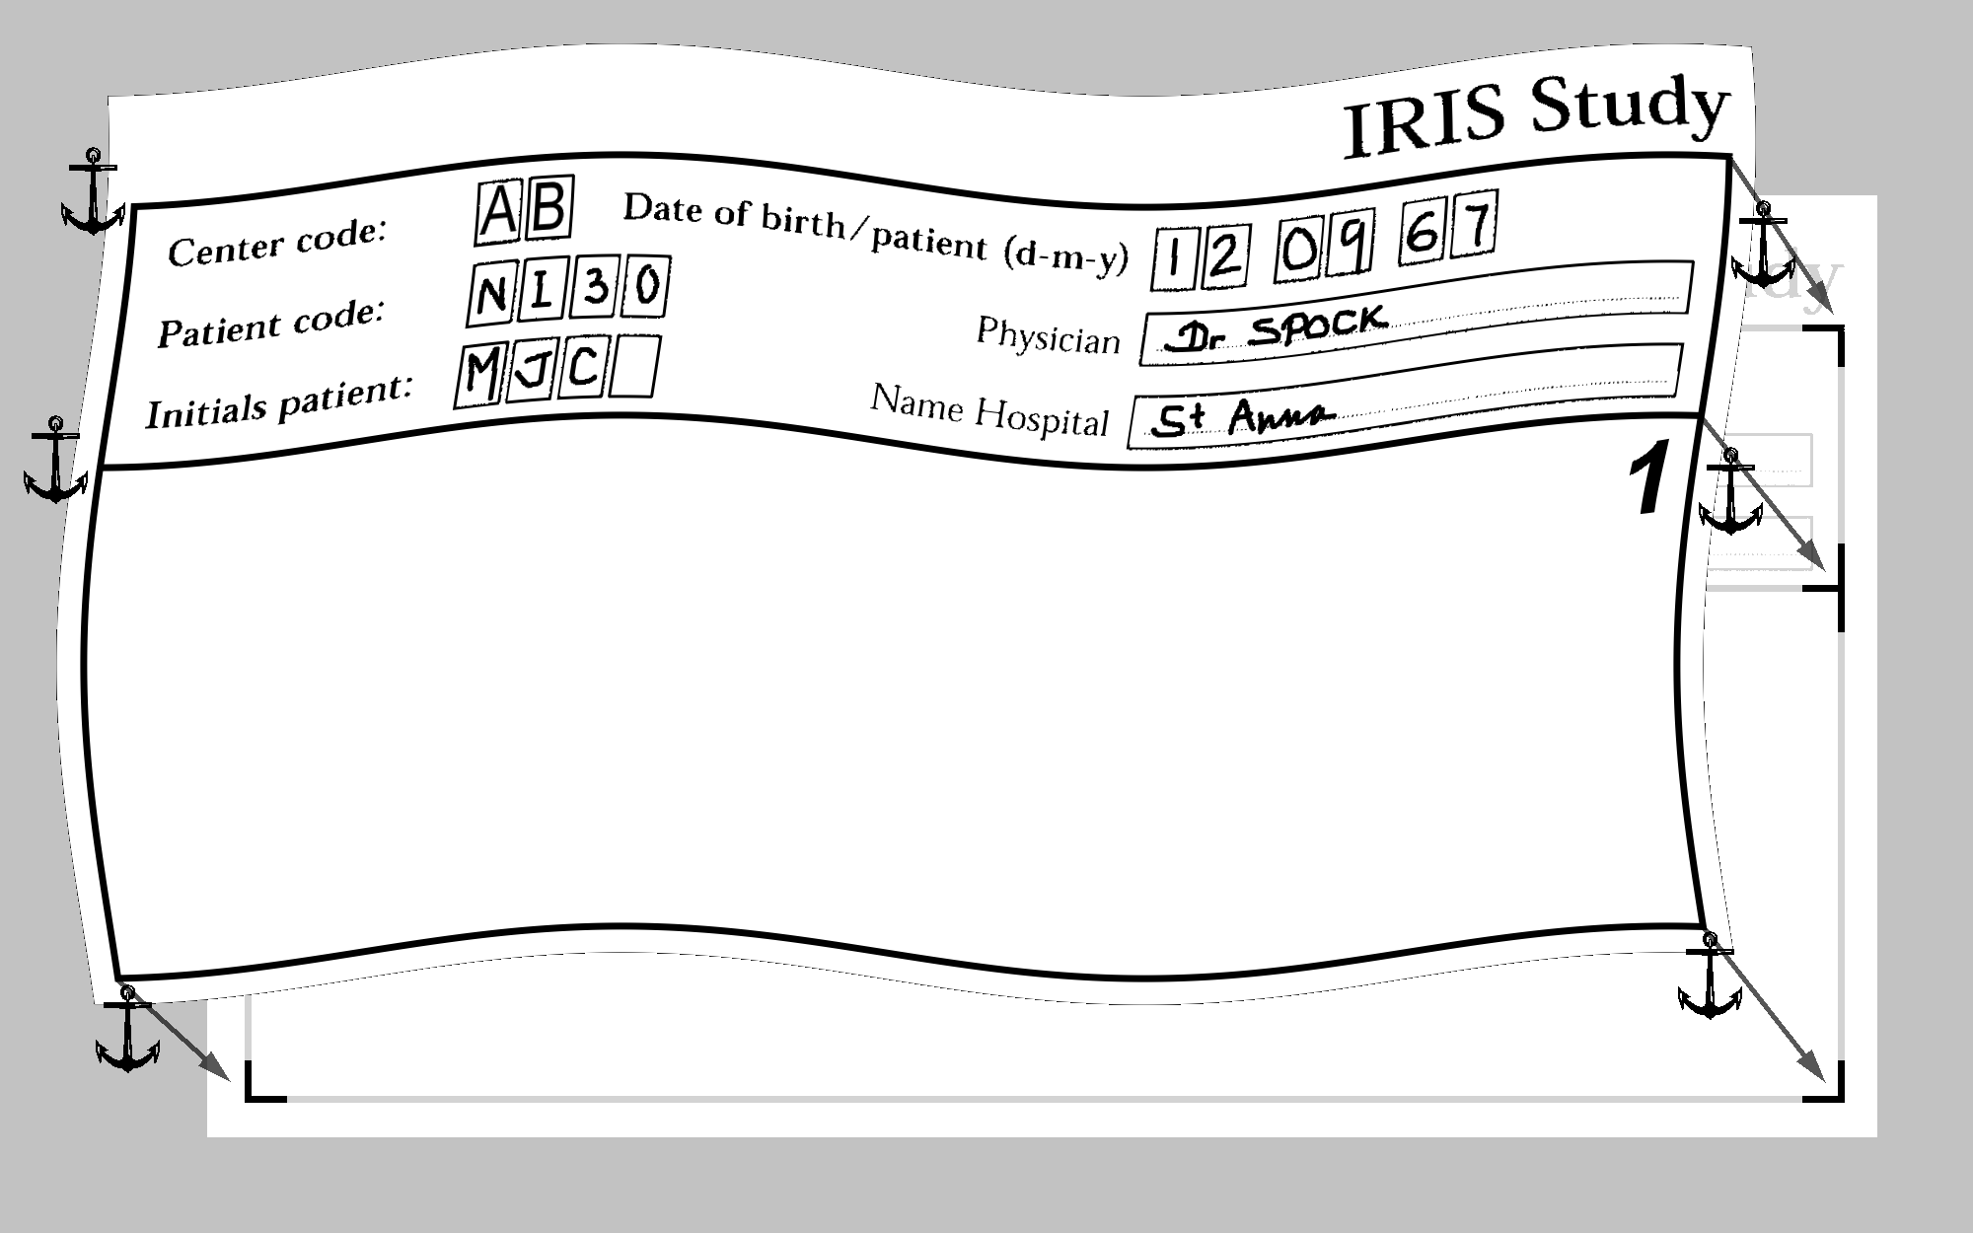
Fixed Layouts (2)
Form identification by fitting
  graphical shapes : lines, frames, logos
  text
  Very high speed (about 30 to 50 images /sec)

Slide 14
Variable Layouts (1)
Grammatical & geographical descriptions
  A structure of the document is established and published: blocks containing fixed keywords
  Speed is linked to the number of document types

Slide 15
Variable Layouts (2)
    Variations in fonts, size, graphical effects (lines, borders,…)

Slide 16
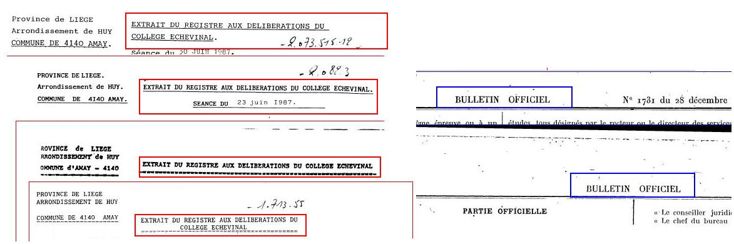
Semi-structured Documents (1)
Identification by titles
  Speed (about 3-5 images/sec, nearly constant)

Slide 17
Semi-structured Documents (2)
Identification by keywords
  Keywords may be found everywhere on the document
  Fuzzy search algorithm
  Regular expressions
  Speed about 1 to 3 image/sec (size of OCR zone)
  Need expertise to identify the mix of documents, need time to define the project

Slide 18

IRISFingerPrint(1)
Identification only based on graphical features :
Size
Layout
Logo
Lines
Marks
...
… 26 32 23 41 76 59 92 …
… 1 2 -2 4 2 3 -2 …
≙ 94,36%

Slide 19
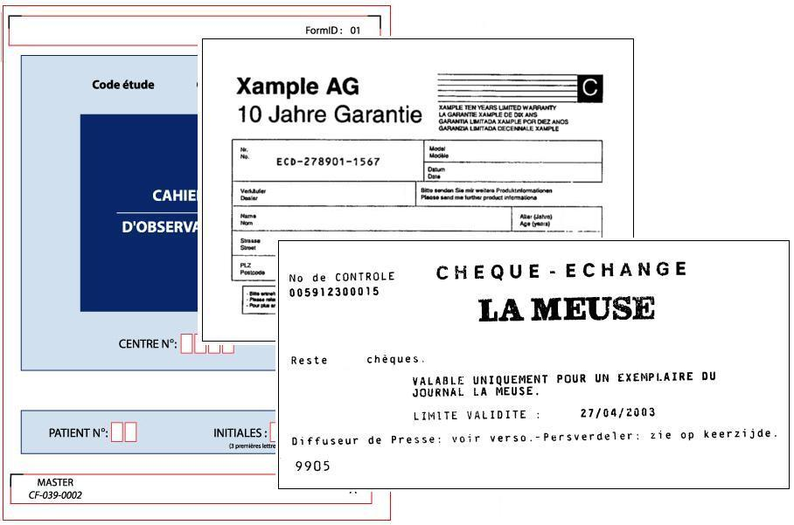
IRISFingerPrint (2)
  No more definition: predefined fingerprints are trained
  Speed about 3 to 5 images/sec, loosely linked to the number of document types
  The documents must have significant layout differences

Slide 20
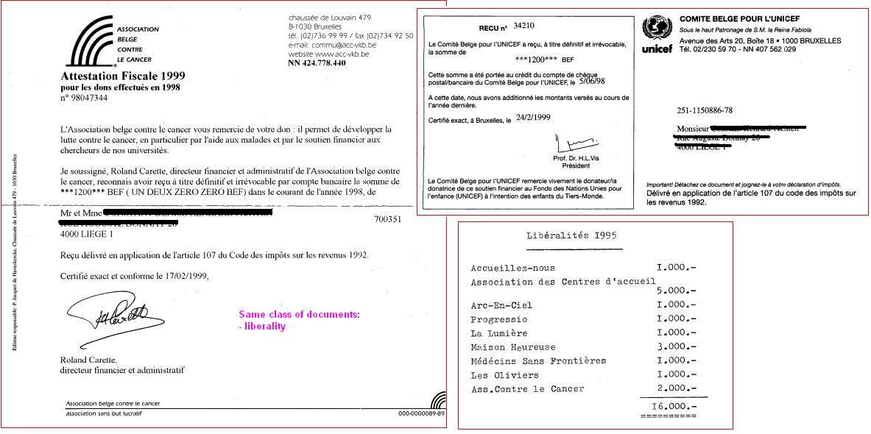
IRISClassify (1)
For structured and unstructured documents
  letters, contracts, forms,… may belong to a same class
  Training of predefined classes, no definition required
  Speed about 0.25 to 0.5 image/sec

Slide 21
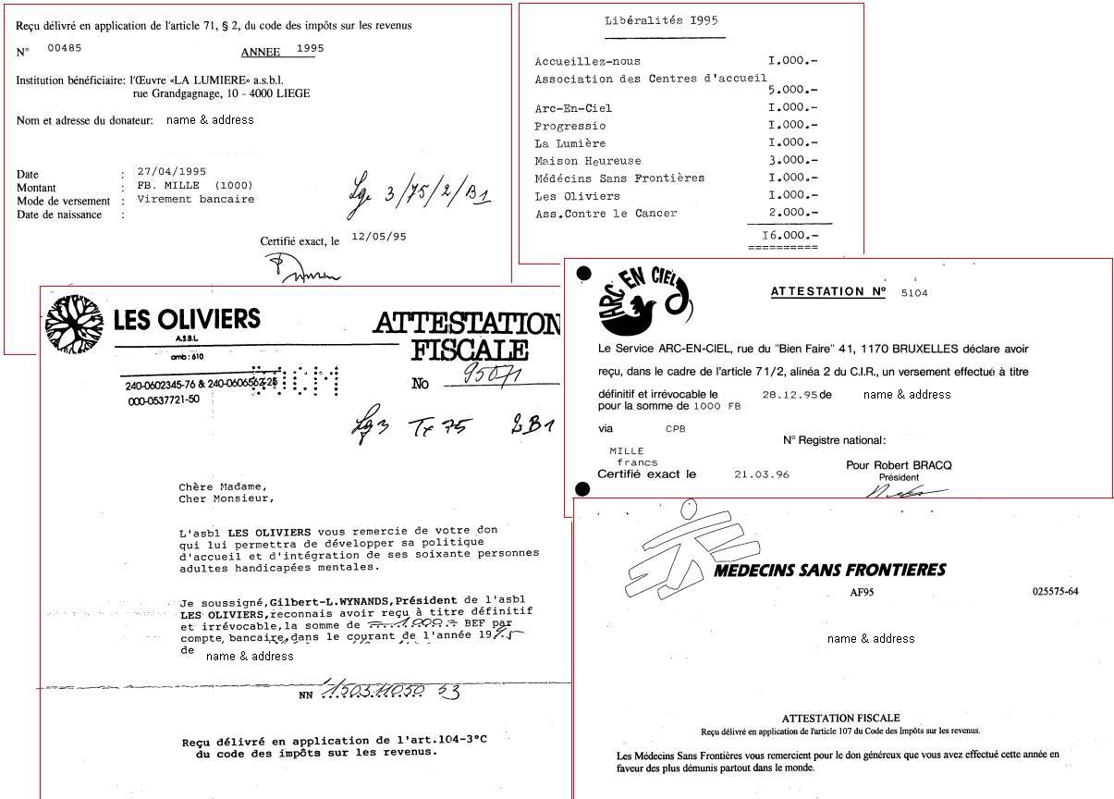
IRISClassify (2)
  Other documents from the same class:

Slide 22
Summary
Method | Speed (image/s) | Pros | Cons | Doc Type
Unique criteria, Unique OCR value, Bar Code, fit | 20 to 50 | Highest speed, High volume, Highest accuracy | Manual definition | Structured or semi-structured
Identification by title | 3 to 5 | Speed | Manual definition | Structured or semi-structured
IRISFingerprint | 3 to 5 | Training, No definition | Only graphical elements | Structured, with sufficient graphical
IRISClassify | 0.25 to 0.5 | Training, No definition, Wide mix of docs | Time for full text OCR and statistics | All
Configuration : Pentium IV, 2.66 GHz, 2 GB RAM)

Slide 23
The Sorting Tree

Slide 24
Sorting Tree :
The Mix of Both Worlds
Identification & Classification working together
All classical criteria may be used
Use of IRISFingerPrint and IRISClassify
Use of any third-party module :
For special identification based on :
cursive handwriting
color schema,
…

Slide 25
Sorting Tree
Get the Optimum
Choose the best technology
for each document class of a project
to optimize the balance speed/accuracy
Combine any technology
With logical AND-OR-NOT operators
Unique identifier, fit, title, keywords,…
IRISFingerprint
IRISClassify
Include third-party engines
Open for specific identification needs

Slide 26
Example of a Sorting Tree
Image Fit ?
Booklet Header
Booklet pages
Appendix…
Classify
Class 1
Class 2
Unknown
for review
Unique ID ?
Page 1
Page 2
Unknown for review

Slide 27
Example of a Sorting Tree :
Get the Optimum (1)
Size
Check
Giro
A3
Image Fit
Doc VAT625
Text length
App VAT625
A4
Image Fit 1
Booklet
Unique ID
Doc 30501
Doc 30502
Doc 30503
Image Fit 2
Doc RABO 4”
Other
Unique Barcode
Sep sheet 1
Sep sheet 2
Other
Classify
Invoice
Mail
Cash Transfer
Small Size
Size
Ticket 1
Ticket 2

Slide 28
Example of a Sorting Tree :
Get the Optimum (2)
<!-- Second Level – based on « Format A4 » -->
<Node Name="Rabo4Inch" Base="FormatA4">
<PageType Value="Rabo4Inch"/>
<DocType Value="Default"/>
<Property Name="FitRabo4Inch" UseLayout="FitRabo4Inch"/>
<Identification>
<MatchProperty Name="FitRabo4Inch" Value="True"/>
</Identification>
</Node>
<Node Name="Booklet" Base="FormatA4">
<Property Name="FitBooklet" UseLayout="FitBooklet"/>
<Identification>
<MatchProperty Name="FitBooklet" Value="True"/>
</Identification>
</Node>

Slide 29
Review Module
Manual Identification
Document Reordering
Split, merge, move documents
For unidentified documents
Image Review
Rotation

Slide 30
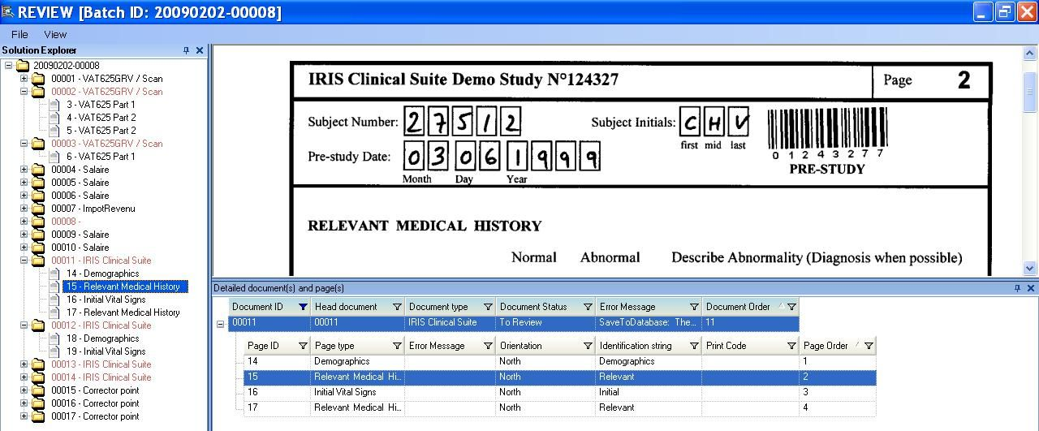
Review Module

Slide 31
Conclusion

Slide 32
Conclusion
Identification and Classification
Sorting Tree : Get the Optimum
The sorting tree optimizes the speed-accuracy balance for each document class in a project
Mix of techniques in a sorting tree :
it makes sense !
Get the optimum

Slide 33
Questions & Answers

Slide 34
A step further
Please Visit our booth for a demo
White Paper on IRISFingerPrint
IRISClassify presentation
IRIS Training Sessions
www.irislink.com

Slide 35
Thank You !
☺

