Slide 1

How to combine ECM and a collaborative platform in one vision & strategy?
Giuseppe Contino
Brands & Partners Manager
Giuseppe.contino@irislink.com

Slide 2
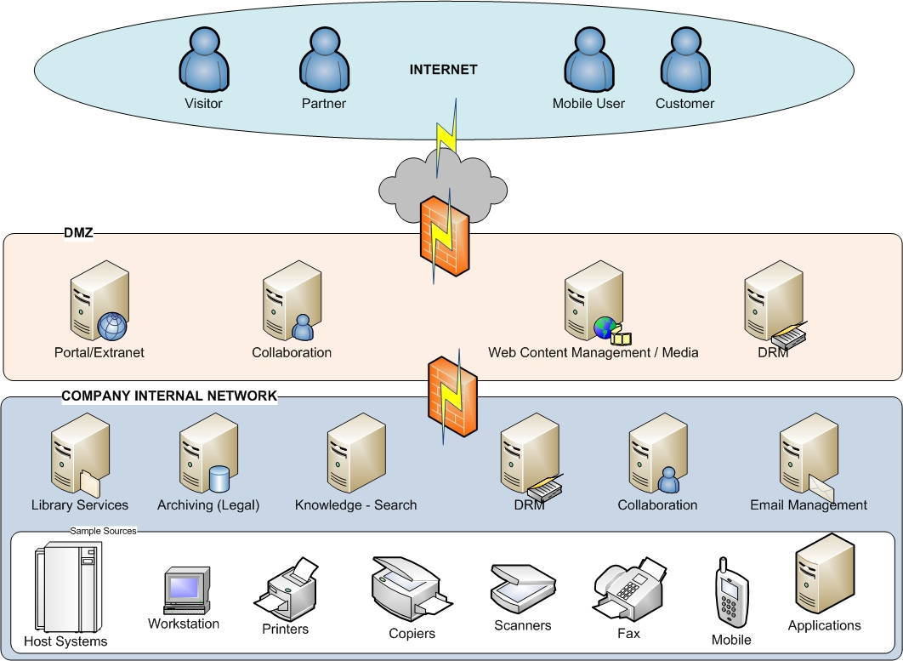

World of information
Notes:
Pino - 3 minutes:
In the world of information, both external actors and internal actors are dealing with information. All these information, structured or unstructured, are managed by different platforms.
Visitor can visit your website
Partners and customers could access extranet and collaborative spaces
Your mobile users could access their information through an external portal
External DRM could be used to protect key documents
Internally, Applications, ERP, Host systems, will produce information (spools, reports) that can be directly ingested in the archiving platform
Office and desktop applications can deal both in collaborative spaces for dedicated and short terms spaces or deal with library services content management platform that are more company wide repositories
All these informations could be searched and handled by a search server.
Internal DRM could be applyed for critical information

Slide 3

What do we mean by collaboration ?
Document Sharing & Working based on space policies
Knowledge exchange
Discussion
Information awareness
Thematic spaces (projects, topic,…)
Local topology
Local policies
Short-term

Slide 4
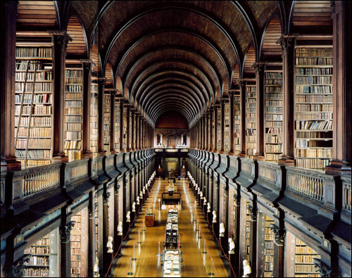
What do we mean by library services ?
Document Sharing & Working based on department policies
Binders management
Information awareness
Company wide topology
Company wide policies
Short to mid-term
Notes:
Pino:
Explain also that collaborative space offers, sometime, library services, the border is less clear than with archiving

Slide 5
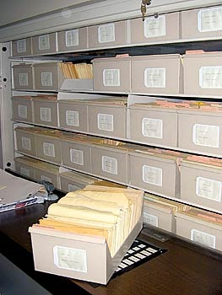
What do we mean by archiving?
Document sharing based on corporate policies
Format conversion
(Legal) protection against changes
Company wide topology
Company wide policies
High-volume management
Storage management
Long-terms

Slide 6
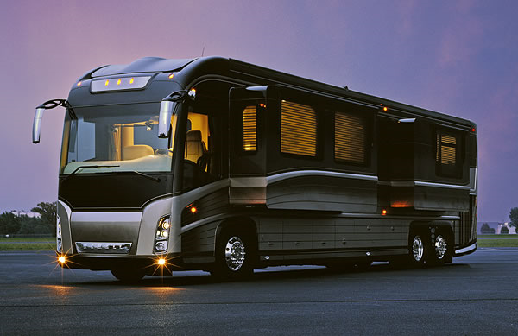

Why a combination of solutions ?
Would you go every day to your office with a coach ? No
Why ? Because it’s for long (-terms) travel.
ECM is like cars, if you want to perform, you’ve to use the right tool regarding the context
Would you from Belgium go to Sicily with this usual Italian car ? No
Why ? Because it’s for short(-terms) travel.

Slide 7
Conceptual architecture
Search Engine with federation
Portal – Collaborative platform
Collaborative
Document Library
Portlets – WebParts on Archive
Portlets – WebParts on Content Management
Portal applications
Archiving Platform
Legal - Reports
Content Management
Platform
applications
Enterprise Service Bus / SOA

Slide 8
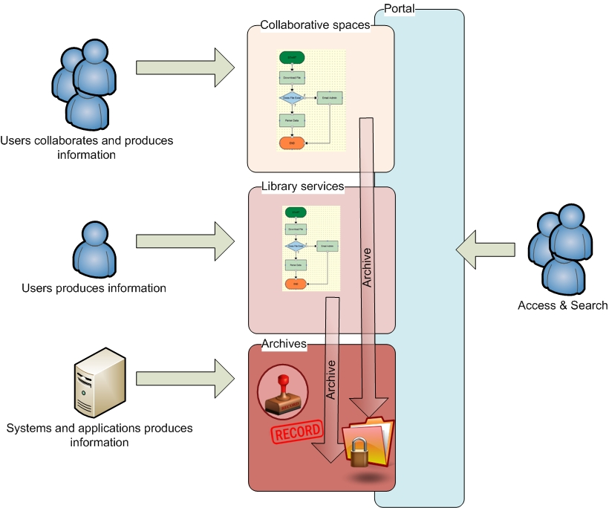
Information Lifecycle and repositories
Information are produced in the best context and archived for long-terms conservation
Legal policies will be applied on needed documents
Rules and workflow event could be the trigger to move a content
Notes:
Pino:
Use sample – contract building – collaboration -> workflow -> archiving + policies

Slide 9
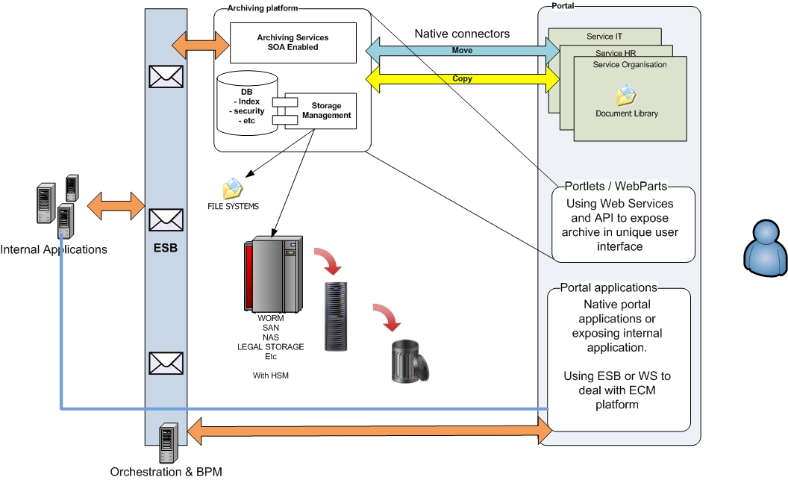
Sample architecture

Slide 10
Conclusion
Collaboration and ECM can be combined to offer an end-to-end solution for managing information
Implementing a reliable and clear architecture will help implementing ILM and SOA within the enterprise
Regarding the impact on the organization, the day-to-day working and the management of critical contents, implementing a collaborative platform will require project management, analysis and change management as well as ECM projects.
Notes:
Complémentaire et pas opposé
Collaboration doit aussi être abordé avec une analyse car tout aussi important pour éviter les problématiques

Slide 11
Q&A

