Slide 1



Slide 2



From paper to SharePoint…
with IRISPowerscan™
A document capture, indexation, OCR and
Microsoft SharePoint integration solution

Slide 3

I.R.I.S. & MICROSOFT
Microsoft Gold Partner
Software developer
Products for SoHo, SMB, Corporates
Key focus on IDR (intelligent Document Recognition), i.e.:
  Paper documents
  Electronic documents
Software infrastructures more and more based on Microsoft products

Slide 4
TYPICAL COMPANY NEEDS
High speed scanning of documents
Separate; Classify & Rename these documents & Extract key data
Create & Compress into different types of searchable documents
Storage on a Microsoft SharePoint Server according to document classification and extracted data

Slide 5




I.R.I.S. Solution
High speed scanning
Document separation & renaming
Creation and compression of searchable documents
IRISDocument Add-on to MS SharePoint
Document storage

Slide 6
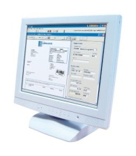
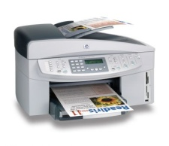

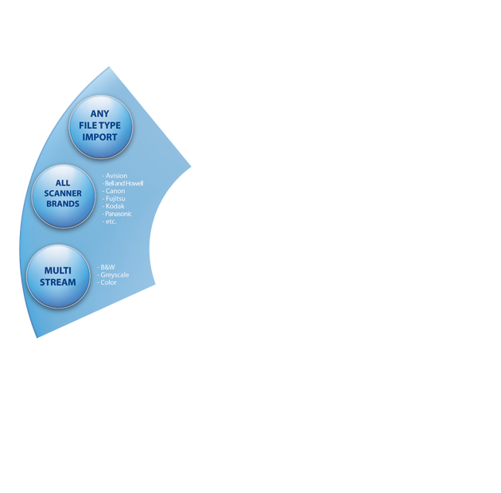
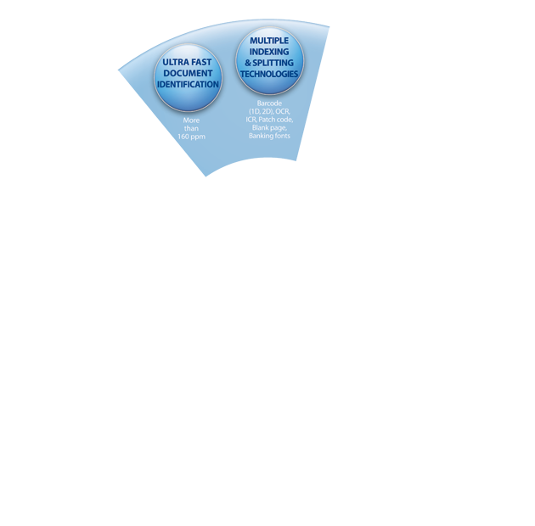





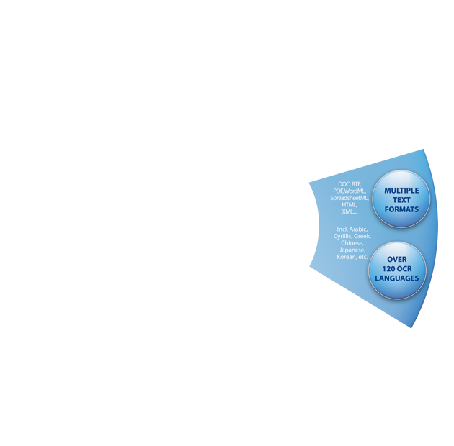


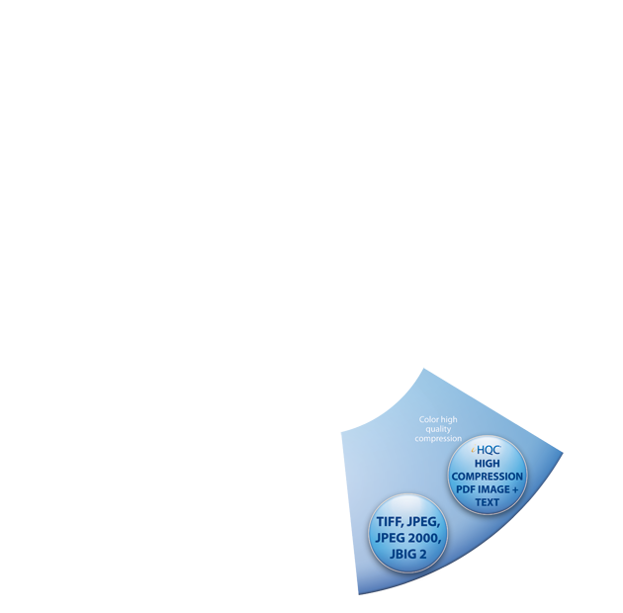


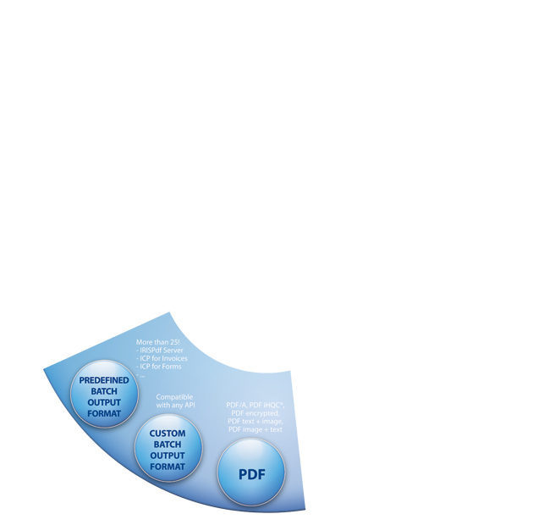


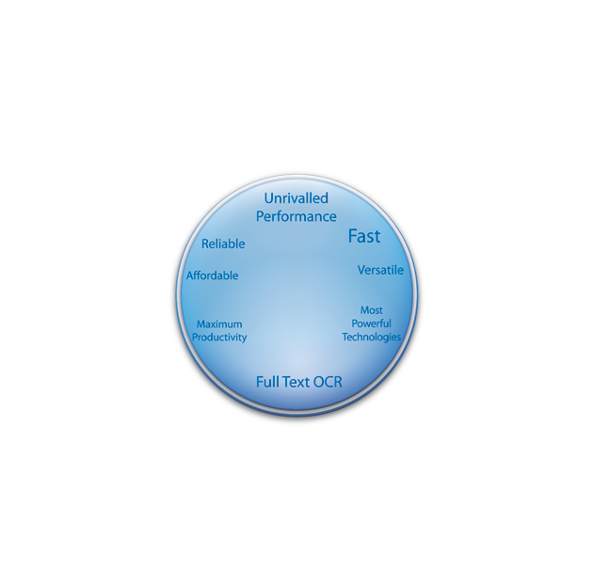

Connects to nearly any scanner
Project based with ready to use templates
User friendly interface that can be personalised
Functionality to control user rights and user interface
Can connect to other applications for post-processing of the documents (BOF API)

Slide 7
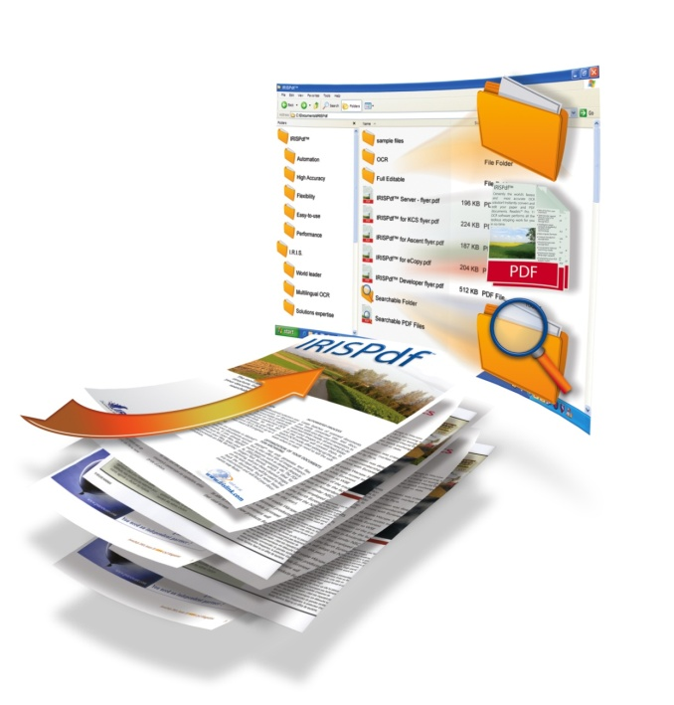


Very powerful image to document converter
Can convert to many different formats such as searchable PDF, PDF/a, XPS, RTF, OpenDocument Text, MS Word, SpreadsheetML, XML, HTML…
Can compress PDF, PDF/a and XPS documents thanks to I.R.I.S. technology
Can digitally sign and protect your PDF files

Slide 8

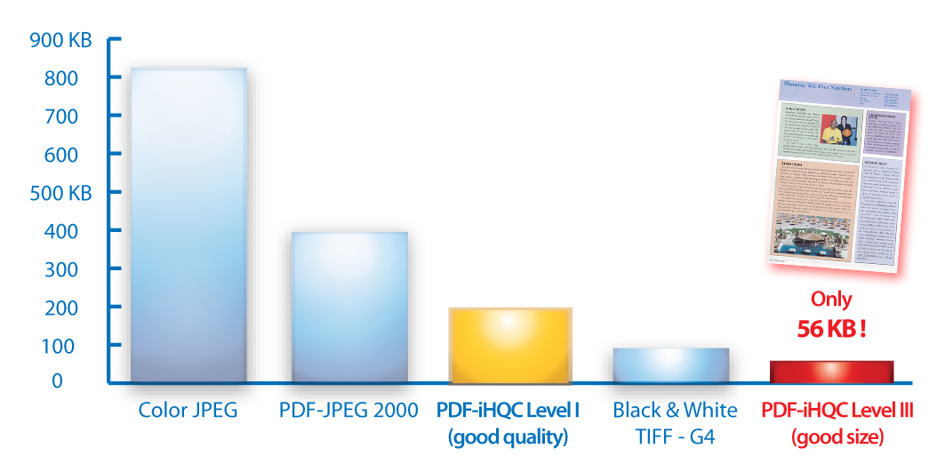
Generates fully searchable PDF-iHQC™ or XPS-iHQC ™ files (high quality color image with the OCRed text)
Several levels of compression (Best Size ⬄ Best Quality)
Exceptional readability (same as the original document)
Less bandwidth used to share your documents
Less storage space to archive all your files

Slide 9

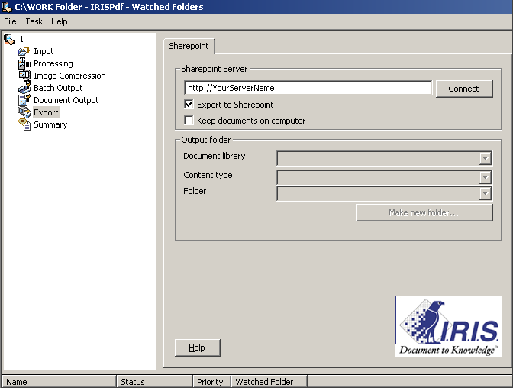
Microsoft SharePoint Add-on

Slide 10
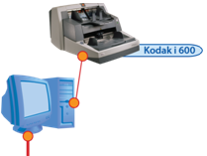





Process I
BOF

Slide 11
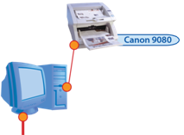
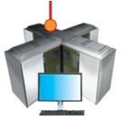
Process II

Slide 12








IRIS Add-on SharePoint v1
IRISPowerscan™
    Scans images and creates document indexes
IRISDocument ™
    Transforms the images into searchable files (with possible iHQC hypercompression)
    Sends the files with their indexes to a SharePoint document library
Document 1
Supplier: AT&T
Date: 08.08.08
Document 2
Supplier: BT
Date: 07.07.07
Document 1.xps
Document 2.pdf
Index.xml
Folder
Supplier Date
Document1.xps AT&T 08.08.08
Document2.pdf BT 07.07.07

Slide 13



IRIS Add-on SharePoint v2
IRISPowerscan™
  Scans images and creates document indexes
  Generates a document type
IRISDocument™
  Transforms the images into searchable files (with possible iHQC hypercompression)
  Sends the files with their indexes to a SharePoint document library, depending on the document type
Invoice 1
Supplier: AT&T
Date: 08.08.08
Mail 1
Subject: Vacation
Mail 2
Subject: Marriage
Invoice 2
Supplier: BT
Date: 07.07.07
Invoice 1.xps
Mail 1.pdf
Mail 2.xps
Invoice 2.pdf
Index.xml
Invoices
Supplier Date
Invoice1.xps AT&T 08.08.08
Invoice2.pdf BT 07.07.07
Mails
Subject
Mail1.pdf Vacation
Mail2.xps Marriage

Slide 14
Document 1
Supplier: AT&T
Date: 08.08.08
Document 2
Supplier: BT
Date: 07.07.07
Document 1.xps
Document 2.pdf
Index.xml
Folder
Supplier Date
Document1.xps AT&T 08.08.08
Document2.pdf BT 07.07.07
Add-on SharePoint v1
Add-on SharePoint v2
Invoice 1
Supplier: AT&T
Date: 08.08.08
Mail 1
Subject: Vacation
Mail 2
Subject: Marriage
Invoice 2
Supplier: BT
Date: 07.07.07
Invoice 1.xps
Mail 1.pdf
Mail 2.xps
Invoice 2.pdf
Index.xml
Invoices
Supplier Date
Invoice1.xps AT&T 08.08.08
Invoice2.pdf BT 07.07.07
Mails
Subject
Mail1.pdf Vacation
Mail2.xps Marriage

Slide 15
Practical Examples
Mailroom solutions
    Scan incoming mail
    Indexation (manual/automatic)
    Distribution inside SharePoint
    Possible archiving to wide ECM solution
Invoice management solutions
    Scan incoming invoices
    Data extraction
    Import and Workflow inside SharePoint
    Possible links with InfoPath Order Forms solutions inside SharePoint
    Links with ERP systems

Slide 16
Live demonstration

Slide 18
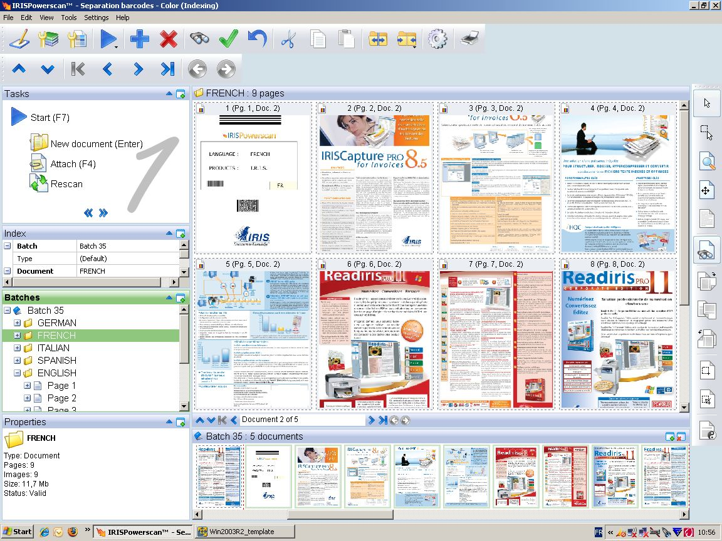





Microsoft SharePoint

Slide 19
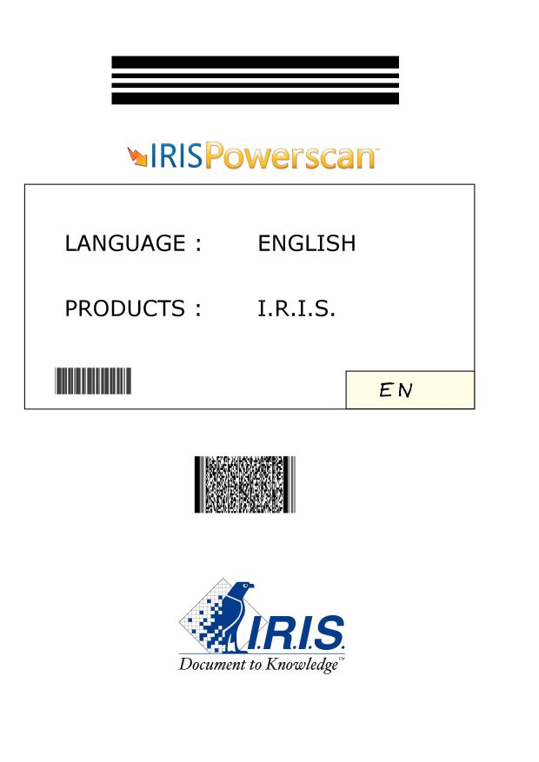

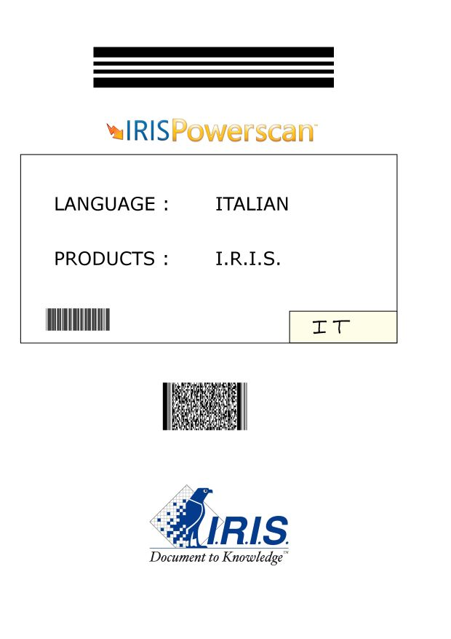

Separation & Indexing
The name of the document
(language of the brochures):
English
French
Spanish
Italian
German
Separator barcode

Slide 20
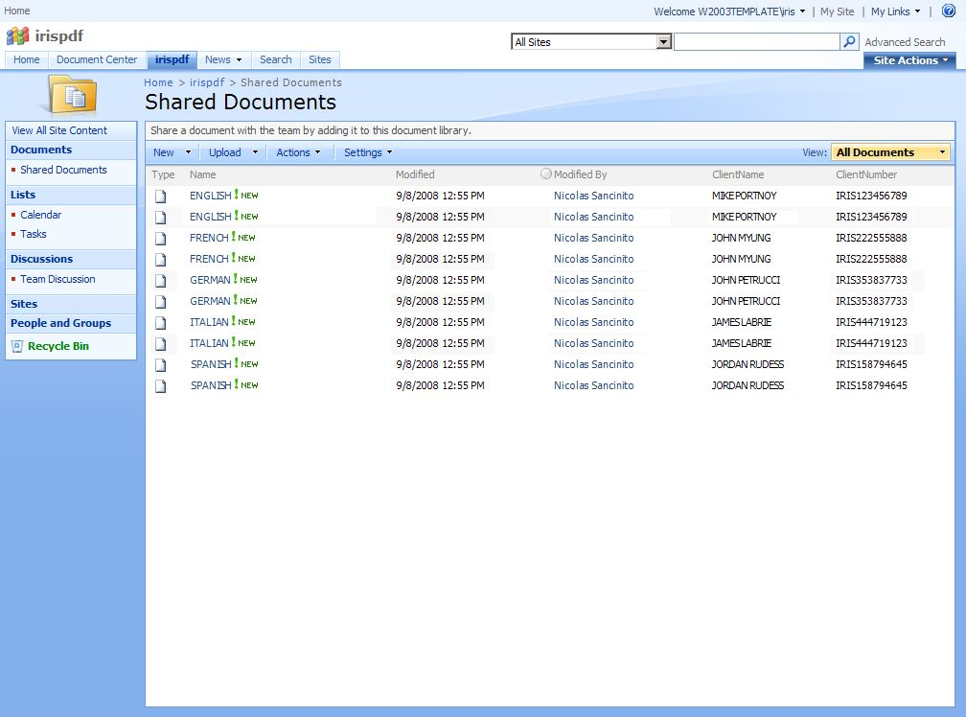

Slide 21
Roadmaps

Slide 22
IRIS Add-on SharePoint v2
IRISPowerscan™
  Scans images and creates document indexes
  Computes a document type
IRISDocument™
  Transforms the images into searchable XPS (with possible iHQC hypercompression)
  Sends the XPS with their indexes to a SharePoint document library, depending on the document type

Slide 23
Planning
SA : May 31, 2009

Slide 24
VARs
Special focus on ECM/ERP/WF VARs (intranet/extranet)
I.R.I.S. message: “Microsoft VARs can have an access to simple and complex applications”
I.R.I.S. support:
  Free to distribute marketing material
  Training and certification programs
  Webinars
  Local support in EMEA & USA
Joint actions:
  Coordinated marketing programs; Presentations & Seminars
  Identification of partnerships

Slide 25
Pricing
IRISPowerscan
  Licensing from 25 ppm to Unlimited ppm
  Ranges from € 395 to € 14.990
IRISDocument Server
  € 2.990
Add-on MS SharePoint
  € 990

