Slide 1


User Experience Services
How Users Work
Sander van der Stap

Slide 2
Vision Statement
User Experience Services provide easy-to-use business-centric access to and interaction within the ECM Suite via familiar user interfaces.

Slide 3
Open Text ECM Suite Offerings
What Does the Suite Consist Of?
Open Text ECM Suite
Collaboration and Community Management
Document Management
Records Management
Digital Asset Management
Web Content Management
Capture & Image
Business Process Management
Reports and Output Management
Data Archiving & Intelligent Storage Mgmt.
E-mail Management
Slide 3

Slide 4

Illustrating the ECM Suite in Enterprise Connect
Today Innovate Corp is building jets

Slide 5
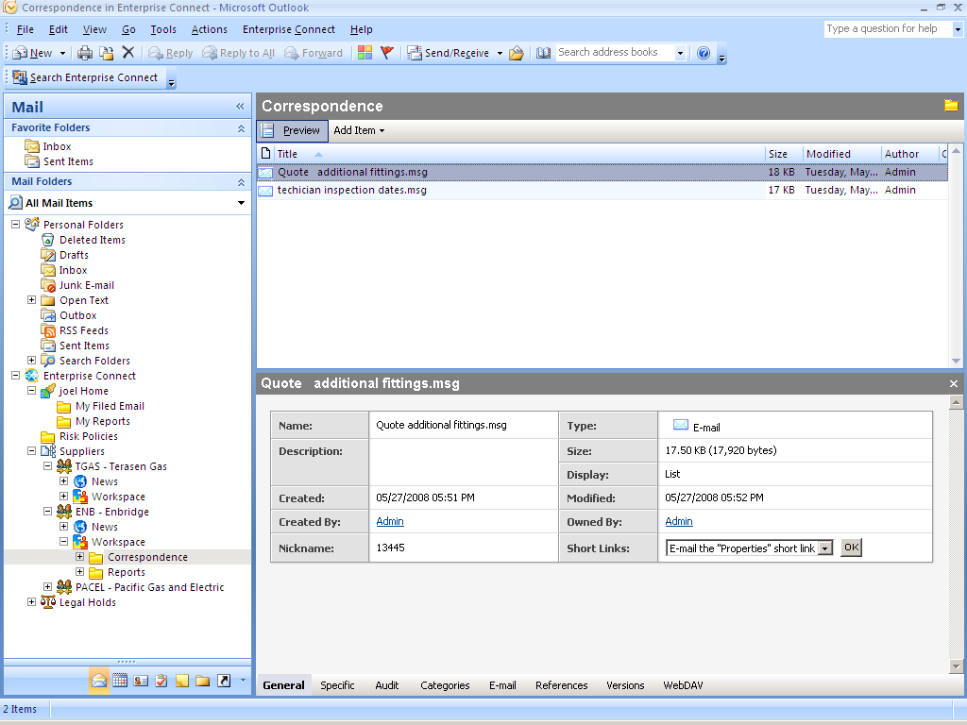
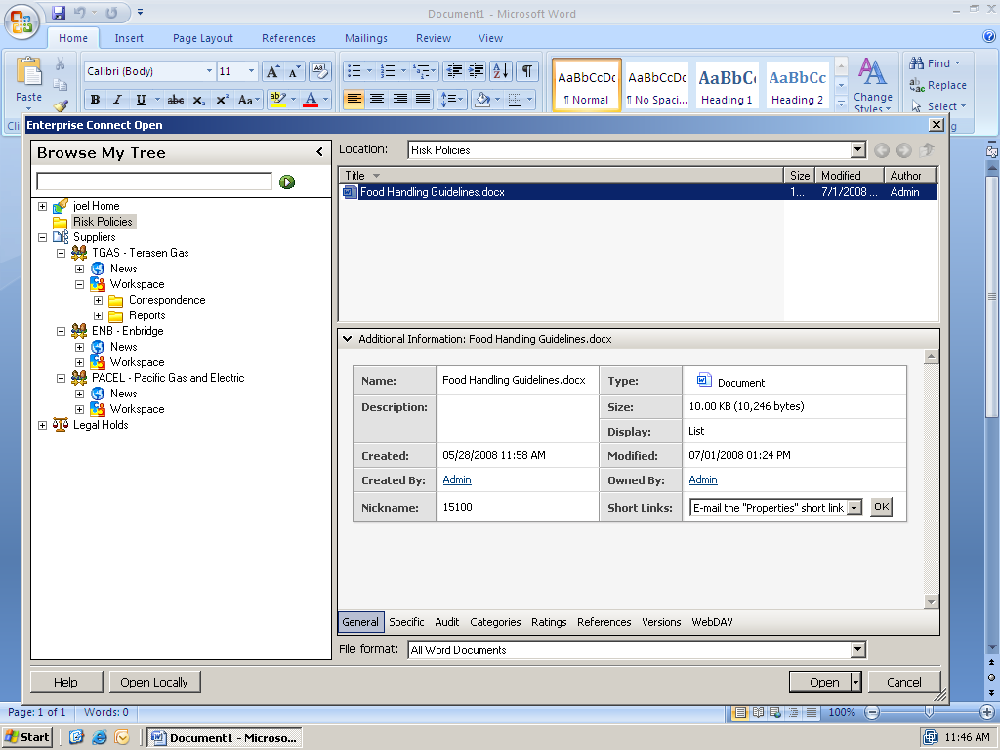
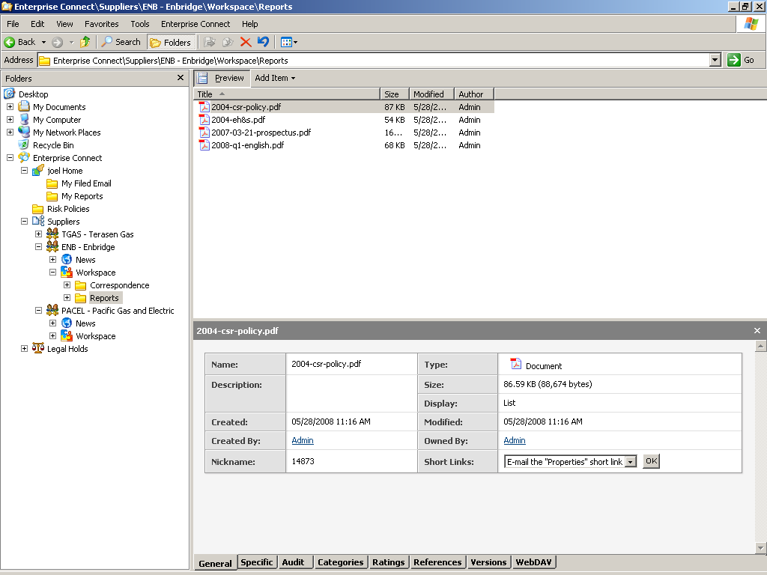
Enterprise Connect
Enterprise Connect is a user interface framework, which exposes content from any data source to the end user inside the Microsoft Environment.

Slide 6


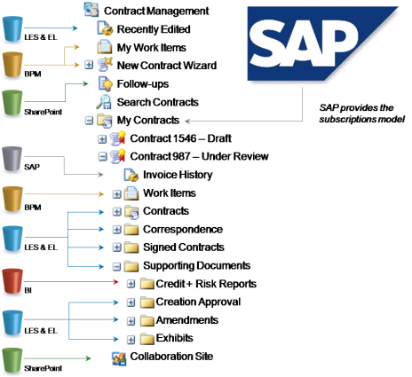


Enterprise Views Services
Enterprise Views is a content virtualization service which allows Enterprise’ to deliver content to users in context via role based virtual views of information.
Data and Process
Enterprise Views
Virtualization Engine
Role Based Views for End Users

Slide 7











Stakeholders: Finance
Can the Contracts get reviewed and approved quickly? Are the Bills paid on time? Is it ALL auditable?
Naveen – CFO

Slide 8




Stakeholders: ITSM
Is it going to save us some money? Will everyone work with the same systems? Will we finally get rid of these silos?
Ted – CIO

Slide 9

Stakeholders: Legal
Will we know where the email is? Will we be compliant? Will it help us manage our risks?
Chris – General Counsel

Slide 10






Content & Process Flows Across the Enterprise
Corporate

Slide 11






Quick Overview of Solution Trees
Raja
Aerospace Engineering
Phyllis
Document Controller
Rebecca
Contract Author
Kevin
Sales Representative
Engineering Solution
All Critical Dates
Requested Contracts
My Projects
Turbine System – FC12
Wingspan – FTC-12
Correspondence
Extranet Project
Critical Dates
Transmittals
Meeting Place
Extranet
Past Projects
Transmittals Solution
My Correspondence
My Tasks
My Transmittals
235 – Oil Sands Transmittal
1400 – Reconnaissance Jet
Engine
Documents
Recipients
Coversheet
Contract Management
My Tasks
My Email
New Contract
Follow-ups
Recently Edited Contracts
My Contracts
Contract 1546 – Draft
Contract 987 – Under Review
Contract
Task
Correspondence
Signed Contracts
Supporting Documents
Steel Inc.’s Extranet
Sales
My Work Items
Request Amendment
My Clients
Bob – ICDE
Linda – Grocery Inc.
Forum
Open Issues
Pending Deliveries
Correspondence
New Business
Sales Reports
Sales Support
Engineering
Transmittals
Contract Management
Sales
Enterprise Views
Enterprise Connect
& ECM Repositories

Slide 12


The Problem
The customer has just realized that the jet needs to fly 10% farther than specified on the contract. They create an email requesting a contract addendum and send it to Innovate Corp.

Slide 13





Content & Process Flows Across the Enterprise
Corporate
Customer Request

Slide 14
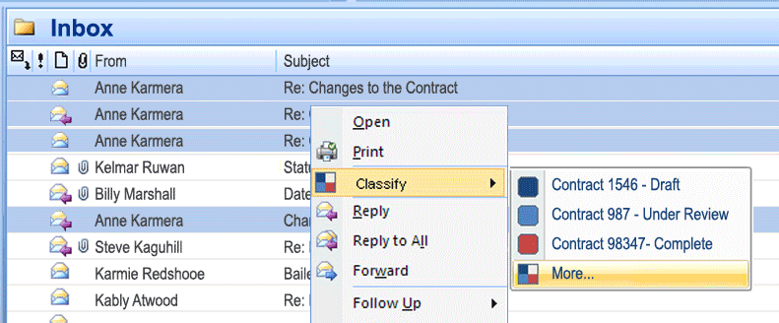

Classifying the request to change the contract
“I want to do everything right on time” - Rebecca
Records Management
E-mail Management

Slide 15
Content & Process Flows Across the Enterprise
Corporate
Customer Request

Slide 16
Architecture & Components
Interfaces
Records Management
Enterprise Connect
Enterprise Views
E-mail Management
LES (DM)
BPM

Slide 17
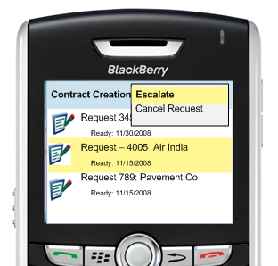
Contract Addendum Status
Kevin wants to see how far along Rebecca’s gotten with the Contract Addendum. He checks the due date of the task, and realizes it’s too late. He escalates the task to the Manager of the Contract group.
“I want everything at my fingertips without having to do any work.”
Business Process Management
Mobility
Futures

Slide 18
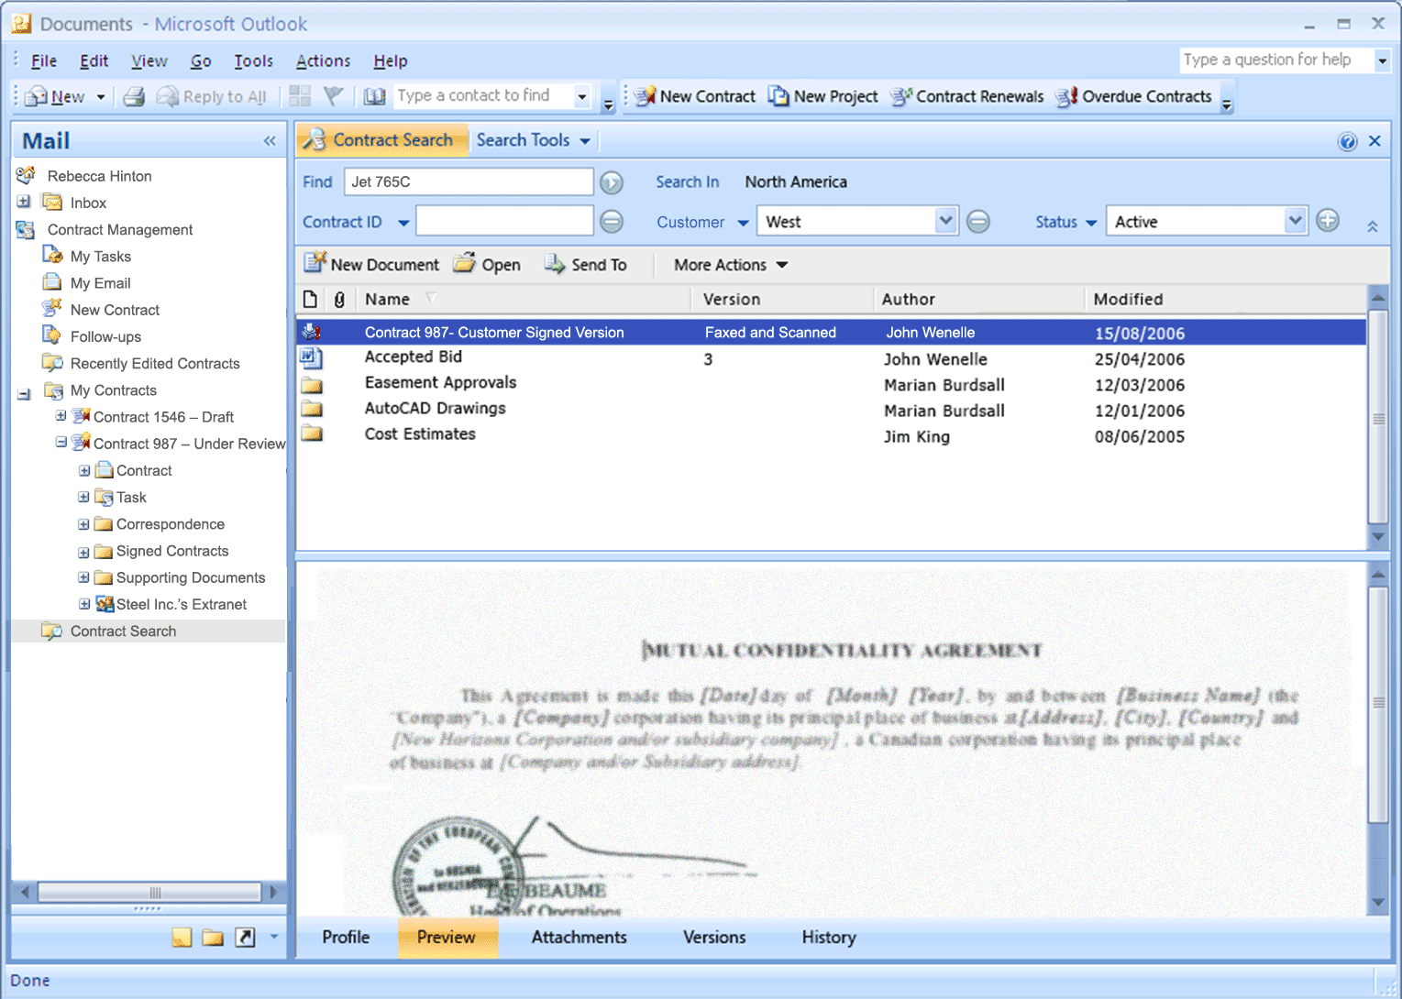

Viewing the Scanned Contract
Capture
Data Archiving & Intelligent Storage Mgmt.
“I want to do everything right on time” - Rebecca

Slide 19
Content & Process Flows Across the Enterprise
Corporate
Customer Request

Slide 20
Architecture & Components
Interfaces
Capture
Data Archiving & Intelligent Storage Mgmt.
Enterprise Connect
Enterprise Views
Records Management
E-mail Management
Capture / Imaging
Web Interface
LES (DM)
BPM
Archiving & Intelligent Storage Management

Slide 21
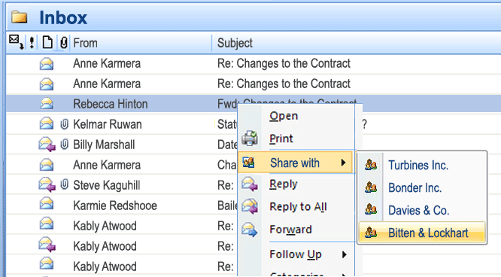
Sharing information with the Subcontractor
Raja sends the contract addendum to the Extranet so that the sub-contractors can access the changes to the contract.
“I want the flexibility to collaborate.” - Raja
Collaboration and Community Management

Slide 22
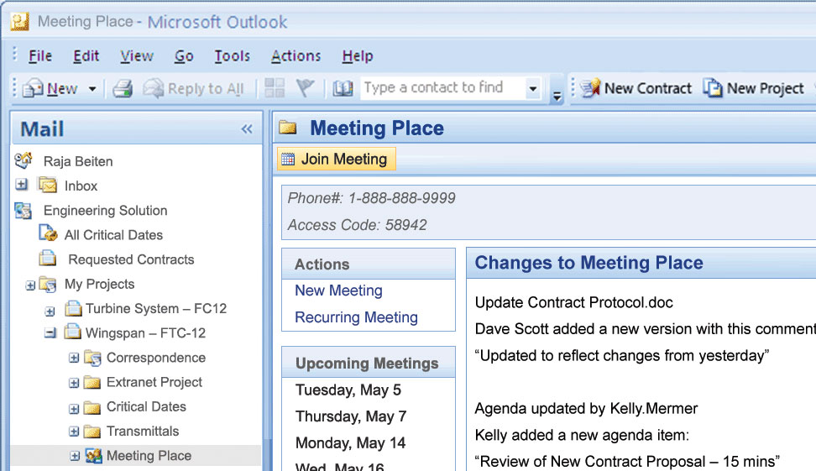
Meets with Contractor
“I want the flexibility to collaborate.” - Raja
Collaboration and Community Management

Slide 23
Content & Process Flows Across the Enterprise
Corporate
External Contractor
Customer Request

Slide 24
Architecture & Components
Capture
Data Archiving & Intelligent Storage Mgmt.
Collaboration and Community Management
Interfaces
Enterprise Connect
Enterprise Views
Records Management
E-mail Management
Business Process Management
Capture & Imaging
Web Interface
LES (DM)
BPM
CCM
Archiving & Intelligent Storage Management

Slide 25
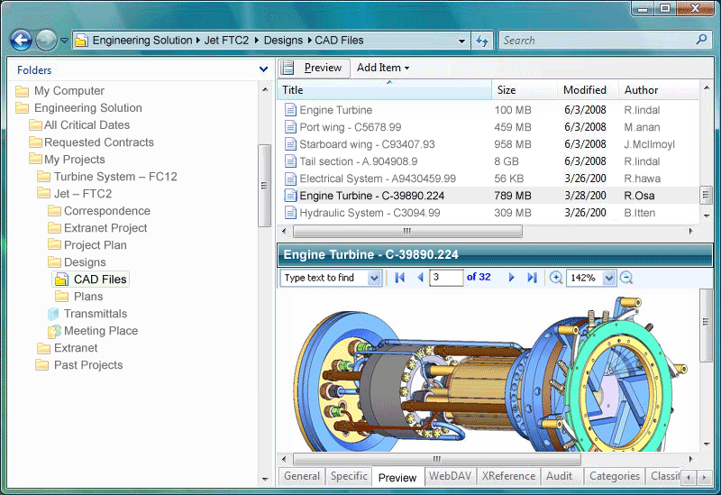
Preview the CAD files
Capture & Imaging
Document Management
“I want the flexibility to collaborate.” - Raja

Slide 26
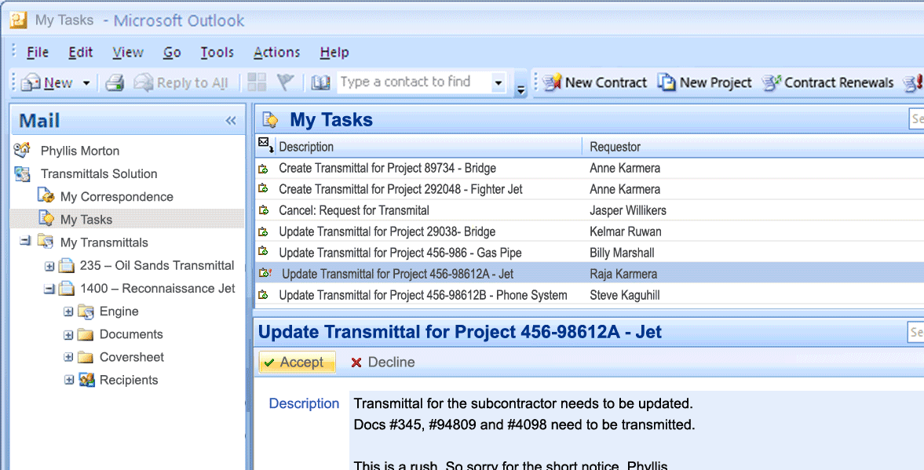
Phyllis Accepts a Task
Business Process Management
“I want to get the documents sent on time.” - Phyllis

Slide 27
Content & Process Flows Across the Enterprise
Corporate
External Contractor
Customer Request

Slide 28
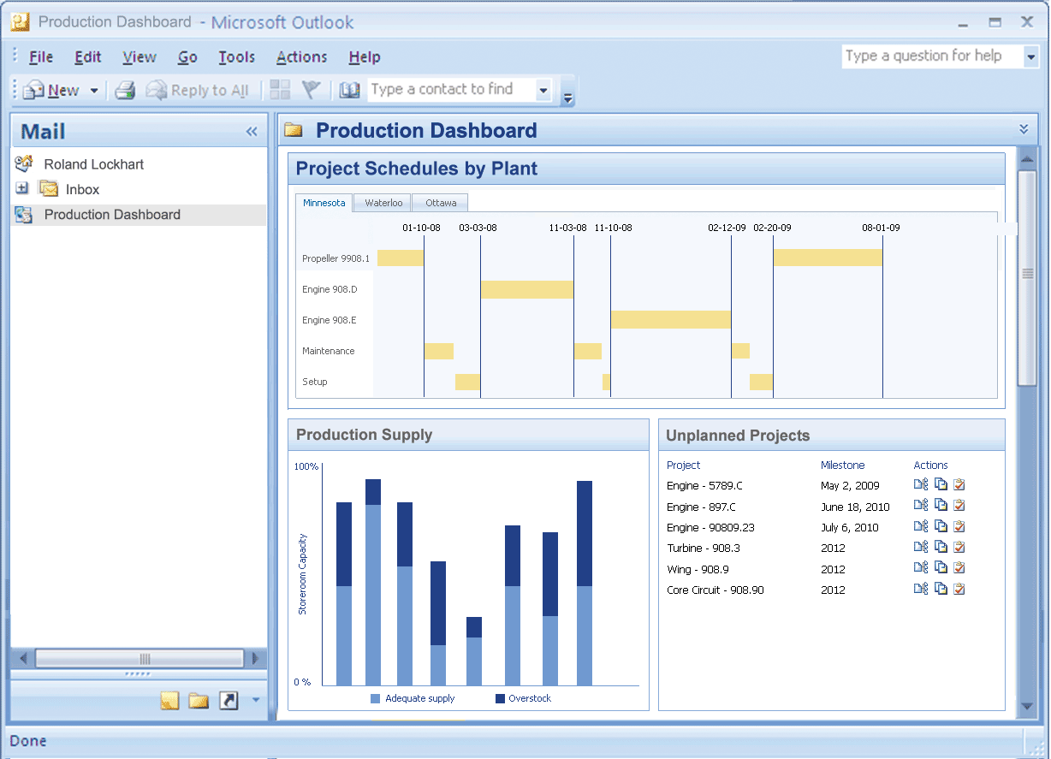

Checks Manufacturing Status
Reports and Output Management
“I want to know what’s going on and when things are due.” - Roland

Slide 29
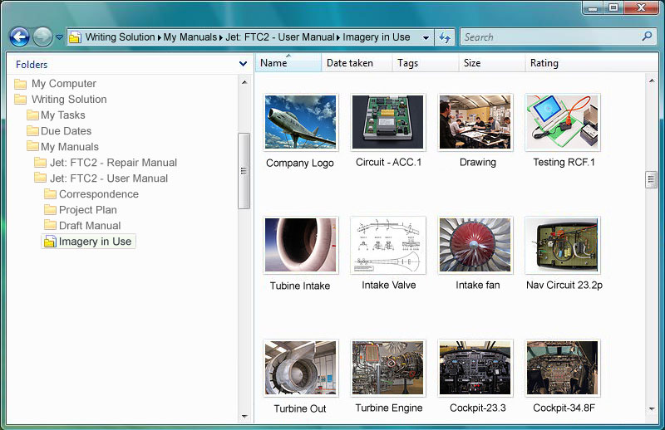

Updating the Manual
Document Management
Digital Asset Management
“I need to be precise and provide the right information.” - Kim

Slide 30
Content & Process Flows Across the Enterprise
Corporate
External Contractor
Customer Request
External SOP’s

Slide 31
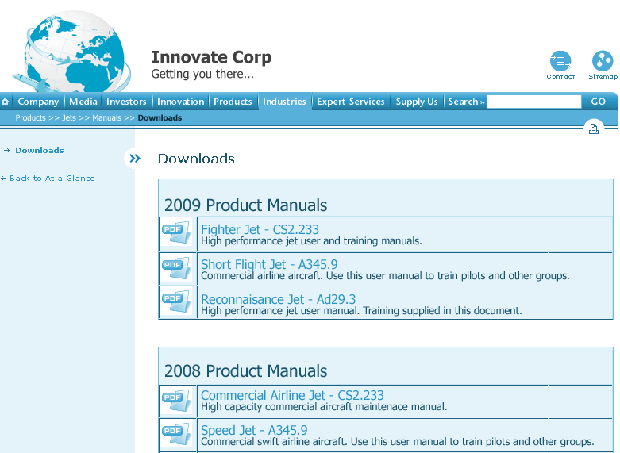

Downloading the most recent version.
Web Content Management
“I need up-to-date content!” - Wren

Slide 32
Content & Process Flows Across the Enterprise
Corporate
External Contractor
Customer Request
External SOP’s

Slide 33
Architecture & Components
Interfaces
Enterprise Connect
Collaboration and Community Management
Document Management
Records Management
Digital Asset Management
Web Content Management
Enterprise Views
DAM Client
Capture
Business Process Management
Reports and Output Management
Data Archiving & Intelligent Storage Mgmt.
E-mail Management
Capture & Imaging
Web Interface
DAM
WCM
LES (DM)
Content
Reporting
BPM
CCM
Archiving & Intelligent Storage Management

Slide 34




















Content in Context
Processes
People
Content

Slide 35
Stakeholders

Slide 36

Stakeholders: Finance
Can the Contracts get reviewed and approved quickly? Are the Bills paid on time? Is it ALL auditable?
Naveen – CFO

Slide 37
Stakeholders: ITSM
Is it going to save us some money? Will everyone work with the same systems? Will we finally get rid of these silos?
Ted – CIO

Slide 38
Stakeholders: Legal
Will we know where the email is? Will we be compliant? Will it help us manage our risks?
Chris – General Counsel

Slide 39
What Happened
Customer is happy
Deadline is met
Costs increases minimized
Compliant and Auditable
Internal and External Collaboration
Innovate Saves the Day Again

Slide 40

Questions?

Slide 41
Thank You

