Slide 1
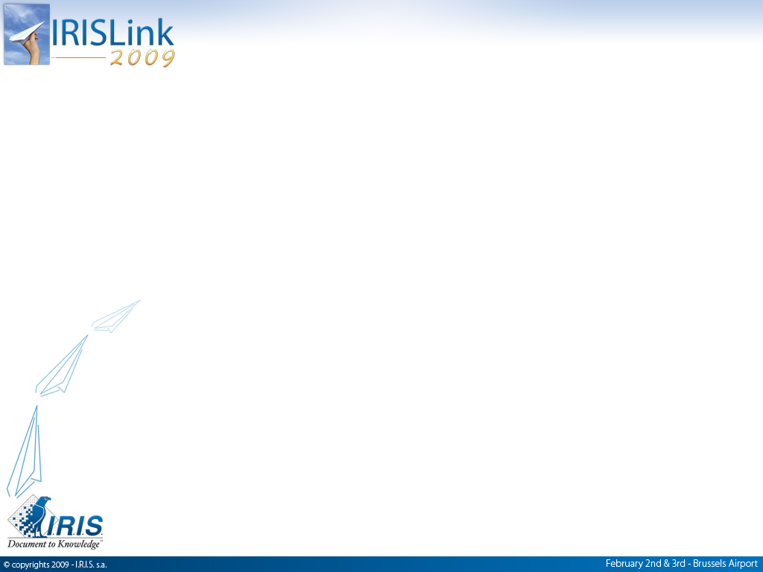
„Electronic Filemanagement – Higher productivity and cost savings for claims processing“
Henry Koks, CZ
Leo Vondenbusch, IRIS Docutec

Slide 2


Slide 3
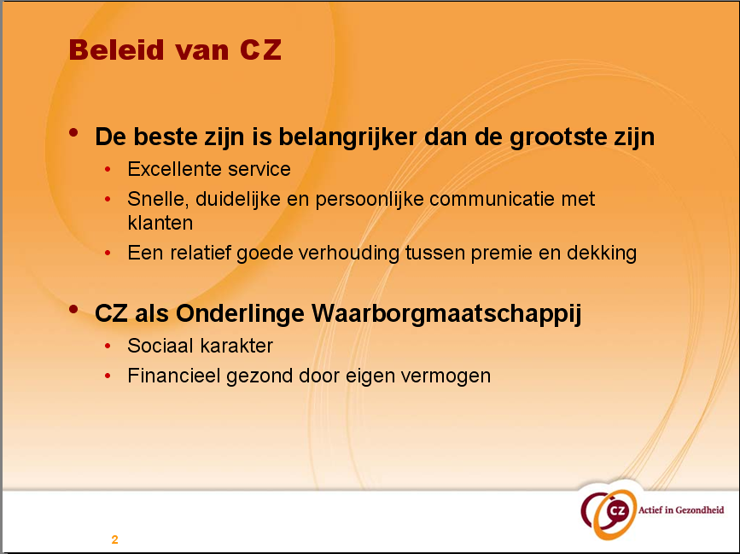

Slide 4
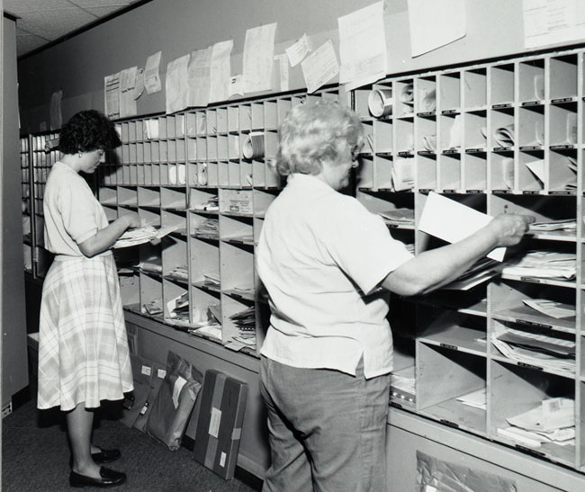
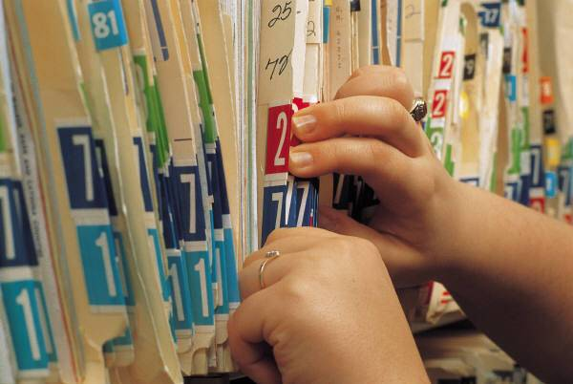

Digital Mailroom: What does it mean?
post sorting
electronic files
business process
Docutec Xtract for Documents … one fits all!

Slide 5
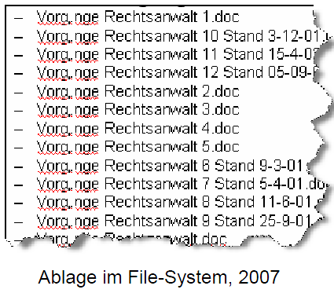
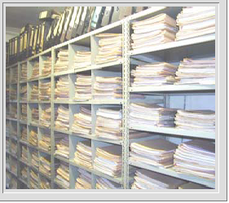
Why Digital Mailroom ?
More than 80% of digital information is stored in „personal files“ 1)
Knowledge will be lost, when „people with knowledge“ leave the company 1)
editing, storage, transfer, archiving, delete will cost 15 til 20% of worktime (AIIM)
Every document will be copied 5 times in average (IDC)
90% of all relevant informations for Knowledge-workers are paper based and are not registered in ECM-solutions (AIIM)
1) The Knowledge Worker Investment Paradox” Gartner Research

Slide 6
Success Factor
Healthcare claims including Forms

Slide 7



I.R.I.S. – Docutec: solution pacages
Business Process Solutions
Digital Mailroom Solutions
NEW:
Solution Package
Accounts Payable
Solution Component
Capture Plus
Solution Package
Factoring
Solution Component
Forms
Solution Package
Healthcare
Solution Package
HR (Human Resources)
Solution Package
Orders
NEW:
Solution Package
Banking
Solution Package
Tax
NEW:
Solution Package
Personalized Mail
SP Healthcare and SC Capture Plus were used at CZ

Slide 8
Classification of claims with
Capture Plus
Claims are scanned in batches
Claims consist of different documents which have to be classified
Claims will be classified according to the results on document level
The relation number will be extracted from a barcode or from the NBF-document
Fields will be extracted according to document types
simple claim
normal claim
claim with dentist
claim from hospital
complex claim

Slide 9
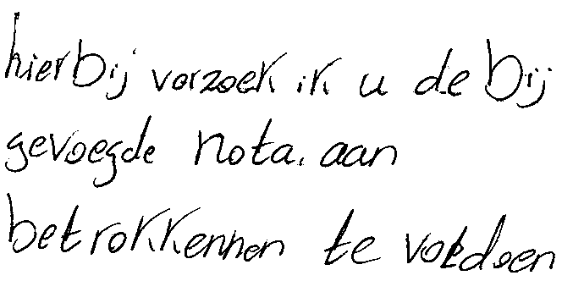
SP Healthcare handles
Declaration forms
 Policy number
 Account number
 Payment mode
 Accident flag
Salesman flag
Claims data

Slide 10
SP Healthcare handles
Invoices
 Care provider
 Invoice reference
 Total amount
 Line items
- Code
- Treated person
- Quantity
- Start- & Enddate
- Amount

Slide 11
SP Healthcare handles
Logical link between a declaration and subsequent invoices
RELATIONNO
INSURANTNO
BIRTHDATE
INITIALS
4534212
5612431
20.06.2004
W.A.
6523123
9563424
22.07.1957
R.A.G
6756355
3057468
15.02.1972
E.T.
9785637
4231245
22.07.1957
R.A.G.
8751238
7843217
03.05.1998
P.K.
5231286
8976513
28.04.1983
O.
7867564
1057646
14.11.1982
F.D.
9785637
2056477
09.01.1967
A.S.H.
5647324
2746351
10.03.2002
A.A.
8763542
5984734
07.12.1953
H.F.U.
Identification of the
treated person

Slide 12
SP Healthcare handles
Logical link between a declaration and subsequent invoices
Payment
mode
Two line items
Data completion and
checking invoice quantity
# 1
# 2

Slide 13
Rollout of the Digital Mailroom project at CZ

Slide 14
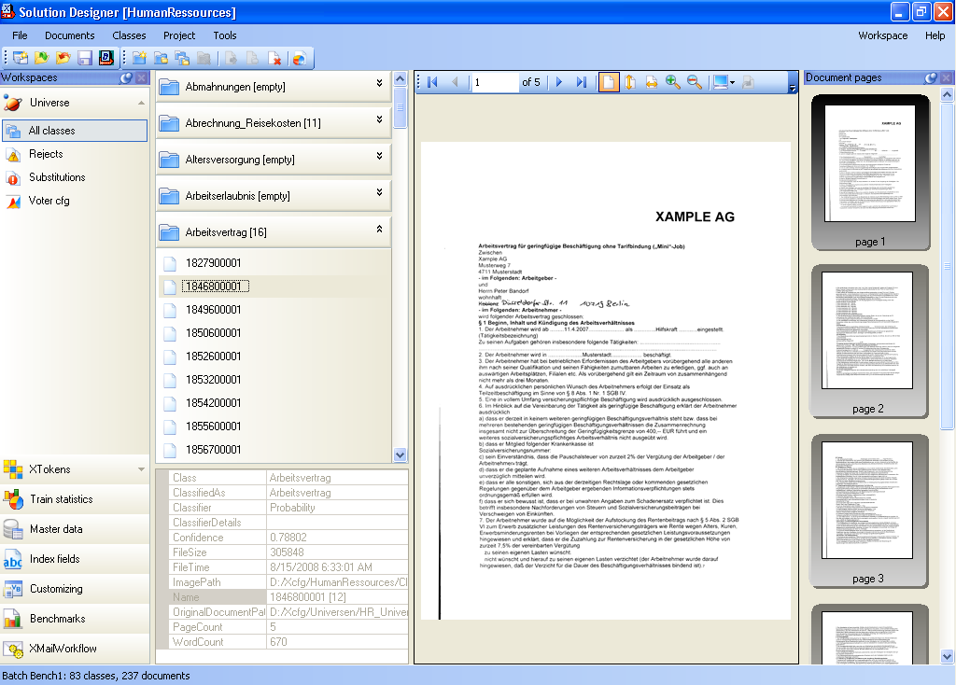
step 1: definition of
a filing structure

Slide 15
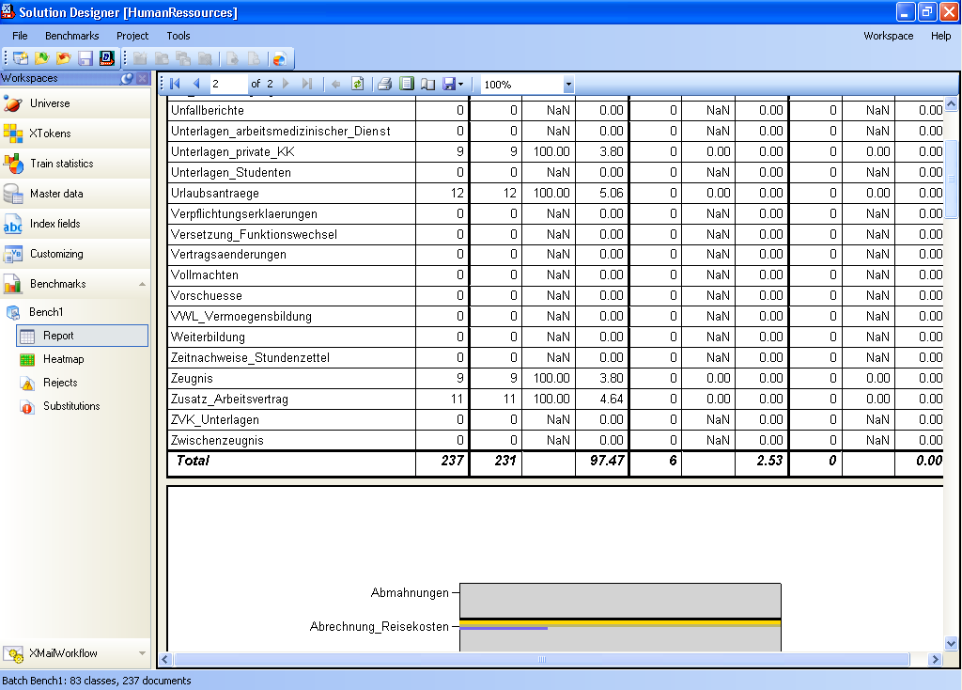
step 2: train the
document types

Slide 16
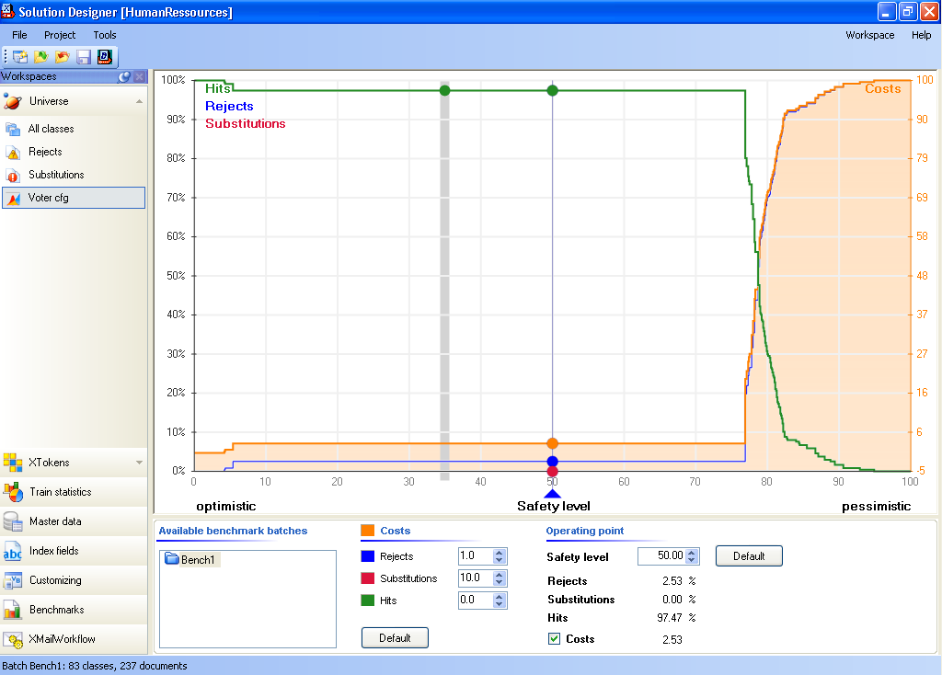
step 3: quality control
of trained documents

Slide 17
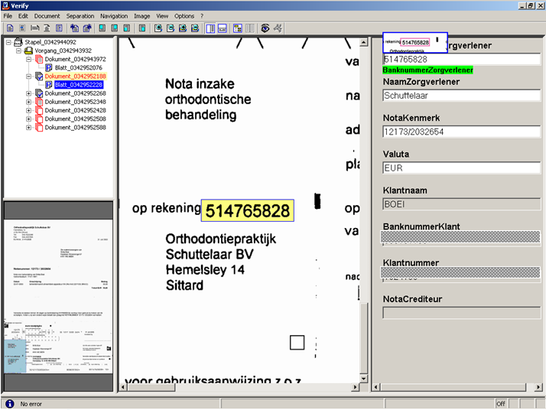
step 4: verification
of reading results

Slide 18
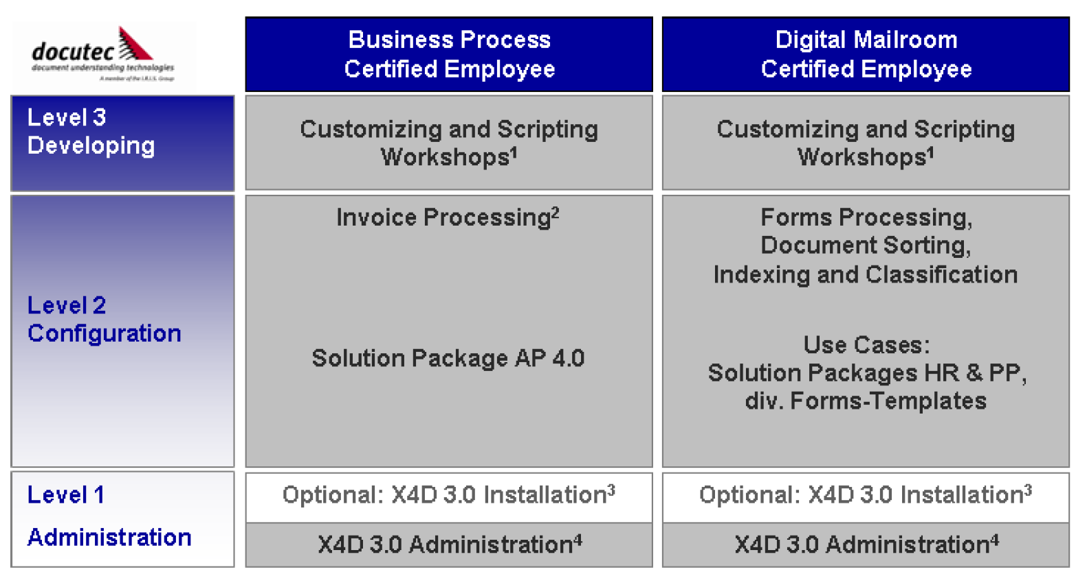
customisation of ruleset
step 5: .net based scripting
of business rules

Slide 19
Process Overview
Scan Department
Classification &
Extraction
Digital Archive
Business Process
Workflow
Notes:
The process:
1 scanning
Claims are prepared for scanning
A batch form is created, carrying a barcode. With this barcode metadata can be found in a table.
Every claim within a batch has e separation sheet with a sequence number. A batch on average contains 50 claims.
Batches are scanned.
2 XC+
For every claim in a batch a record is made in table CMN30. If a claim has to be handled by XC+, also a record with the relevant data (xml in) is created in a table on the docutec-server. The document itself is stored in content manager and copied by docutec when needed for their processes.
Docutec picks up claims, makes internal batches with on average 10 claims and tries to classify each claim:
1 classify each document, and then based on the combination of classes come to a conclusion on claim level. The conclusions are based on the current processes in the business and can be simply changed in a script
2 try to find the relation number of the customer based on the barcode value delivered by the scan application. If no barcode is available try to find the number printed on the document with the class NBF. If that document is not available within a claim, then try to find it with the addresses on the invoices and a master data table.
If the class of the claim is not mondzorg, the results of classify are stored in xml-out in that table on the docutec server.
If the class is mondzorg, data will be extracted from the separate invoices, like amounts, dates, codes and the care provider. After that the results of classify and extraction are stored in xml-out in that table on the docutec server.
The state is changed into exported.
3 release module
The release module picks up claims with the state exported and changes the corresponding record in CMN30with the results of XC+. It then changed the state into delete on the docutec server (and XC+ can then finish that claim by sending it to a trash queue for 4 days, after that it is gone).
If for a claim the class and / or relation number is not found, the claim is sent to a team that has to add that information by manual actions and visual checks on the documents.
If a claim (by XC+ or manual added) has a class and a relation number, it is sent to a self developed workflow (based on Lotes Notes).
With the use of hostbridge the user then can transfer the results from XC+ to the back office for further administration and checks (and finally making an invoice payable).

Slide 20
Benefits of the new Mailroom
a claim is only handled once by a user, at the end of the chain when finishing it in the back office.
no manual sorting before scanning and no indexing on relation number on every claim. Every 10 % correctly classified claims is about 1 fte less
X4D is transparent and easy to use, so quickly CZ can maintain and change it on its own.
X4D can simply be extended for documents other then claims, again by CZ itself.
X4D fits in a structure with independent components because of simple import and export actions. Therefore a component can quickly be replaced by another one

Slide 21
Xtract for Documents
A document bridge for your networked world
Thank you very much!
Questions ?
Docutec AG -
a member of the I.R.I.S. Group
Heussstraße 23
52078 Aachen
Germany
Phone.: +49 241/920 35-0
Fax: +49 241/920 3-505
More infos: www.docutec.de

